Slide 1
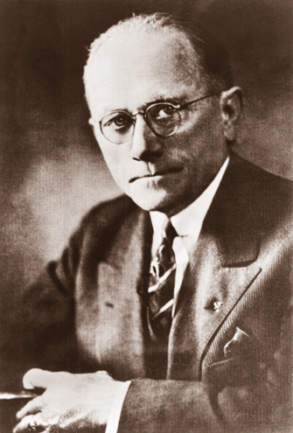
Page 189
Bilbo’s Return

Slide 2
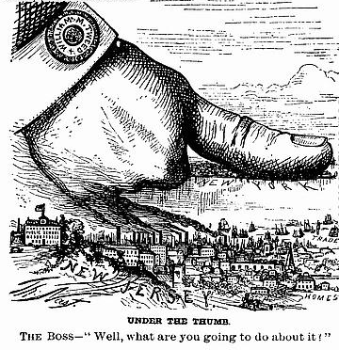
What is this cartoon about?

Slide 3
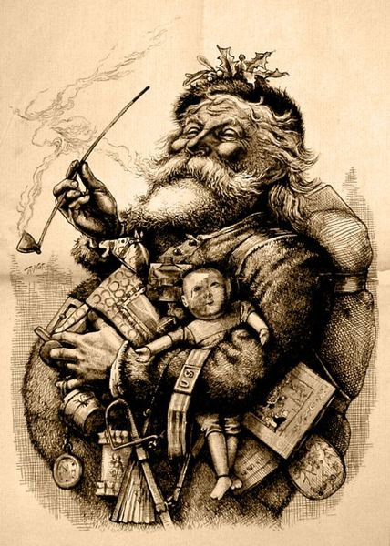
Merry Old Santa Claus
Thomas Nast

Slide 4
Objectives
MS1 Explain how geography, economics, history, and politics have influenced the development of Mississippi.
MS1c Identify renewable (e.g., trees) and non-renewable (e.g., minerals) resources of the state.
MS1d Analyze advanced personal economic choices (e.g., timber industry, shipping industry, gaming industry).

Slide 5
Objectives
MS1e Analyze the historical and political significance of key events in our state's development .
MS2a Identify the influence of the industrial and agricultural revolution in our state.
MS3a Trace the effects of migration to and from the state (e.g., The Great Migration, etc.).
MS3d Analyze the significance of key events in our state's history.

Slide 6
Review
Changes in Mississippi small towns.
The Great Migration
Black Middle-Class
Governor Henry Whitfield
Flood of 1927.

Slide 7
Overview
Bilbo as Governor Again.
The Wisconsin Report.
Junior Colleges.
Economy.

Slide 8
The 1927 governor race
Theodore Bilbo vs. Dennis Murphree
Promises textbook and plant to produce them.
Massive road program. (Bricks)
Bilbo wins by 16,500 votes. (In the primary)
Bilbo was not very productive in his second term.

Slide 9
Was Ole Miss a great school?
NO!

Slide 10
Was Mississippi A&M a great school?
NO!

Slide 11
The Wisconsin Report
Governor Whitfield visited the University of Wisconsin.

Slide 12
The Wisconsin Report
University of Wisconsin worked with the state government to solve problems.

Slide 13
The Wisconsin Report
Bilbo wanted to use the report to improve the 3 major state colleges.

Slide 14
What are the 3 Major state Colleges?
The 1930 license plate, what is different about that plate?
Ole Miss colors.
The 1929 license plate, what is different about that plate?
Mississippi A&M colors.
The 1931 license plate, what is different about that plate?
State Teachers College colors.

Slide 15
What is the problem?
The report recommended closing all 3 schools.
Ole Miss
Mississippi A&M
State Teachers College
Build one large state university in Jackson.

Slide 16
Bilbo’s reaction?
Dismiss all 3 president at
Ole Miss
Mississippi A&M
State Teachers College
Also the president at
State College for Women
In addition he removed about 20 faculty members and 80 other school personnel.

Slide 17
accreditation
The Southern Association of Colleges and Schools withdrew the university’s accreditation.

Slide 18
Response to Bilbo’s actions
Bilbo was criticized greatly.
Recent research shows that Bilbo did improve the schools.

Slide 19
Name Changes
Mississippi A&M
Mississippi State College
Mississippi State University
State Teachers College
Mississippi Southern College
University of Southern Mississippi
Jackson College (1940)
Jackson State University

Slide 20
Name Changes
Delta’s Teacher College
Delta State University
Alcorn A&M College
Alcorn State University

Slide 21
What was an agricultural high school?
Boarding Schools.

Slide 22
How do we save the schools?
Started adding college class the schools.
In 1928, the legislature created the Commission of Junior Colleges.

Slide 23
What is a junior college?
The first two years of college work.
Can you get a degree?
Yes!

Slide 24
What is the degree called?
An Associate Degree.
What follows an Associate degrees?
Bachelors Degree

Slide 25
How many types of bachelors degrees?
2
What are they called?
BA
BS
Bachelor Art Degrees
Bachelor's Science Degrees
Math

Slide 26
What follows a bachelors degrees?
Masters Degree
How long does it take to get a Masters Degree?
18 to 24 Months
How many types?
2

Slide 27
What follows a Masters degrees?
Doctorate
How long dose it take to get a Doctorate Degree?
4 years to forever.

Slide 28
How many Universities in Mississippi?
8
Mississippi University for Women
Alcorn State University
Mississippi Valley State University
Delta State University
University of Mississippi
Jackson State University
University of Mississippi Medical Center
Mississippi State University
University of Southern Mississippi

Slide 29
How many colleges in Mississippi?
12
Belhaven College
Reformed Theological Seminary
Blue Mountain College
Rust College
Mary Holmes College
Southeastern Baptist College
Millsaps College
Tougaloo College
Mississippi College
Wesley Bible Seminary
Mississippi College
School of Law
William Carey College

Slide 30
How many community Colleges in Mississippi?
16
Coahoma Community College
Meridian Community College
Copiah-Lincoln Community
College
Mississippi Delta Community
College
East Central Community College
Mississippi Gulf Coast Community
College
East Mississippi Community
College
Northeast Mississippi Community
College
Hinds Community College
Northwest Mississippi Community
College
Holmes Community College
Pearl River Community College
Itawamba Community College
Phillips Junior College
Jones County Junior College
Southwest Mississippi Community
College

Slide 31
Junior College life
Four students lived in each room of the crowded dormitories.
Almost all of the students worked to pay a portion of their tuition serving meals, shoveling coal in the boiler room, or working in the fields.
An evening social followed dinner when males and females could mingle outside for thirty minutes.
Most Saturdays a movie played in the auditorium and boys could escort girls, but the seats had folding desktops, which had to be raised to separate males and females. Teachers roamed the aisles with flashlights to ensure division of the sexes.

Slide 32
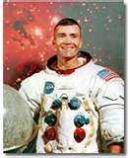
Perkinston Junior College
Fred Haise, Jr.
Today is
In 1927 the junior college at Perkinston graduated its first class of one. He had to march with the high school students, and Governor Theodore G. Bilbo delivered the commencement address.

Slide 33
Mississippi’s economy
What happened to cotton prices during World War I?
High Cotton prices

Slide 34
Mississippi’s economy
What happened to cotton prices at the end of World War I?
How low?
From 49 cents/pound to 9 cents
Cotton prices drop
82% drop in 1 year

Slide 35
Big Planters
Sharecropping and investing in the stock market.
How did they use some of that money?

Slide 36
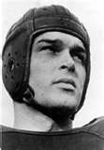
Football
No
Helmet look like this?
The Cotton States League

Slide 37
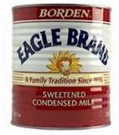
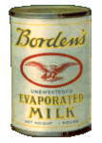
New Industries
Borden opens a condensed milk factory in Starkville.
What is condensed milk?
What do you use condensed milk in?

Slide 38
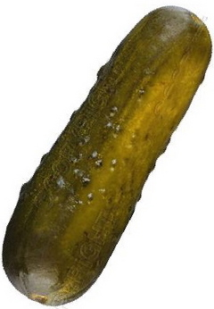
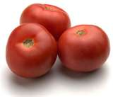
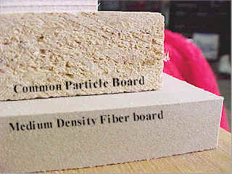
New Industries
Canneries open.
Fiberboard.

Slide 39
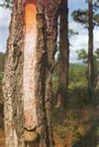
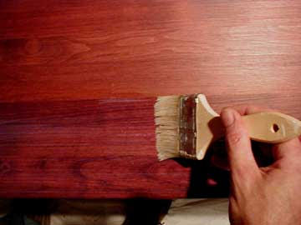
New Industries
Resin.
What was the biggest boom industry in the 1920s?

Slide 40
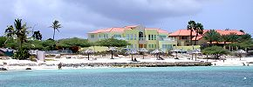
New Industries
Real Estate.
What did it sale for?
$200 a foot.

Slide 41
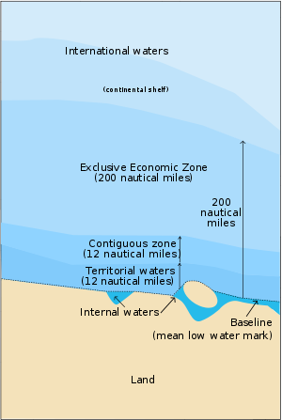
New Industries
12 miles off the coast, a casino was opened. Why 12 miles?
A state can enforce it’s laws in the state's territorial waters.

Slide 42
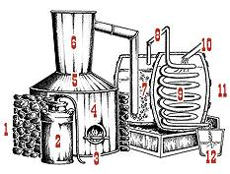
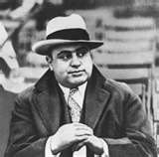
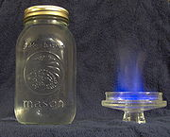
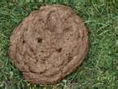
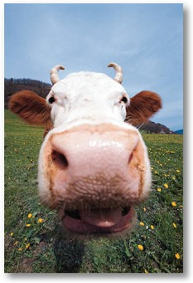
Why worry about state law?
Prohibition, the 18th Amendment.
White (Kiln) Lightening
Recipe:
75 lb. plain white corn meal 300 lb. sugar 1 lb. yeast 300 gallons of water
Optional flavoring
Moonshine still
Cowpatty
Al Capone

Slide 43
What brought the good times to an end?
The Great Depression
and the
21st Amendment.

Slide 44
Review
Bilbo as Governor Again.
The Wisconsin Report.
Junior Colleges.
Economy.

Slide 45
Homework
Read pages 195 to 198

