Slide 1
Welcome to oral communications
S p e e c h & D e b a t e
Mr. ErvIn

Slide 2
Urban legends
An urban legend, urban myth, urban tale, or contemporary legend is a genre of folklore comprising stories circulated as true, especially as having happened to a friend or family member, often with horrifying or humorous elements. These legends can be entertainment, but often concern mysterious peril or troubling events, such as disappearances and strange objects. They may also be moralistic confirmation of prejudices or ways to make sense of societal anxieties.

Slide 3
Terms to know:
Credible: a credible source is a source that contains accurate information backed up by evidence. Should cite sources.
Peer-reviewed: A source that has been reviewed by other experts in the field or topic the article relates to and determined to be accurate and credible.
Primary: The source that is being cited, referred to, or written about.
Secondary: A source that analyzes the primary source.
Tertiary: A source that uses secondary sources to analyze a primary source; for example: an encyclopedia.
Bias: A pre-held position or predetermined opinion about an issue or subject.
Bias confirmation: Sources that appeal to bias; sources that are chosen because they agree with a preconceived notion.

Slide 4
Terms to know:
Echo chamber: an environment in which a person encounters only beliefs or opinions that coincide with their own, so that their existing views are reinforced and alternative ideas are not considered, especially on social media and the internet.
Echo Chamber Video
CRAAP Method
Real or Satire?
GoDaddy

Slide 5
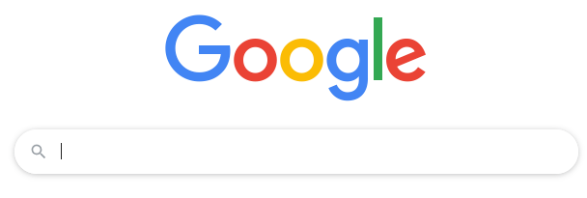
How to use google for research

Slide 6
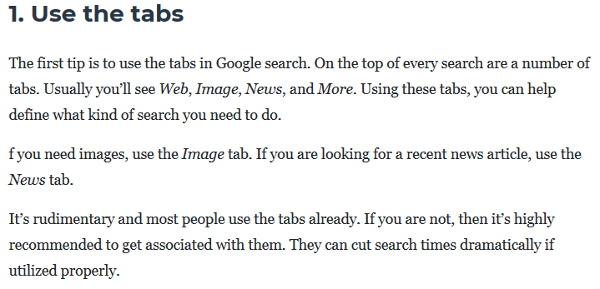

Slide 8
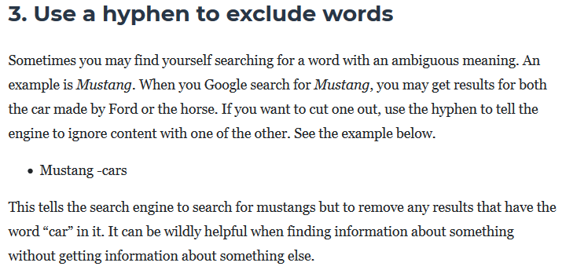

Slide 9
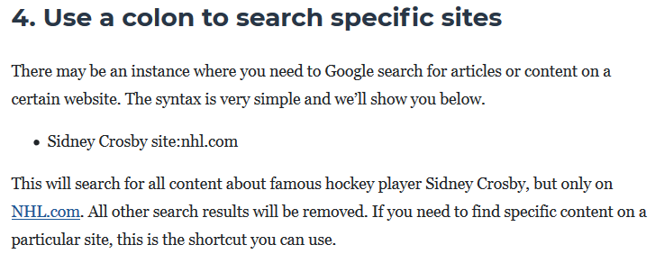

Slide 10
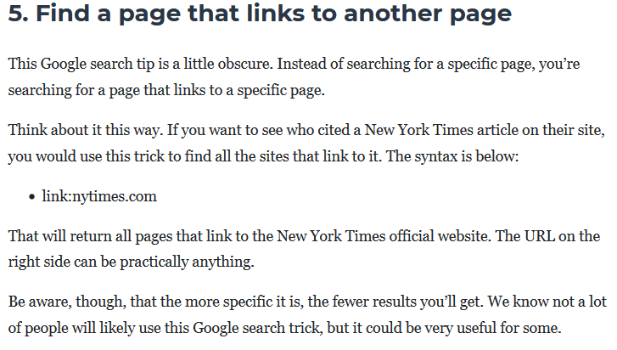

Slide 11
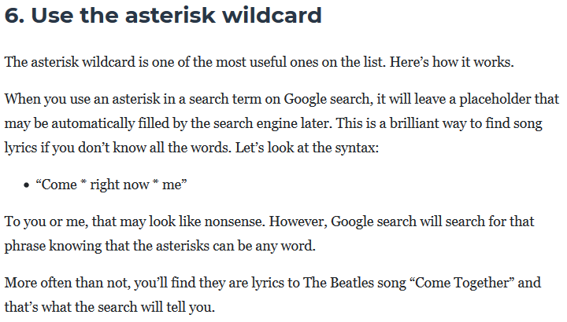

Slide 12
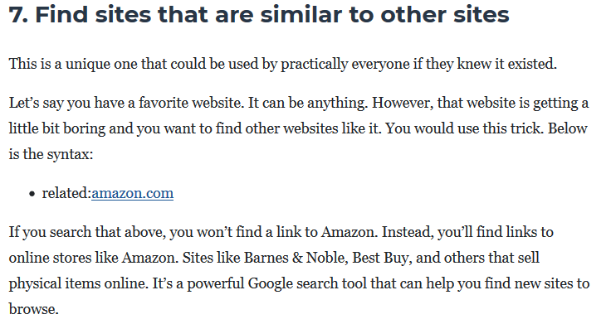

Slide 15
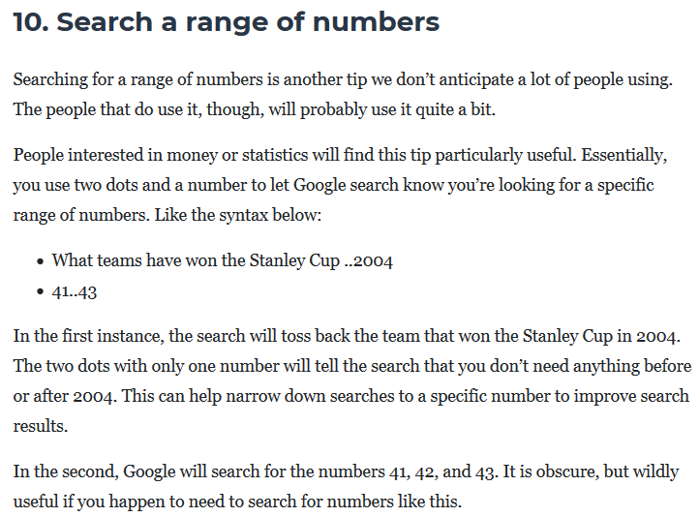

Slide 16
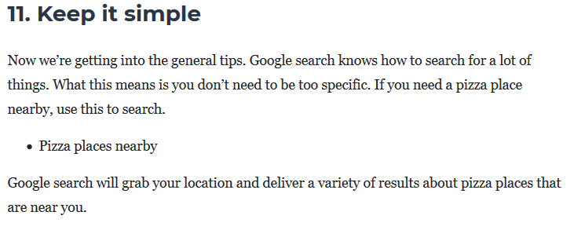

Slide 17
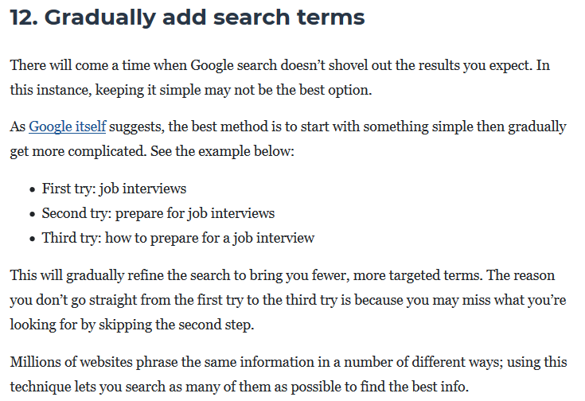

Slide 18
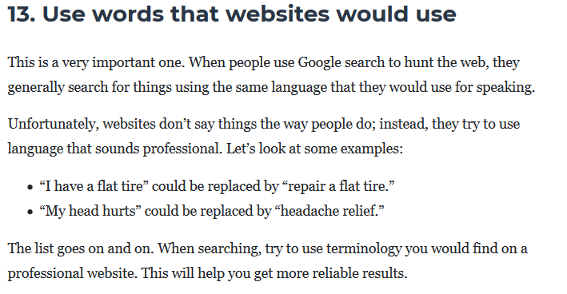

Slide 19
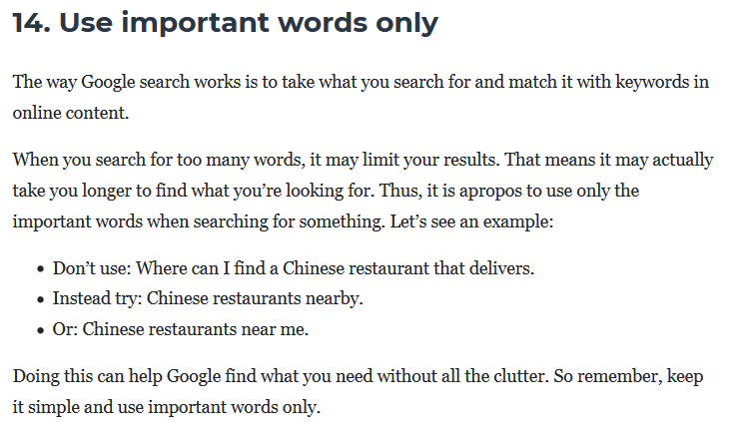

Slide 20
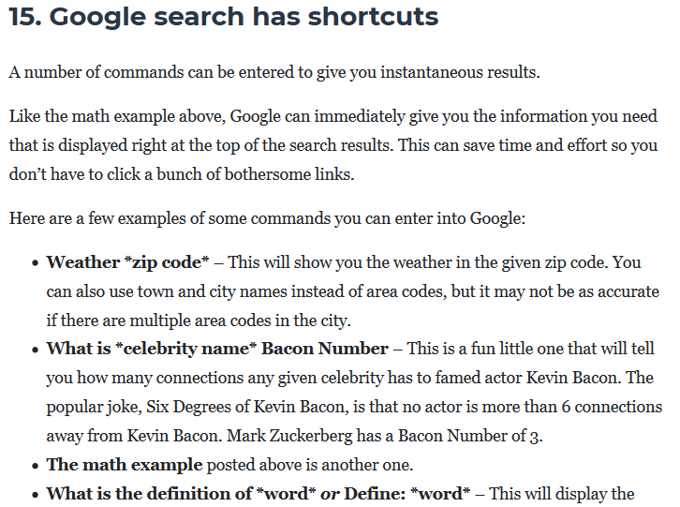

Slide 21
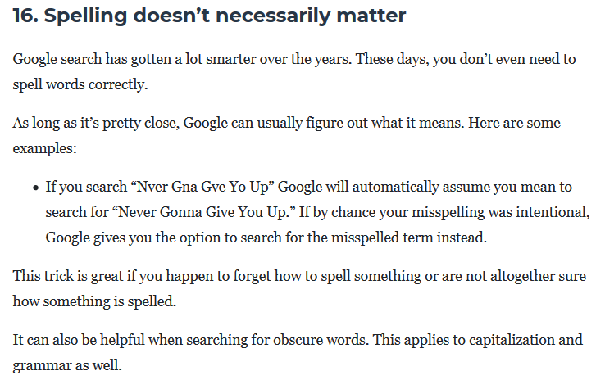

Slide 23
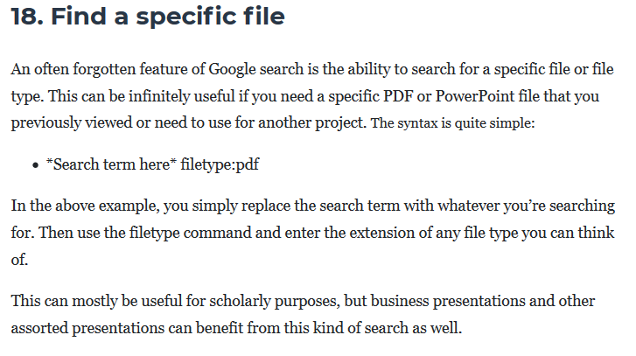

Slide 24
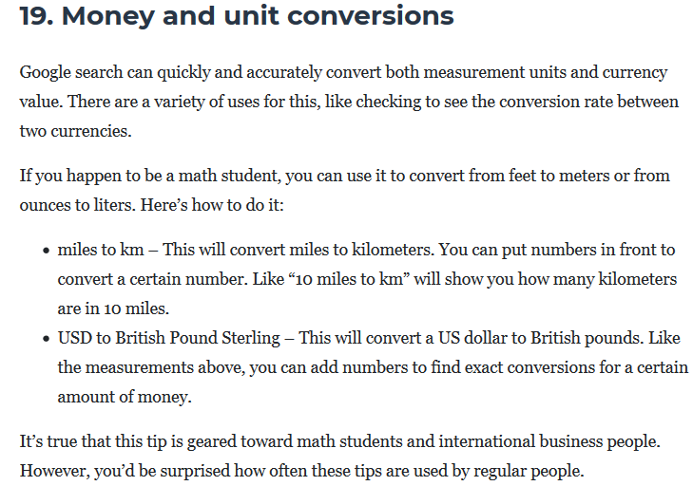

Slide 25
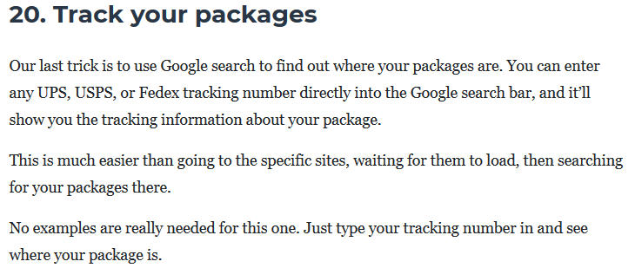

Slide 27
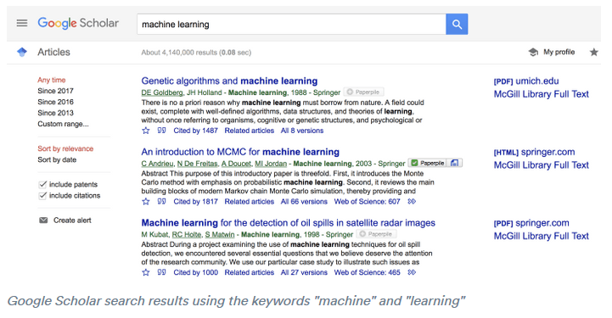

Slide 29
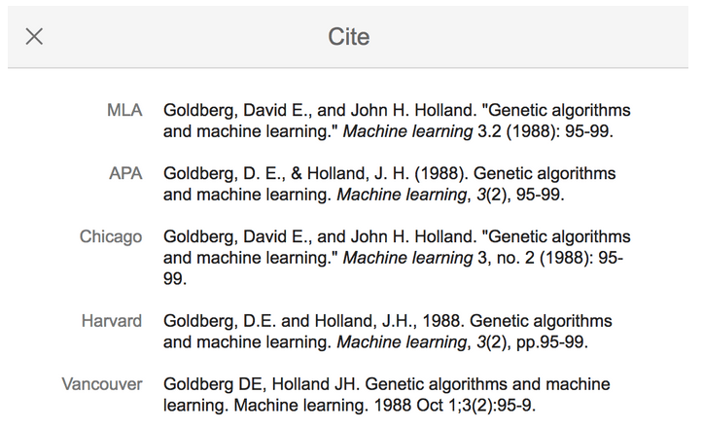

Slide 30
Proof vs. Evidence:
A “proof” is sufficient evidence or a sufficient argument for the truth of a proposition.
In casual conversations, most people use the word "proof" when they mean that there is indisputable evidence that supports an idea.
In every academic discipline other than math, nothing is ever literally “proven,” but rather evidence is collected that supports a logical, rational conclusion or argument.
In natural and social sciences, the best explanation for an observable phenomenon as supported by facts is called a “theory.”
In literature, a reasonable conclusion based on evidence is also called a theory.

Slide 31
Integrating Quotations in MLA Style
Now that you know how to find sources, it’s time to learn how to integrate information from your sources into your writing and speeches.
Quotations can enliven your writing if you know when to quote and how to integrate. Overuse of quotations should be avoided, but strategic use of quotations can help you elaborate on your main points and give credibility to your argument.

Slide 32
Integrating Quotations in MLA Style
When to quote rather than paraphrase:

Slide 33
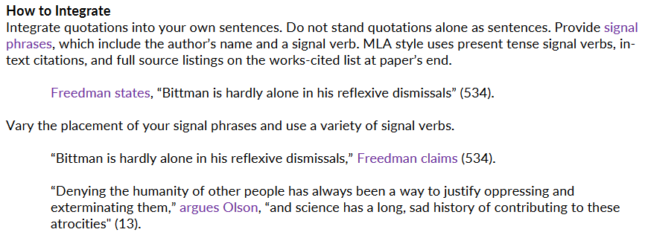
Integrating Quotations in MLA Style
How to integrate:
Remember: a quotation can never stand alone as its own sentence.

Slide 34
Integrating Quotations in MLA Style
Signal Phrases (dialogue tags)
These are examples; this is not an exhaustive list.

Slide 35
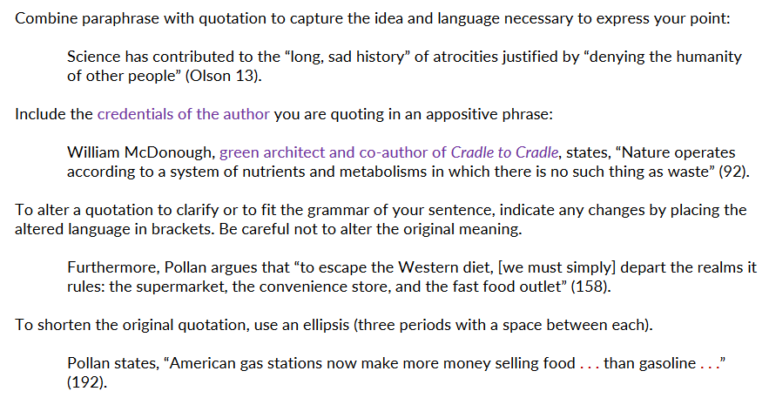
Integrating Quotations in MLA Style

Slide 36
Integrating Quotations in MLA Style
Punctuation

Slide 37
Knee-Jerk Reactions
You experience a knee jerk when your doctor taps your knee with a rubber mallet and your leg automatically kicks out. The idiom "a knee jerk reaction" means that you respond to something in an equally unthinking way.

Slide 38
Knee-Jerk Reactions
A woman finds a risqué text from another woman
on her husband’s phone, which he’d left behind upon
leaving on a business trip.
So she SOLD THEIR HOUSE and moved out before
he got home from his business trip.

Slide 39
Knee-Jerk Reactions
The wife’s reactions may be based on the reputation of men, her perceptions, or possibly her own personal experiences or the experiences of others, but…

Slide 40
Knee-Jerk Reactions
What if the text was a prank by one of the Husband’s friends? What if the text was sent to the wrong number?
It’s possible the woman’s conclusion was correct, but should she have taken such drastic action without getting more facts and information?

Slide 41
Critical Thinking:
The objective analysis and evaluation of an issue in order to form a judgment
*Ask questions * Recognize personal bias *Get all the facts and information you can

Slide 42
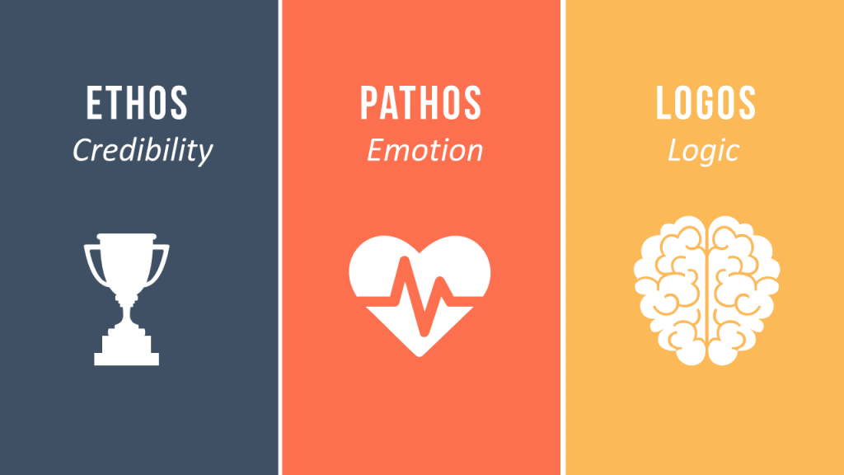

Slide 43
Ethos: appeal to credibility
How can we establish credibility?
Cite credible sources
Cite your credentials or the credentials of your source/author/experts
Use your sources and facts in an honest way; for example, don’t cherry pick or use facts out of context.

Slide 44
Cherry Picking
Cherry picking is a logical fallacy in which someone points out evidence that supports their claim while ignoring the evidence against their claim. The name of this fallacy is an allusion to the act of picking cherries off a tree, in which you only take the good fruits while leaving the bad ones behind.

Slide 45
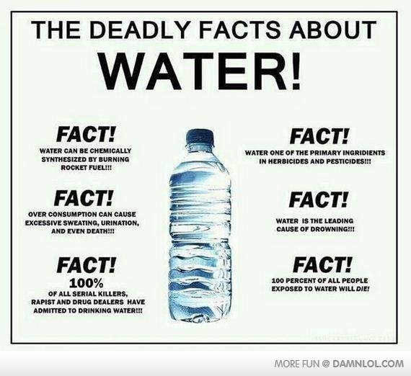
Cherry Picking
GMOs
Economy
Vaccines
Foreign Policy

Slide 46
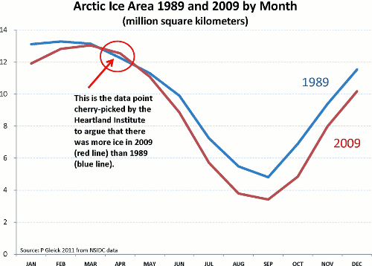
Cherry Picking

Slide 47
Pathos: appeal to emotion
Pathos: a way of convincing an audience of an argument by creating an emotional response to an impassioned plea or a convincing story.
* Pathos can be employed by telling a story, but make sure the story is a representative example, and not cherry-picked.

Slide 48
Pathos
In what ways does this commercial use pathos?
ASCPA Video

Slide 49
Logos: appeal to logic
Logos: a way of persuading an audience with reason, using facts and figures.

Slide 50
Logos: appeal to logic

Slide 51
Ethos, Pathos, and Logos all working together:
Ethos Pathos Logos

Slide 52
Logical Fallacies
Fallacies are common errors in reasoning that will undermine the logic of your argument. Fallacies can be either illegitimate arguments or irrelevant points, and are often identified because they lack evidence that supports their claim.
Avoid these common fallacies in your own arguments and watch for them in the arguments of others.

Slide 53
Logical Fallacies
Examples:
Slippery Slope: This is a conclusion based on the premise that if A happens, then eventually through a series of small steps, through B, C,..., X, Y, Z will happen, too, basically equating A and Z. So, if we don't want Z to occur, A must not be allowed to occur either. Example:
If we ban AR-15s then eventually the government will ban all rifles, so we should not ban AR-15s.

Slide 54
Logical Fallacies
Post hoc ergo propter hoc (False cause): This is a conclusion that assumes that if X occurred after Y, then Y must have caused X.
I drank bottled water and now I am sick, so the water must have made me sick.

Slide 55
Logical Fallacies
Hasty Generalization: This is a conclusion based on insufficient or biased evidence. In other words, you are rushing to a conclusion before you have all the relevant facts. Example:
Even though it's only the first day, I can tell this is going to be a boring course.

Slide 56
Logical Fallacies
Begging the question/assuming the premise: The conclusion that the writer should prove is assumed within the claim. Example:
Filthy and polluting coal should be banned.

Slide 57
Logical Fallacies
Either/or (False dilemma) : This is a conclusion that oversimplifies the argument by reducing it to only two sides or choices. Example:
America: Love it or leave it!

Slide 58
Logical Fallacies
Ad hominem: This is an attack on the character of a person rather than his or her opinions or arguments, sometimes using personal insults. Example:
"You've only ever lived in the city. The issues that matter to farmers are clearly beyond your comprehension."

Slide 59
Logical Fallacies
Ad populum/Bandwagon Appeal: This is an appeal that presents “what most people”, or a group of people think, in order to persuade one to think the same way. Getting on the bandwagon is one such instance of an ad populum appeal. Example:
“If you were a true American, you would support the president!”

Slide 60
Logical Fallacies
Red Herring: This is a diversionary tactic that avoids the key issues, often by avoiding opposing arguments rather than addressing them. Example:
Climate change may be a problem, but if we stop using oil, how will we drive our cars?

Slide 61
Logical Fallacies
Straw Man: This fallacy oversimplifies or misrepresents an opponent's viewpoint and then attacks that hollow argument. Example:
People who oppose gun-control legislation think Americans don’t have a right to defend their homes against intruders!

Slide 62
Logical Fallacies
Moral Equivalence: This fallacy compares minor misdeeds with major atrocities, suggesting that both are equally immoral. Example:
“Taxation is theft!”

Slide 63
Logical Fallacies
Ladies and gentlemen of the jury, look at the bloody clothes, the murder weapon. Imagine the helpless screams of the victim. Such a crime deserves no verdict except guilty, guilty!

Slide 64
Logical Fallacies
Ladies and gentlemen of the jury, look at the bloody clothes, the murder weapon. Imagine the helpless screams of the victim. Such a crime deserves no verdict except guilty, guilty!
Red herring. The fact that the crime was horrible doesn’t imply the defendant’s guilt.

Slide 65
Logical Fallacies
How can you possibly believe the theory of evolution? That would mean that you believe that an elephant evolved from a worm, and that’s just ridiculous.

Slide 66
Logical Fallacies
How can you possibly believe the theory of evolution? That would mean that you believe that an elephant evolved from a worm, and that’s just ridiculous.
Straw man. Reducing the (very complex) theory of evolution to “elephants evolved from a worm” is to create a distorted, misrepresentative, and oversimplified view of the theory.

Slide 67
Logical Fallacies
You can hardly blame President Trump for having extramarital affairs. Many presidents, when faced with similar situations, have yielded to the same temptations.

Slide 68
Logical Fallacies
You can hardly blame President Trump for having extramarital affairs. Many presidents, when faced with similar situations, have yielded to the same temptations.
Red herring. The fact that others have had affairs is not really relevant to whether or not Clinton ought to be blamed for having affairs.

Slide 69
Logical Fallacies
More high school students are reporting having had sex than ever before since sex education was introduced in schools; Therefore, to reduce this, we must eliminate sex education.

Slide 70
Logical Fallacies
More high school students are reporting having had sex than ever before since sex education was introduced in schools; Therefore, to reduce this, we must eliminate sex education.
False cause. The mere fact that more sexual activity followed the creation of sex education does not entail that the new course caused more sex.

Slide 71
Logical Fallacies
We should pass a constitutional amendment making it illegal to burn the American flag. Anyone who thinks otherwise just hates America.

Slide 72
Logical Fallacies
We should pass a constitutional amendment making it illegal to burn the American flag. Anyone who thinks otherwise just hates America.
Straw man. Many who oppose a constitutional amendment banning flag burning do so for fairly sophisticated reasons (e.g., a belief in the importance of free speech even when the speech is unpopular.)

Slide 73
Logical Fallacies
The Soviet Union collapsed after taking up atheism. Therefore, we must avoid atheism for the same reasons.

Slide 74
Logical Fallacies
The Soviet Union collapsed after taking up atheism. Therefore, we must avoid atheism for the same reasons.
False cause. The speaker assumes that taking up atheism caused the collapse of the Soviet Union without providing any evidence of a causal connection.

Slide 75
Logical Fallacies
logical fallacies

Slide 76
Informational Thesis
Include: Topic, purpose, a preview of your main points (in this case, three).

Slide 77
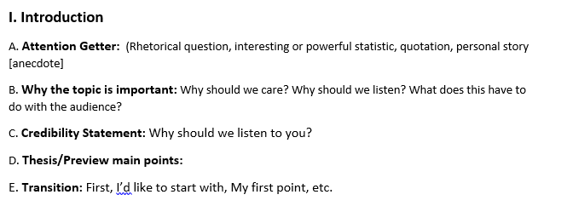
Introduction

Slide 78
Conclusion

Slide 79
MLA Format Formula
Author.
Title of source.
Title of container,
Other contributors,
Version,
Number,
Publisher,
Publication date,
Location.
Be sure and include punctuation.
If the information is missing, skip it.

Slide 80
Persuasive Speech

Slide 81
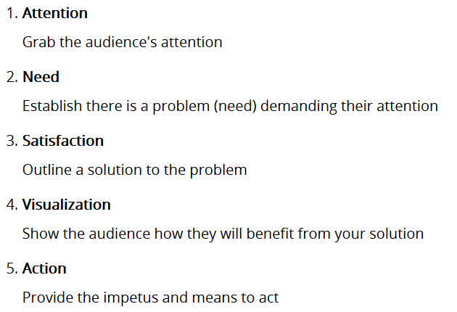
Monroe’s Motivated Sequence

Slide 82
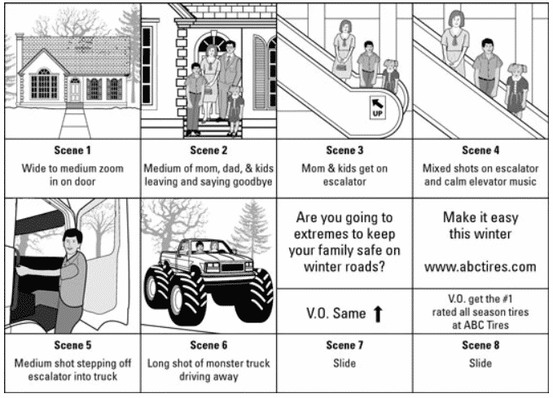

Slide 83
Persuasive Speech

Slide 84
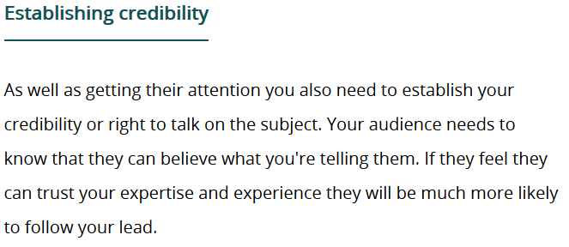
Persuasive Speech

Slide 85
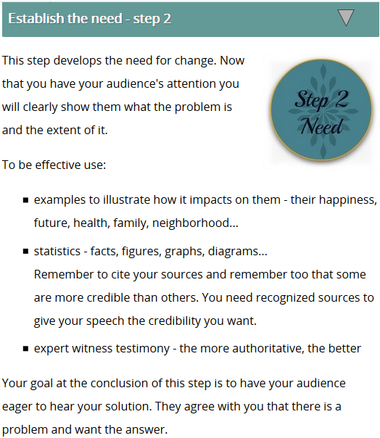
Persuasive Speech

Slide 86
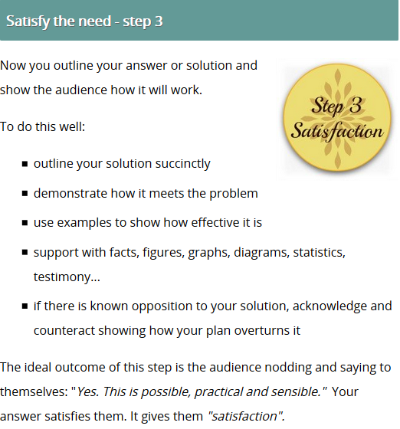
Persuasive Speech

Slide 87
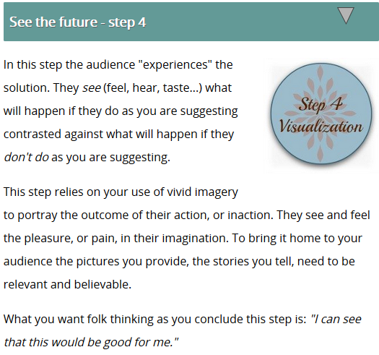
Persuasive Speech

Slide 88
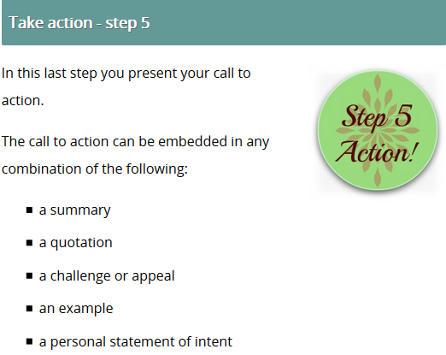
Persuasive Speech

Slide 89
Persuasive Speech
Thesis Statement
Topic + Opinion + Three Reasons (In any order)
Example:
Childhood vaccinations (topic) should be mandatory, (opinion) as they are safe, reduce the risk of illness, and protect other people from contagious diseases (reasons).

Slide 90
Introduction
Hook: Personal story (anecdote), startling statistic, interesting fact, quotation, joke
Reason for listening: How does this topic affect your audience? Why should your audience care? INCLUDE FACTS, DATA, AND SOURCES.
Speaker credibility: Why should we listen to YOU?
Thesis (Topic + Opinion + Reason) Tell the audience what you’re about to talk about, your opinion on the topic, and preview your main points.

Slide 91
Conclusion
Remind the audience of your thesis: Restate your argument and summarize your main points.
Remind the audience of the impact on their lives
Tell the audience exactly what you want them to do. It should be something they can do immediately.
Leave the audience with something to think about: quotation, rhetorical question, challenge, or circle back to your opening anecdote.

