Slide 1
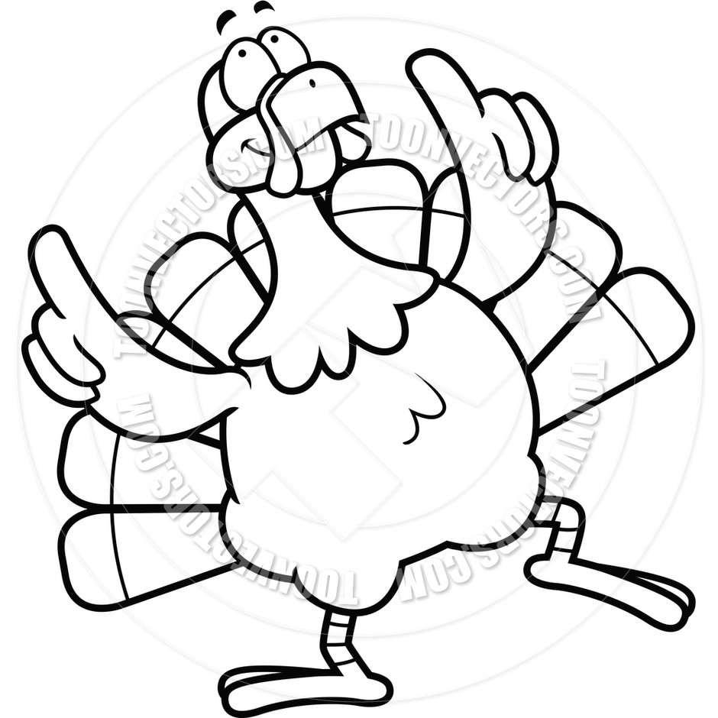
Week of: 11th-15th
Skills for the Week
Reading-identifying the central message, compare and contrast, and B/M/E
Writing-informative writing
Language- verbs and past tense verbs
Math- skip counting
*Spelling, reading, and math test this week
Remind: Enter this number- 81010
Test this message-@66ckkd
662-429-9117
mariann.word@dcsms.org
Vocabulary Words
Homework
dull-not bright, colorful, or shiny; boring, not interesting
solid-hard and firm
mushy-soft and wet like
mush
slurp-eat or drink something in a noisy way
Practice getting on IXL. Login information should be in the zipper pouch in their folder.
or more short
four for bear
world eye far
part same think
give friend front
live horse store
prove fourth
Spelling Words
November 11th-15th- No Lunch Visitors
November 12th-Progress Reports
November 25th-29th- Thanksgiving Holiday

