Slide 1
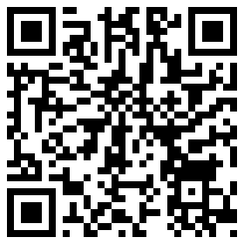
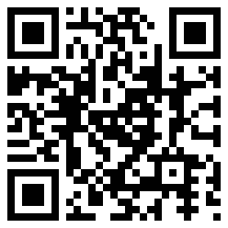
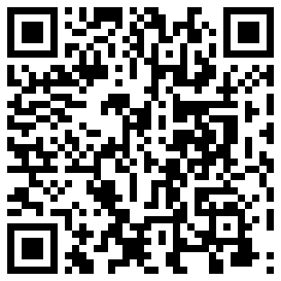
Critical Analysis of “Everyday Use”
http://userpages.umbc.edu/~jamie/html/on__everyday_use_.html
http://www.lonestar.edu/13778.htm
http://www.ukessays.co.uk/essays/english-literature/everyday-use.php

