Slide 1
The Mole
Relating Chemical Formulas and Mass

Slide 2
Review
What is atomic mass?
How is it calculated?
What is the definition of an atomic mass unit?

Slide 3
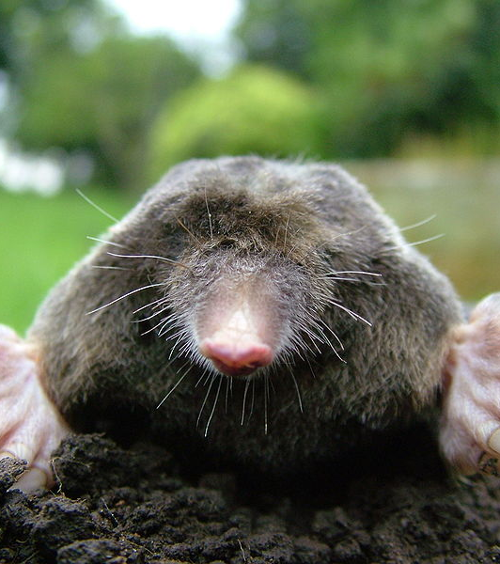
The Mole
The number of atoms in exactly 12 g of Carbon-12

Slide 4
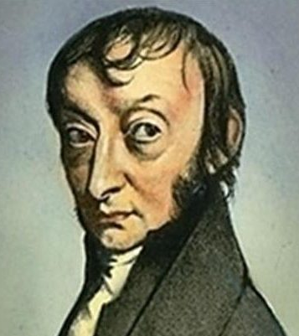
Avogadro’s Number
The number of particles in one mole.
N_{A} = 6.022 * 10²³
Named in honor of Amedeo Avogadro

Slide 5
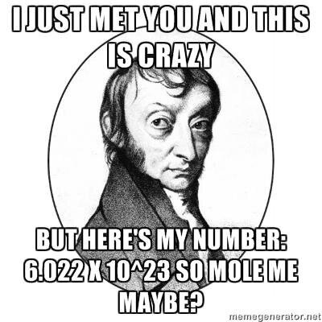

Slide 6
Molar Mass
Mass of one mole of any element.
Equal to the atomic mass of an element in grams.
Find the molar mass of the following elements:
Mg
F
Ag
Sn
U

Slide 7
Formula Mass
Mass of exactly one mole of any compound.
Add up the molar mass of all constituent elements.
Don’t forget to multiply each element by the number of atoms in a formula unit.
Find the formula mass of each compound:
Sodium chloride
Lithium sulfate
Silver nitrate

Slide 8
Molar Mass Conversions
Used to convert between mass and moles.
Uses the molar mass as a conversion factor.
Moles → Mass
Multiply by molar mass
Mass → Mole
Divide by molar mass

