Slide 1


Friday, August 16, 2019
Section 2 (next clean page)
  Date page: 8-16-19
  Think about a tall glass of water with ice cubes.
  Write from the perspective of an ice cube in a glass of water. How do you feel in the glass, what do you wonder? You’re writing from the perspective of the ice cube in first person (use those words – I, me, my). ☺
Practice writing “e” in cursive when finished.
7:55 – 8:35

Slide 2
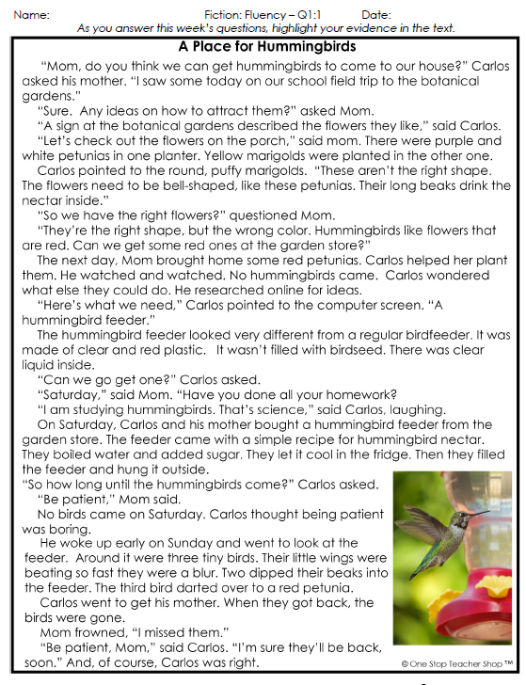
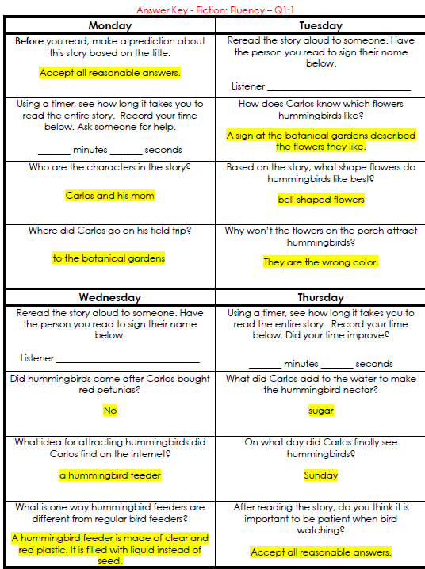
Reading Homework

Slide 3
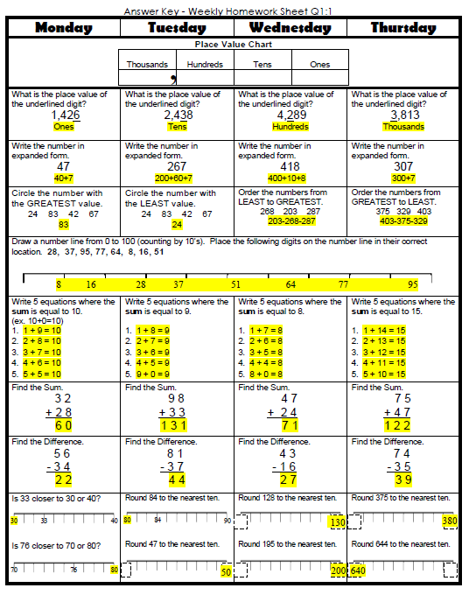
Math Homework

Slide 4

CHOMP TIME
F.A.S.T. Groups
Focused Academic Support Time

Slide 5
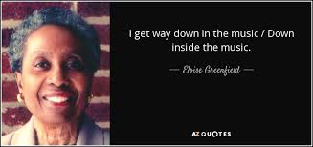
F.A.S.T. Designations
Computers – Epic: Adalyn Jaylie Jearon Amiyah Cohen Emma Caydance Kaylee Jordyn | Mrs. Roby: LLI Jaiden Macon Kaylah Katelynn | Mrs. Thompson: LLI Landon Paisleigh | IDR – 40 book challenge Aiden Alexis Cayli Brena Khamani Carleen McKenzie Erin Noah Elin
8:40 – 9:10

Slide 6
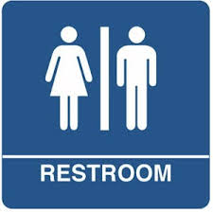
Restroom Break
9:10 – 9:20

Slide 7
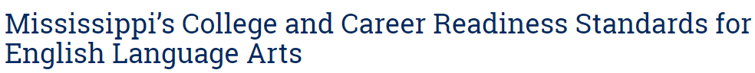

Reading Time
9:20 – 9:55
Objective: RI.3.1
I can ask and answer questions to demonstrate understanding of a text, referring explicitly to the text as the basis for answers.
Objective: RI.3.9
I can compare and contrast the most important points and key details presented in two texts on the same topic.

Slide 8
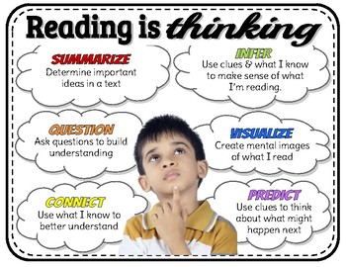
Strategies to help reading comprehension

Slide 9
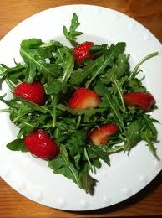
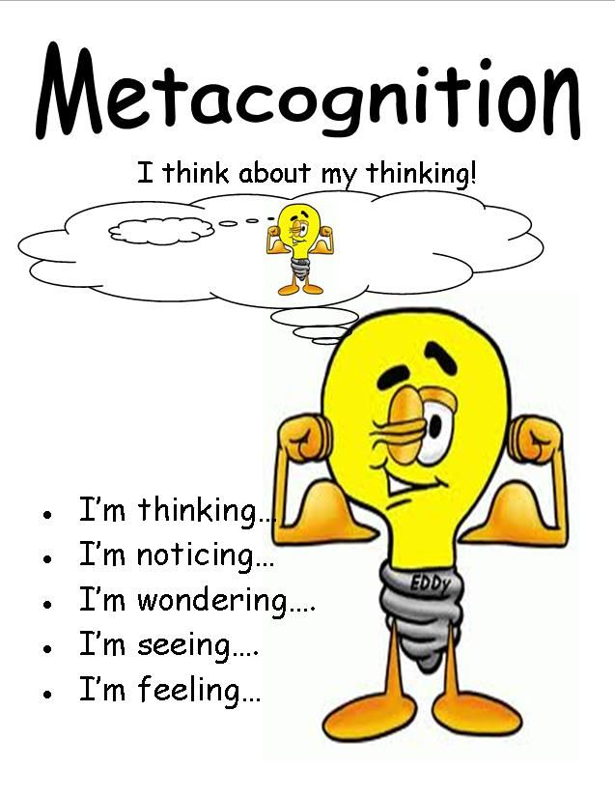
Let’s always think as we are reading.
METACOGNITION –
Who’s ready to make a
“Reading Salad?”
Anchor Chart: Thinking About My Reading

Slide 10
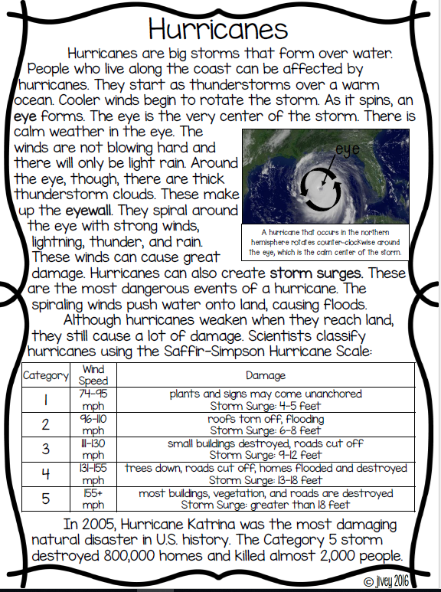
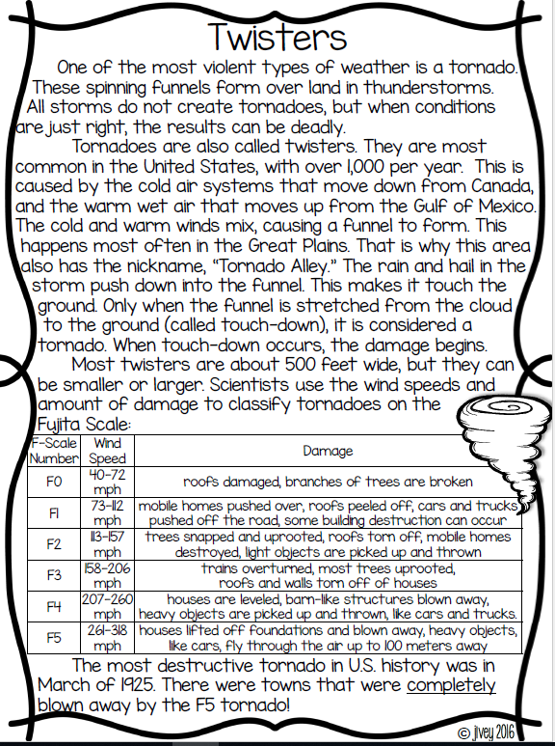

Slide 11
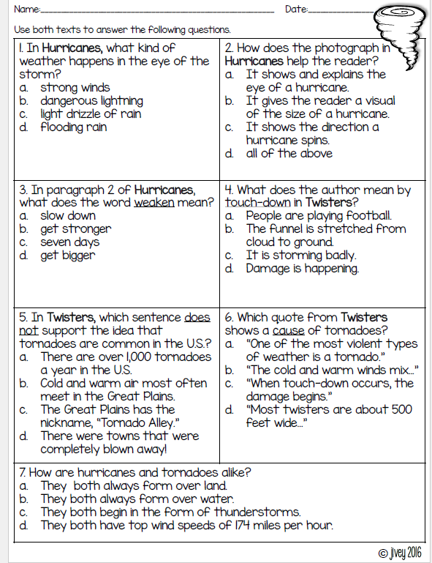
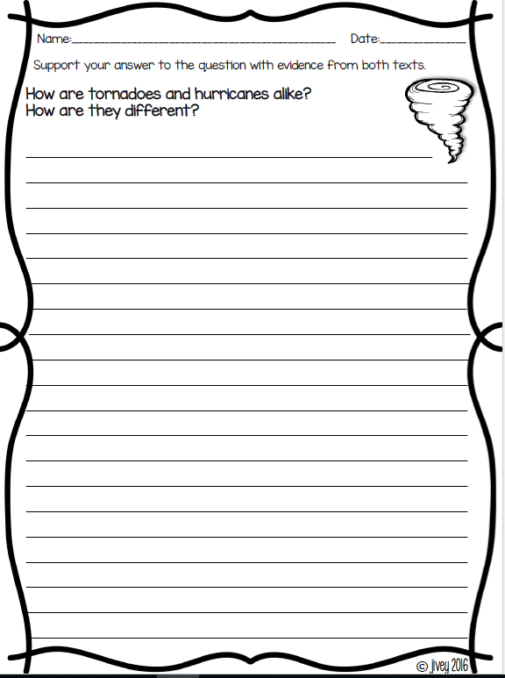

Slide 12
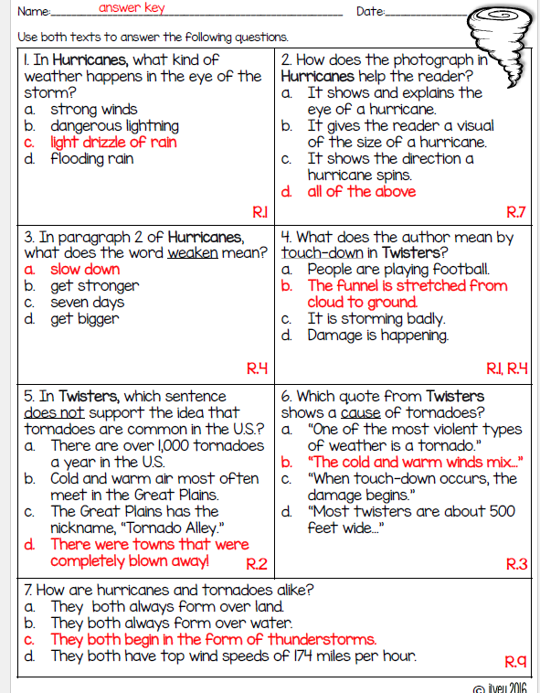
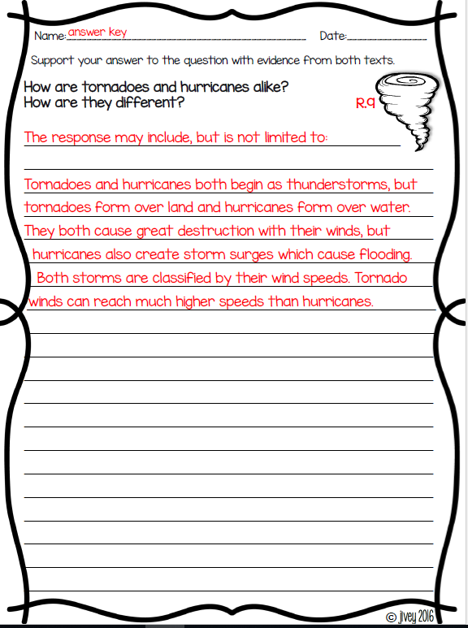
Answer Key

Slide 13

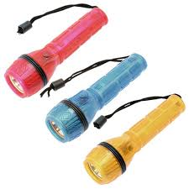
Computers - Epic:
  Jaiden
  Macon
  Kaylah
  Katelynn
  McKenzie
  Erin
  Noah
  Elin
  Landon
  Paisleigh
Independent Daily Reading & Teacher Conferences
Flashlight Friday
All others Independent Novel for Book Challenge! ☺
9:55 – 10:25

Slide 14



Vocabulary & Grammar Time
Snack Time
10:25 – 10:40

Slide 15
snap – speak sharply or angrily
How might you feel if someone snapped at you?
If someone snapped at me, I might feel… because…
What might you say to someone who snapped at you?

Slide 16

Did Olive Snap?
Olive’s friend asked her if she wanted to go for a bike ride. “I can’t,” said Olive with a smile. “But thanks for asking me.”
Did Olive snap? Why do you think that?
Turn to your Partner

Slide 17

Did Olive Snap?
Olive was working on a jigsaw puzzle. “Can I help you with the puzzle?” asked Olive’s little brother. “No, you cannot,” said Olive in an angry voice. “Stop bothering me.”
Did Olive snap? Why do you think that?
Turn to your Partner

Slide 18
What’s the new word we are learning that means “speak sharply or angrily”?
snap

Slide 19
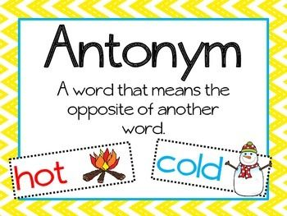
likely – probably will happen or is probably true
unlikely – probably will not happen or is probably not true

Slide 20
likely
What are you likely to do after school today? Turn to your partner
After school, I’m likely to…
Why are you likely to do that after school?

Slide 21
unlikely
What are you unlikely to do after school today? Turn to your partner
After school, I’m unlikely to…
Why are you unlikely to do that after school?

Slide 22
What’s the new word we are learning that means “probably will happen or probably true”?
What is the antonym of likely?
likely
unlikely

Slide 23
Out of Classroom!
Recess 10:40 – 11:05

Slide 24

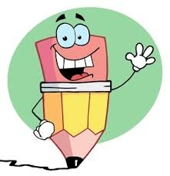

Writing Time
Objective: W3.3
Write narratives to develop real or imagined experiences or events using effective technique, descriptive details, and clear event sequences.
11:05 – 11:30

Slide 25

Gather at the Carpet…
Was it a perfect transition?

Slide 26
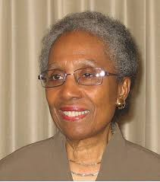

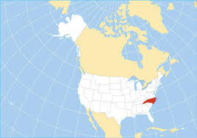
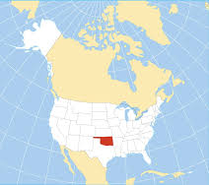
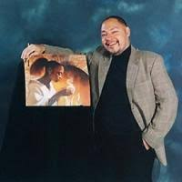
Author: Eloise Greenfield
Born in North Carolina
Listen Carefully
Illustrator: Floyd Cooper
Born in Oklahoma

Slide 27
After page 18
What is happening in this story?
Turn to your Partner
What is this story about? Turn to your partner

Slide 28
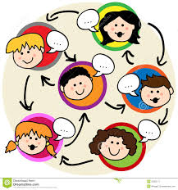
Share Time – Classroom Discussion
This story tells about a time when Tamika was upset about a family member.
If you were to write a story about a time you were upset about a family member, what might you write? (We’ll add these to our People We Can Write About chart)
We can also add something to our Writing Ideas chart – Write stories from your own life

Slide 29

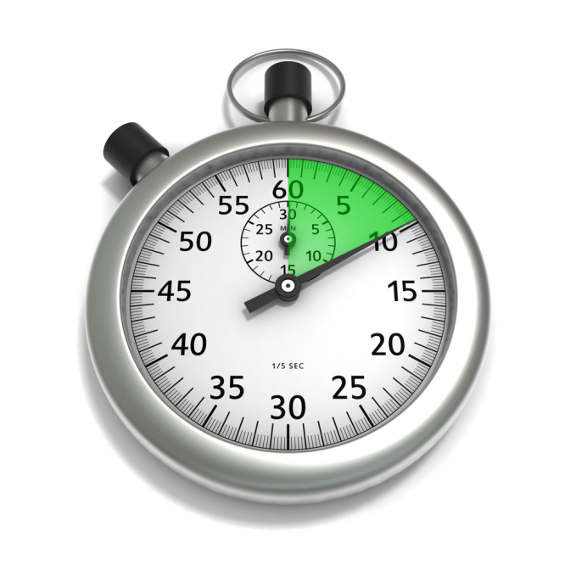
Writing Time
Writing Journal – Section 2
Remember:
Write silently
Double-space, or skip every other line
Continue writing until time is up
Write about anything you want
Objective: W3.3 Write narratives to develop real or imagined experiences or events using effective technique, descriptive details, and clear event sequences.

Slide 30
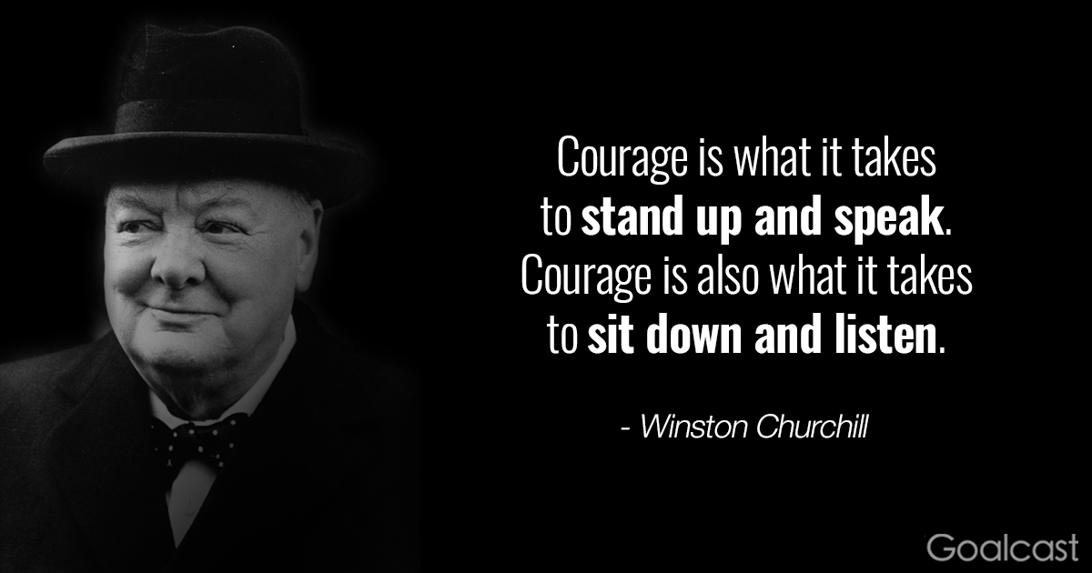
Share Time – Classroom Discussion
Who wrote about someone in your own life?
What other things did you write about today?

Slide 31
Math Fluency & Focus Lesson!
11:35 – 11:55

Slide 32
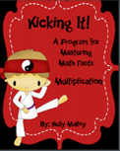
Kicking it Quiz!

Slide 33
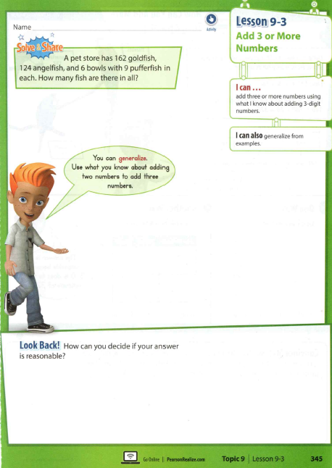

Slide 34
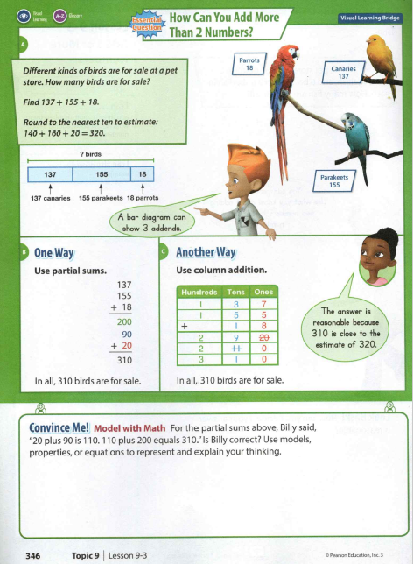
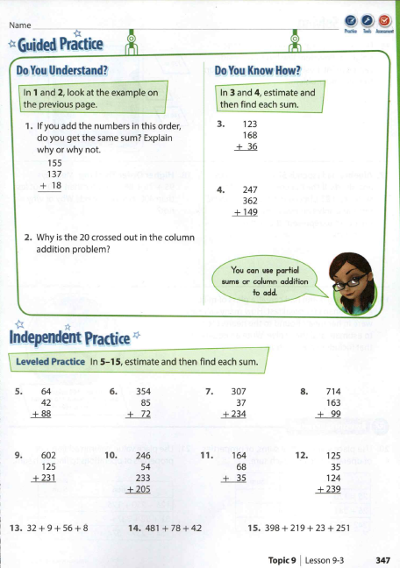

Slide 35
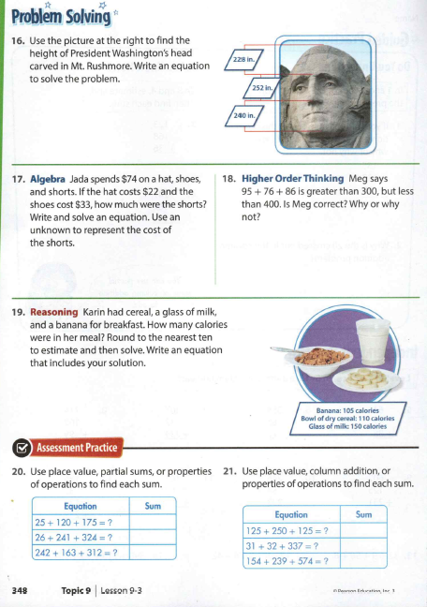

Slide 36

Out of Classroom!
Lunch 12:35 – 1:05

Slide 37
Restroom Break
1:05 – 1:10

Slide 38

Out of Classroom!
Activity 1:10 – 1:55

Slide 39

Extra Recess Earned!
1:55 – 2:15

Slide 40
Math Quiz!
2:15 – 2:45

Slide 41

SCIENCE TIME
Objective: P.3.5.1
I can plan and conduct scientific investigations to determine how changes in heat (i.e., an increase or decrease) change matter from one state to another (e.g., melting, freezing, condensing, boiling, or evaporating).
2:45 – 3:10

Slide 42
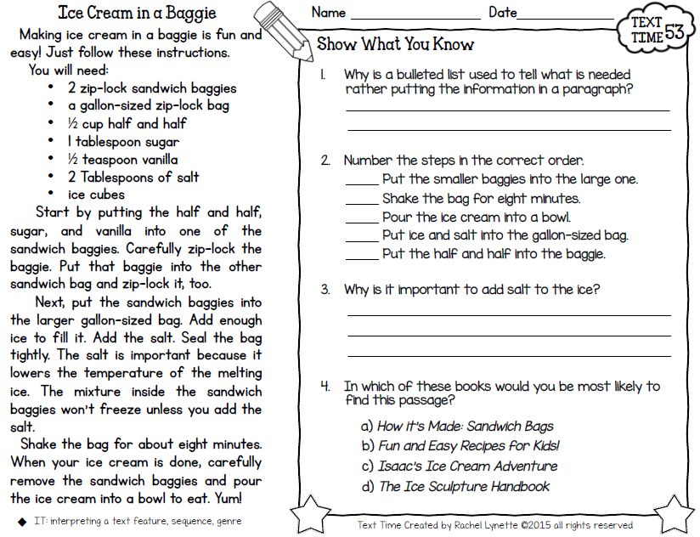
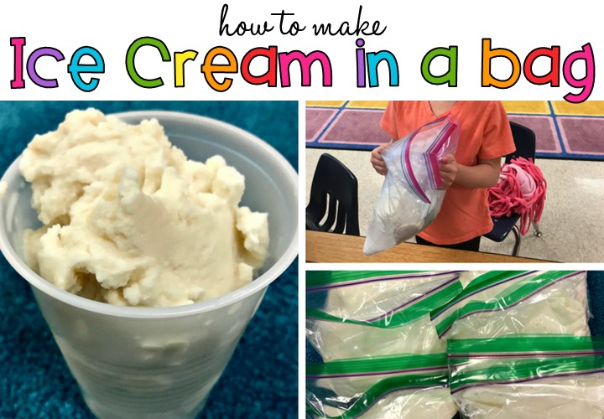
Let’s Make Some Ice Cream

Slide 43
Restroom Break
3:10 – 3:15

Slide 44

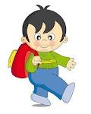


3:15 Wrap Up!
Pair-Up back to back and share one thing you learned in class today with your partner
Pack-Up
Office will announce:
Car Riders – Leave around 3:20
Bus Riders – (listen to intercom for dismissal)
2:30 – 3:20
How much time has elapsed?

