Slide 1
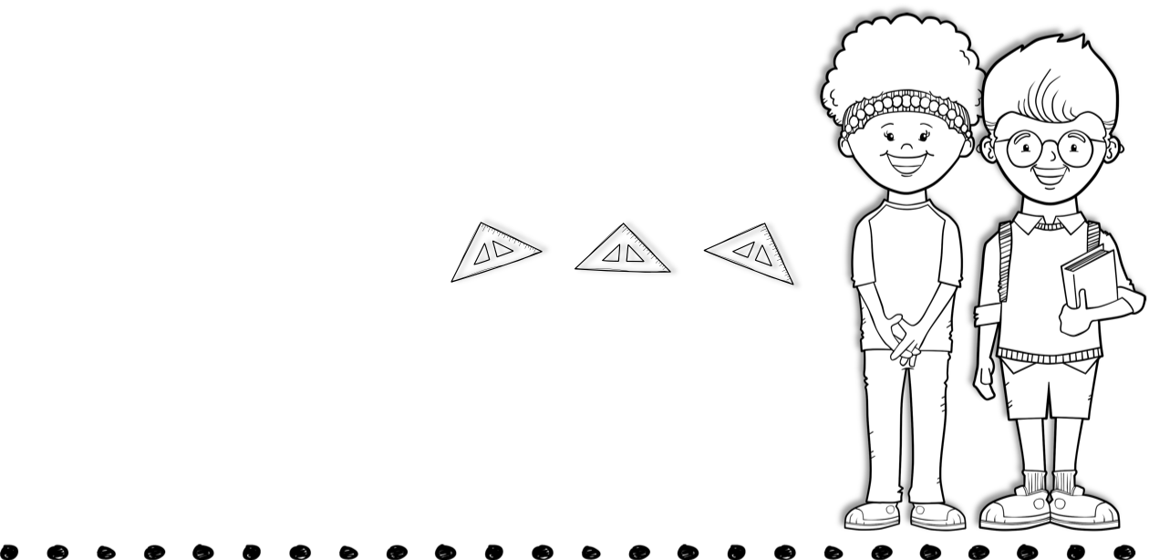
Feb 1st- 5th
Skills for the Week
Contact Me
Reading-point of view, character response, and story structure
Writing-biographies
Math-fractions & word problems
Language-adjectives
Math, spelling, and vocabulary test on Friday.
662-429-9117
mariann.word@dcsms.org
Text
Vocabulary Words
Activity
occasionally- once in a while, but not often
encourage- give someone confidence by praising or helping the person
disapprove-do not agree with it or you think it is bad or wrong
approve- you think it is good or right
insist- demand or ask for something very firmly
create-make something new
predict- say what you think will happen in the future
fabulous-wonderful or terrific
hurl-throw hard and fast
pester-keep bothering or annoying someone
glare-look at someone or something in an angry way
overalls-pants with shoulder straps and a top part that covers the chest
Monday- Music
Tuesday- PE
Wednesday-Art
Thursday- Computer
Spelling Words
drink sky try
pink think slam
and by game
home hide jump
fumble thing time
year teach each
read eat
Upcoming Events
February 12th &15th- no school

