Slide 1
Agriculture
Page 159

Slide 2
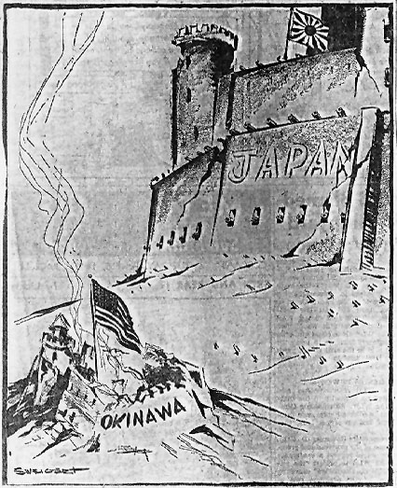
What is this cartoon about?

Slide 3
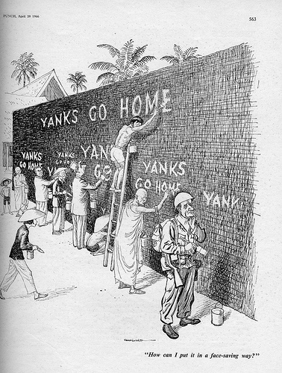
How can I put it in a face-saving way?

Slide 4
Objectives
MS1 Explain how geography, economics, history, and politics have influenced the development of Mississippi.
MS1d Analyze advanced personal economic choices (e.g., timber industry, shipping industry, gaming industry).

Slide 5
Objectives
MS1e Analyze the historical and political significance of key events in our state's development .
MS2a Identify the influence of the industrial and agricultural revolution in our state.
MS3d Analyze the significance of key events in our state's history.

Slide 6
Review
Segregation
Lynching
Black reaction to segregation
Education

Slide 7
Overview
Sharecropping System
New Labor
Chinese
Italian
Agricultural Problems
Lumber Industry

Slide 8
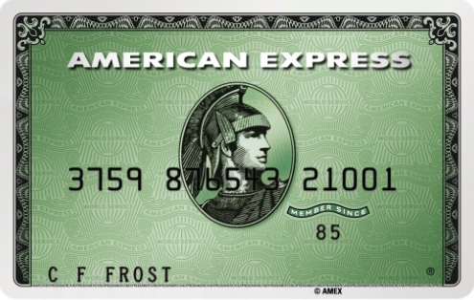
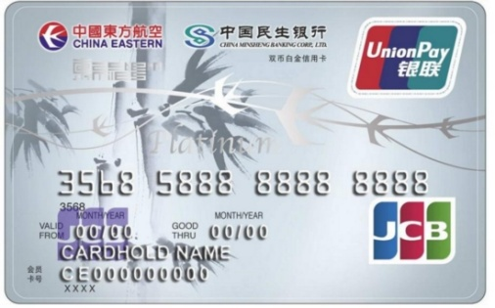
What is credit?
Credit is the ability to buy something now and pay for it later.
Do we use credit today?
Yes.

Slide 9
What is sharecropping?
Is a person who did not own the land they farm, the house they live in, or often the tools they used.
In Mississippi, in 1890, what percentage of farm families were sharecroppers?
60%.

Slide 10
How did sharecropping start?
The South had been devastated by war; planters had ample land but little money for wages or taxes.
At the same time most of the former slaves had labor but no money and no land; they rejected the kind of gang labor that typified slavery.

Slide 11
Tenant Farming and Sharecropping.
Sharecropping agreements can be in the form of tenant farming or sharecropping.
There are three different types of contracts.

Slide 12
Three different types of contracts.
Workers can rent plots of land from the owner for a certain sum and keep the whole crop.
Workers work on the land and earn a fixed wage from the land owner but keep some of the crop.
No money changes hands but the worker and land owner each keep a share of the crop.

Slide 13
Sharecropping arrangements
No money changes hands but the worker and land owner each keep a share of the crop.
50% of the crop to the Land Owner
50% of the crop to the Sharecropper
100% of the crop

Slide 14
Sharecropping arrangements
The sharecropper purchased seed, tools and fertilizer, as well as food and clothing, on credit from a local merchant, or sometimes from a plantation store.

Slide 15
The Problem
Who gets paid first?
The Land Owner.
Who gets paid second?
The merchant .

Slide 16
Sharecropping arrangements
The cropper would harvest the whole crop and sell it.
The merchant who had extended credit and the landowner's share were deducted and the cropper kept the difference.

Slide 17
The Problem
The Land Owner 50%
The merchant 60%
Sharecopper/ -10%
Tenant Farmer

Slide 18
Sharecropping/Tenant Farming
By the early 1930s there were 5.5 million white tenants, sharecroppers, and mixed cropping/laborers in the United States, and 3 million blacks.

Slide 19
Sharecropping/Tenant Farming
In Mississippi, by 1900, 36% of all white farmers were tenants or sharecroppers, while 85%of all black farmers were.

Slide 20
Sharecropping/Tenant Farming
In Mississippi, many sharecroppers were not able to move. Why?
State laws.

Slide 21
State Laws
In Mississippi, sharecroppers were not able to leave the plantation until the debts were paid.
Could not move from one plantation to other.

Slide 22
U. S. Department of Justice
In 1907, investigated the system of sharecropping in Mississippi, and concluded that black sharecroppers on 1/3 of the large plantations were held in near slavery.

Slide 23
Delta Planters
Were still clearing land for farming, so they need more laborers. So where do you get more labor?
Out side the state, Chinese labor. Why?

Slide 24
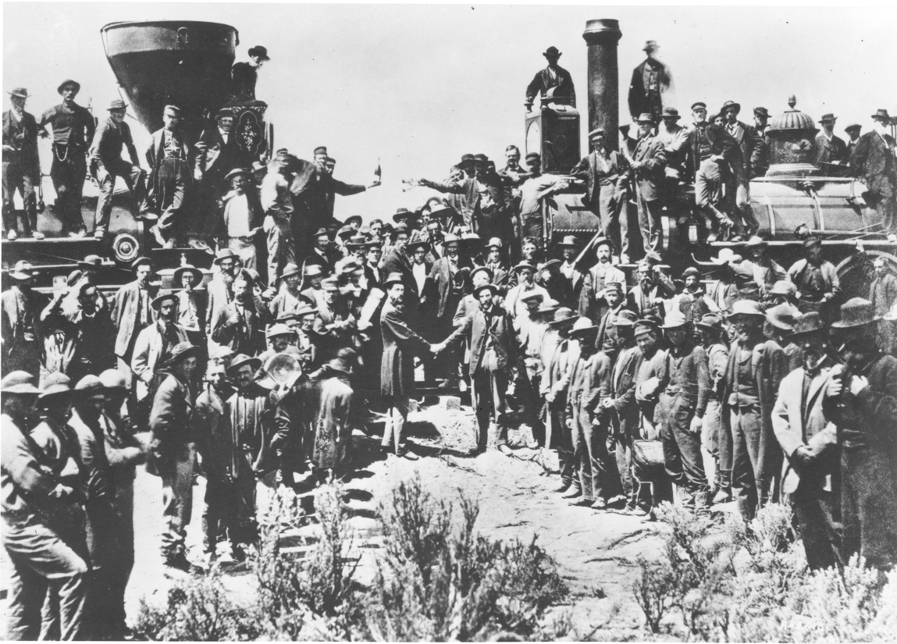
The Transcontinental Railroad

Slide 25
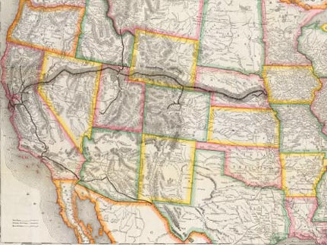
Which side was harder to complete, east or west?
The Transcontinental Railroad

Slide 26
Why was it harder?
The Transcontinental Railroad

Slide 27
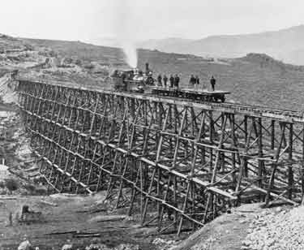
12⁰ Limit

Slide 28
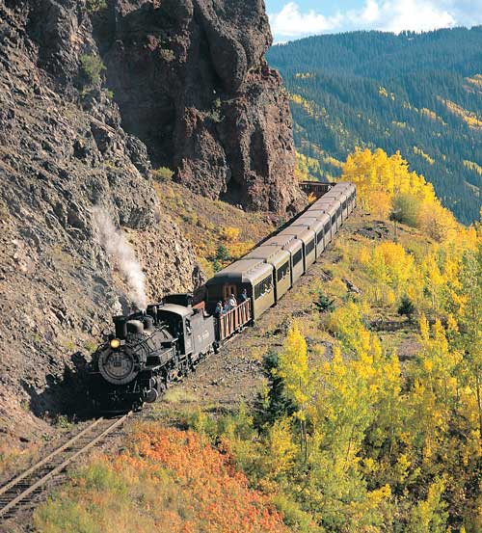
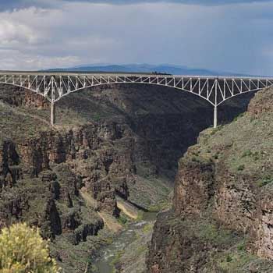

Slide 29
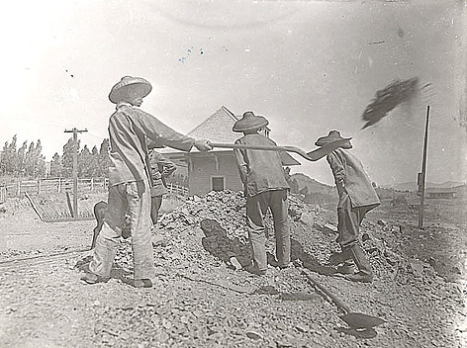
Why Chinese labor?
During Reconstruction, freedmen resisted gang labor on plantations because of their pre-Civil War experience with the system. Their insistence on independent labor forced the adoption of sharecropping, but planters hoped to use the Chinese to re-establish the gang labor system.

Slide 30
What was the problem Chinese labor?
But when their labor contracts ended, the Chinese left the fields quickly. They established grocery stores and other small businesses that catered to blacks.

Slide 31
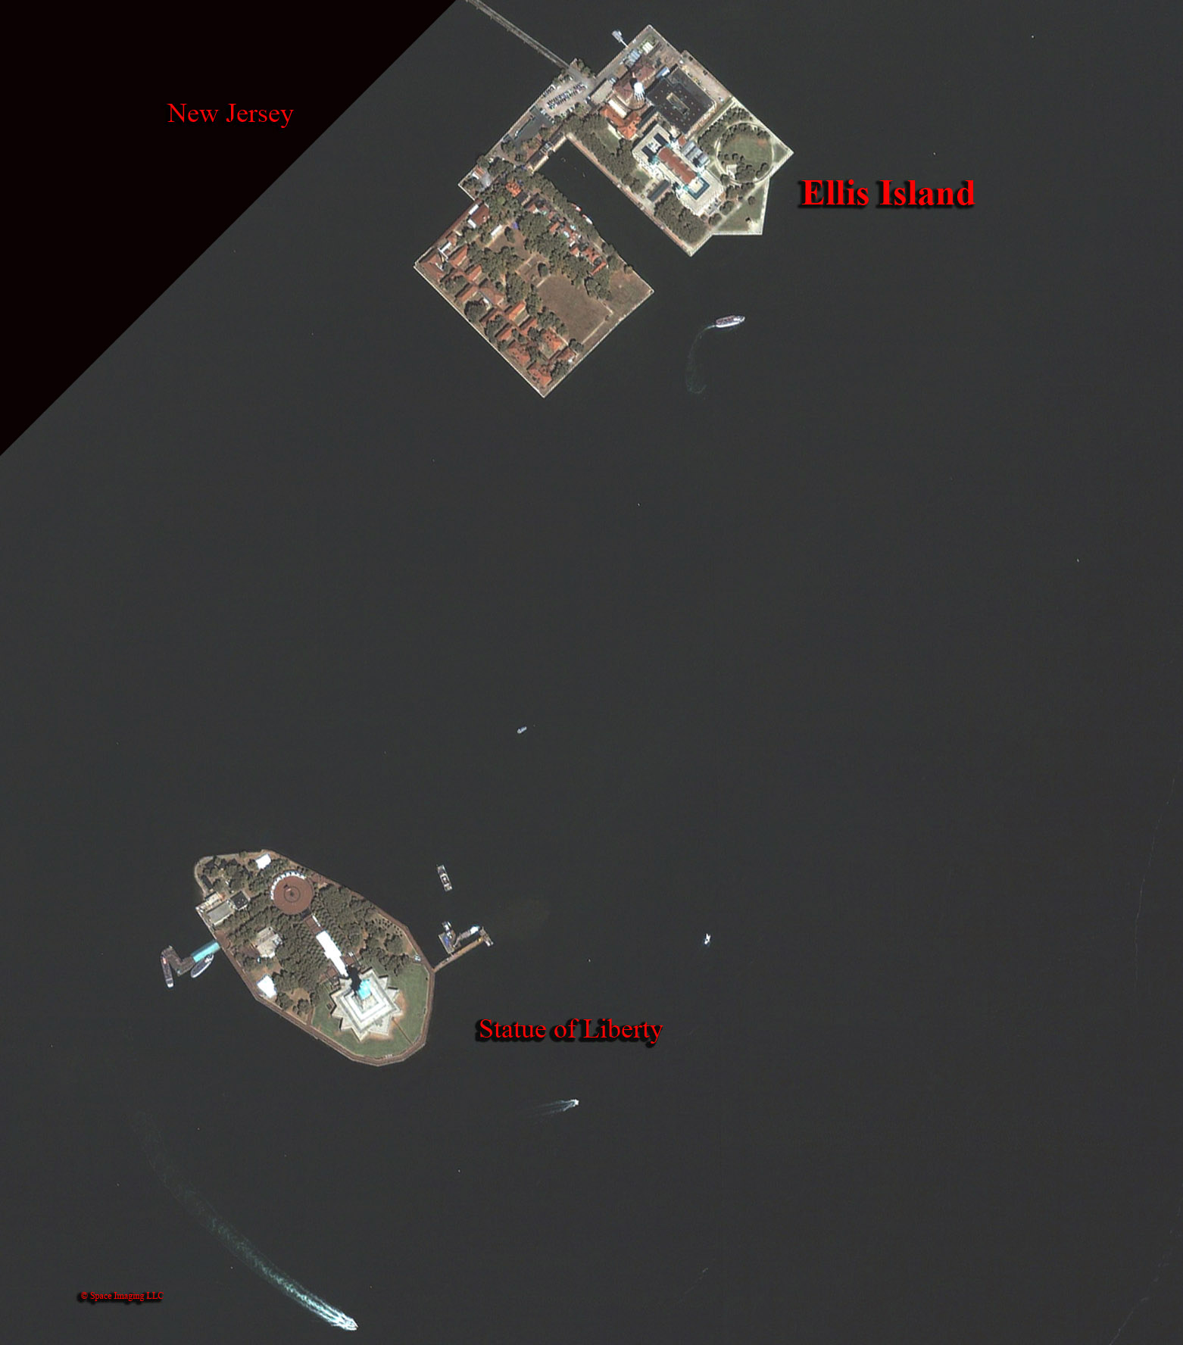
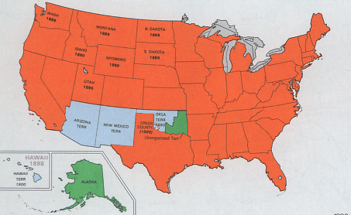
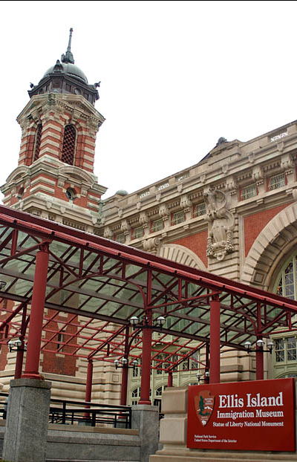
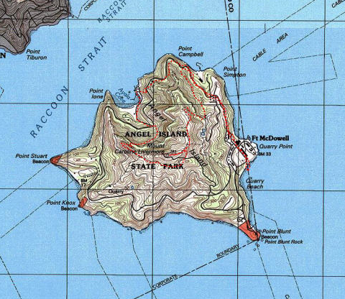
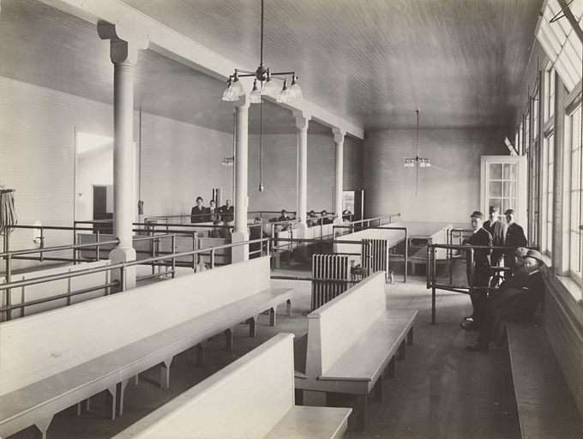
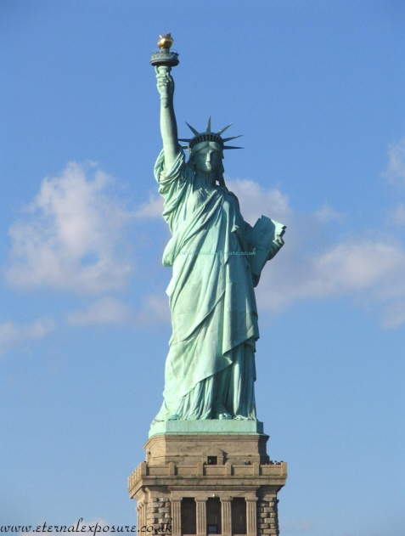
No more Chinese. Where do you get labor from?
Ellis
Island
Hudson River
Ellis
Island
Angel
Island
Statue
of Liberty

Slide 32
Which group comes from the East Coast?
The Italians

Slide 33
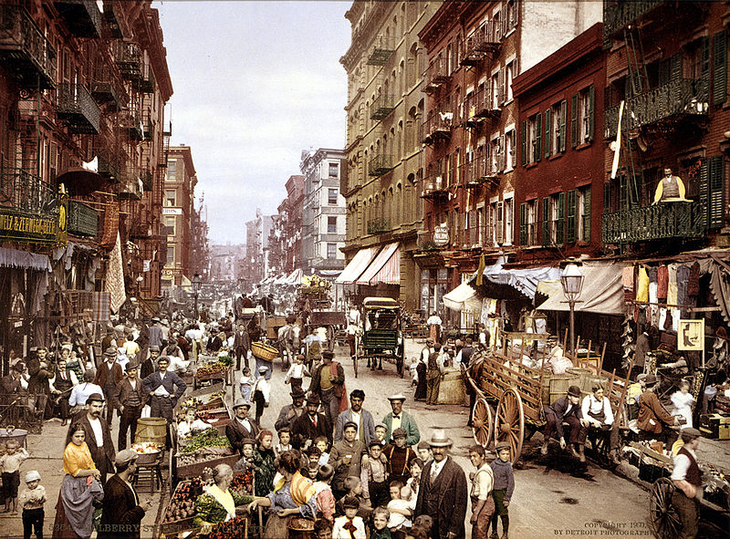
Little Italy in New York, ca.1900.

Slide 34
What is the problem with Italian labor?
They sometimes refused to allow the planters to sell their crop.
They also resisted buying items at inflated prices at the plantation store.

Slide 35
How did land owners react?
The planters charged Italians higher ginning fees than they did blacks.
Increased the cost of everything from transportation to medical treatment.

Slide 36
How did Italians react?
The Italians protested the treatment to their government, which led to investigations by the press and the U.S. Department of Justice.

Slide 37
Sharecropping
The number of black landowners fell from about 7 percent in 1900 to less than 3 percent in 1925.
In the Delta, 90 percent of the sharecroppers in 1925 were black.

Slide 38
Agricultural Problems after 1900
What are the 2 problems faced by farmers?
Topsoil erosion.
Boll weevil.

Slide 39
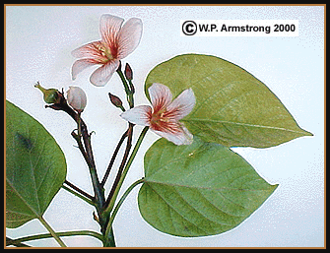
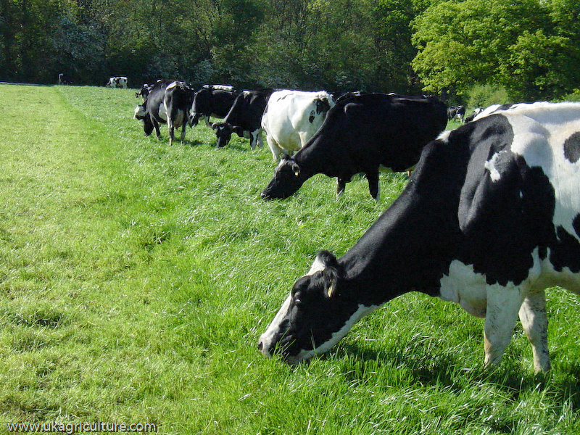
New Crops in the Southwestern part of the state
Tung trees
Dairy cows
Tomatoes

Slide 40
Lumber Industry
At the turn of the century, Mississippi became a leading supplier of lumber to the nation.

Slide 41
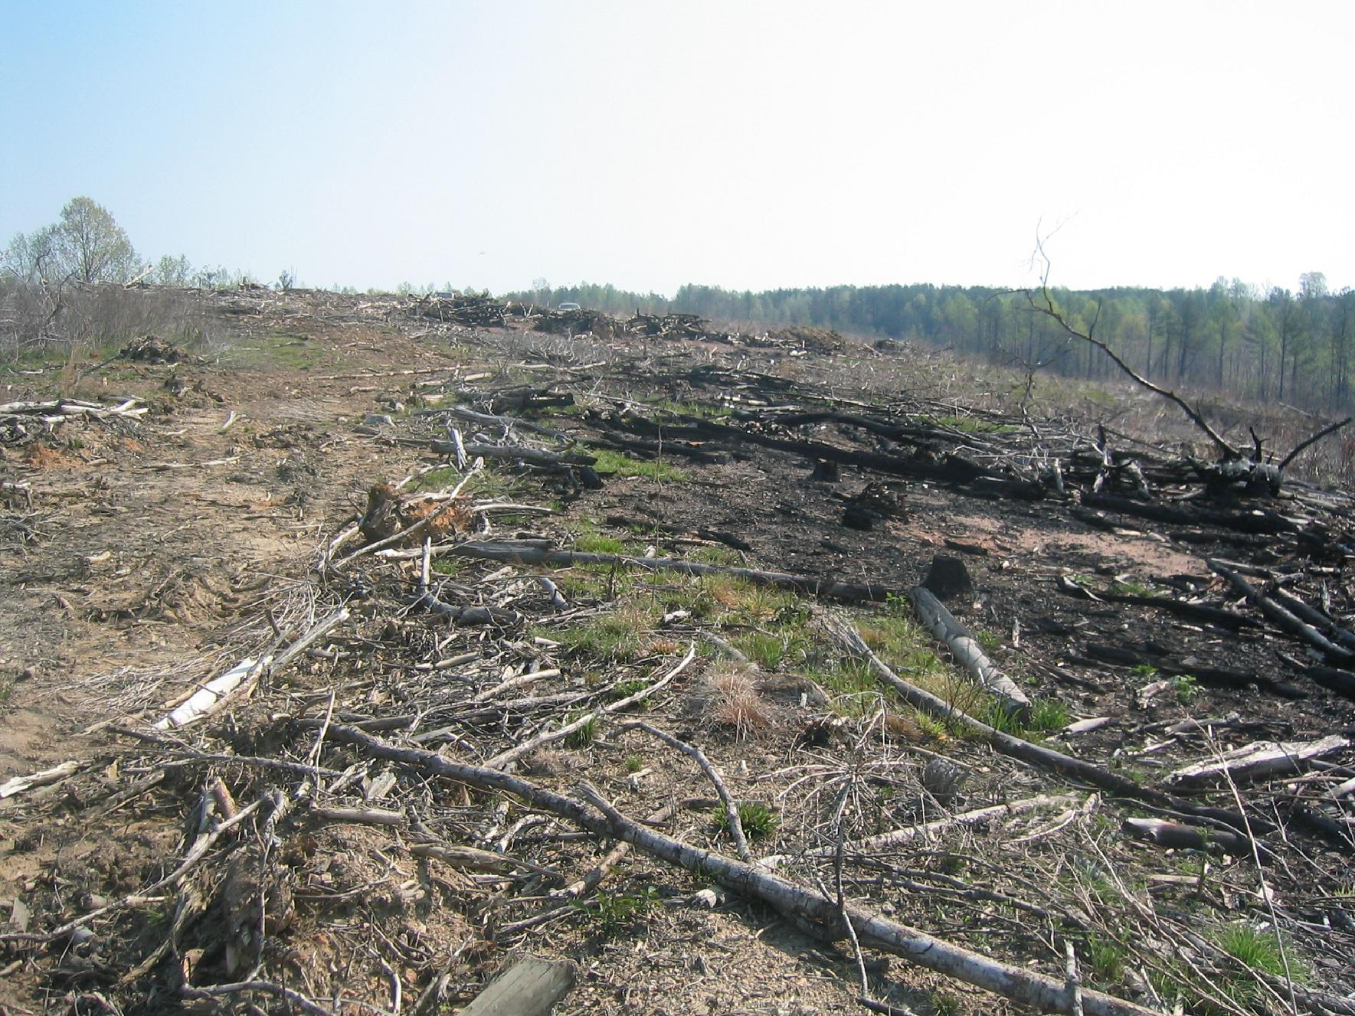
Lumber companies would clear-cut trees.

Slide 42
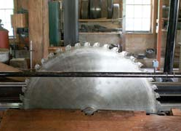
Saw Mill Towns
Some towns grow up and became large cities.
Some did not.
What are some large cities in Mississippi today that started out as saw mill towns?

Slide 43
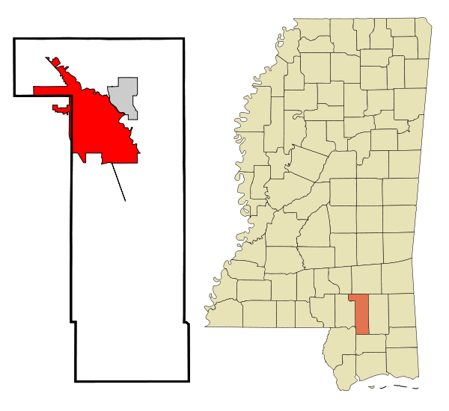
What is in Hattiesburg?
Population in July 2008: 51,993. Population

Slide 44
Southern Miss

Slide 45
William Carey University

Slide 46
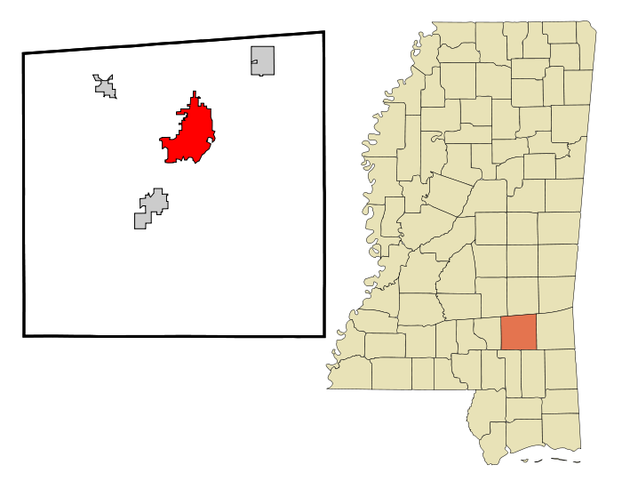
Laurel Mississippi
As of the census of 2000, there were 18,393 people

Slide 47
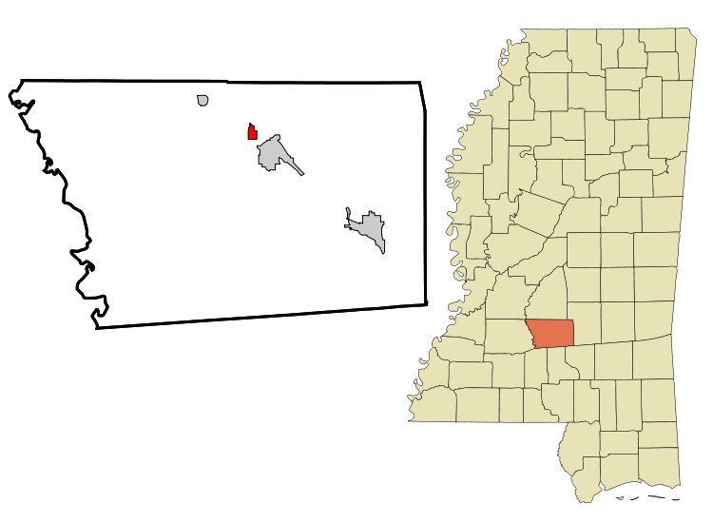
D’Lo Mississippi
As of the census of 2000, there were 394 people
D'Lo was featured in Life magazine for sending proportionally more men to serve in World War II than any other town of its size; 38 percent of the men who lived in D'Lo served.

Slide 48
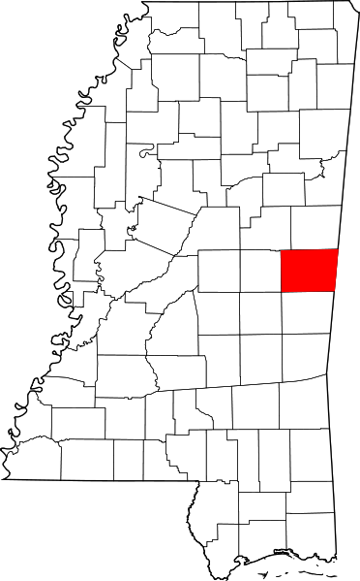
Electric Mills Mississippi
Electric Mills is an unincorporated community in Kemper County.
The town of Electric Mills was established in 1913 and named after the modern, electrically-powered mill, which was one of the first mills to be completely electric-powered. Much of the town was removed after milling ceased in 1941.

Slide 49
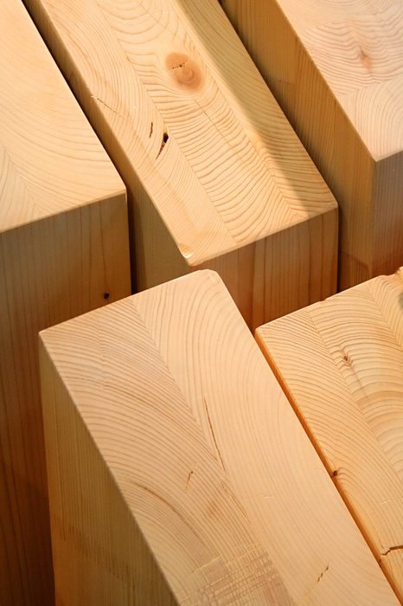
When did the lumber boom end?
The End of World War I

Slide 50
Why did it end?
All the valuable
trees were gone

Slide 51
Review
Sharecropping System
New Labor
Chinese
Italian
Agricultural Problems
Lumber Industry

Slide 52
Homework
Read pages 166 to 170.

