Slide 1
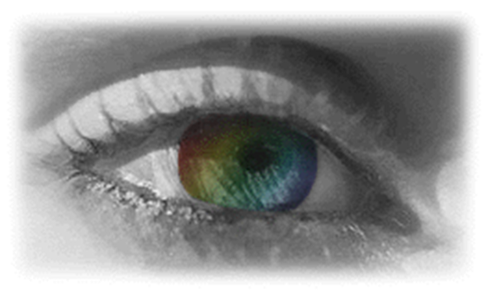
Optics
This lesson engages students in the study of color and light as they conduct experiments dealing with transparent, translucent and opaque objects, refraction and reflection, and convex and concave lenses.
Grades: 4-12

