Slide 1
Schoology: Syncing Grades to PowerTeacher pro
HSSD Tech Department

Slide 2
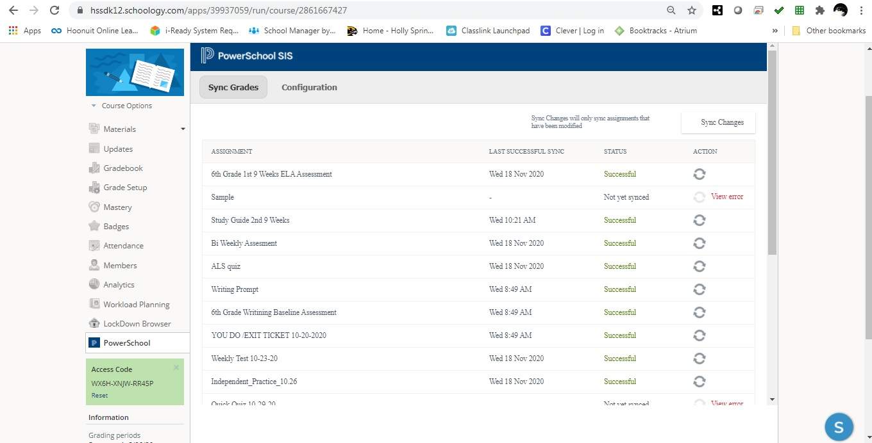

Slide 3
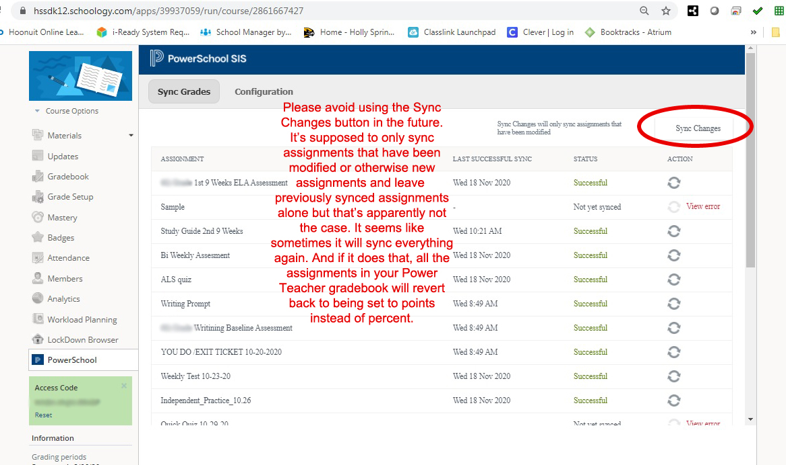

Slide 4
