Slide 1
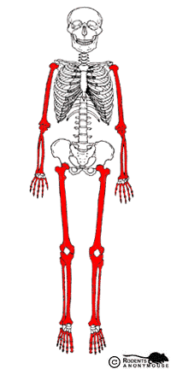
Bone structure
C. Classification of bone
bones are classified according to the following shapes:
1. Long bones- consist of a shaft (diaphysis)
and two expanded ends (epiphysis)
.
Examples- forearm and thigh bones

Slide 2
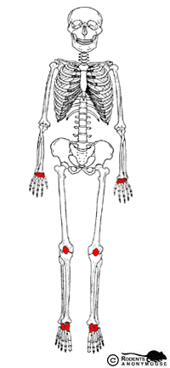
Bone structure
Short bones- somewhat cubelike, with roughly equal lengths and widths.
Made mostly of spongy bone, but their outer parts are made of thin compact bone
Examples- ankles, wrists, and knees

Slide 3
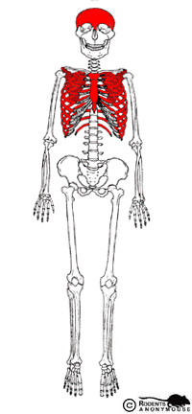
Bone structure
3. flat bones- platelike structures with broad surfaces.
the outer part is made of a layer of spongy bone tissue sandwiched between two layers of compact bone tissue.
Examples- ribs, scapulae, some bones of the skull.

Slide 4
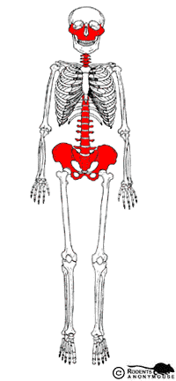
Bone structure
Irregular bones- have a variety of shapes and most are connected to several other bones. They do not belong to any other
category.
made mostly of spongy bone tissue enclosed by a thin crust of compact bone tissue.
Examples- vertebrae and many facial bones

