Slide 1
Welcome to Mrs. Dake’s Class

Slide 2
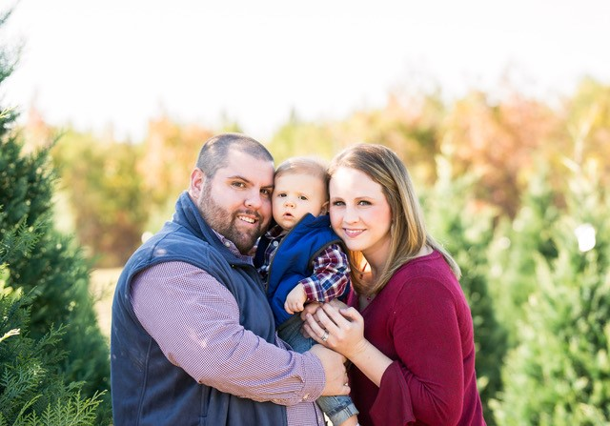
About the Teacher
6th Year teaching- 5th Year at PPS.
Husband- Will
One son- Baker
Two dogs- Scarlet and Chip.
So ready for a llama fun!

Slide 3
Supplies & Prices
School Supplies are provided by school.
Handwriting Paper- $10
INOW Parent Portal- $5
Technology Contribution (Includes head phones)- $15
School Contribution- $15
PPS School T-shirt- $10
PPS Tote (No backpacks allowed)- $10

Slide 4
Lunchroom Prices
Breakfast and lunch served daily.
Breakfast- $1.25 per meal
Lunch- $2.50 per meal
Go to School website, “Parent links”, and then “PayPams” to add money to your child’s lunch account OR send in a sealed envelope with child’s name and my name on the front.

Slide 5
Orientation Packet Pick-Up
First Grade Orientation Packet Pick-up
(Zero contact drive-through)
Northington Street Entrance
Wednesday, August 26th, 2020 from 11:00am-1:00pm and 4:30-6:00 pm
Please make every effort to pick up your child’s folder. Fill out the paperwork and send it back on the first day.

Slide 6
Orientation Information
Make sure to watch the school-wide video on the school website. At contactless pick-up you will receive:
Back to school paperwork
Our classroom handbook
Car rider sign
Transportation tag- must wear to school the first few days.
Remember forms and fees can be sent on the first day.

Slide 7
Meet me on Zoom
Monday, August 31st, 2020
11:00am-1:00pm & 4:30-6:00pm
Every Child will have an assigned zoom meeting time and meeting ID (written on your Welcome Letter) to meet with me and have a Q&A session.

Slide 8
First Week of School info
September 8th- First Day of school
Morning- First grade parents will be allowed to walk in on the first day
You will be assigned a time to arrive.
Masks are required during arrival at school and dismissal.
Car riders will start dismissal at 2:05pm.
Car tags must be visible.

Slide 9
Health and Safety
New Health and Safety Policies on school website. Here are a few you need to know:
Masks must be worn in hallways and common areas of the school.
Water bottles can be brought to school because water fountains will not be used.
Health and Safety are very important at PPS.

Slide 10
Daily Binders
Every student will have a “Daily Binder”
Will be sent home daily.
Includes Behavior Calendar (must be initialed Daily) with power paws.
Includes Math and Reading Homework.
Includes anything that will come home from school that parents need to see.
Reading overviews.
Leader in Me sheets
Reading Logs
You may also send lunch money, notes, and other things that you need me to see. This will be checked every morning.

Slide 11
We are going to have a “LLAMA” fun this year!

