Slide 1
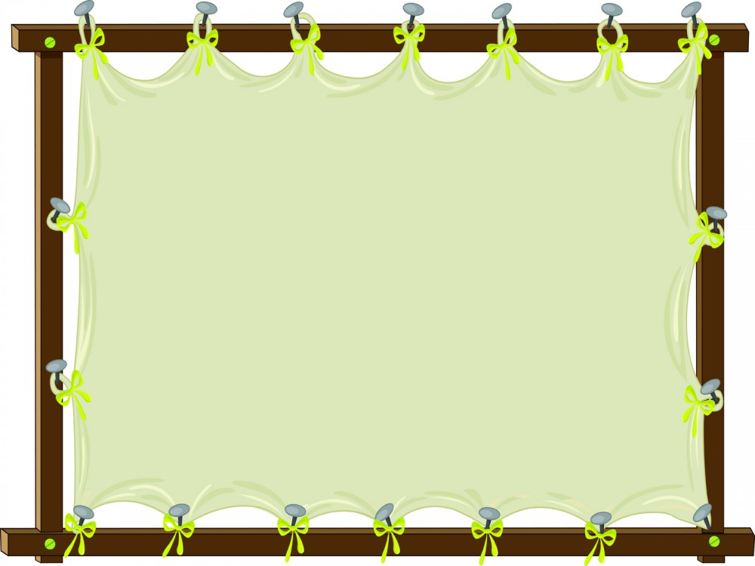
4,378 What number is in the hundreds place?
3

Slide 2
6,876 What number is in the tens place?
7

Slide 3
3,214 What is the value of the 1?
10

Slide 4
8,243 What is the value of the 8?
8,000

Slide 5
2,165 What is the value of the 1?
100

Slide 6
6,477 What number is in the tens place?
7

Slide 7
6,477 What number is in the thousands place?
6

Slide 8
6,477 What is the value of the 6?
6,000

Slide 9
6,477 What is the value of the 7?
70

Slide 10
9,996 What is the value of the 9?
900

Slide 11
Finish the expanded form. 5,469 5,000 + _____ + 60 + 9
400

Slide 12
Finish the expanded form. 3,117 3,000 + 100 + ______ + 7
10

Slide 13
Finish the expanded form. 9,476 ______ + 400 + 70 + 6
9,000

Slide 14
Finish the expanded form. 5,623 5,000 + 600 + 20 + _____
3

Slide 15
Finish the expanded form. 1,043 1,000 + 0 + _____ + 3
40

Slide 16
Write the number in standard form. five thousand, two hundred seventy-one
5,271

Slide 17
Write the number in standard form. eight thousand, seven hundred fifteen
8,715

Slide 18
Write the number in standard form. six hundred nine
609

Slide 19
Write the number in standard form. three thousand, three hundred seventy-one
3,371

Slide 20
Write the number in standard form. one thousand, four hundred ten
1,410

Slide 21
Write the number in standard form. seven thousand, eight hundred fifty-three
7,853

