Slide 1
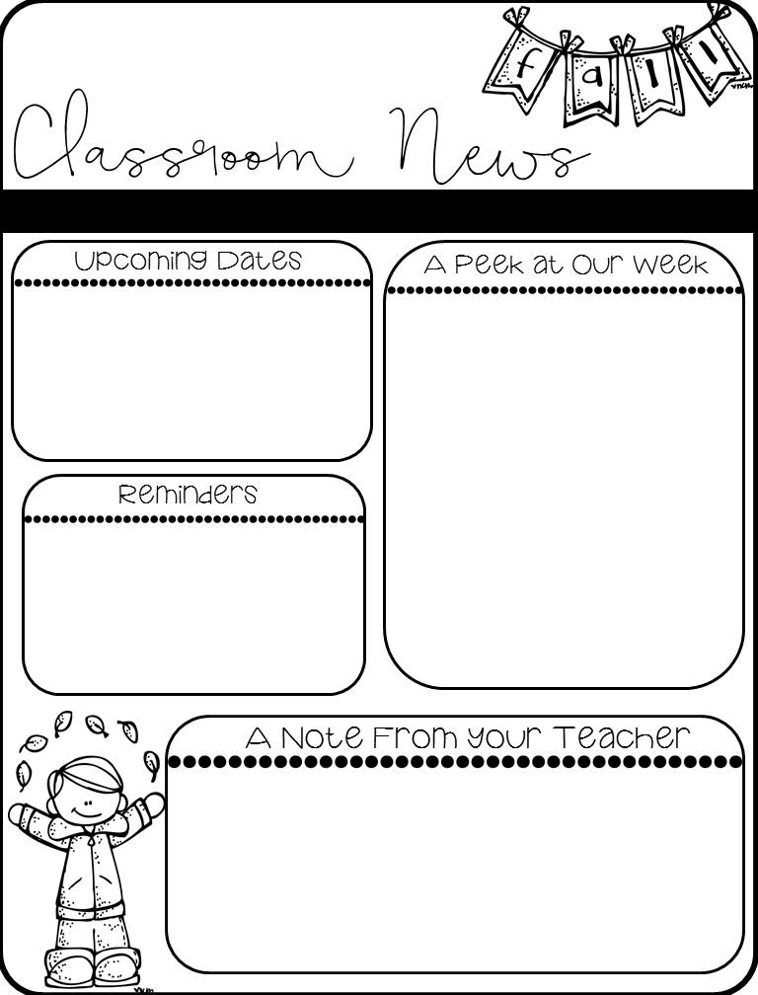
THIS Friday
October 2nd – E-Learning Day – Students will learn from home!
Story of the Week: Henry & Mudge
Grammar Skill: Predicates
Phonics Skill: Consonant Blends
All tests will be given on Thursday – Vocabulary, Spelling, Skills, and Grammar Tests
Math – Topic 2 – Addition Strategies – Daily Grade will be given on Wednesday of this week!
TIC TAC TOE Spelling Homework is assigned EVERY WEEK! This week it is due on Thursday due to E-Learning on Friday.
Don’t forget to check Class Dojo Daily for Behavior. You can see all of the good choices that your child is making throughout the day as well as the things that they may need to work on. Reminders from mom and dad that good choices are important is always helpful here at school! Thanks for all that you do!

