Slide 2
Nucleic Acids
A macromolecule that carries our genetic material (DNA)
Contain genes—the blueprint/instructions for making proteins, located at certain points in a chromosome
Proteins carry out all cellular activity
Two types:
DNA: deoxyribonucleic acid
RNA: ribonucleic acid

Slide 3
Nucleotides
Make up nucleic acids (the monomer)
Have three parts:
Sugar
Deoxyribose (DNA)
Ribose (RNA)
Phosphate
Nitrogen base:
Adenine
Guanine
Cytosine
Thymine (DNA only)
Uracil (RNA only)

Slide 4
DNA Structure discovered by James Watson and Francis Crick in 1953
Double helix: like a twisted ladder
Sugar and phosphate form the “sugar phosphate backbone”
Nitrogen bases bond in the middle with weak hydrogen bonds
All other bonds are strong covalent bonds

Slide 5
DNA Structure
Nitrogen bases bond only to their complementary base pair with hydrogen bonds
A’s bond with T’s
C’s bond with G’s
We call these the “complementary base pairing rules”

Slide 6
Nitrogen Bases (2 types)
Purines (small word, big base)
Adenine
Guanine
Pyrimidines (big word, small base)
Cytosine
Thymine
Chargaff’s rules
A=T and C=G
Weak hydrogen bonds hold the pairs together
A double bonds to T; C triple bonds to G

Slide 7
Practice: Label the DNA.
nucleotide
Weak hydrogen bond
Pyrimidines
(C or T)
3’
5’
Purines
(A or G)
5’
3’
Strong covalent bond
Deoxyribose sugar
phosphate
Notes:
Label ends first (left to right) and then label each arrow as it pops up.

Slide 8
RNA Structure
Single strand of nucleotides with exposed bases
RNA bases bind with DNA bases
A’s bind with U’s
C’s bind with G’s
Notes:
RNA single strand image: © AndreaLaurel 2012 https://flic.kr/p/cpSgCs

Slide 9
Try this!
 | DNA | RNA
Types of nitrogen bases
Type of sugar used
Shape
A, T, C, G
A, U, C, G
deoxyribose
ribose
double helix
single strand

Slide 10
Basics of Heredity
Chromosomes = tightly coiled strands of DNA
Different organisms have different numbers of chromosomes
Ex. Humans have 23 pairs (46 total – 23 from mom and 23 from dad)
Ex. Dogs have 37 pairs (74 total – 37 from mom and 37 from dad)
Genes = a piece of DNA that has instructions to code for one protein
One chromosome can contain thousands of genes linked together!
So, genes are pieces/sections of DNA. Chromosomes are long strands of DNA all bunched up.

Slide 12
DNA REPLICATION Background
When a cell is ready to divide, it must first copy its DNA. The process of making an identical copy of DNA is called DNA Replication.
DNA → DNA
Parent DNA makes 2 exact copies of DNA
Occurs in nucleus during S (synthesis) phase of the cell cycle.
Why??
Occurs in Cell Cycle before PMAT so each new cell can have its own FULL copy of DNA
during the S Phase (Synthesis) of the Cell Cycle.
DNA Replication ensures that each new cell will have exactly the same DNA as the original cell.

Slide 13
DNA REPLICATION
Enzyme Helicase unzips the DNA into two strands.
Openings are called “origins of replication”
Several places along the DNA will be unzipped at once

Slide 14
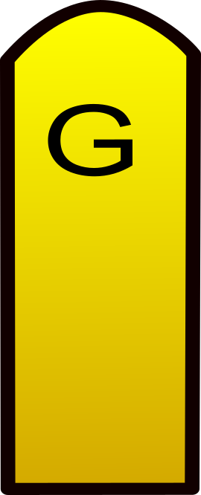
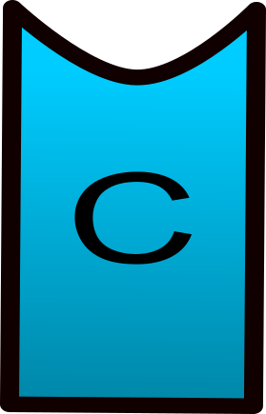
DNA REPLICATION
Enzyme DNA Polymerase adds complementary nucleotides to the template strands.
A’s bond to T’s and C’s bond to G’s
DNA Polymerase only adds nucleotides to the free 3’ end of the template strand. This forms new DNA strands in the 5’ to 3’ direction ONLY.
5’
3’
3’
5’

Slide 15
DNA REPLICATION
Two identical DNA molecules are formed, each with an “old” strand and a “new” strand. We call this Semi-Conservative Replication.

Slide 16
Semi-Conservative Replication
Each parent strand is now a template (pattern) that determines the order of the new bases
Forms a “complementary” strand to original strand
The newly synthesized double helix is a combination of one “old” (or original) and one “new” DNA strand

Slide 17
DNA REPLICATION
SUMMARY
Unzip the DNA.
Enzymes help find complementary bases and bind them according to base-pairing rules. (A-T and C-G)
Two identical DNA molecules are formed, each with an “old” strand and a “new” strand. We call this Semi-Conservative Replication (because part of the molecule is conserved/saved.)
Notes:
Resources I love:
Build a DNA molecule: http://learn.genetics.utah.edu/content/molecules/builddna/
DNA Replication Animation: http://www.stolaf.edu/people/giannini/flashanimat/molgenetics/dna-rna2.swf
DNA Replication Animation: http://sites.fas.harvard.edu/~biotext/animations/replication1.swf
Crash Course YouTube video: https://www.youtube.com/watch?v=8kK2zwjRV0M

