Slide 1
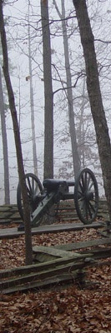
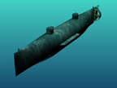



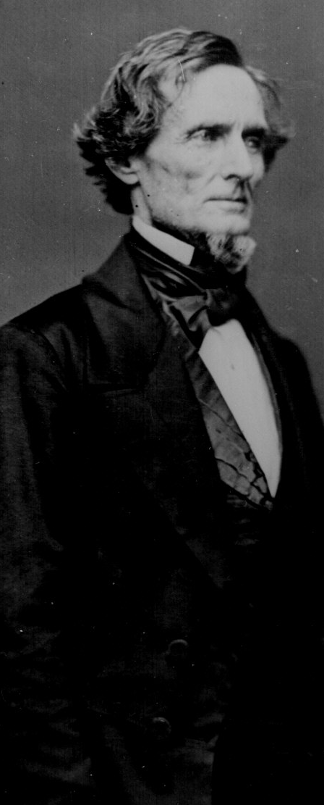
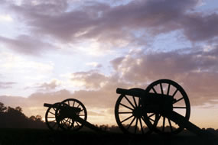
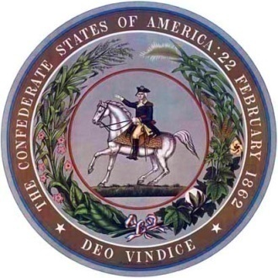
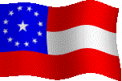
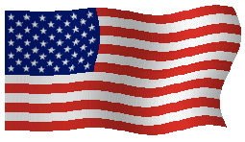
Civil War
C.S.S. Hunley 1863 (40’ 8”)
Page 115

Slide 2
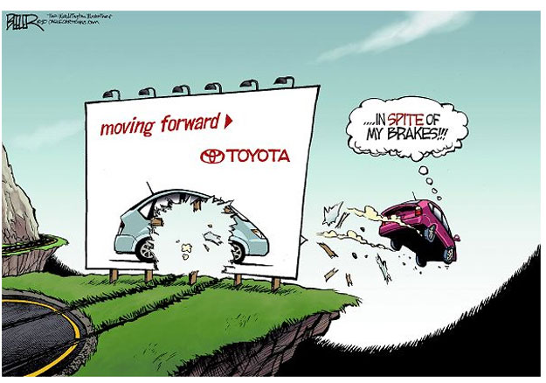

Slide 3
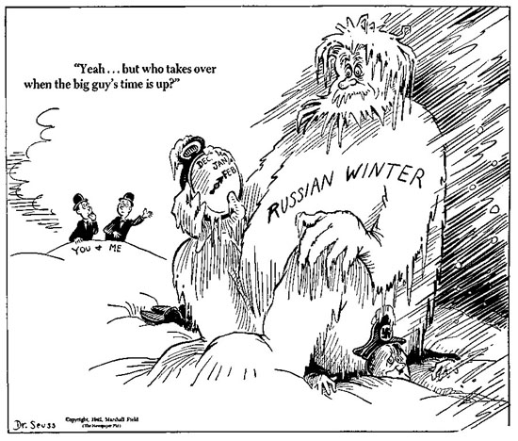

Slide 4
Objectives
MS1 Explain how geography, economics, history, and politics have influenced the development of Mississippi.
MS1e Analyze the historical and political significance of key events in our state's development (e.g., Civil War, Civil Rights Movement, etc.).

Slide 5
Objectives
MS3 Describe the relationship of people, places, and environment through time.
MS3d Analyze the significance of key events in our state's history.
MS3e Analyze the ways Mississippians have resolved conflict and adapted to change, and continue to address cultural issues unique to our state.

Slide 6
Objectives
MS4 Demonstrate the ability to use social studies tools (e.g., timelines, maps, globes, resources, graphs, a compass, technology, etc.).

Slide 7
Review
Secession
Fort Sumter
shiloh

Slide 8
Overview
Battle for Vicksburg
The last two years of the war
The home front
End of slavery
Medical Practice

Slide 9
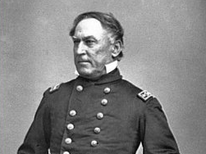
New Orleans had already fallen to Union forces led by Admiral Farragut.
Admiral David Glasgow Farragut

Slide 10
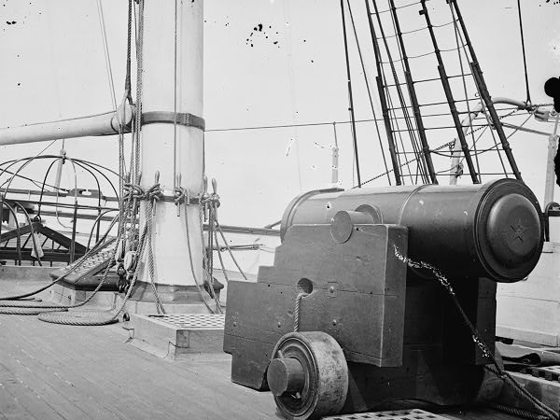
After a heavy bombardment, he ran past Fort Jackson and Fort St. Philip and the Chalmette, Louisiana batteries to take the city and port of New Orleans, Louisiana on April 29, 1862.

Slide 11
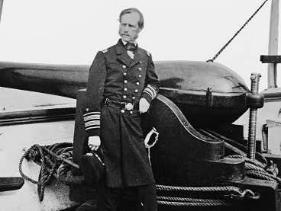
At the Siege of Port Hudson, the Confederates were able to concentrate on Farragut's flotilla and inflict heavy damage on his warships.
Farragut's battle group was forced to retreat with only two ships able to pass the heavy cannons.

Slide 12
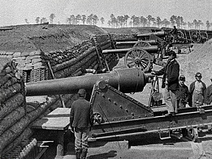
General Banks was left to continue the siege at Port Hudson without advantage of naval support.
General Banks accepted the surrender of the Confederate garrison at Port Hudson on July 9, 1863, ending the longest siege in US military history. (5 days after Vicksburg)

Slide 13
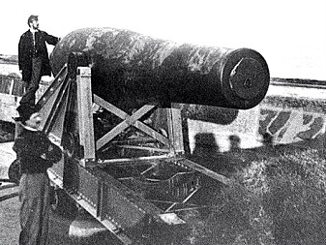
Vicksburg, which sat high on bluffs above the river, made boats traveling in both directions vulnerable to artillery fire from the Confederate batteries on the shore line and on the high bluffs.

Slide 14
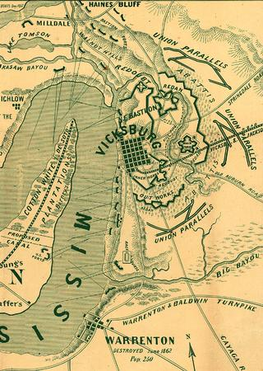
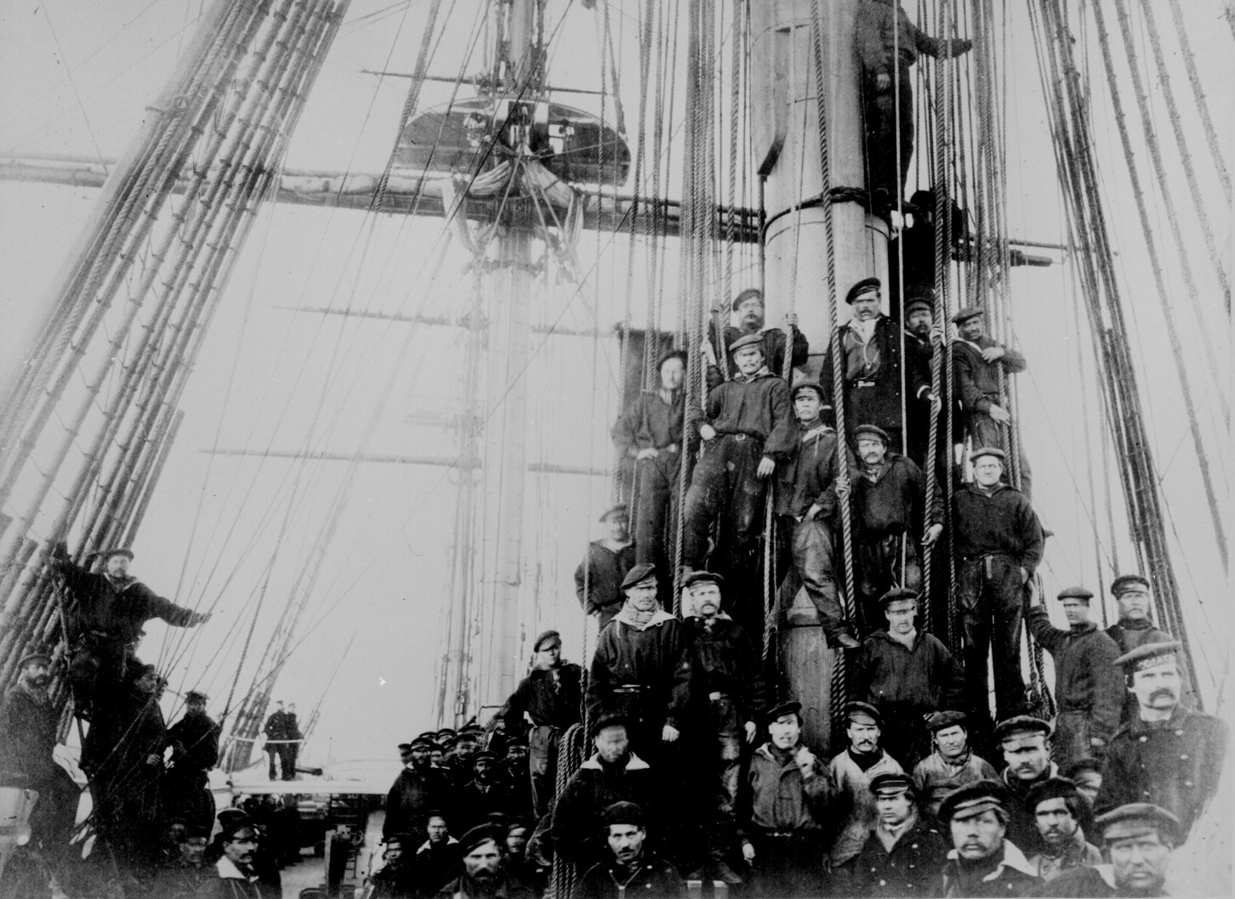
There they hoped to build a canal so ships could avoid the guns at Vicksburg
In June 1862, Admiral David Farragut sailed up the river from New Orleans, running his ships past the Vicksburg artillery and landing troops on the Louisiana side.

Slide 15
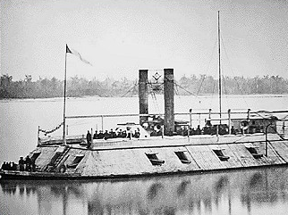
The falling level of the Mississippi River made this plan impossible, and Farragut’s ships and men returned to New Orleans.

Slide 16
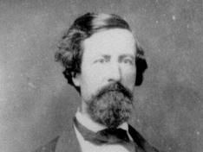
General John Clifford Pemberton
General John C. Pemberton, commander of the Confederate forces in Mississippi.

Slide 17
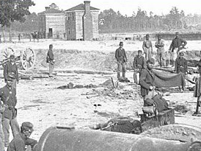
In late October, Grant invaded north Mississippi, intending to capture Jackson.
General John C. Pemberton ordered Van Dorn to resist Grant’s advance.

Slide 18
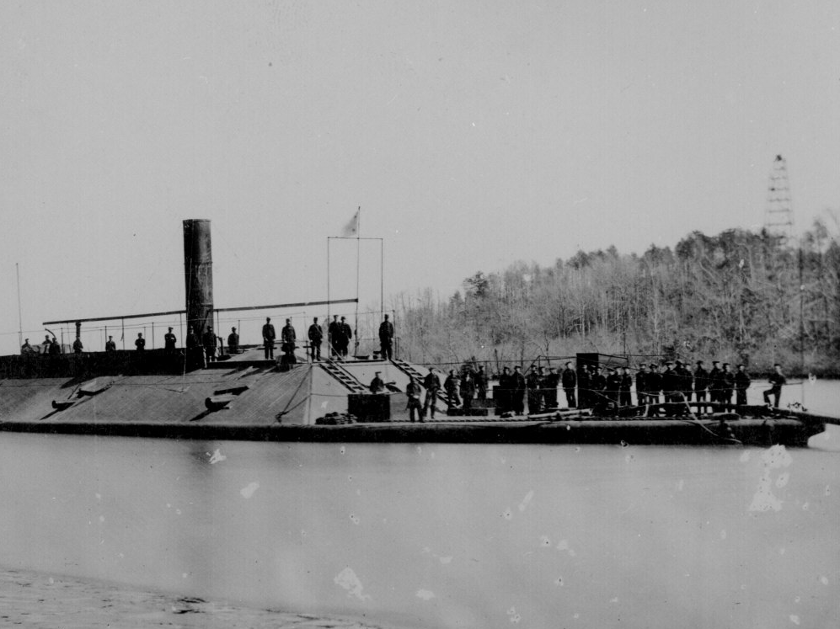
Union control of the Mississippi River allowed Grant to get around Van Dorn and forced him to retreat.
They crossed the river by using United States Navy ships that had run the guns at Vicksburg.

Slide 19
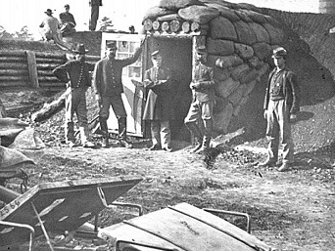
Grant, however, had to return to Tennessee after Confederate cavalry under Nathan Bedford Forrest, formerly of Tippah County, cut his supply lines in Tennessee and Van Dorn destroyed his supplies at Holly Springs.

Slide 20
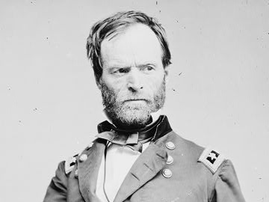
In December 1862, the Union began a direct attack on Vicksburg.
General William Tecumseh Sherman

Slide 21
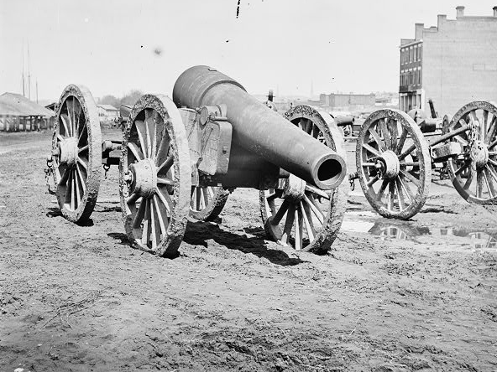
Landing troops north of the city. The high water limited his movements, however, and the Confederate defenders threw back his direct assaults.

Slide 22
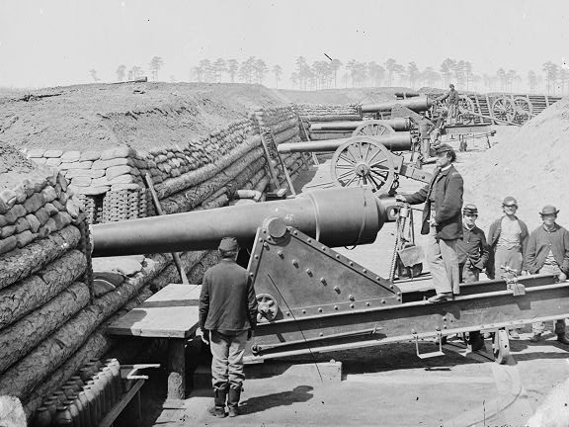
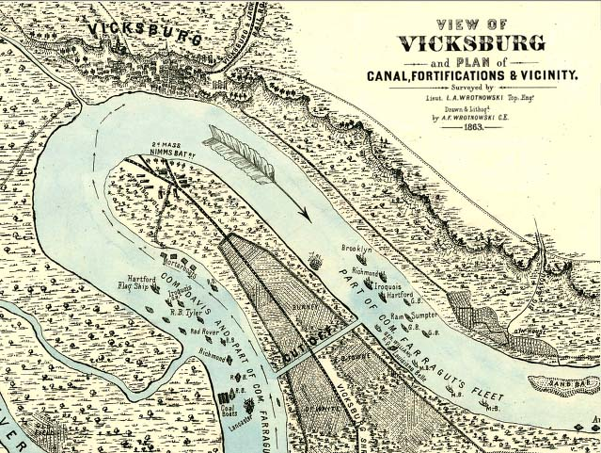
Grant then tried to build a canal to bypass Vicksburg, but floods and Confederate artillery doomed this effort.

Slide 23
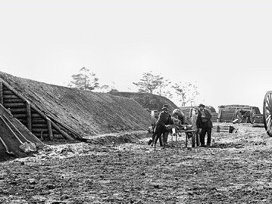
By March 1863, Grant had concluded that Vicksburg could not be captured from the north.
So, in mid-April, Grant moved his forces past the Vicksburg river defenses to the area south of the city, landing his troops south of Grand Gulf.

Slide 24
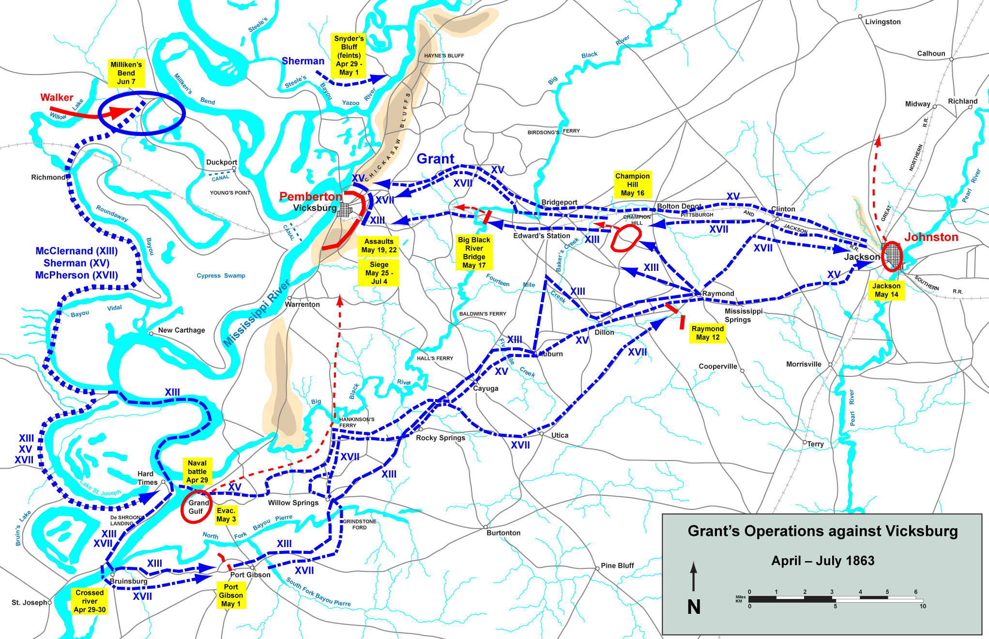
Grand Gulf
Sherman (XV)
McClernand (XIII)
McPherson (XVII)

Slide 25
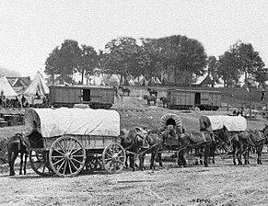
Hoping to capture Pemberton’s army as well as Vicksburg, Grant moved his troops to the northeast.
After taking Jackson in mid-May, Grant marched west toward Vicksburg.

Slide 26
Jackson and on to Vicksburg
McPherson (XVII)
Sherman (XV)
McClernand (XIII)
Sherman (XV)
McPherson (XVII)

Slide 27
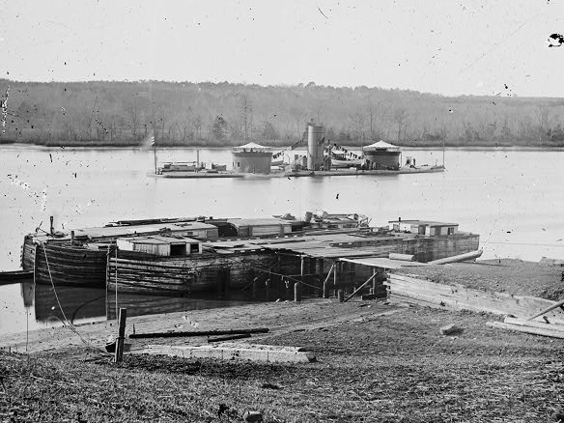
He met Pemberton’s troops at Champion Hill, near Edwards, and forced the southern troops to retreat..
Vicksburg was now surrounded by the Union army and navy.

Slide 28
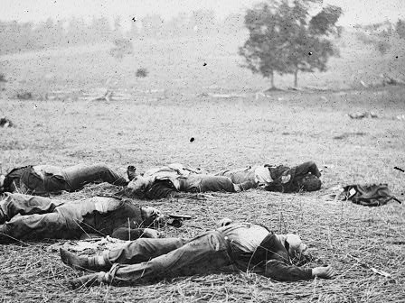
Repeated federal attacks were pushed back, although casualties were heavy.
Confederate reinforcements could not force their way through the federal lines.

Slide 29
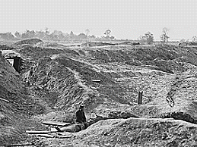
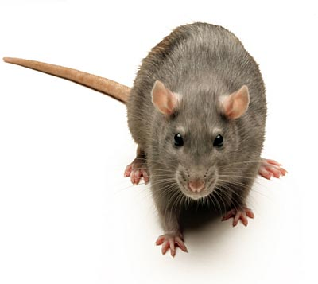
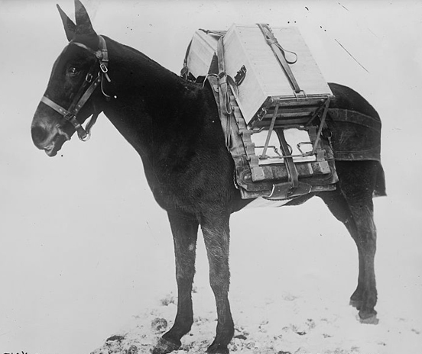
The city was under steady shelling, and many residents were forced to live in caves.
Food was in such short supply that people ate mules and rats.

Slide 30
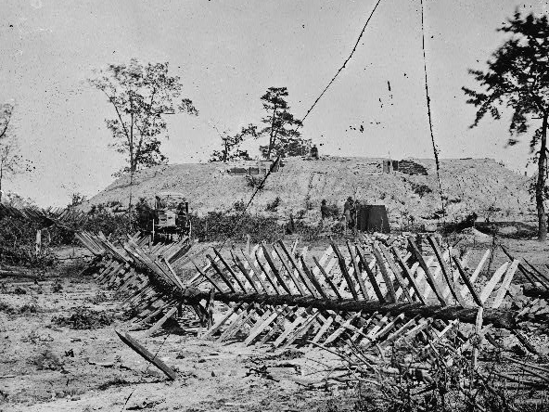
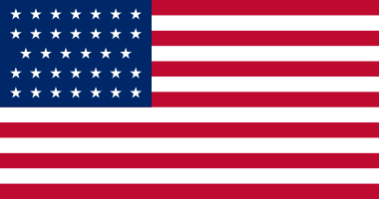
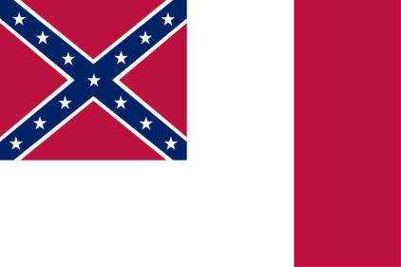
On July 4, 1863, after a six-week siege, Pemberton surrendered.
Tradition holds that the Fourth of July holiday was not celebrated by Vicksburg until World War II, because of the surrender of the city on July 4.

Slide 31
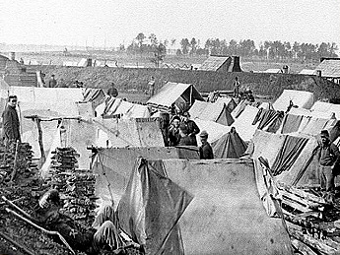
Grant first demanded unconditional surrender. But Grant reconsidered, not wanting to feed 30,000 hungry Confederates in Union prison camps, and offered to parole all prisoners.

Slide 32
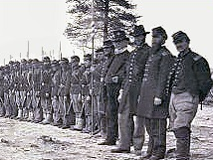
The full campaign, since March 29, claimed 10,142 Union and 9,091 Confederate killed and wounded (29,495 surrendered).
Pemberton turned over to Grant 172 cannons and 50,000 rifles.

Slide 33
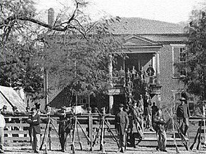
The Confederate surrender following the siege at Vicksburg is sometimes considered, when combined with Gen. Robert E. Lee's defeat at Gettysburg the previous day, the turning point of the war.

Slide 34
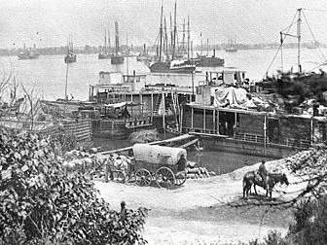
With the surrender of Port Hudson on July 9, the Mississippi River was firmly in Union hands and the Confederacy split in two.

Slide 35
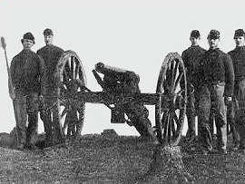
Almost two full years of hard fighting remained. General Sherman took over command of Union troops in the West.

Slide 36
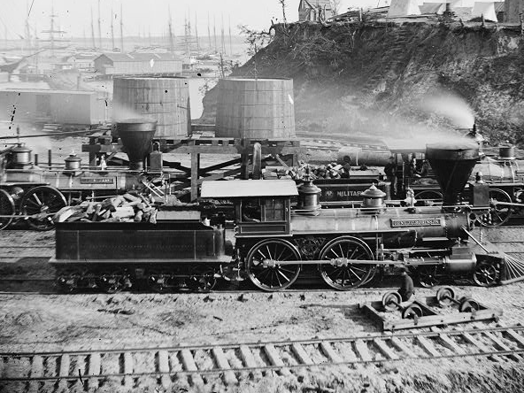
He rebuilt the Memphis and Charleston Railroad and protected it from Confederate attempts to cut the supply lines for the Union troops attacking Chattanooga and Atlanta.

Slide 37
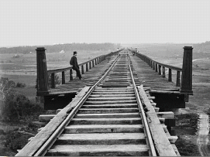
In February 1864, Sherman began a campaign to capture Meridian, which was strategically located at the junction of the north-south Mobile and Ohio Railroad and the east-west Southern Railroad.

Slide 38
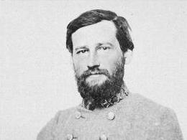

Lieutenant General Stephen Dill Lee
Although southern cavalry units led by W. Wirt Adams of Vicksburg and Stephen D. Lee,
resisted Sherman’s advance.
First president of the school

Slide 39
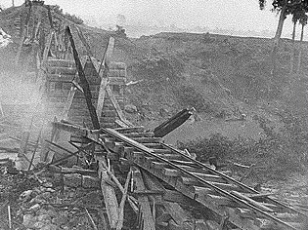
During the Battle of Meridian in 1864, General William Tecumseh Sherman led troops into the city, destroying the railroads and burning much of the area to the ground.

Slide 40
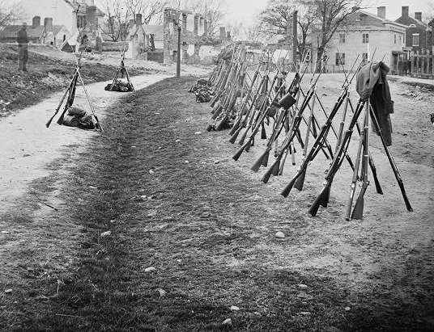
After the destruction of the city, Sherman is reported to have said, "Meridian with its depots, store-houses, arsenal, hospitals, offices, hotels, and cantonments no longer exists.

Slide 41
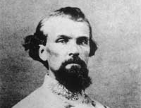
To keep Confederate cavalry under General Nathan Forrest away from the supply lines, Union troops continued to raid north and east Mississippi.
General Nathan Bedford Forrest

Slide 42
Brice’s Cross Roads
Lee and Forrest did defeat federal troops at Brice’s Cross Roads in Prentiss County in June 1864.
Page 122

Slide 43
In August 12, 1864,
Forrest surprised Union troops
and raided Memphis. (Fort Pillow)
Delegates at an 1867 KKK convention in Nashville named him the first organization's Grand Wizard, or leader-in-chief.
He officially denied participation.
In the Congressional investigation on Klan activities in 1871, the committee concluded that Forrest's involvement with the Klan was limited to trying to get it to disband.
General Nathan Bedford Forrest

Slide 44
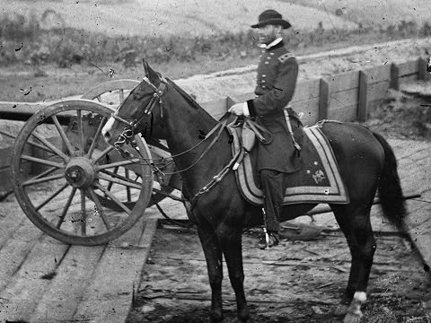
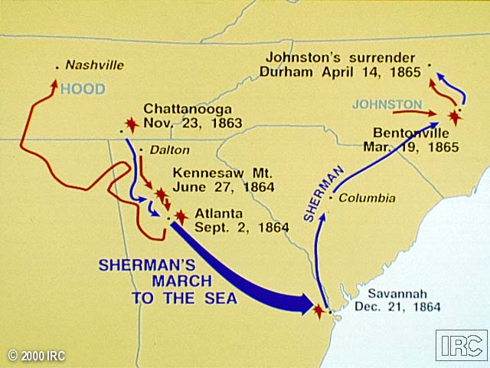
Sherman made his famous march from Atlanta to Savannah, and then swung north into South Carolina.

Slide 45
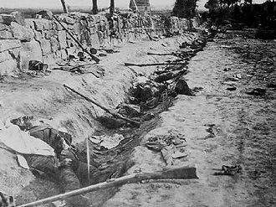

Grant meanwhile attacked and captured Richmond in March 1865.

Slide 46





Ulysses S. Grant
Robert Edward Lee
General of the Army of the United States
General (CSA)

Slide 47

McLean house Appomattox Court House, Va..
General Robert E. Lee surrendered his army to Grant at Appomattox Court House in April 1865.

Slide 48

The war was over.

Slide 49

The remaining Confederate troops in Mississippi and Alabama surrendered on May 4.

Slide 50


Jefferson Finis Davis
Union troops captured Confederate President Jefferson Davis on May 10, 1865, at Irwinville, Georgia.

Slide 51

Imprisonment of Davis
In December 1868, the court rejected a motion to nullify the indictment, but the prosecution dropped the case in February 1869.
He was placed in irons for three days. Davis was indicted for treason a year later.
After two years of imprisonment, he was released on bail which was posted by prominent citizens of both northern and southern states
On May 19, 1865, Davis was imprisoned in a casemate at Fortress Monroe, on the coast of Virginia.
A casemate at Fortress Monroe

Slide 52
Carolina Life Insurance Company
Jefferson Davis became the president of the Carolina Life Insurance Company and served from November 23, 1869 to August 25, 1873.
In 1873 by the Southern Life Insurance Company of Memphis bought Carolina Life Insurance Company.
Both companies went into bankruptcy in late 1875 or early 1876.

Slide 53
U.S. Senate
Elected to the U.S. Senate again, he was refused the office in 1875, having been barred from Federal office by the Fourteenth Amendment to the United States Constitution.

Slide 54
Beauvoir
Sarah Anne Ellis Dorsey invited Jefferson Davis to stay at Beauvoir and to write his memoir The Rise and Fall of the Confederate Government.
Davis arranged to purchase the property in 1879 for $5500 to be paid in three installments. Six months later, Dorsey died before the other two payments were made and left the estate to Davis in her will.

Slide 55

Around 80,000 Mississippians fought in the Confederate Army.
Around 500 Mississippians fought in the Union.
More than 17,000 black Mississippi slaves and freedmen fought for the Union.

Slide 56

About 27,000 men died in Mississippi.
Many more returned home with permanent injuries.
The bitterness of their defeat, however, lasted for generations.

Slide 57

The Home Front
Men volunteered for military service and formed units to protect the state.
Women made uniforms and served as nurses.

Slide 58

Those who had voted against secession either joined in the defense of the state or kept their feelings to themselves.
Greenwood LeFlore, the Choctaw chief who had remained on his plantation near Greenwood, was one of the few open defenders of the Union.

Slide 59

Both the legislature and the governor had to carry out their duties from a number of locations in order to avoid Union troops.
During the Civil War, Enterprise, Meridian, Macon, and Columbus all temporarily served as the state capital.

Slide 60

Local citizens often gave criminals only a brief, informal trial before hanging them.

Slide 61


Financing
Mississippi had always been short of specie; the state’s wealth was tied up in land, slaves, and cotton.
Little cotton could be sold because the Union had captured New Orleans and blockaded the coast.

Slide 62

Both Mississippi and the Confederate States of America borrowed.
Mississippi itself borrowed almost $9 million.

Slide 63

Slavery
The fear of slave revolts increased.
It became increasingly difficult to maintain productivity.

Slide 64


Was it the
Emancipation Proclamation ?
What ended slavery in the United States?
NO!

Slide 65
So, what ended slavery in the United States?
The 13th Amendment
Section 1. Neither slavery nor involuntary servitude, except as a punishment for crime whereof the party shall have been duly convicted, shall exist within the United States, or any place subject to their jurisdiction.
Section 2. Congress shall have the power to enforce this article by appropriate legislation.

Slide 66

Soldiers
Often, they destroyed or burned what they did not take.
Both Union and Confederate troops “requisitioned” food, livestock, and wagons.
Soldiers seized liquor, silverware, and other valuables.

Slide 67

When the troops moved on, the civilians had to make do with what was left.
All of these problems got worse after the Union army entered Mississippi in 1862.

Slide 68

Medical Practice
Illnesses like measles and mumps were very common.
Deadly diseases such as dysentery, diarrhea, typhoid, and malaria run through the camps.

Slide 69

Wounded
He might have to wait until there was a lull in the battle before an ambulance could get to him or his comrades could carry him to the rear.
Bullets often remained in the body and caused infection.

Slide 70



If the infection was in the arms or legs, they could be amputated.
Chloroform and ether were just coming into use during operations, including amputations.
Once at the hospital, he ran the risk of infection from unclean instruments and perhaps a shortage of necessary medical supplies.

Slide 71




C.S.S. Arkansas
Isaac Brown
Page 118

Slide 72








Emancipation Proclamation
Also specifically exempted were New Orleans and thirteen named parishes of Louisiana, all of which were also already mostly under Federal control at the time of the Proclamation.
The state of Tennessee had already mostly returned to Union control, so it also was not named and was exempted. Virginia was named, but exemptions were specified for the 48 counties that were in the process of forming West Virginia, as well as seven other named counties and two cities.
The proclamation did not name the border states of Kentucky, Missouri, Maryland, or Delaware, which had never declared a secession, and so it did not free any slaves there.
Kentucky
Tennessee
Missouri
West Virginia
Maryland
Louisiana
Delaware

Slide 73


Talk about two things not in the book.
Medal of Honor
1,522 during the Civil War.

Slide 74



Vicksburg, Mississippi
Higgins volunteered to act as the color bearer for his regiment on that day as the acting color bearer had been previously wounded.

Slide 75


On May 22, Grant launched a major assault against Vicksburg.
The 2nd Texas Infantry, which succeeded in repulsing the attack.
The color bearer (Higgins) continued to advance towards the Confederate lines.

Slide 76

Seeing this, "at least a hundred men took deliberate aim at him, and fired at point-blank range", yet Higgins was not hit.
When they saw that he did not falter, the Texans then ceased firing and cheered on Higgins to keep coming.

Slide 77


What was the first military submarines?
Los Angeles class submarines

Slide 78


A Yale graduate, designed and built a submarine torpedo boat in 1776.
David Bushnell
A keg of powder, was to be attached to an enemy ship's hull and detonated by a time fuse.
Turtle submarine

Slide 79


What was the first successful use of a Military submarine?

Slide 80



C.S.S. Hunley

Slide 81


The sub sank, on the first test dive, 5 of the crew died.
On February 17, 1864 Hunley sank USS Housatonic off Charleston Harbor, the first time a submarine successfully sank another ship in war.
Though it sank in the same engagement shortly after signaling its success.
On the second test dive , the entire eight-man crew (including Horace Lawson Hunley himself) drowned.
USS Housatonic

Slide 82



USS Monitor vs. CSS Virginia

Slide 83

USS Monitor

Slide 84
Review
Battle for Vicksburg
The last two years of the war
The home front
End of slavery
Medical Practice
C.S.S. Arkansas
Two items (Medal of Honor and submarine)

Slide 85
Review for Test.

