Slide 1
Bellwork 11/13/19
What are Gametes?
How many chromosomes do they have?
What chromosomes do males and females have?

Slide 2
Bellwork 11/14/19
What is crossing over? When does it occur
What is Independent Assortment? When does it occur?
What is nondisjunction? What does it cause to happen in the new gametes?

Slide 3
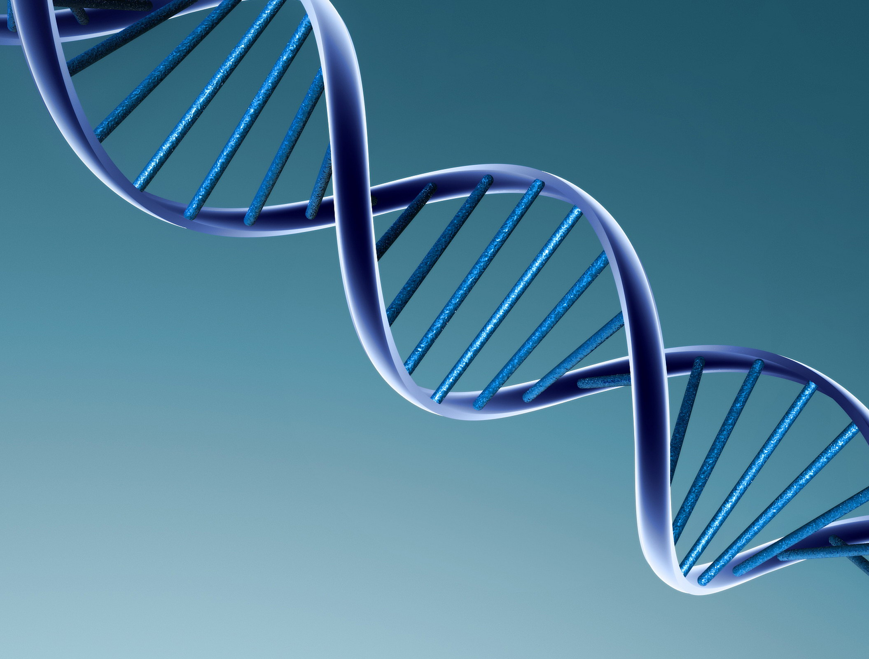
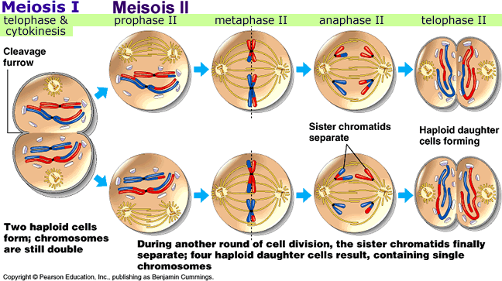
Chapter 11-4
Meiosis

Slide 4
Daily Objectives
Compare the number of chromosomes in body cells and in gametes.
Summarize the events of meiosis.
Compare and contrast meiosis with mitosis.
Describe how alleles from different genes can be inherited together.

Slide 5
Think About It
As geneticists in the early 1900s applied Mendel’s laws, they wondered where genes might be located.
They expected genes to be carried on structures inside the cell, but which structures?
What cellular processes could account for segregation and independent assortment, as Mendel had described?

Slide 6
Chromosome Number
Chromosomes—those strands of DNA and protein inside the cell nucleus—are the carriers of genes.
The genes are located in specific positions on chromosomes.

Slide 7
Diploid Cells
A body cell in an adult fruit fly has eight chromosomes.
Four of the chromosomes come from its male parent, and four come from its female parent.
These two sets of chromosomes are homologous, meaning that each of the four chromosomes from the male parent has a corresponding chromosome from the female parent.

Slide 8
Diploid Cells
A cell that contains both sets of homologous chromosomes is diploid, meaning “two sets.”
The diploid number of chromosomes is sometimes represented by the symbol 2N.
For the fruit fly, the diploid number is 8, which can be written as 2N = 8.
Diploid cells have twice the number of chromosomes in a sperm or egg cell.

Slide 9
Haploid Cells
Some cells contain only a single set of chromosomes, and therefore a single set of genes.
Such cells are haploid, meaning “one set.”
The gametes of sexually reproducing organisms are haploid.
For fruit fly gametes, the haploid number is 4, which can be written as: N = 4.

Slide 10
Phases of Meiosis
Meiosis is a process in which the number of chromosomes per cell is cut in half through the separation of homologous chromosomes in a diploid cell.
Meiosis usually involves two distinct divisions, called meiosis I and meiosis II.
By the end of meiosis II, the diploid cell becomes four haploid cells.

Slide 11
Meiosis I
Just prior to meiosis I, the cell undergoes a round of chromosome replication called interphase I.
Each replicated chromosome consists of two identical chromatids joined at the center.

Slide 12
Prophase I
The cells begin to divide, and the chromosomes pair up, forming a structure called a tetrad, which contains four chromatids.

Slide 13
Prophase I
As homologous chromosomes pair up and form tetrads, they undergo a process called crossing-over.
First, the chromatids of the homologous chromosomes cross over one another.

Slide 14
Prophase I
Then, the crossed sections of the chromatids are exchanged.
Crossing-over is important because it produces new combinations of alleles in the cell.

Slide 15
Metaphase I and Anaphase I
As prophase I ends, a spindle forms and attaches to each tetrad.
During metaphase I of meiosis, paired homologous chromosomes line up across the middle of the cell.

Slide 16
Metaphase I and Anaphase I
During anaphase I, spindle fibers pull each homologous chromosome pair toward opposite ends of the cell.
When anaphase I is complete, the separated chromosomes cluster at opposite ends of the cell.

Slide 17
Telophase I and Cytokinesis
During telophase I, a nuclear membrane forms around each cluster of chromosomes.
Cytokinesis follows telophase I, forming two new cells.

Slide 18
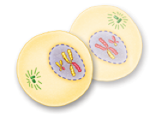
Meiosis I
The two cells produced by meiosis I have sets of chromosomes and alleles that are different from each other and from the diploid cell that entered meiosis I.

Slide 19
Meiosis II
The two cells produced by meiosis I now enter a second meiotic division.
Unlike the first division, neither cell goes through a round of chromosome replication before entering meiosis II.

Slide 20
Prophase II
As the cells enter prophase II, their chromosomes — each consisting of two chromatids— become visible.
The chromosomes do not pair to form tetrads, because the homologous pairs were already separated during meiosis I.

Slide 21
Metaphase II
During metaphase of meiosis II, chromosomes line up in the middle of each cell.

Slide 22
Anaphase II
As the cell enters anaphase, the paired chromatids separate.

Slide 23
Telophase II and Cytokinesis
In the example shown here, each of the four daughter cells produced in meiosis II receives two chromatids.

Slide 24
Telophase II and Cytokinesis
These four daughter cells now contain the haploid number (N) — just two chromosomes each.

Slide 25
Gametes to Zygotes
The haploid cells produced by meiosis II are gametes.
In male animals, these gametes are called sperm. In some plants, pollen grains contain haploid sperm cells.
In female animals, generally only one of the cells produced by meiosis is involved in reproduction. The female gamete is called an egg in animals and an egg cell in some plants.

Slide 26
Gametes to Zygotes
Fertilization — the fusion of male and female gametes — generates new combinations of alleles in a zygote.
The zygote undergoes cell division by mitosis and eventually forms a new organism.

Slide 27
Comparing Meiosis and Mitosis
Mitosis does not normally change the chromosome number of the original cell.
This is not the case for meiosis, which reduces the chromosome number by half.
Mitosis results in the production of two genetically identical diploid cells, whereas meiosis produces four genetically different haploid cells.

Slide 28
Comparing Meiosis and Mitosis
Mitosis is a form of asexual reproduction, whereas meiosis is an early step in sexual reproduction.
There are three other ways in which these two processes differ.

Slide 29
Replication and Separation of Genetic Material
In mitosis, when the two sets of genetic material separate, each daughter cell receives one complete set of chromosomes.

Slide 30
Replication and Separation of Genetic Material
In meiosis, homologous chromosomes line up and then move to separate daughter cells.
As a result, the two alleles for each gene segregate from each other and end up in different cells.

Slide 31
Replication and Separation of Genetic Material
The sorting and recombination of genes in meiosis result in a greater variety of possible gene combinations than could result from mitosis.

Slide 32
Changes in Chromosome Number
Mitosis does not normally change the chromosome number of the original cell.
Meiosis reduces the chromosome number by half.

Slide 33
Changes in Chromosome Number
A diploid cell that enters mitosis with four chromosomes will divide to produce two diploid daughter cells, each of which also has four chromosomes.

Slide 34
Changes in Chromosome Number
On the other hand, a diploid cell that enters meiosis with four chromosomes will pass through two meiotic divisions to produce four haploid gamete cells, each with only two chromosomes.

Slide 35
Number of Cell Divisions
Mitosis is a single cell division, resulting in the production of two genetically identical diploid daughter cells.

Slide 36
Number of Cell Divisions
Meiosis requires two rounds of cell division, and, in most organisms, produces a total of four genetically different haploid daughter cells.

Slide 37
Gene Linkage and Gene Maps
Question: How can two alleles from different genes be inherited together?

Slide 38
Gene Linkage
Thomas Hunt Morgan’s research on fruit flies led him to the principle of gene linkage.
After identifying more than 50 Drosophila (fruit fly) genes, Morgan discovered that many of them appeared to be “linked” together in ways that seemed to violate the principle of independent assortment.

Slide 39
Gene Linkage
For example, Morgan used a fly with reddish-orange eyes and miniature wings in a series of test crosses.
His results showed that the genes for those two traits were almost always inherited together.
Only rarely did the genes separate from each other.

Slide 40
Gene Linkage
Morgan and his associates observed so many genes that were inherited together that, before long, they could group all of the fly’s genes into four linkage groups.
The linkage groups assorted independently, but all of the genes in one group were inherited together.
As it turns out, Drosophila has four linkage groups and four pairs of chromosomes.

Slide 41
Gene Linkage
Morgan’s findings led to two remarkable conclusions:
First, each chromosome is actually a group of linked genes.
Second, it is the chromosomes that assort independently, not individual genes.
Alleles of different genes tend to be inherited together when those genes are located on the same chromosome.

Slide 42
Gene Mapping
In 1911, Columbia University student Alfred Sturtevant wondered if the frequency of crossing-over between genes during meiosis might be a clue to the genes’ locations.
Sturtevant reasoned that the farther apart two genes were on a chromosome, the more likely it would be that a crossover event would occur between them.

Slide 43
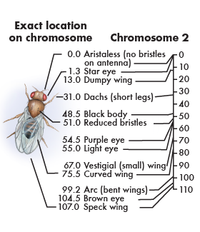
Gene Mapping
If two genes are close together, then crossovers between them should be rare. If two genes are far apart, then crossovers between them should be more common.
By this reasoning, he could use the frequency of crossing-over between genes to determine their distances from each other.

Slide 44
Gene Mapping
Sturtevant gathered lab data and presented a gene map showing the relative locations of each known gene on one of the Drosophila chromosomes.
Sturtevant’s method has been used to construct gene maps ever since this discovery.

