Slide 1
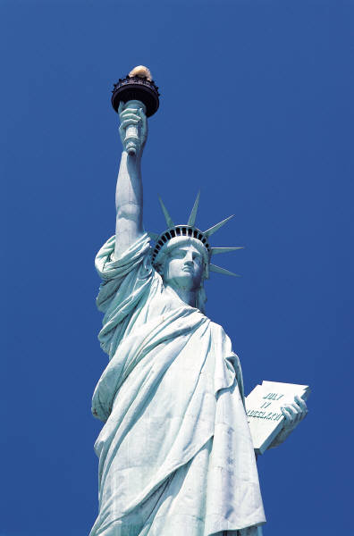
The Statue of Liberty
By Andrew, Zane, &
Judson

Slide 2
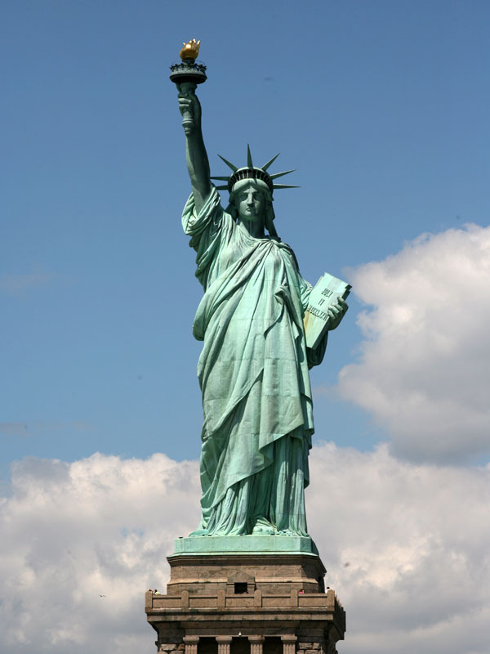
Frederic Auguste Bartholdi is the sculptor
It was finished rebuilding in New York on July 5, 1986

Slide 3
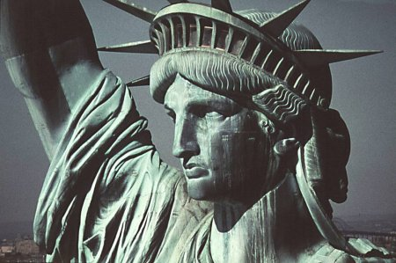
It is made of copper.
It is 306 feet tall!!

Slide 4
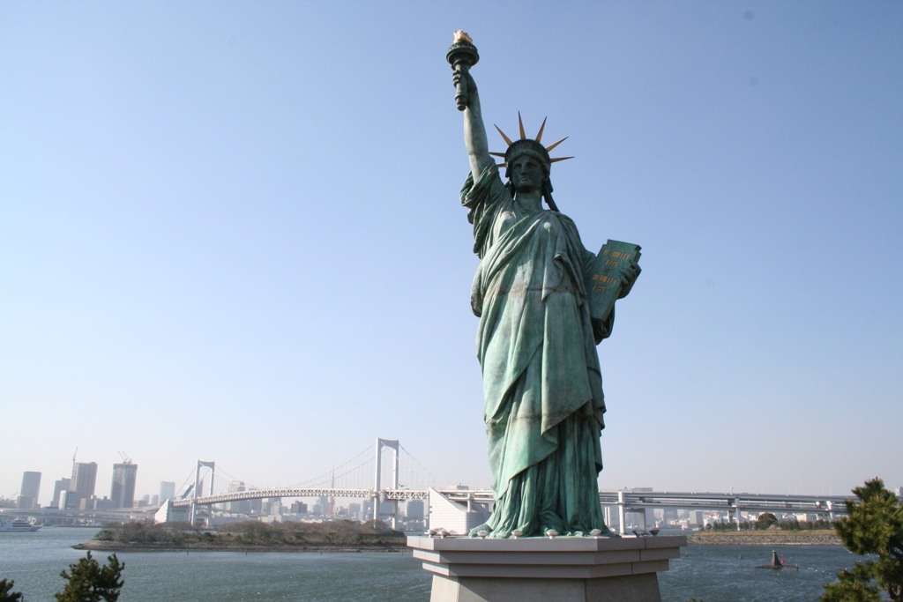
It is used for a national symbol of freedom.

Slide 5
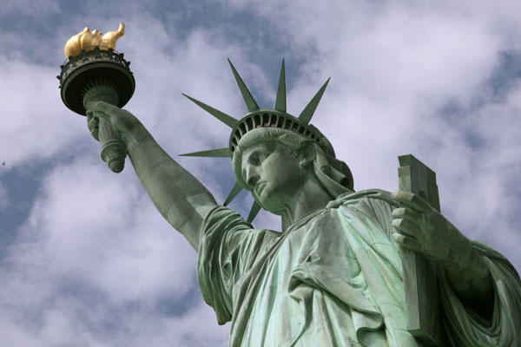
Total weight of statue is 225 tons
At the feet of the statue lie broken shackles that represent freedom from cruelty.
There is a miniature Statue of Liberty in Birmingham, AL.

Slide 6
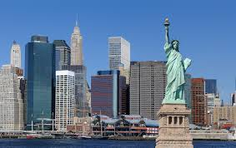
Resources:
Statueof liberty.org

