Slide 1
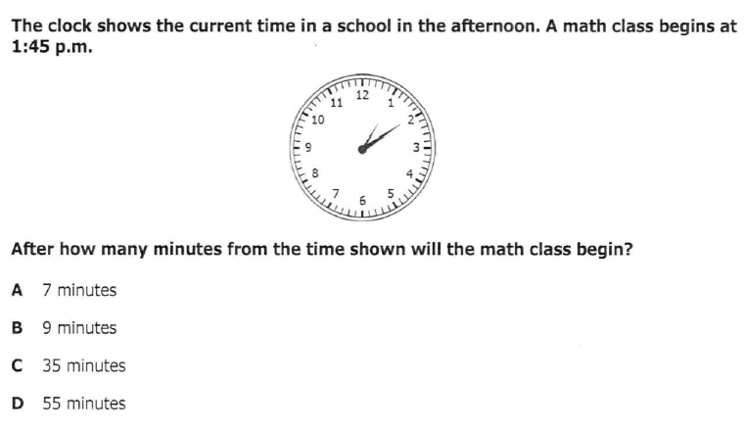
Tuesday, October 22, 2019
Tuesday: Classworks
M - Amiyah - 1
M – Erin - 2
M – Jaiden – 3
M – Caydance - 4
M – Jaylie – 5
M – Macon – 6
M – Paisleigh - 7
M – Jearon - 8
M – Landon – 9
M – Kaylee - TC
Independent Novel when finished
7:55 – 8:30

Slide 2
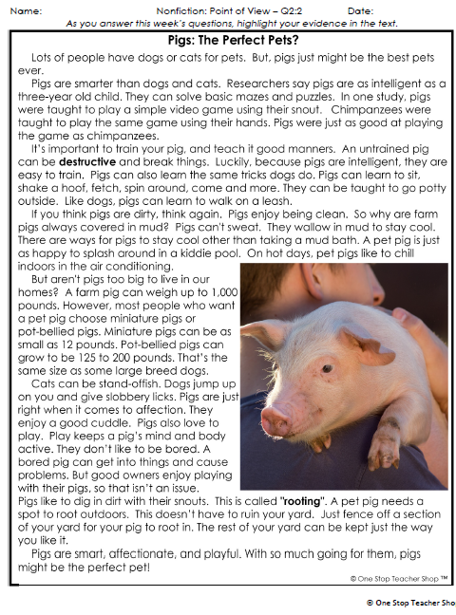
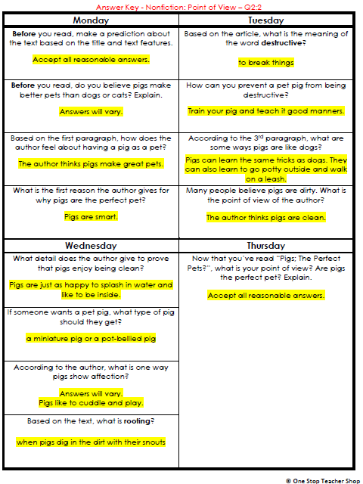
Reading Homework

Slide 3
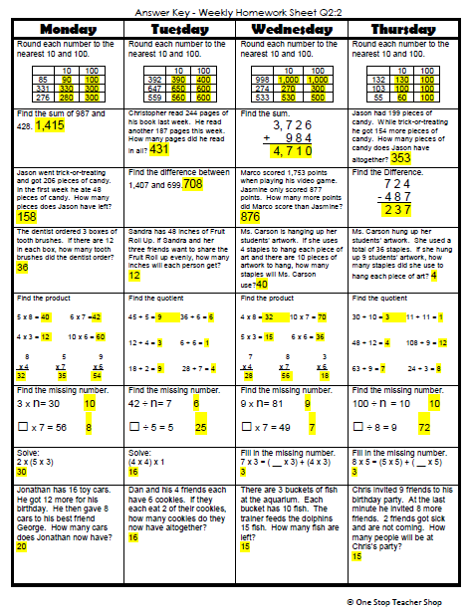
Math Homework

Slide 4

CHOMP TIME
F.A.S.T. Groups
Focused Academic Support Time

Slide 5
F.A.S.T. Designations
Computers – Classworks: R - Aiden- 1 M - Erin - 2 M - Jearon - 3 M - Emma - 4 R – Adalyn – 5 M – Alexis - 6 R - Brena- 7 M - Carleen - 8 R - Kaylee – 9 R – Kaylah - TC | Mrs. Roby: LLI Paisleigh Jaiden | Mrs. Thompson: LLI Jaylie Caydance Amiyah Cohen | Paired Partners Book Club: Khamani - Katelynn McKenzie – Cayli Noah - Elin
Landon – Phonics 1st with Mrs. Page
Macon – SIPPS with Mrs. Bess
8:40 – 9:10

Slide 6
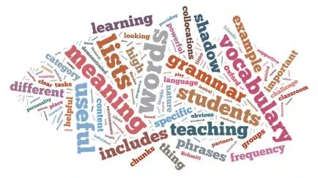


VocabularyQuiz
9:10 – 9:15

Slide 7

Reading Test
9:15 – 10:30
As needed

Slide 8
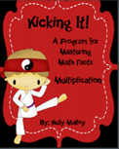
Kicking it Quiz!

Slide 9
Out of Classroom!
Recess 10:40 – 11:05

Slide 10

Writing Time
11:05 – 11:35

Slide 11
Team captains pass out Writing Journals to your group

Slide 12

Gather at the Carpet with your Writing Journal and pencil.
Are we still the best?

Slide 13

Curiosity
Last time we heard Are You a Dragonfly? and started thinking about animals we were curious about.
Why might curiosity be an important quality for a writer to have?
Writers do not have to know a lot about a topic when they begin writing about it, but they do need to be curious about it.

Slide 14

Curiosity
By researching things, authors can gather interesting information that they can share with others in their writing.
Today you will hear a nonfiction book that is also about animals but is written in a different style from Are You a Dragonfly?

Slide 15
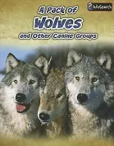
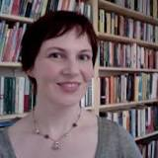
New book:
Canine groups means “dog-like animals that live together”
Listen to how the author chose to present this information about wolves and other canines in this book.
Author: Anna Claybourne

Slide 16
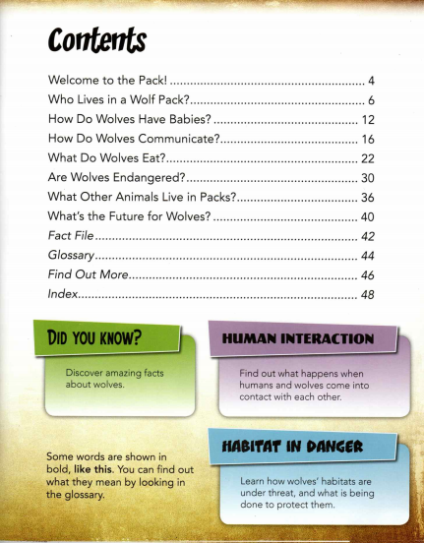
“Table of” Contents Page
The Contents page lists the names of the chapters along with the page number where each begins.
Let’s look at the chapter titles.

Slide 17
Read Aloud:
Listen as I read the first two chapters: Welcome to the Pack! and Who Lives in a Wolf Pack?
What interesting things have you heard so far about wolves?
What are you curious about?
How does the author present the information about wolves in this book?
The author used a Question & Answer Format!
Author: Anna Claybourne

Slide 18


Quick Write – 5 minutes
If you were going to write a question-and-answer book about the animal you chose, what questions could you write?

Slide 19
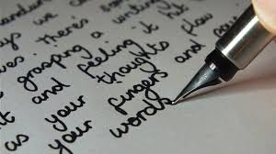
Sharing and Reflecting
What did your partner write about today?
What did your partner write that you are curious to know more about?

Slide 20

Computers – Classworks:
  M - Katelynn - 1
  M – Kaylah -2
  M – Emma - 3
  M – McKenzie - 4
  M - Adalyn - 5
  M - Lexi - 6
  M – Jaiden – 7
  M - Erin - 8
  M – – 9
  M – Cayli - TC
  Mrs. Roby
  LLI:
  Carleen
  Jearon
  Brena
  Macon
Independent Daily Reading & Teacher Conferences
  Mrs. Thompson:
  SIPPS
  Landon
  Amiyah
  Jaylie
  Cohen
  Kaylee
  Caydance
  Paisleigh
Everyone else – Independent Novel
11:35 – 12:05

Slide 21
Math Time!
Let’s watch a video to review elapsed time!
12:05 – 12:35

Slide 22
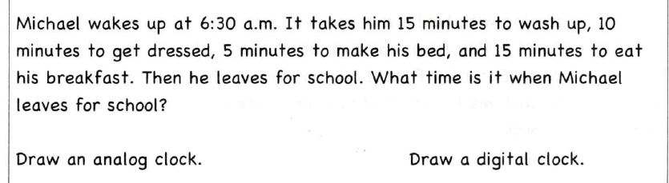
Elapsed Time Review

Slide 23
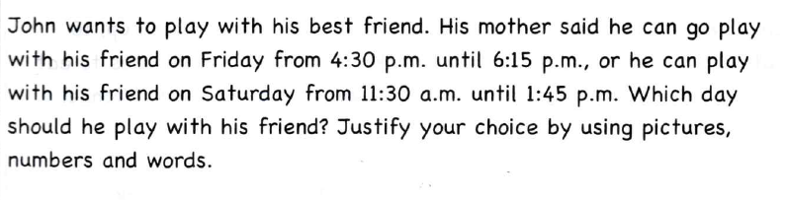
Elapsed Time Review

Slide 24
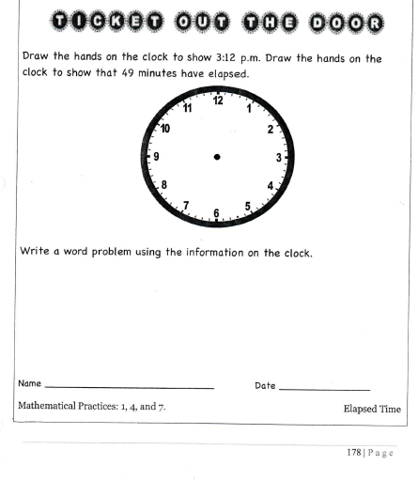

Slide 25

Out of Classroom!
Lunch 12:35 – 1:05

Slide 26
Restroom Break
1:05 – 1:10

Slide 27

Out of Classroom!
Activity 1:10 – 1:55

Slide 28
Math Test!
1:55 – 3:15

Slide 29
Restroom Break
3:10 – 3:15

Slide 30

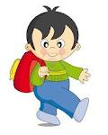


3:10 – 3:15 Wrap Up!
Pair-Up back to back and share one thing you learned in class today with your partner
Pack-Up
Office will announce:
Car Riders – Leave around 3:20
Bus Riders – (listen to intercom for dismissal)
2:30 – 3:20
How much time has elapsed?

