Slide 1
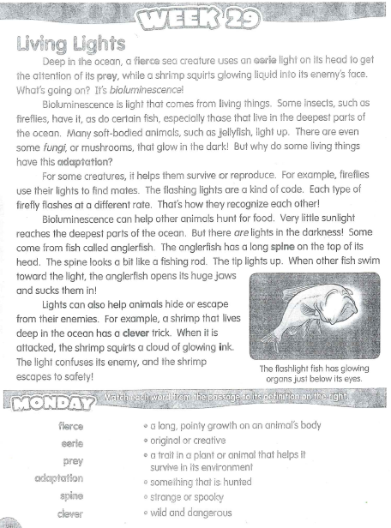
Thursday, November 7, 2019
Thursday: Classworks
Free Choice - Amiyah - 1
Free Choice – Erin - 2
M – Landon – 3
M – Caydance - 4
Free Choice – Jearon – 5
M – Paisleigh – 6
M – Brena - 7
M – Macon - 8
M – Jaylie – 9
M – Jaiden - TC
7:55 – 8:30

Slide 3
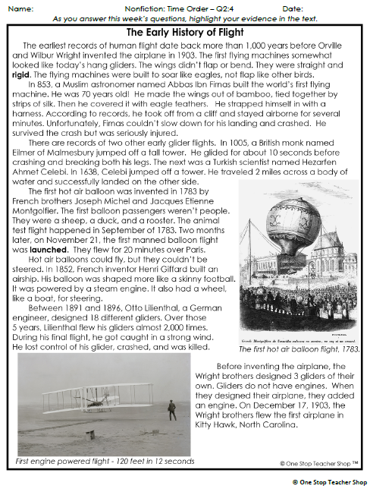
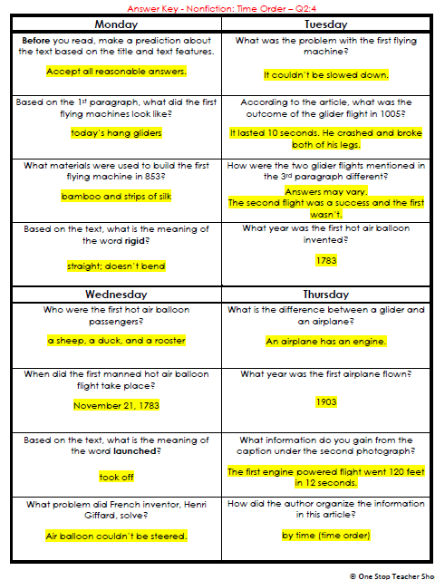
Reading Homework

Slide 4
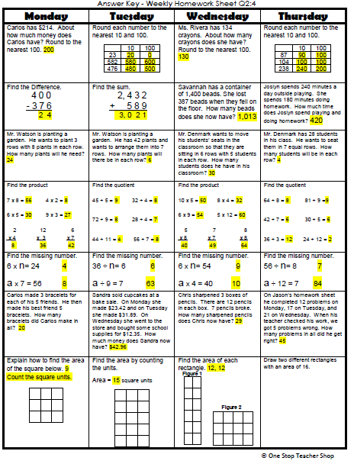
Math Homework

Slide 5
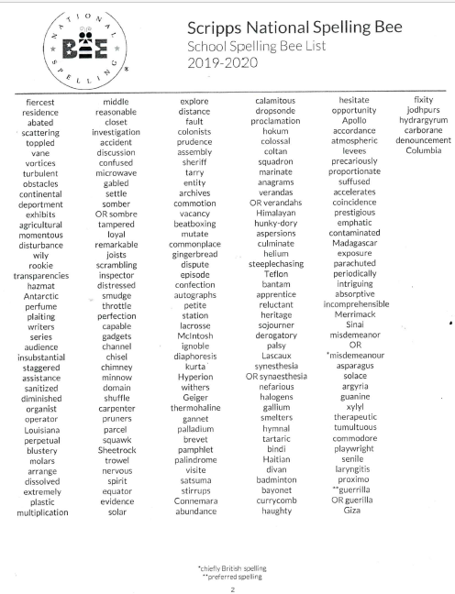

Reminder:
Classroom Spelling Bee
November 12th

Slide 6

CHOMP TIME
F.A.S.T. Groups
Focused Academic Support Time

Slide 7
F.A.S.T. Designations
Computers – Classworks: M - Kaylah- 1 M – Emma - 2 Free Choice - Aiden - 3 Free Choice - Lexi - 4 R – Erin – 5 M – Adalyn - 6 M – McKenzie - 7 M - Cayli - 8 Free Choice - Jaiden – 9 M – Khamani - TC | Mrs. Roby: LLI Carleen Jearon Brena | Mrs. Thompson: SIPPS Cohen Amiyah Caydance Jaylie Kaylee Paisleigh | IDR: Everyone else
No Spotlight today!
Landon – Phonics 1st with Mrs. Page
Macon – SIPPS with Mrs. Bess
8:40 – 9:10

Slide 8

Reading Time
Objective: RL.3.3 Describe characters in a story and explain how their actions contribute to the sequence of events.
Objective: RL.3.5 Refer to parts of stories and poems when writing or speaking about a text, using terms such as chapter, scene, and stanza; describe how each successive part builds on earlier sections.
Objective: RL.3.7 Use information gained from illustrations, other visual elements, and the words in a text to demonstrate understanding of the text.
9:10 – 9:45

Slide 9

Gather at the Carpet with your MM handbook, and pencil.
Are we still the best?

Slide 10

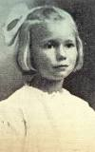
Reading Strategy: Visualizing
Let’s review the story by explaining what is happening in each of the following parts:
p10 – “Ma hugged and kissed me before Pa took my hand and led me out into the dark winter air.”
p22 – “At exactly seven o’clock, the train chugged away from my home and headed down the mountain.”
p30 – “The second I laid eyes on Grandma Mary, I felt downright warm inside.”

Slide 11
Reading Strategy: Visualizing
I will read a passage from Mailing May aloud.
As I read, I want you to close your eyes and visualize the scene, or picture it in your mind.
Think about what you hear, smell, and feel, in addition to what you would see.

Slide 12
Read Aloud –
p21
“The big black steam engine was already waiting, hissing and snorting like a boar hog. The sight made me go all tingly, seeing as I’d never ever ridden on a train before.”
How did you visualize the scene at the train station? What words helped you to visualize? Turn to your partner

Slide 13
Read Aloud –
First 2 paragraphs of p25
Turn to page 14 in your MM Student response book. Read the passage with your partner and talk about what you visualized.
Turn to page 15 in your MM Student response book. Draw how you visualized the scene. Write a sentence or two at the bottom explaining what it shows.

Slide 14
In preparation of sharing drawings
How would you like your partner to act while you’re sharing your drawing with him or her. Tell your partner now.
Share your drawings

Slide 15
Class Discussion
How did you visualize what May saw from the train? What words in the passage helped you?
How is your drawing like your partner’s drawing? How is it different?

Slide 16
Reflection
How did you show your partner respect when you shared your drawings with each other?
Why is it important to be respectful when sharing work we’ve done?

Slide 17

Restroom Break
9:45 – 9:55

Slide 18

Computers – Classworks:
  M - Katelynn - 1
  M – Landon -2
  M – Emma - 3
  M – Adalyn - 4
  M - Macon - 5
  M - Kaylee - 6
  M – Elin – 7
  M - Brena - 8
  Free Choice – Carleen – 9
  R – Kaylee - TC
Independent Daily Reading & Teacher Conferences
  Mrs. Roby
  LLI:
  Jaiden
  Paisleigh
  Mrs. Thompson:
  LLI
  Jaylie
  Caydance
  Amiyah
  Cohen
Everyone else – Independent Novel
9:55 – 10:25

Slide 19
Out of Classroom!
Recess 10:40 – 11:05

Slide 20
Writing Time
11:05 – 12:05

Slide 21
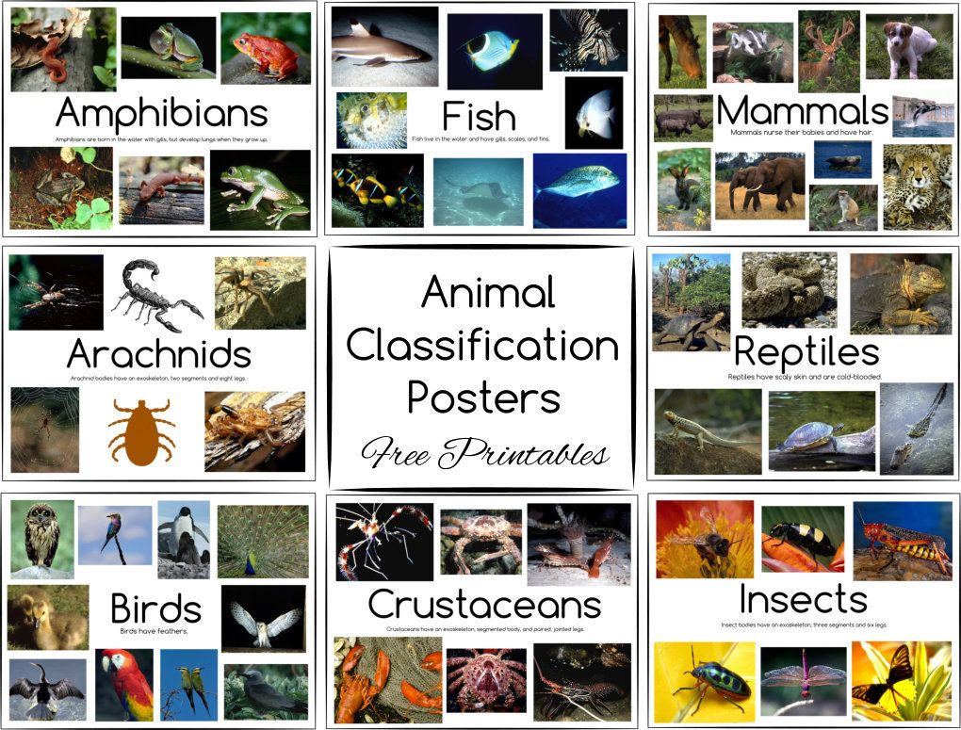
Research Project Continues – begin rough draft of book!
Animal Research Project
  Groups: #1 birds, #2 fish, #3 reptiles, #4 mammals, #5 amphibians (each student has their own animal)
  Information to obtain:
    Habitat
    Physical characteristics
    Diet
    Adaptations
    Endangered status
11:05 – 12:05

Slide 22
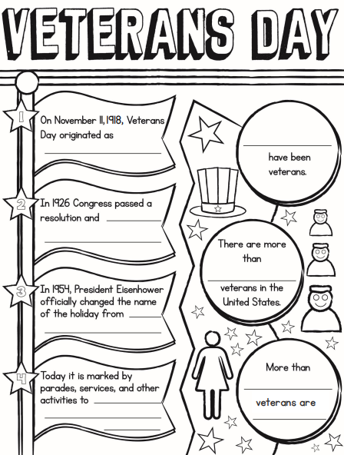
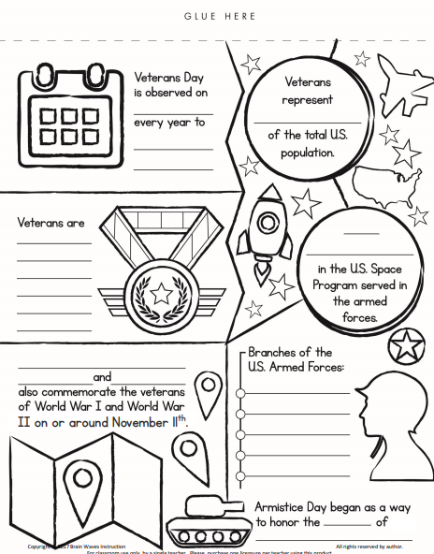
Veteran’s Day Fact Hunt

Slide 23

Out of Classroom!
Lunch 12:35 – 1:05

Slide 24
Restroom Break
1:05 – 1:10

Slide 25

Out of Classroom!
Activity 1:10 – 1:55

Slide 26
Finish Veteran’s Day Fact Hunt

Slide 27
Math Fluency & Focus Lesson!
2:30 – 3:10

Slide 28
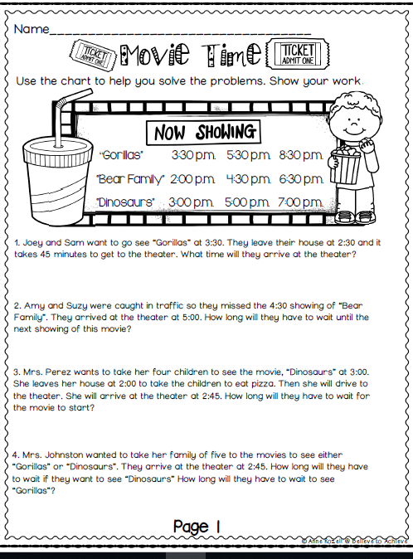

Slide 29
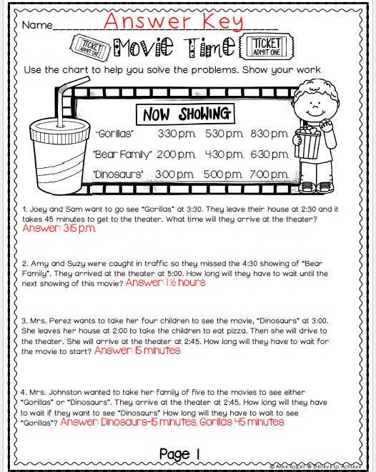

Slide 30
Restroom Break
3:10 – 3:15

Slide 31




3:10 – 3:15 Wrap Up!
Pair-Up back to back and share one thing you learned in class today with your partner
Pack-Up
Office will announce:
Car Riders – Leave around 3:20
Bus Riders – (listen to intercom for dismissal)
2:30 – 3:20
How much time has elapsed?

