Slide 1
Multiplying with 0 and 1
Lesson 5-3
3.OA.3, 3.OA.8

Slide 2
Objective
I can use patterns and properties to multiply with 0 and 1 as factors.

Slide 3
Vocabulary
Identity (one) Property of Multiplication

Slide 4
Vocabulary
Zero Property of Multiplication

Slide 5
Set the Purpose
You have learned how to use patterns to create fact tables for multiplying with 2, 5, and 9. Today, you will use the same ideas to discover patterns when you multiply with 0 and 1.

Slide 6
Connect
Think back to when you multiplied with 2, 5, and 9. Did you multiply with 0 and 1 when you created your fact tables?
Tell me some examples of multiplication facts you know with 0 and 1.

Slide 7
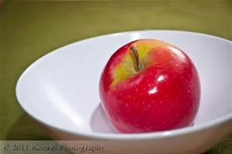
Pose the Problem
Taj has 6 bowls. He puts 1 apple in each bowl. How many apples does Taj have?
does he use?

Slide 8
Teaching Tool 38
How many counters can you show for 0 x 9 and 9 x 0?
How many counters will you show for
1 x 9?
Work with a partner to complete the tables for 1 and 0. Remember to use the Commutative Property and what you already now about 2s, 5s, and 9s.

Slide 9
Academic Vocabulary
Look at the completed table. What do you notice about what happens when you multiply a number by 1?
The Identity Property of Multiplication says that when you multiply a number and 1 the product is that number.
What pattern do you see in the products for the 0s facts? The Zero Property of Multiplication says when you multiply a number and 0 the product is zero.

Slide 10
Write to Explain
Kent says that the multiples of 1 and of 0 are the easiest multiplication facts to learn. Do you agree or disagree with Kent? Why? Give an example with 1 as a factor and with a 0 as a factor.

Slide 11
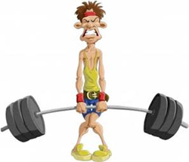
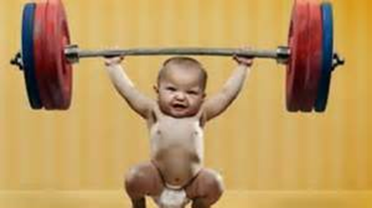
Writing to Explain - Rubric

Slide 12
1 Point - WEAK
Yes.
Like 12 x 0 = 0 and 8 x 1 = 8
(Correct examples are given, but no explanation is provided.)

Slide 13
2 POINTS
Kent is right. Multiply any number times 0 and you get 0. Multiply any number times 1 and you get that number.
6 x 0 = 0 and 6 x 1 = 6
(Correct examples are given, and my explanation has some good ideas.)

Slide 14
3 POINTS – STRONG!
I agree with Kent. Any number times 0 is always 0. This makes 0 facts super easy to know. Even 9,999 x 0 is easy – it’s 0!
Any number times 1 is that number, so 1s facts are easy, too. Even 4863 x 1 = 4,863.

