Slide 1
Matter: Properties and Changes
An Introduction to Chemistry

Slide 2
Properties
Properties can be used to identify a substance.
Properties can describe a substance or describe how a substance changes.

Slide 3
Properties
Extensive Properties
Intensive Properties
Are dependent on the amount of a substance present.
Mass
Volume
Concentration
Does not depend on the amount of a substance present.
Density
Boiling Pt.
Etc.

Slide 4
Physical Properties
Can be observed without changing the identity of the substance.
Include properties involving changes of state.

Slide 5
Physical Properties
Examples:
Density
Malleability
Solubility
Boiling Point
Freezing/Melting Point
Conductivity

Slide 6
Chemical Properties
Can only be observed by changing the identity of the substance.
Most chemical properties describe how a substance changes.

Slide 7
Chemical Properties
Examples:
Combustibility
Flammability
Corrosiveness
Acidity

Slide 8
Changes in Matter
A change in form, state, or substance.

Slide 9
Physical Change
Any change that does not alter the identity of the substance.

Slide 10
Physical Changes
Examples:
Boiling
Melting/Freezing
Sublimation
Cutting
Bending
Dissolving
Mixing

Slide 11
Chemical Changes
A change which results in the formation of a new substance with new properties.

Slide 12
Chemical Changes
Examples:
Burning
Combustion
Corrosion
Rusting
Neutralization

Slide 13
Indications of Chemical Change
Three Signs of a Chemical Reaction
Release of a gas
Release of heat or light.
Formation of a Precipitate

Slide 14
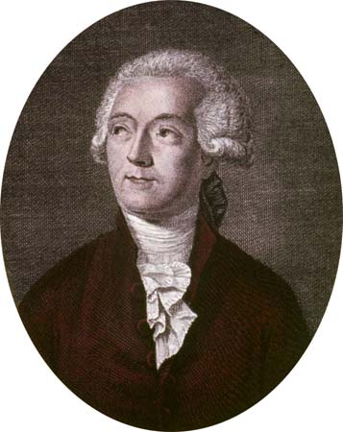
Conservation of Mass
First developed by Antoine Lavoisier
Mass cannot be created or destroyed in any chemical or physical change.

Slide 15
Classification of Matter
Pure Substances
All one type of matter.
Compound
Separated by chemical reactions.
Simplest unit: Molecule/formula unit
Element
Cannot be separated by chemical reactions.
Simplest unit-atom
Mixtures
More than one type of matter.
All substances retain properties.
Heterogeneous-not completely mixed, segregated regions.
Homogeneous- mixed completely. No parts are left unmixed.

