Slide 1
Cell Transport and Homeostasis
Notes:
Copyright©USBIologyTeaching.Com
This PowerPoint is designed to be used with the curriculum at USBiologyTeaching.Com.

Slide 2
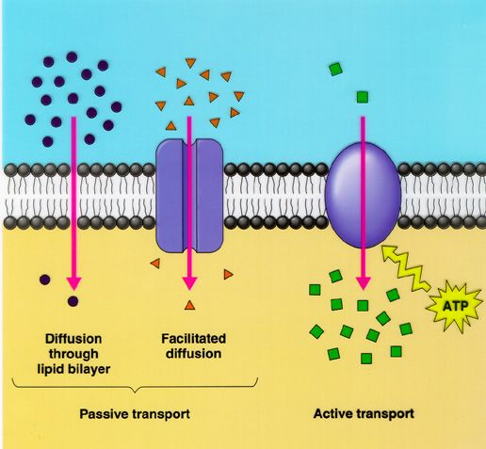
Cell Transport
In order for cells to maintain homeostasis they have to control what enters and leaves the cell.
Homeostasis-maintaining an internal balance. Stability.
Types of cellular transport
Passive Transport- the movement of materials into and out of the cell without the use of energy.
Active Transport- movement of materials into and out of the cell with the use of energy.

Slide 3
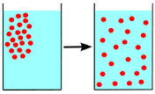
Diffusion
Diffusion-A type of passive transport where molecules move from an area of high concentration to an area of lower concentration.
The difference in the concentration of molecules across a distance is call the concentration gradient.
The molecular movement that occurs is a result of kinetic energy. The molecular collisions that result from the movement cause the molecules to move from areas where they are highly concentrated.

Slide 4
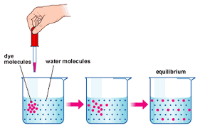
Equilibrium
Molecules will eventually reach equilibrium if they are able to move free of other influences.
Equilibrium occurs when the concentration and distribution of the molecules is the same throughout the entire space.

Slide 5
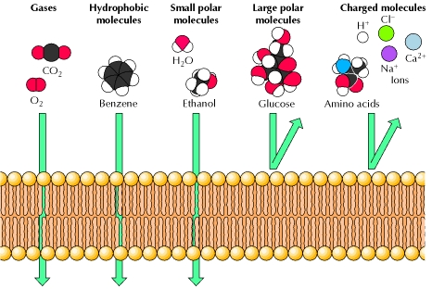
Diffusion Across the Cell Membrane
The cell membrane allows some molecules to pass through freely.
Those molecules will move from an area of high concentration on one side of the membrane to an area of low concentration on the other side.
Examples of molecules that diffuse freely are carbon dioxide and oxygen.

Slide 6
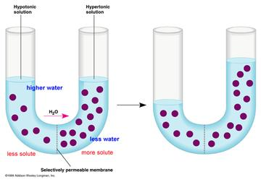
Osmosis-Passive transport (no energy)
Osmosis is the diffusion of water molecules from an area of high concentration to an area of lower concentration.
In some cases, large solutes cannot diffuse across the membrane of the cell, however the water will.

Slide 7
Predicting the Direction of Osmosis
A solution is composed of a solute and a solvent.
Solvent-the substance that dissolves the solute. (ex. water)
Solute-the substance that is being dissolved. (ex. salt, sugar)
The direction of osmosis depends on the relative concentrations of the solutions in the cell compare to their environment.

Slide 8
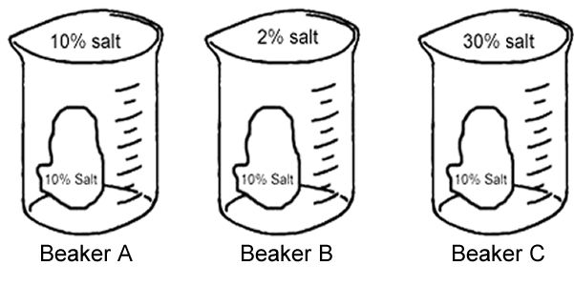
Osmosis Practice Problem
For each beaker, determine whether water will go into the cell or out the cell with 10% salt.

Slide 9
Predicting the Direction of Osmosis
Hypertonic-higher concentrations of solutes in the solution than the cell.
(cell will lose water-shrivel)
Hypotonic-lower concentrations of solutes in the solution than what is in the cell.
(cell will gain water)
Isotonic-equal concentrations of solutes inside and outside of the cell.
(water will moved equally in both directions)
Notes:
Hypo swells up like a hippo!

Slide 10
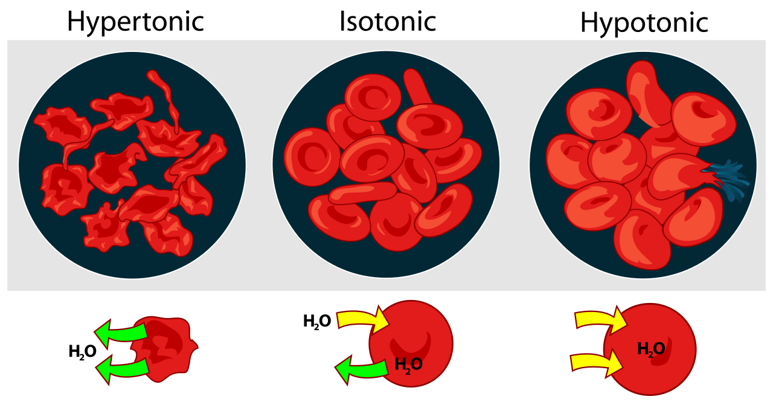
Impact on Vertebrate Animal Cells
In a hypertonic environment animal cells will experience crenation and will undergo shrinkage.
In a hypotonic environment a animal cell will eventually burst experiencing plasmolysis.
Isotonic the cell will stay them same

Slide 11
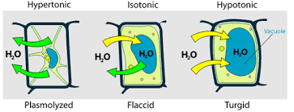
Impact on Plant Cells
Turgor pressure is the pressure exerted on the plant cell wall.
This occurs when plant cells are in a hypotonic environment. In this state, plant cells are turgid.
In a hypertonic environment a plant cell will experience plasmolysis and the plant cell will lose turgor pressor. This cause a plant to wilt.

Slide 12
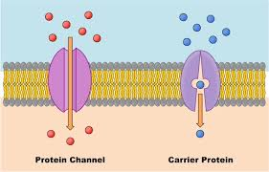
Facilitated Diffusion-passive transport
Some molecules are too large or are not soluble in lipids and cannot diffuse freely across the membrane.
These molecules will require the help of a specific protein in the cell membrane called a carrier protein.

Slide 13
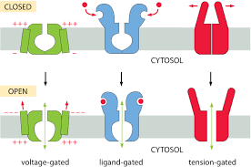
Ion Channels-passive transport
Ion channels are type of proteins that allow specific ions into or out of the cell.
Each ion channel is specific a particular ion.
Ion channels can be always open or can be gated.
Gated ion channels can open 3 ways
Stretching the cell membrane
Electrical signals
Chemicals in cytosol or environment

Slide 14
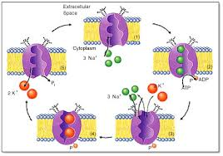
Active Transport
Active transport is the movement of material up the concentration gradient from a low concentration to a high concentration.
It requires energy (ATP)!!!
Ion channels and carrier protein that assist in active transport are called cell membrane pumps.

Slide 15
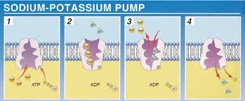
Sodium Potassium Pump-active transport
A type of cell membrane pump that transport Na+ and K+ ion up (low to high) their concentration gradients.
Some animal cells need to have a higher concentration of Na+ outside of the cell and a higher concentration of K+ inside of the cell.
Sodium Potassium Pump Video- Khan Academy

Slide 16
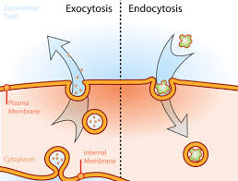
Movement with Vesicles
Some molecules are too large to move through the membrane or through a channel protein.
Cell will use endocytosis or exocytosis in order to transport these bulk materials into or out of the cell.
They require ENERGY!

Slide 17
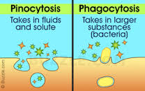
Endocytosis-active transport
Endocytosis is the process where the cell ingests large particles, external fluid and macromolecules.
The cell will form a vesicle around the material
Two types
Pinocytosis-transport of solutes or fluids
Phagocytosis-transport of large particles or wholes cells.
Phagocytes ingest bacteria and viruses and destroy them with the help of lysosomes.

Slide 18
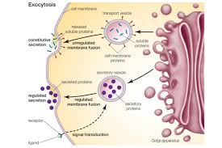
Exocytosis
Exocytosis is a process where materials from a vesicle are released from a cell.
This process allows cells to get rid of excess waste and toxins.
These are packaged by the golgi apparatus and transported to the cell membrane where it fuses and releases the contents outside of the cell.

