Slide 1
10 as a Factor
Lesson 5-5
3.OA.3, 3.OA.8

Slide 2
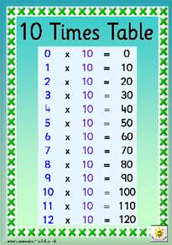
Objective
I can use patterns to multiply with 10 as a factor.

Slide 3
Set the Purpose
You know how to multiply by numbers less than 10. Today you will learn to multiply by 10.

Slide 4
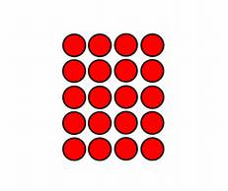
Connect
What models have we used to model multiplication?

Slide 5
Pose the Problem
Duke runs 10 miles each week. How many miles will he run in 3 weeks? Discuss with a partner what strategy you will use to solve the problem?

Slide 6
Demonstrate

Slide 7
Demonstrate
How many counters are in each row?
What do the 10 counters in a row stand for in the problem?
Duke runs 10 miles each week?
What do the 3 rows stand for in the problem?
Duke runs for 3 weeks.
What multiplication fact does this array show?
3 x 10 = 30

Slide 8
Whole Class Discussion
What would an array for 4 x 10 look like?
4 rows with 10 counters in each row.
How much is 4 x 10?
How can we use these products to find 5 x 10?
Add another row to the 4 x 10 array.

Slide 9
Teaching Tool 39
Work with a partner to complete Teaching Tool 39.
Look for patterns as you work.

Slide 10
Multiplying by 10
Use the method of your choice to solve these multiplication problems. What do you notice about the products?
4 X 10 =
2 X 10 =
9 X 10 =
5 X 10 =

Slide 11
Pattern – Multiplying by 10
When you multiply a number by 10, write that number and add a zero after it!
8 X 10 = 80
3 x 10 = 30
9 x 10 = 90

Slide 12
Writing to Explain
Dad asks what you know about patterns when you multiply by 10. Write to explain the pattern, how to use it, and how you know that you are right. Use your age as one factor and 10 as the other factor.

Slide 13
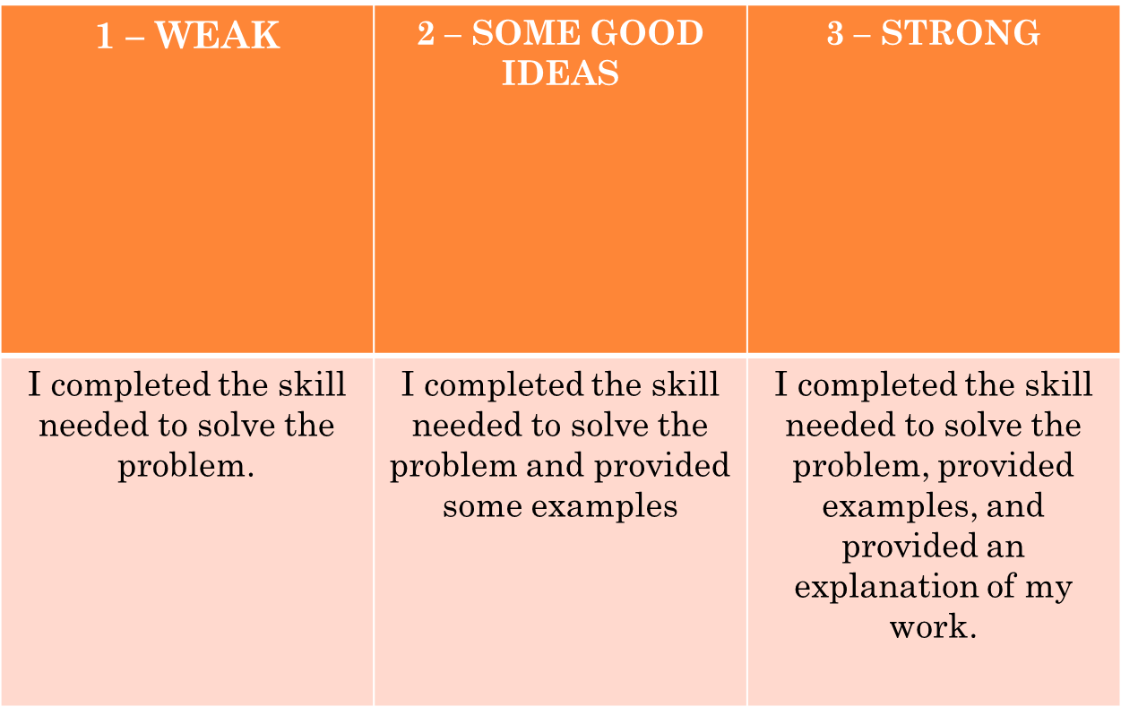
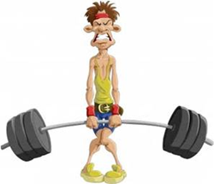
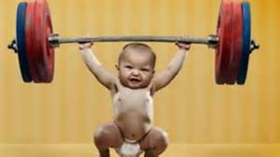
Writing to Explain - Rubric

Slide 14
1 Point - Weak
9 x 10 = 90
(The answer is correct, but no explanation is given)

Slide 15
2 Points
Multiples of 10 always end in a zero. I’m 9 years old.
So 9 x 10 = 90. I wrote the 9 with a zero after it. I’m right because I counted by 10s in my head 9 times.
(The answer is correct and there are some good strategies that have been used.)

Slide 16
3 Points – Strong!
I know that every multiple of 10 ends with a zero. This easy pattern lets you multiply in your head. I’m 9 years old. To find 9 x 10, first I write the 9 in the tens place. Then, I write a 0 after it in the ones place. To know that I’m right, I count by tens 9 times:
10, 20, 30, 40, 50, 60, 70, 80, 90.

