Slide 1
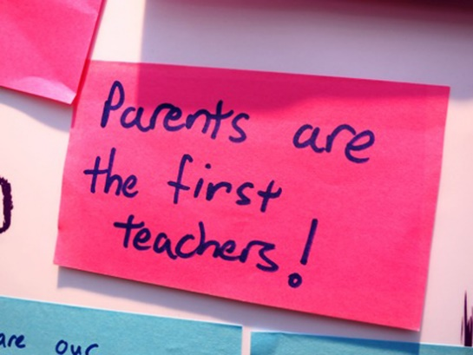
Welcome to the
Kindergarten-2nd Grade
Parent Literacy
and
Math Learning Event

Slide 2
10:00am-10:15am- Mrs. Bowen
Parent and Family Digital Learning Guide
Copyright Piracy Reminders
10:15am-10:45am- Mrs. Ezell
Math
10:45am-11:25am- Mrs. Buzzell
Literacy and Reading
11:20-11:30am- Mrs. Bowen
Question and Answer Time
Survey

Slide 3
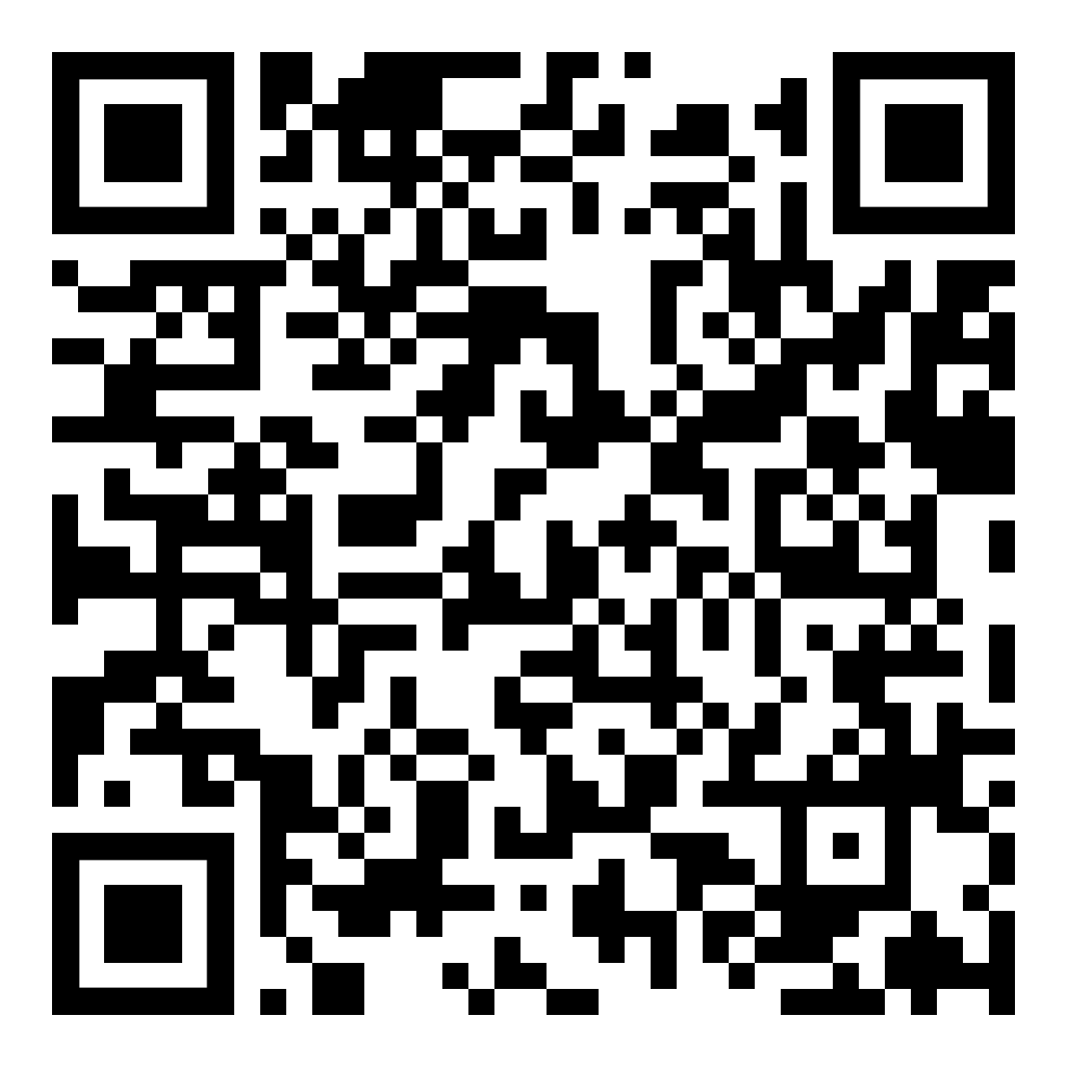
Link to Guide

Slide 4
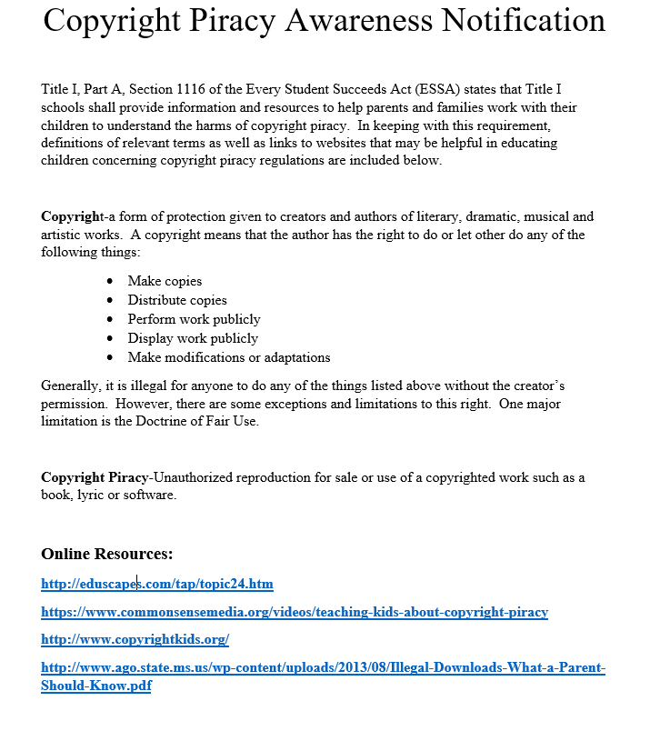
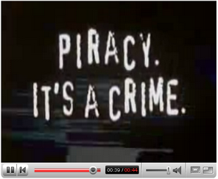
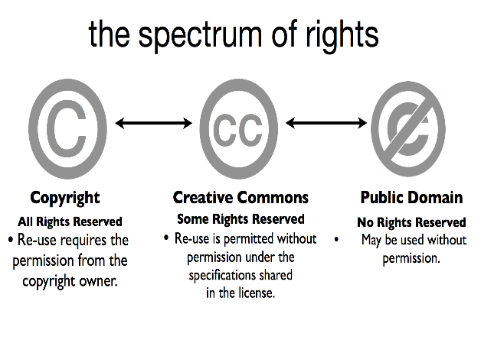
Copyright Piracy Reminders

Slide 5
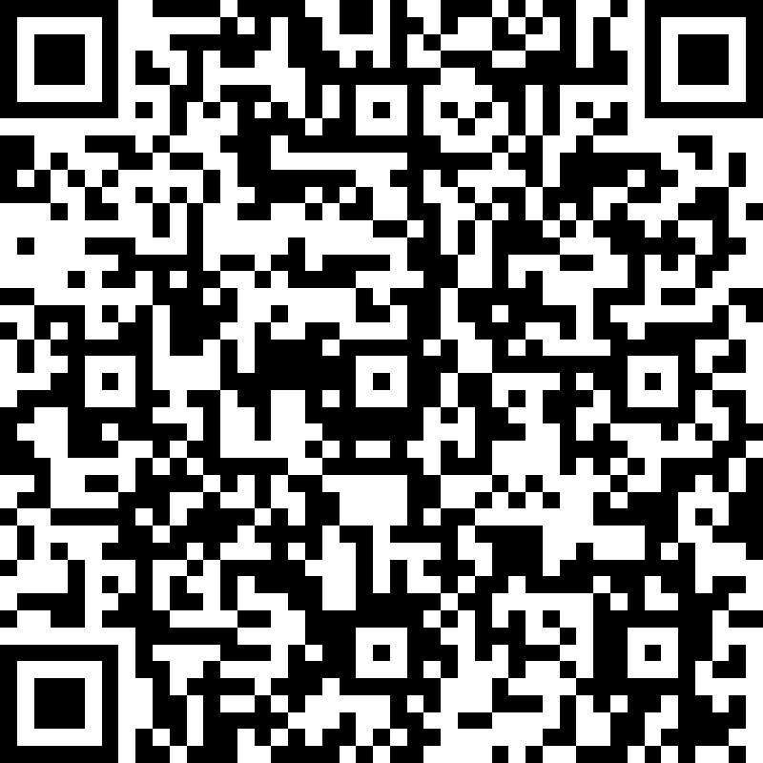
Link to survey
Questions???
Heather Bowen
Family Engagement Coordinator
heather.bowen@hcbe.net
210-8075- Direct Line

