Slide 1
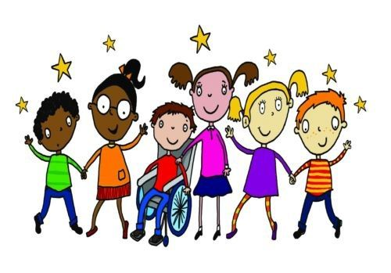
Everyone Is Different

Slide 2
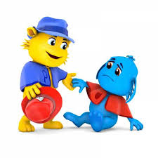
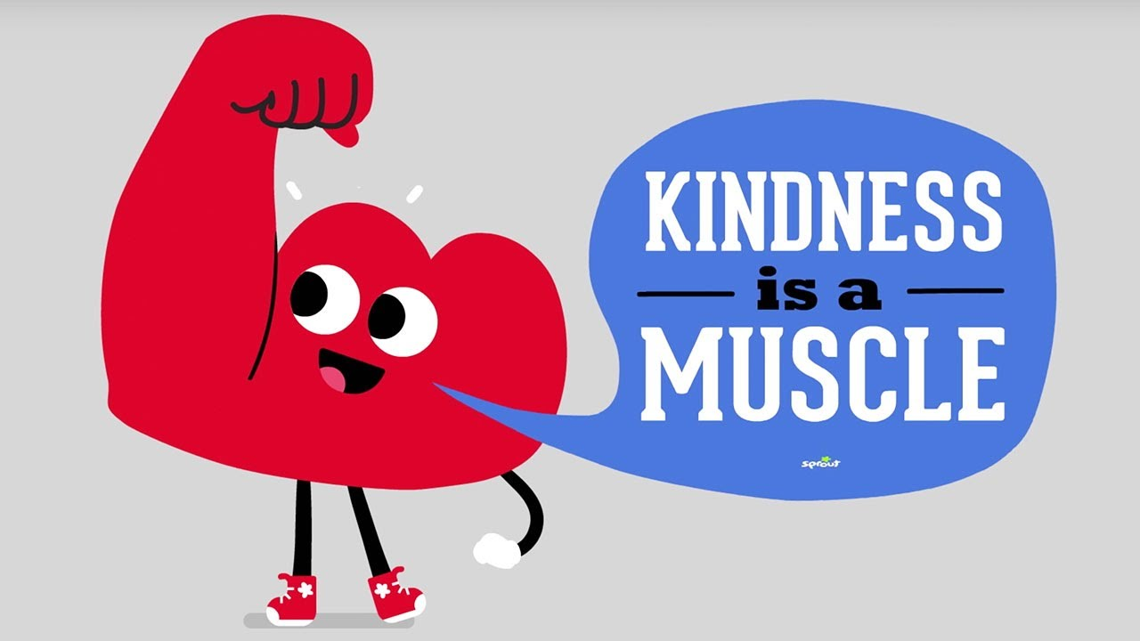
How can you be a good friend?
Listen
Be kind
Share
Help

Slide 3
Can you name some things that make us different to each other?
Height
Eyes
Physical abilities
Hair

Slide 4
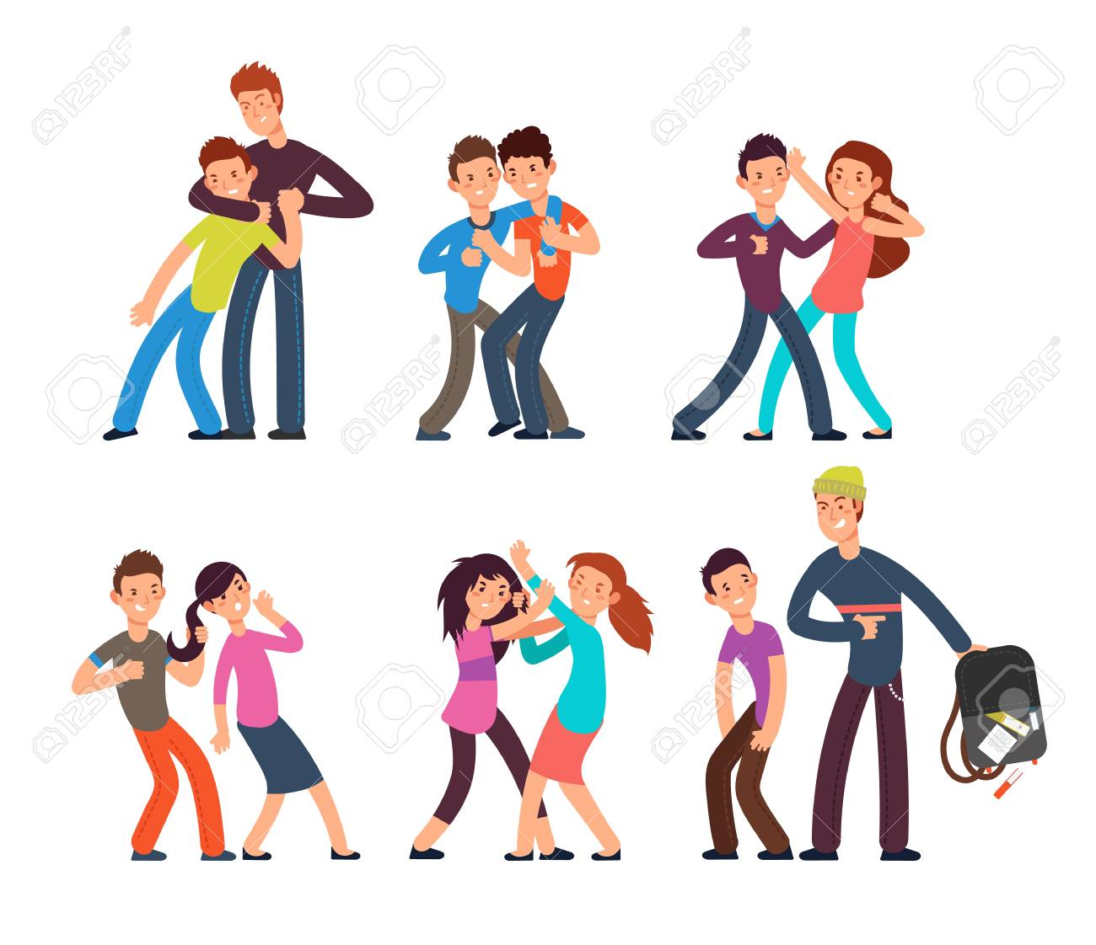
What is bullying?
https://www.youtube.com/watch?v=BjN9rqdNNVA
Say mean things
Hurting others
Talking about others
Excluding others
Ignoring
Making fun of others
https://www.youtube.com/watch?v=EvhIdB_8WXE

Slide 5
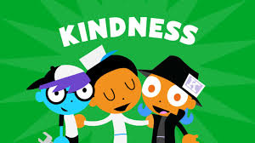
How can we stop bullying?
Talk to an adult
Be a good friend
Don’t follow the crowd
Speak up and say no

