Slide 1
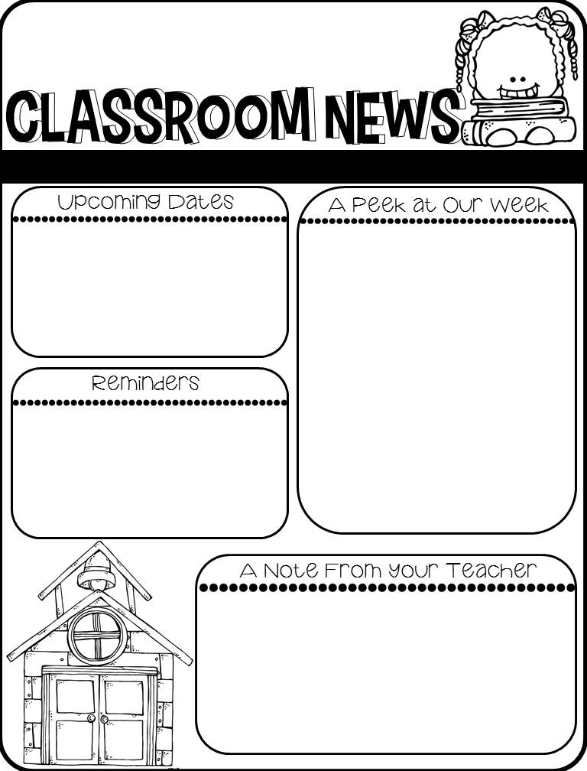
September 18th – E Learning more information to follow
IMPORTANT ANNOUNCMENT
Breakfast & Lunch is now provided free to all students until December. Please fill out the lunch form even if you don’t normally qualify.
This week will be spent becoming familiar with routines and expectations. Much of what we do is different this year due to COVID-19. We want the children to remain healthy and to feel safe here at school. Please keep your child at home if they are not feeling well. Make sure that they are practicing good hygiene and wearing their mask.
Don’t forget to send snack or snack money each day.
Don’t forget to attach the green transportation tag to your child or their bag for the first week of school.
Each week, I will send home a newsletter. This newsletter will also be available to view on my website. It will provide an overview of your child’s week and any important announcements. Please read it carefully so you don’t miss anything.

