Slide 1
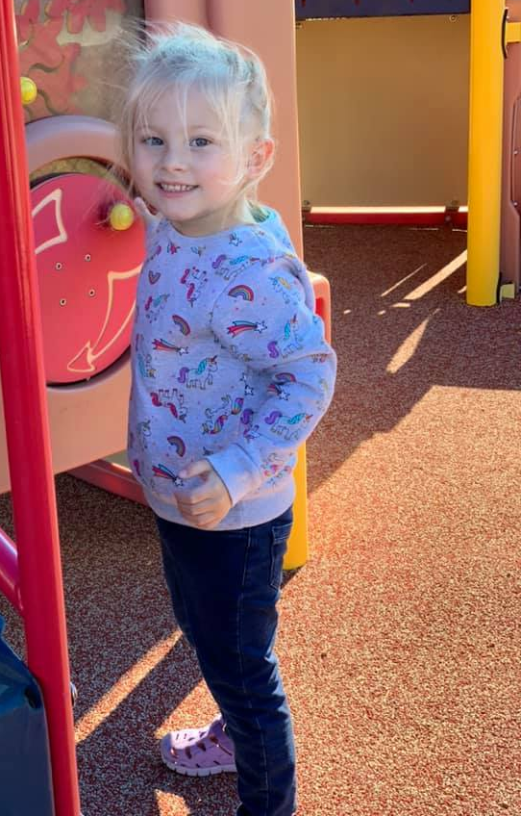
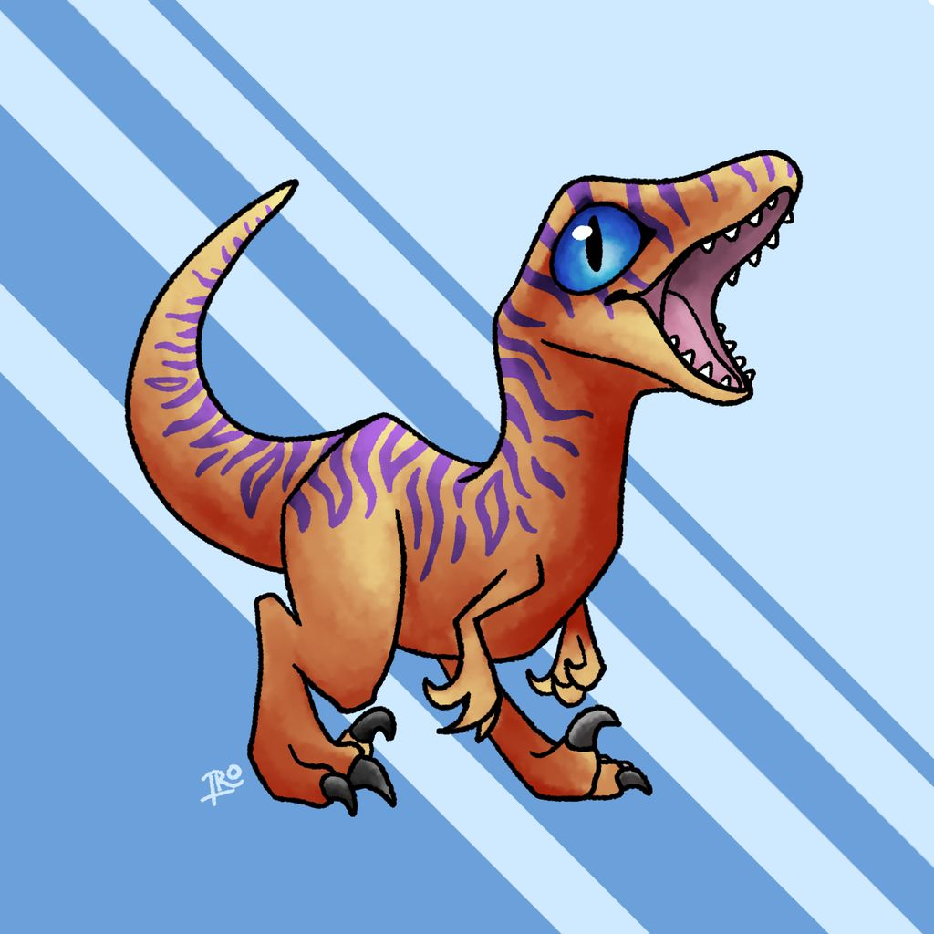
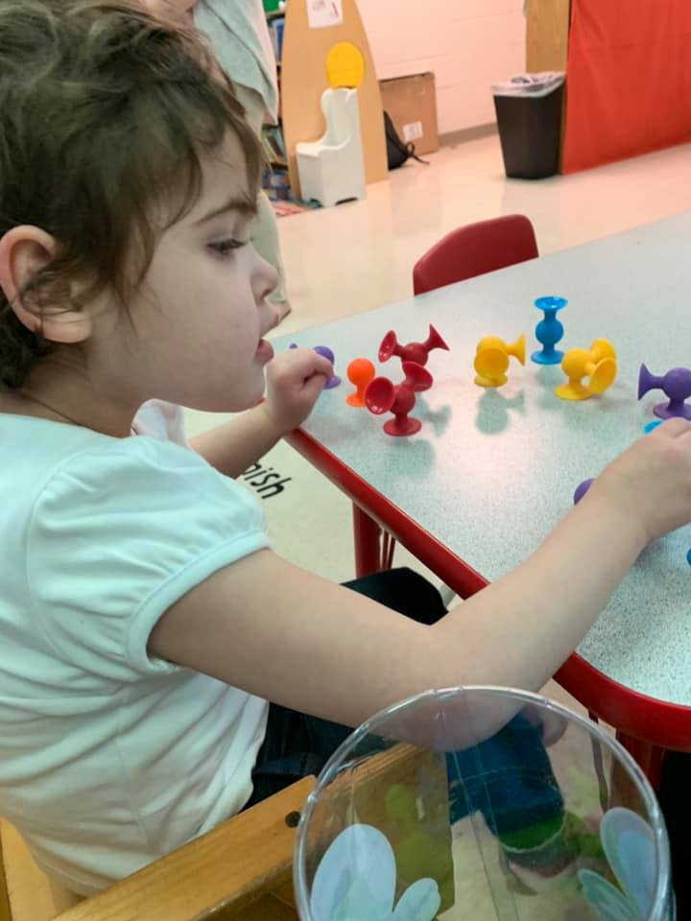
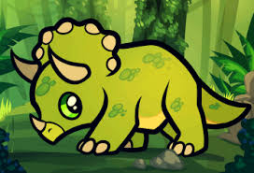
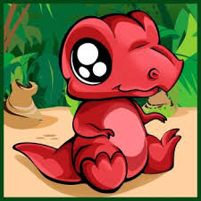
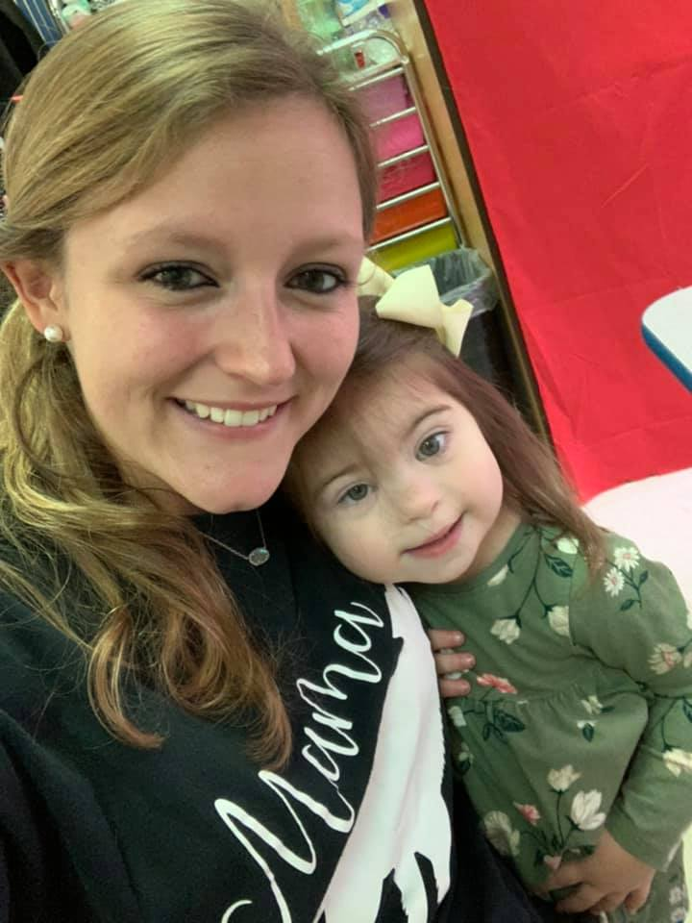
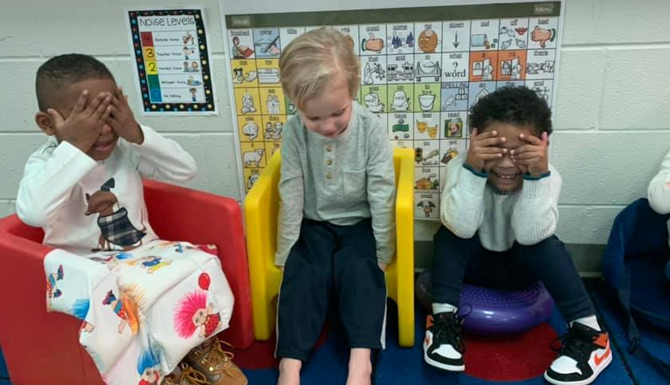
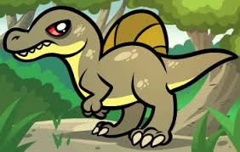
Week 2
Distance Learning AM Class
April 1st-7th

Slide 2
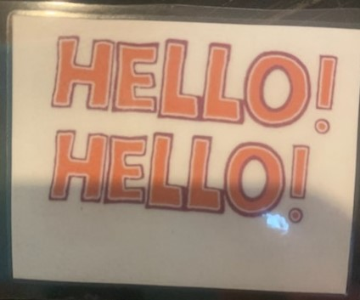
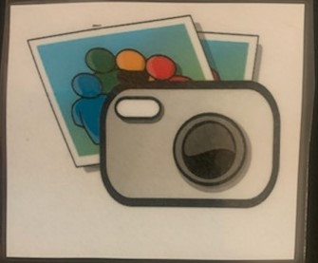
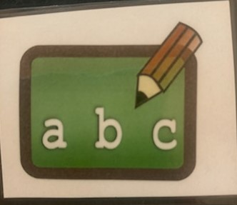
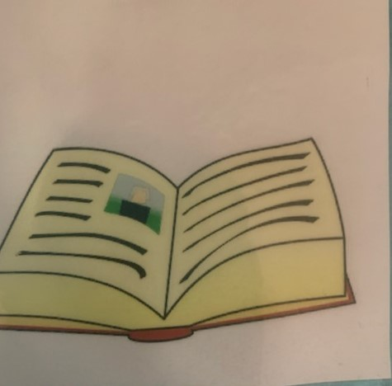
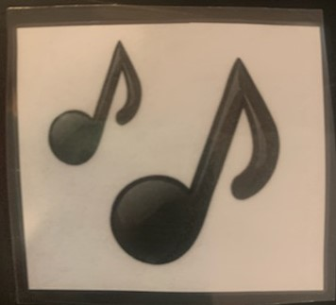
Circle Time!
Hello! Hello! Song
___ is here today
ABC’s
Monthly Song
Book

Slide 3
Questions of the week
Ask one question a day. Let your child answer either verbally or by touching their response. Try talking about it.
Here is the link to the questions. You can print them off or just use your electronic device to show them the pictures to choose from.

Slide 4
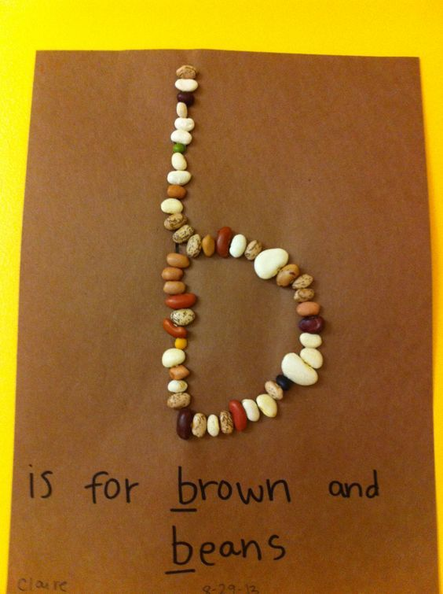
Letter Bb
Letter Bb Song
Try to make the Letter Bb out of Beans!
Blow Bubbles!
Draw with a Blue crayon/marker!
Pick one, two, or all worksheets to do together!
Worksheets

Slide 5
Number 2
Sort out items (Ex. Cheerios and Fruit loops, colors, Cups and bowls, the color of veggies straws, etc)
Count out objects while using your pointer finger to touch the object (Ex. Count how many baby dolls, cars, etc.)
Worksheets (Pick one, two or all to do)

Slide 6
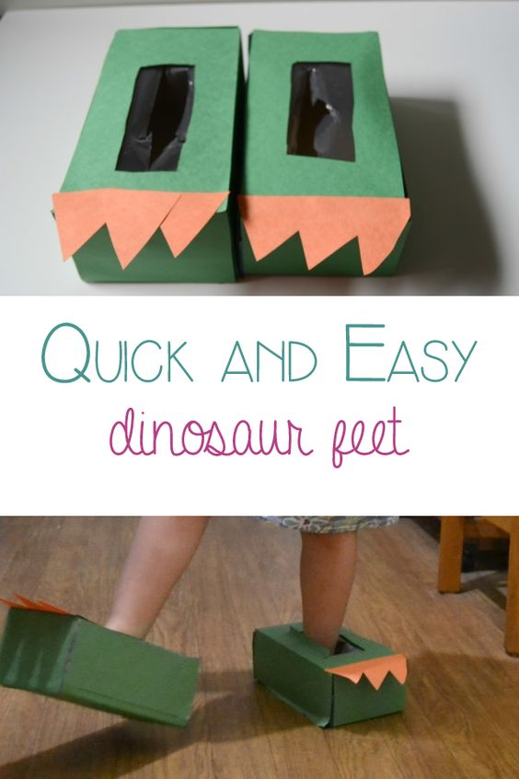
Storytime!
Twinkle Twinkle Dinosaur <- Click Link
Do one of these Dinosaur Themed activities:
Dinosaur Line Tracing
Dinosaur Feet
Coloring Page

Slide 7
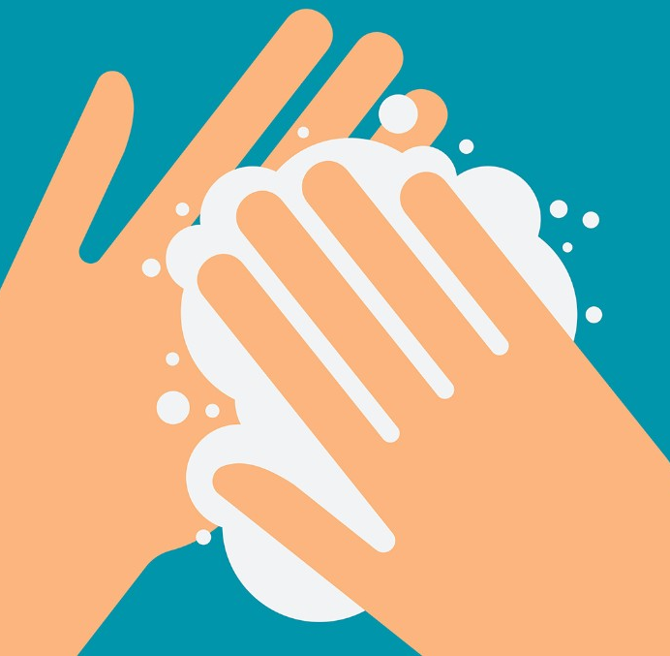
Social Skill: Washing your hands
Continue to work on hand washing and discussing the importance. Here is a sequencing sheet about handwashing. Print it off and help your child sort them in the correct order.
Handwashing
Go over this skill with your child. Practice washing your hands!
Wash your dolls hands, or dinosaurs. It is so important to know how to keep your hands clean to stay safe from germs.

Slide 8
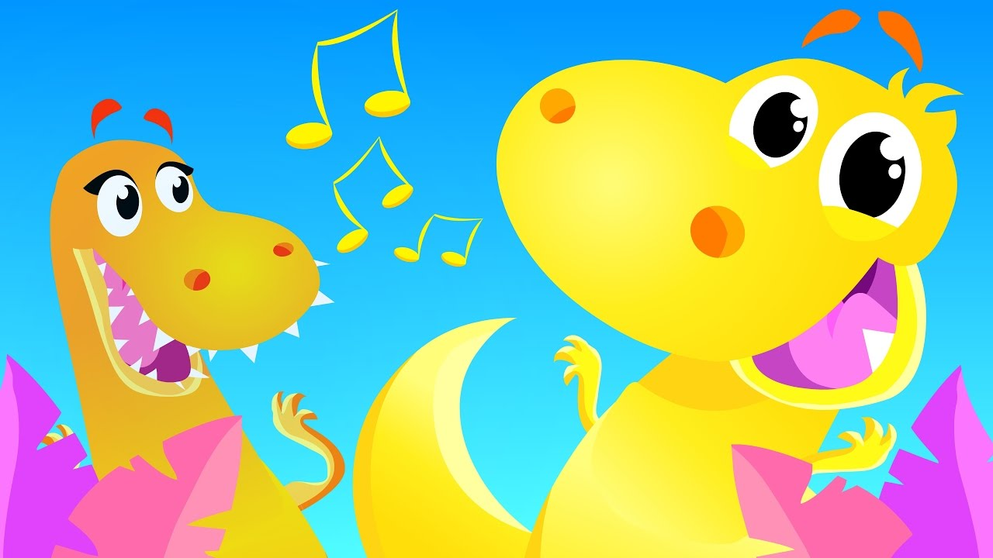
Movement Break!!!
Dinosaur Stomp
Count to 100!

Slide 9
Go outside this week and find these items. Send pictures! I would love to see your smiling faces.

