Slide 1
Colorado Measures of Academic Success (CMAS) High School Administration Training for DACs
Sara Loerzel
Fall 2014

Slide 2
Science and Social Studies Administration Overview
Timeline
Roles and Responsibilities
Scheduling and Testing Time Procedures
The Test Environment
Test Administration
Make-Up Testing
Accessibility Features and Accommodations
Security
Testing Irregularities
Data
Receiving and Retrieving Materials

Slide 3
What is a “Standardized” Assessment?
All students will have the same test content, resources, directions, testing conditions, and scoring procedures.
A score obtained by one student in one part of Colorado will mean the same as the same score obtained by another student in a different part of Colorado.

Slide 4
Definitions
PearsonAccess Test Session: Virtual data grouping of students who are grouped together within PearsonAccess for test management purposes
Test Section: The parts of a CMAS: Science and Social Studies assessment. Each content area of the CMAS: Science and Social Studies assessments includes three sealed test sections
Physical Testing Group: Students who test within a physical testing environment at the same time

Slide 5
CMAS Components
TestNav: Software that runs the assessment
Make sure your apps are up-to-date
TestNav 8 is new software that is supported by iPads and Chromebooks
PearsonAccess: Software that is used to manage student data
PearsonAccess.com: Web portal to PearsonAccess and other resources

Slide 6
Timeline

Slide 7
Spring 2014 CMAS Assessment Window
CMAS: Science and Social Studies
Assessment | Testing Dates
High School Social Studies | November 3– 21, 2014
High School Science

Slide 8
Fall 2014 Tentative Dates
 | Date | Description | Role
 | Early September – October 9 | Submit Student Data Uploads/update participation counts for initial orders | DAC/Student Enrollment
 | Mid September | Online test session set-up begins | DAC/SAC
 | October 20 | Materials scheduled to arrive in districts | DAC
 | October 27 | Proctor caching test content begins (prior to testing) | District Determined
 | October 21 – November 18 | Additional Orders – Secure Materials | DAC
 | October 21 – November 25 | Additional Orders – Non-Secure Materials | DAC
 | November 3 – November 21 | Student Testing | ALL
 | December 1 | Deadline to schedule UPS pickups | DAC
 | December 3 | Deadline for UPS pickups | DAC

Slide 9
Changes from Last Spring
High School Timing
Student Data Upload and Accommodated Special Forms Assignment
Mark Test Complete feature in PearsonAccess and invalidation
Spanish audio available as accommodation
If all students have completed the test section, the Test Administrator may end the test section.

Slide 10
Roles and Responsibilities

Slide 11
Key Personnel
District and School Leadership
District Assessment Coordinator (DAC)
Student Enrollment (Data)
District Technology Coordinator (DTC)
Accommodations Specialists
School Assessment Coordinator (SAC)
School Technology Coordinator (STC)
Test Administrators (CMAS)
Students!
Notes:
Only the DAC and Student Enrollment roles have access to PII.

Slide 12
Key DAC Responsibilities
Understand all procedures and coordinate with key personnel
Develop district specific procedures
Employ a security plan
Schedule assessments and make-ups with SACs
Include all schools (REACH OUT TO CHARTER SCHOOLS)
Train SACs in security, administration, and district procedures
Assign permissions in PearsonAccess
MONITOR TESTING
Receive, manage, and return materials
Manage required Forms
Manage tasks in PearsonAccess
Investigate, declare, and report misadministrations

Slide 13
PearsonAccess Tasks for the DAC
Before and During Testing
See PearsonAccess Training for specific instructions
Set up user accounts and assign permissions
Assign students to test sessions
Assign specific forms to students
Add/remove student registrations based on enrollment
Order additional materials
After Testing
Verify that all sessions are completed
Update data files to include accommodations that were used
*Individuals with the DAC user role will have access to Personally
Identifiable Information (PII)

Slide 14
Student Enrollment (Data)
District may assign student data management tasks to designated personnel. Alternatively, many DACs will also be the student enrollment person.
*Individuals with the Student Enrollment user role will have access
to Personally Identifiable Information (PII)

Slide 15
District Technology Coordinator (DTC)
All DTCs must have site readiness training
Participate in Pearson/CDE site visits
Participate in regional DTC meetings
PROCTOR CACHE!
Identify local device availability
Identify local bandwidth needs
Manage updates
Secure technology
Provide district technology support
Assist in developing school site schedules
Work with School Technology Coordinators (STC)

Slide 16
Accommodations Specialists
Special Education and Linguistic
Maintain IEP/504/English Learner Plans
Assist in planning for and training for accommodations

Slide 17
School Assessment Coordinator
Train all Test Administrators
Provide security training to all personnel that will be in the testing area
Collect and maintain security agreements
Work with other personnel to develop school site schedule and procedures (including accommodated sessions and make-ups)
Assemble and maintain a master list of all students and their accommodations
Maintain secure location for test materials and chain of custody
Ensure test environment compliance
MONITOR TESTING!
Transcribe student responses from large print and braille test books into scannable test books
Collect, sort, secure, and return all test materials to DAC by district determined date

Slide 18
PearsonAccess Tasks for the SAC
Set up user accounts
Assign students requiring special forms for the computer-based assessment to the appropriate form
Request and manage materials for paper based form
Request, from your DAC, additional secure and non-secure materials as needed
Assign all students to a test session
Register/add new students
Mark individual student tests complete if not in completed status
Verify that all testing sessions have been completed
Verify that PearsonAccess has been updated to reflect the accommodations used during testing, including students taking paper-based assessments

Slide 19
CMAS Test Administrator
Individual at school level responsible for directly administering the CMAS: Science and Social Studies assessments
Must be employed by the school/district
Be trained and have read the Test Administrator’s Manual prior to any assessment administration
Be trained in any specific accommodations they are providing
Must sign security agreement before assessment administration begins
Read the directions to students exactly as they appear in the Test Administrator’s Manual
Test session management
Administer sections actively

Slide 20
Students
Meet with students to review school testing policies and expectations
Test results should be reflective of individual effort
Practice Testing Environments (ePATs)
Expose students to sample items
Familiarize students with online test engine, TestNav 8, and embedded supports
Available on PearsonAccess.com

Slide 21
CMAS: High School Science and Social Studies Program Overview

Slide 22
Who should be Tested?
Students designated as 12th graders. Participating 12th graders typically will be students who are:
Designated as 12th grade for the first time
Part of School Year 2011-12 freshman cohort (2014-15 anticipated year of graduation)
Part of School Year 2012-13 freshman cohort or later classified as 12th grader due to credit accumulation
In their fourth year or less in high school
Notes:
1. How does not including a 5th year senior affect our participation rate?
All first year 12th graders should take the CMAS science and social studies assessments. Students can become 5th year high school students following a variety of paths. Students who are 5th year high school students and first year 12th graders should take the assessment. Students who are 5th year high school students and second year 12th graders are not expected to participate in the science and social studies assessments.
2. Are you excluding 5th and 6th year seniors from participation on the SPF?
First year 12th graders, whether they are 4th or 5th year high school students, are expected to take the assessments and are expected to be included in participation calculations for accountability purposes.
3. If a student is retained and a junior, are they are still expected to take the assessment? (retaining was due to lack of progress or credits)
Students should take the science and social studies assessments if they are designated as 12th graders for the first time. If students are held back in 11th grade and will not graduate in the spring of that school year, the students should be tested in the fall of the next school-year when they are considered 12th graders. As an enrolled 11th grader, the above described student would be expected to take the Colorado ACT in the spring.
4. Would a student classified as a junior but graduating in spring of 2015 take the test?
For 2014-2015, only first year 12th graders should be taking the assessments. As an enrolled 11th grader, the above described student would be expected to take the Colorado ACT in the spring. September 2, 2014
5. Should 5th year seniors take the CoALT?
Students who are in 12th grade for the first time should take the high school CoAlt: Science and Social Studies assessments.

Slide 23
Test Structure
Each content area consists of 3 sections
Each section includes 24 items
Option 1: Administer 3 sections to students in one day
Option 2: Administer 1 section per day
The assessments include the following item types:
Selected Response
Constructed Response
Computer-Enabled/Technology-Enhanced
Simulations (science)
Performance Events (social studies)
Notes:
Option 1: this can be all in one sitting or with extended breaks between sections.

Slide 24
Scheduling and Testing Time Procedures

Slide 25
CMAS: High School Test Structure and Timing
CMAS: Science and Social Studies Section Administration Time for Elementary and Middle School
Time for Set Up and Transition (Estimated) | Required Testing Time for All Students | Additional Testing Time
(10 minutes) | 55 minutes | 15 minutes
New
If all students have completed the test section, the Test Administrator may end that particular test section.

Slide 26
Students must have 70 minutes to test
Required to be on task for 55 minutes*
Students are entitled to a full 70 minutes without interruption to complete section*
Start the clock when directions are complete
Treat technology interruptions as any other “interruption to testing”
Note the time of the technology interruption
Student must be given remaining time to complete section
*If all students have completed the test section, the Test Administrator may end that particular test section.
New

Slide 27
After 55 Minutes
District Decisions:
Sit Quietly
Read (cannot use any electronic reading devices)
Must not do any writing or any other activity
May be released to location outside testing area
What to do when all students are completed with section
School Site Considerations:
To where will students be released?
To whom will students be released?

Slide 28
Section Timing: District and School Level Decisions
Select Timing Option (1, 2, 3, or 4)
If Option 1 or 2 is selected, indicate where students should go when finished

Slide 29
Timing Options
Option 1 – Students may read for the remainder of the 55 minutes and then leave the room. | SAY You will have 70 minutes to complete Section 1 of the test, but you must remain in your seat for at least 55 minutes. If you have completed Section 1 before 55 minutes are up, you may sit quietly or read, but you must not do any writing. If after 55 minutes you have completed the test, I will excuse you to ___________________________.
Option 2 – Students are to sit quietly for the remainder of the 55 minutes and then leave the room. | SAY You will have 70 minutes to complete Section 1 of the test, but you must remain in your seat for at least 55 minutes. If you have completed Section 1 before 55 minutes are up, you must sit quietly for the remainder of the time. If after 55 minutes you have completed the test, I will excuse you to ________________________.
Option 3 – Students may read for the remainder of the 70 minutes. | SAY You will have 70 minutes to complete Section 1 of the test. If you have completed Section 1 before time is up, you may sit quietly or read, but you must not do any writing.
Option 4 – Students are to sit quietly for the remainder of the 70 minutes. | SAY You will have 70 minutes to complete Section 1. If you have completed the test before time is up, you must sit quietly for the remainder of the time.

Slide 30
Timing Options
Option 1 – Students may read for the remainder of the 55 minutes and then leave the room. | SAY You will have 70 minutes to complete Section 1 of the test, but you must remain in your seat for at least 55 minutes. If you have completed section 1 before 55 minutes are up, you may sit quietly or read, but you must not do any writing. If after 55 minutes you have completed the test, I will excuse you to ___________________________.
Option 2 – Students are to sit quietly for the remainder of the 55 minutes and then leave the room. | SAY You will have 70 minutes to complete Section 1 of the test, but you must remain in your seat for at least 55 minutes. If you have completed Section 1 before 55 minutes are up, you must sit quietly for the remainder of the time. If after 55 minutes you have completed the test, I will excuse you to ________________________.
Option 3 – Students may read for the remainder of the 70 minutes. | SAY You will have 70 minutes to complete Section 1 of the test. If you have completed Section 1 before time is up, you may sit quietly or read, but you must not do any writing.
Option 4 – Students are to sit quietly for the remainder of the 70 minutes. | SAY You will have 70 minutes to complete Section 1. If you have completed the test before time is up, you must sit quietly for the remainder of the time.
If all students have completed a test section, the Test Administrator may end the test section.

Slide 31
CMAS Scheduling Considerations
Each content area consists of 3 sections
Test sections can only be administered to students in consecutive order
To the extent possible, all students within should be assessed at the same time. If not possible, all students should be assessed within the shortest timeframe practicable.
Scheduling may be site dependent

Slide 32
CMAS Scheduling Considerations
Schedule first group/first day with more of a time cushion than other groups if you can
If you have to do multiple sessions, schedule smallest group first
Determine whether one content area will be completed before beginning the next, or if testing will alternate between the two content areas (make-ups excluded)
Determine whether the district wants to condense testing (make-ups excluded) or spread throughout the testing window
Determine whether students will take an entire session in one day or take one section per day (make-ups excluded)
Remember: This is Colorado

Slide 33
CMAS Scheduling Considerations: Accommodated Sessions
All students now have extended time included in their test sessions
Students using Text-to-Speech (TTS, replaces English Oral Scripts) may be in the same session with other students if they use headphones if headphone noise does not impact other students
Students who need double time (110 minutes) must be scheduled in a separate session
“Teacher Read Directions” Accommodation is not available in CMAS: Science and Social Studies
CDE recommends administering Oral Scripts for social studies individually

Slide 34
The Test Environment

Slide 35
Student-to-Test Administrator Ratio
Student-to-Test Administrator ratio must not exceed 30 to 1
Test Administrator must be able to actively monitor the space within the testing environment
Consider room configuration
Make special considerations for large testing environments or environments with complicated configurations
Test Administrators must:
Actively proctor
Remain attentive and in the room during the entire testing section
Circulate throughout the room during the test
Should be able to see students working, not student work

Slide 36
The Test Environment
The testing environment must:
Be adequately lit, quiet, free of distractions, and heated or cooled
Provide an adequate writing surface (paper-based)
Be free of electronic devices and music
“Do Not Disturb/Only Authorized Personnel Allowed” sign must be placed on the door during test sessions

Slide 37
The Test Environment
No food or drinks are allowed on desks or near test materials
The testing environment must be free of any content related posters or aids that suggest possible answers to students
Word walls
Steps for solving math equations
Any content related materials

Slide 38
The Test Environment
Generally, posters that do not include content specific definitions, content related processes or solutions may remain on the wall

Slide 39
Room Configuration
Students should not be able to see each other’s work from a normal testing position
Consider the following seating configurations to maintain test security:
Seat students in every other seat (useful in a computer lab setup)
Arrange monitors back-to-back
Seat students back-to-back
Seat students in a semicircle (useful for schools using laptops)
Seat students in widely spaced rows or in every other row (appropriate for a classroom setup)
Dividing screens or other privacy materials may be used if students cannot be placed far enough away from each other

Slide 40
Unauthorized Visitors and the Media
Only students, Test Administrators/Examiners, and authorized school, district, state personnel, or state-sanctioned test monitors may be in testing areas during administration
Media are not allowed to have access to the tests before, during, or after test administration, or take pictures or video of testing materials or testing students

Slide 41
Test Administration

Slide 42
Test Administration Materials
Test Administrator’s Manual (TAM)
Fill in and select options for after the test session
Read script exactly as written
Practice in advance!
Student Authorization Tickets
Hand out and collect in the test environment
Have a master list on hand
Authorization Tickets are secure!
Seal Code
Write on board or poster
Take down after testing starts
Section Exit Instructions Poster

Slide 43
Active Administration
Active Administrators:
Administrators May Not:
Ensure students have all necessary materials for each section
Ensure a standardized testing environment
Follow all scripts exactly as written
Move throughout the room during testing
Read directions to students when asked
Use proximity to keep students on task
Use “continue working” script
Provide feedback
Clarify test questions
Answer content related questions
Interfere with the students’ demonstration of skills
Interact with students in any way that would impact student responses
Engage in other tasks during test sessions
Read sources, items, or student responses

Slide 44
Administration Steps
Prepare the test environment and situate students
Start session in PearsonAccess
Follow directions and read script in the Test Administrator’s Manual
Hand out Student Authorization Tickets and scratch paper
Assist students in logging on to TestNav 8
Complete directions to students and start session
Actively administer each test section
Collect Student Authorization Tickets and scratch paper
End test section
Close session in PearsonAccess after third section only
At this point, the status of all tests for all students in the session must be “Completed” or “Marked Complete”*
*SACs must mark a student’s test complete

Slide 45
During Testing

Slide 46
Technology Tip
If students are testing on iPads or Chromebooks, note the specific device on which each student is testing. Each student should use the same device for all three sections to aid in response data recovery if needed.
Additional “during testing” technology tips will be provided at the end of today’s session.

Slide 47
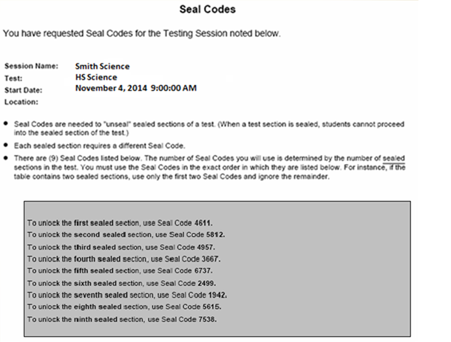
Seal Codes
Only three seal codes will be used in each section
Cross off the last six seal codes to avoid confusion

Slide 48
Time for Set up and Transition
School site log in
Start up TestNav 8
Log in
Test transfer (from proctor cache)
First item may take time to load
Give directions
Review sample items

Slide 49
Signing in to TestNav

Slide 50
If a Student is Using Text-to-Speech …
Remember to test the audio before signing in
After student signs in, audio cannot be adjusted

Slide 51
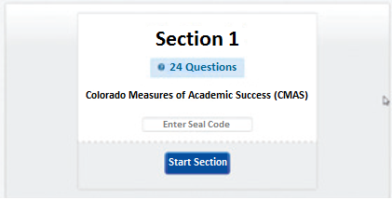
Test Administrator: Direct Students through Section Entry
<SAY> The Assessment is divided into three sections. You are only to work on
Section 1. You should see a screen that says Section 1. If you do not, raise
your hand.
Display only the first seal code on the blackboard, whiteboard, chalkboard, or other surface. Point to the seal code.
<SAY> Enter the four-digit seal code in the “Enter Seal Code” field. Select the blue
“Start Section button and wait for further directions.

Slide 52
Section Timing: District and School Level Decisions
Determine whether students will test sections consecutively or if they will break between test sections

Slide 53
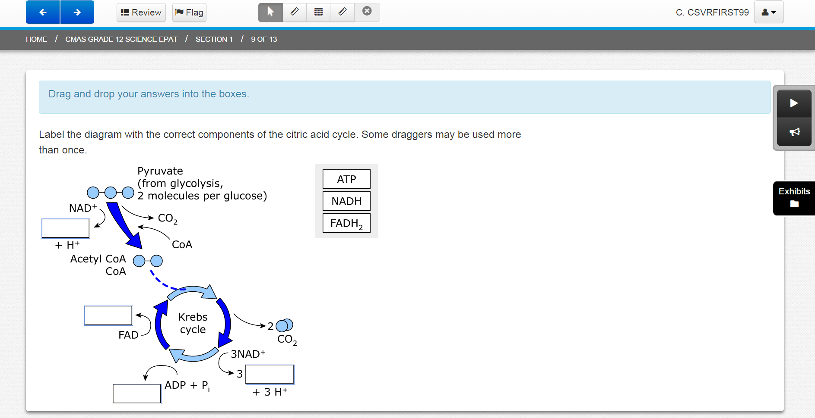
Test Administrators may assist individual students by re-reading scripted directions from the manual or by reading the direction text that appears in the blue banner on a student’s screen.
<SAY> I cannot help you answer any test questions. I will only be able to help you with questions about the directions highlighted in blue banners. You may or may not know the answers to all of the questions. Answer the best you can.
Redirection script: [Student name], please continue working.

Slide 54
If Students Test Consecutively …
Access the Review Screen.
Scroll down to the last item and select the View button.
Select the forward arrow button on the upper left corner of your screen.
Select the green Continue button next to “Go to the next section.”
A Section Exit Warning screen will pop up. Select “Yes” to confirm that you want to leave this section.

Slide 55
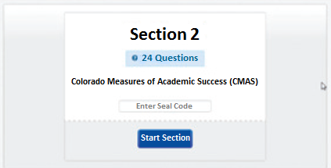
If Students Test Consecutively …

Slide 56
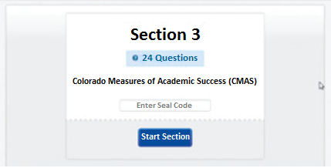
If Students Test Consecutively …

Slide 57
Submit Final Answers After Section 3

Slide 58
Make-Up Testing

Slide 59
Make-Up Testing
Priority: minimize risk of prior exposure to test content that could result in an invalidation

Slide 60
Make-Up Testing Options and Considerations
 | PearsonAccess Demand on Test Administrators | Security Risk | Logistical Demand
Option 1 **Recommended** | Moderate | Low | Moderate
Student Completes Missed Test Section in Advance of Re-Joining Original Physical Testing Group
Option 2 | Low | High | Low
Student Tests with Original Physical Testing Group
Option 3 | High | Moderate | High
Student Completes Missed Test Section in Any Available Physical Testing Group in Advance of Re-Joining Original Physical Testing Group

Slide 61
Accessibility Features and Accommodations

Slide 62
Accessibility
TestNav 8
Embedded features: available to all students to increase accessibility
Embedded accessibility features that must be requested ahead of time: available to all students to increase accessibility
Additional embedded and non-embedded accommodations available to students consistent with their IEP, 504, or English Learner plans

Slide 63
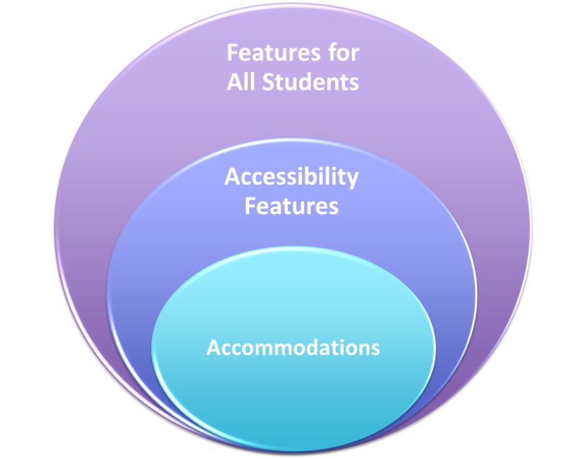

Slide 64
Accessibility Features Available to All Students
Feature
Scientific calculator
Answer eliminator
Extended time
Flag items for review
General administration considerations
General administration directions repeated
Highlighter
Line reader guide (Ruler)
Magnification/ enlargement
Navigation tools
Pointer
Redirect student to the test
Ruler (can also be used as a line guide)
Writing tools
Periodic Table
Notepad
New

Slide 65
Periodic Table

Slide 66
Periodic Table

Slide 67
Embedded Features that Must Be Requested
Selected by form
Text-to-speech
Continue to play
Click to hear *CDE recommends students are taught to default to this
Spanish audio (accommodation)
Color contrast (accommodation)
Text-to-speech with color contrast (accommodation)
Spanish audio with color contrast (accommodation)
Oral script (accommodation)

Slide 68
Accessibility Features Available to All Students Who Use Similar Accessibility Strategies During Instruction
Feature | Description | Icon
Text-to-Speech | Select “Play” OR 2) Select “Click to Hear” button

Slide 69
Important Text-to-Speech Considerations
Assigning students to Text-to-Speech
Form assignment driven by SDU
PearsonAccess User Interface
Difference between Text-to-Speech and Oral Script
Students using Text-to-Speech in a group testing environment must use headphones
While the Text-to-Speech accessibility feature is available to all students, it may not be appropriate for all students. Student should be using similar access strategies during instruction.

Slide 70
Should every student be given Text-to-Speech (TTS)?
No. Only students who really need this accessibility feature should have it
Security issues: There is only one form for text-to-speech
Training issues: students must know how to use it before testing
Network performance issues: file sizes for items with TTS are 4-10 times larger than regular item files. Network and computer performance estimates are based on the standard file size

Slide 71
Accommodations
Must be based on an individual need documented in the student’s approved IEP, 504, or English Learner plan
A master list of all students and their accommodations must be maintained by the SAC and/or the DAC. These will need to be recorded in PearsonAccess. Please include students using text-to-speech.
Accommodations are available for computer-based and paper-based administration.
Paper-based form is itself intended to be an accommodated form

Slide 72
Accommodations for Computer-Based Administration
Presentation
English oral script used for:
On-site translations into languages other than Spanish*
On-site sign language presentation*
Spanish audio
Spanish oral script*
Color contrast, including high contrast and reverse contrast
External cover overlays
Word-to-word dictionaries (English/native language)
Assistive technology devices – compatibility will need to be established
*Due to the number, length and complexity of sources in the Social Studies assessment, it is recommended that this accommodation be provided individually when practicable.
New

Slide 73
Spanish Audio
Students select to play button to hear the text in Spanish
Students can control volume

Slide 74
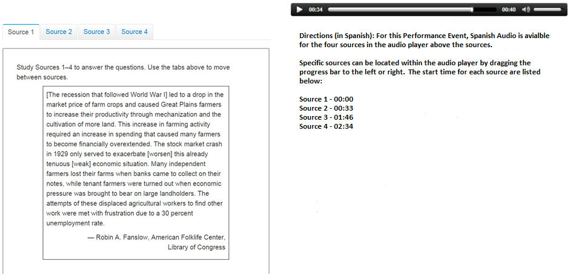
Spanish Audio in Performance Events - Directions

Slide 75
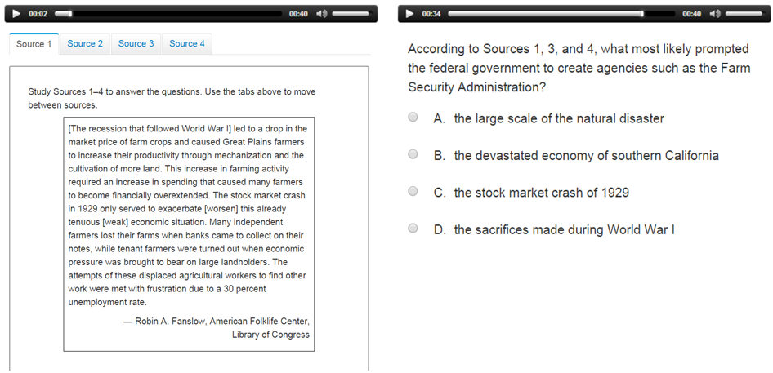
Spanish Audio in Performance Events – Interacting with Items

Slide 76
Accommodations for Computer-Based Administration
Response
Written responses in Spanish
Scribe (must be individually administered)
English
Other languages
Assistive technology devices – compatibility will need to be established

Slide 77
Assistive Technology
Devices with demonstrated TestNav 8 compatibility:
www.pearsononlinetesting.com/at

Slide 78
Accommodations for Computer-based Administration
Setting
Small group
Individual
Timing
Extended time greater than time and a half
Time of day
Multiple breaks (requires separate setting)

Slide 79
Accommodations for Paper-based Administration
The paper-based form is an accommodation.
Use only a #2 pencil!
Paper-based form is available for a student who:
Has a neurological disorder, a condition that causes seizures, or another health condition that prevents the student from accessing the computer*
Needs a braille form with tactile graphics
Requires assistive technology not compatible with TestNav 8
Writes responses in a language other than English or Spanish
*Students with disabilities that prevent them from utilizing devices safely may meet this criterion.

Slide 80
Accommodations for Paper-based Administration
Presentation
Braille with tactile graphics
Large print (Reminder: computer-based has zoom and magnifier)
External cover overlays
English oral script (text-to-speech in computer-based)*
On-site translations into languages other than Spanish
On-site sign language presentation
Spanish oral script (also computer-based)*
Word-to-word dictionary (English/native language)
*Due to the number, length and complexity of sources in the Social Studies assessment, it is recommended that this accommodation be provided individually when practicable.

Slide 81
Accommodations for Paper-based Administration
Response
Braille note-taker
Scribe (also for computer-based)
Must be administered individually
Speech-to-text
Assistive technology devices (word prediction)
Setting (same as computer-based)
Small group
Individual
Timing (same as computer-based)
Extended time greater than time and a half
Time of day
Multiple breaks (requires separate setting)

Slide 82
CDE Accommodations Contacts
Mira Monroe – IEP and 504 Accommodations
monroe_m@cde.state.co.us
Heather Villalobos Pavia – Linguistic Accommodations
villalobos-pavia_h@cde.state.co.us

Slide 83
Security

Slide 84
Test Security Protocols
Protection of student information and data
Protecting the validity of the state assessments
Financial considerations

Slide 85
Security Plan
Successful Security Plan requirements:
All personnel have appropriate training
All involved personnel understand security protocols
All involved personnel have signed security agreements
Think broadly about who is in the testing environment!
Test environments are secured against unauthorized personnel
Establish a documented chain of custody
Materials are kept in a central, secure location

Slide 86
Test Materials Security
Secure
Non-Secure
Student Authorization Tickets
Seal codes
Paper test books
Social Studies source books
Oral scripts
Test Administrator Manual (TAM)
Procedures Manual

Slide 87
Maintaining Security of CMAS
All secure test materials must be secured while in the Test Administrator’s possession
No duplication of secure CMAS materials is permissible (exception: Oral Scripts translated into languages other than Spanish)
No cell phones or other communication, reproduction or recording devices are allowed during test sessions
Manage devices!

Slide 88
Chain of Custody
Document before, during, and after testing
Deliver materials to schools no more than 1 week in advance
Complete school security checklist
Deliver paper based forms and materials (oral scripts) on the day of testing
Distribute only the content area being assessed
Return materials to a designated secure location
Not stored in classrooms
Return materials to Pearson
Notes:
A documented chain of custody is a record of where materials are before, during and after testing, by using the school security checklist form. Materials should not be delivered to schools more than one week in advance of testing. Test books must be distributed right before administration, and only the content area being assessed may be distributed. For instance, if my school is currently testing science, then only the science test is to be distributed. The tests are distributed the day of testing, not before.
In depth materials packing and shipping information is covered in the logistics training.
The chain of custody is essential, and in the big picture means that you have documentation of where any of the CMAS materials are at any given time. This applies from the time materials arrive in the district, throughout administration, during packing and shipping, and even after materials leave the district. Keeping an accurate record of materials shipped can help you solve any problems if they were to arrive.
Materials must be returned to a designated secure location each day. Materials must not be stored in classrooms in advance of or following days of administration.
Secure materials are all the test books, including large-print and Braille test books. The oral scripts and teacher read directions are also secure and must be returned to Pearson with not to be scored materials.

Slide 89
Testing Irregularities

Slide 90
Testing Irregularities
Misadministrations
Security Breaches
Emergencies/Unforeseen Circumstances
Technology Issues

Slide 91
Misadministrations
A misadministration is any event that leads to the invalidation of one or more student test scores in one or more test sessions.
DACs investigate, identify, and declare misadministrations.

Slide 92
Misadministrations
A student moves on to the next test section
Note: this will be extremely rare. Train Test Administrators to erase/remove Seal Codes once a test is underway
A student receives help from anyone on a test item
A student uses an unauthorized instrument, such as a calculator, cell phone or notes, during a test session
A student is denied appropriate accommodations or given the wrong accommodations

Slide 93
When a Misadministration Occurs
The student must stop working on that content area, but must still complete the other content area assessment as normal
The Test Administrator must inform and consult with the SAC, who must inform and consult with the DAC
Use discretionary judgment
The appropriate invalidation code must be entered into the student’s record in PearsonAccess
The student receives a “no score” for the content area

Slide 94
Major Misadministrations
Misadministrations affecting an entire class or group of students
Systematic unethical behavior
A teacher, administrator or other person gives students hints, prompts or answers to questions
A teacher, administrator or other person violates security procedures
A Test Incident Report must be submitted to CDE

Slide 95
Breach of Secure Test Materials
Students obtain or share secure test materials
Discussing, reproducing, or transmitting, by any means, secure test materials, or descriptions of secure test materials
A Test Incident Report must be submitted to CDE

Slide 96
Student Illness that Interrupts Testing
Be mindful of student illness prior to testing. If a student is likely to become sick, schedule them for a make-up
The student’s needs are the primary consideration
The student may make up the test
The student may only have the amount of time that was left when the test was suspended

Slide 97
Emergencies
If there is an emergency requiring the test to be stopped:
Evaluate and respond to the emergency… safety first!
If it is possible to do so without any risk to students, note the time remaining in the test section.
Students will be allowed to use the remainder of the testing time to complete the section at a later date.
Ensure that personnel who “clear” the testing space are authorized personnel.

Slide 98
District Policies for Testing Irregularities
Misadministrations and test security breaches are declared to preserve the validity of test scores and assessment data
Districts should establish policies and procedures for investigating and declaring misadministrations and test security breaches
A record of testing irregularities must be kept by the DAC
Reports or suspicions of major misadministration and security breaches must be reported to CDE as soon as practicable
Invalidations should not be used as a disciplinary measure
Districts should establish policies and procedures for how and when to apply disciplinary actions to students or staff arising from testing irregularities
CDE reserves the option to investigate and declare misadministrations and apply its own disciplinary sanctions

Slide 99
Testing Irregularities: Assistance and Reporting
If there has been a major misadministration or security breach, the DAC must notify Sara Loerzel, in the Assessment Unit.
For assistance in determining whether or not a misadministration has occurred, please contact the Assessment Unit.
For major misadministrations and security breaches, submit a Test Incident Report to CDE.

Slide 100
Data

Slide 101
Uploading High School Demographic Data to PearsonAccess
CMAS:
Notify Jessica Allen at allen_j@cde.state.co.us by September 22 to use ACT demographic data from Spring 2014
OR
Upload high school (12th grade) demographic data to PearsonAccess by October 9th for initial orders
CoAlt:
Upload high school (12th grade) demographic data to PearsonAccess by October 9th for initial orders

Slide 102
Student Data Upload (SDU) Layout
SDU will drive accommodated and special form assignment (e.g., Text-to-speech, Spanish audio, color contrast)
High school layout will be available in early-to-mid September
New

Slide 103
Receiving and Returning Test Materials

Slide 104
Test Materials
Online and Paper
Test Administrator’s Manual
CMAS Secure Return Envelope
School Security Checklist
Online Only
Student Authorization Tickets
Seal Code Document
English and Spanish Oral Scripts for Online Form
Onsite Translations into Languages other than English/Spanish
Paper Only
Test Books, including Braille and Large Print
Source Book (Social Studies Only)
Periodic Table (Science Only)
English and Spanish Oral Scripts for Paper Form
Onsite Translations into Languages other than English/Spanish

Slide 105
Receiving Test Materials
Materials will be shipped to districts
Purple Pearson labels on all boxes
Box with ONLY a purple label contains the District Coordinator Kit
District Coordinator Kit contains forms for DAC to check in materials
Pallet Detail
District Packing List
District Receipt Form
Green labels on CMAS boxes
Pink labels on CoAlt boxes

Slide 106
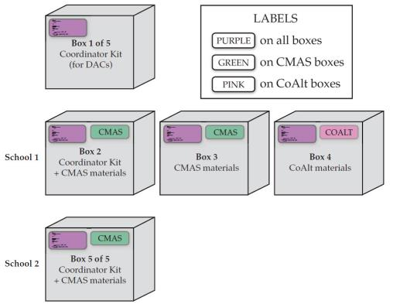
Receiving Test Materials
DACs to use Pallet
Detail to identify which
boxes go to each school
SAC to verify materials
received with the School
Packing List
Notes:
Coordinator Kits in school boxes are School Coordinator Kits.

Slide 107
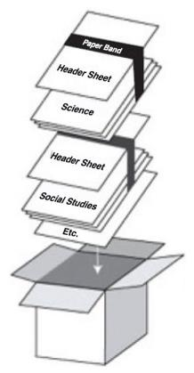
Returning Test Materials-SACs
SACs
Collect all secure materials and group as follows:
Scorable test books
Test books must be grouped by content area. Top the grouped test books with a completed header sheet and secure with a paper band.
Unused test books
Secure return envelopes
Accommodated materials
Electronic materials must be removed from any devices after testing and verification sent to the DAC
Prepare materials for packaging
Check and deliver CMAS scorable test books to the DAC ASAP
Check and deliver CMAS nonscorable materials to the DAC
Return materials in original boxes
Notes:
Secure return envelopes should contain CMAS Student Authorization Tickets and seal code documents.

Slide 108
Returning Test Materials-DACs
DACs
Use District Receipt Form to verify that all materials are signed in from SACs*
Sort materials (scorable and nonscorable) for return to Pearson
Scorable materials must have a header sheet for each content area
Prepare boxes for shipping
Schedule pickup with UPS by December 1, 2014
Deadline for UPS pickup of materials is December 3, 2014
*Collect and return scorable materials to Pearson as soon as possible

Slide 109
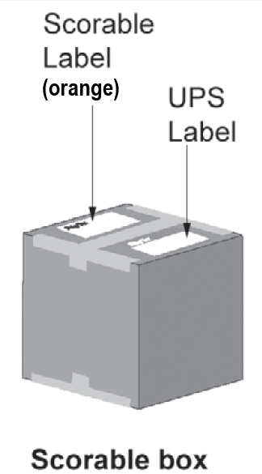
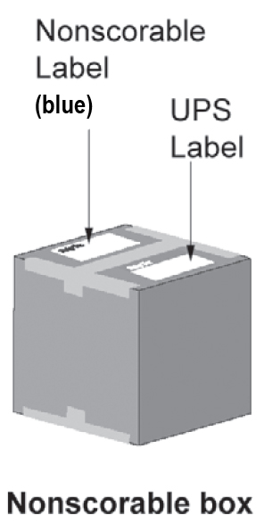
Returning Test Materials-DACs
Collect all secure materials from SAC
Collect all scorable materials from SACs immediately after testing ends. If a school finishes testing before the testing window closes, the DAC may ship the scorable materials back to Pearson at that time.
Use District Receipt Form to verify that all materials are signed in from SACs
Each box needs two labels

Slide 110
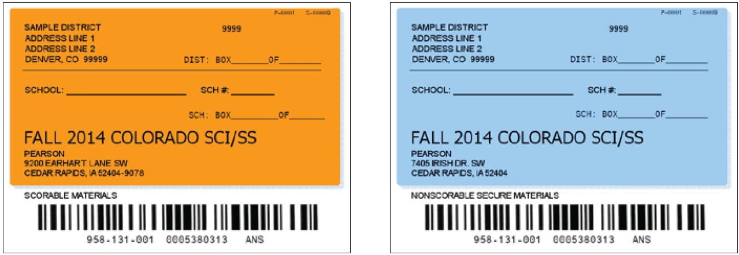
Returning Test Materials-DACs
Return Labels
Identify boxes containing CMAS scorable documents with an orange return label. The address on the orange labels is:
9200 Earhart Lane SW, Cedar Rapids, IA 52404-9078
Identify boxes containing nonscorable materials with a blue return label. The address on the blue labels is:
7405 Irish Dr SW, Cedar Rapids, IA 52404
Scorable Material Return Label
Nonscorable Material Return Label

Slide 111
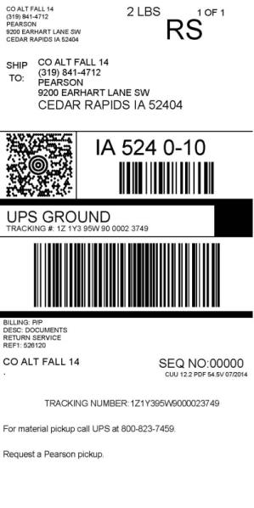
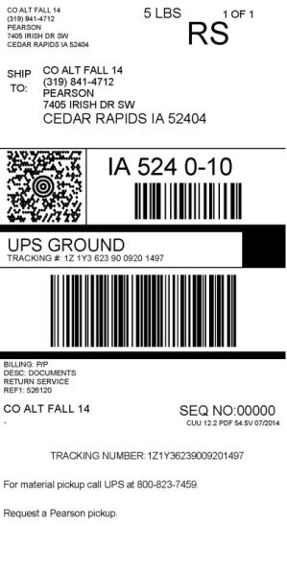
Returning Test Materials-DACs
UPS Labels
A white UPS label must also be used on ALL boxes. The address on each UPS label must match the address on the orange scorable or blue nonscorable return label used on the box.
Ensure that the addresses on the UPS label and the return label match when applying to the box.
Scorable Material UPS Label
Nonscorable Material UPS Label

Slide 112
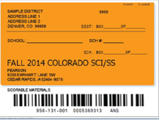
Returning Test Materials-DACs
Ensure correct label combination on boxes for scorable materials return
Scorable Material UPS Label
Scorable Material Return Label
Notes:
The UPS label will contain a weight amount. This is a system generated label based on the amount of materials that shipped. You do not need to stay within that weight limit. Fill the box, when UPS picks the shipment up the weight will be corrected.
NOTE: The orange label is used for scorable return materials. The scorable materials are returned to our scanning center for processing.

Slide 113
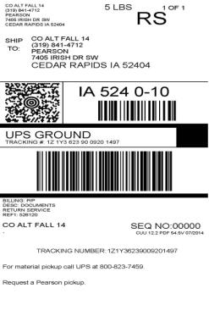
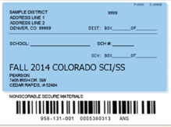
Returning Test Materials-DACs
Ensure correct label combination on the boxes for nonscorable materials return
Nonscorable Material UPS Label
Nonscorable Material Return Label
Notes:
The UPS label will contain a weight amount. This is a system generated label based on the amount of materials that shipped. You do not need to stay within that weight limit. Fill the box, when UPS picks the shipment up the weight will be corrected.
NOTE: The blue label is used for nonscorable return materials. The nonscorable materials are returned to our security check in center for processing.

Slide 114
Frequently Asked Questions
Have rules about home school and private school students changed?
Additional information in the Procedures Manual and Data Supplement
Will students take student surveys this fall?
This will be a district decision

Slide 115
Forms and Training

Slide 116
Forms
Prior to Testing
During Testing
After Testing
loerzel_s@cde.state.co.us Fax: 303-866-6680
Signed Security Agreement | DAC sends to Pearson at colorado.forms@pearson.com
 | SACs maintain all other signed agreements
Verification of District Training | DAC sends to Sara Loerzel at CDE
Test Incident Report | DAC sends to Sara Loerzel at CDE
School Security Checklist | SAC to TA/TE
District Receipt Form | DAC to SAC
Post Test Compliance Form | DAC sends to Sara Loerzel at CDE

Slide 117
District Training
Everyone involved in CMAS administration must be trained each year. This includes DACs, SACs, CMAS Test Administrators, technology personnel and any other school or district staff involved in CMAS administration
DACs and SACs are responsible for ensuring that all individuals involved in test administration receive training and sign a security agreement

Slide 118
Training
Comprehensive training must include:
Test Security
Standardized Test Environment
Test Administration
Test Session Management (for appropriate personnel)
Test Administrator Role vs. Teacher Role
Opportunity for personnel to ask questions

Slide 119
Contact

Slide 120
CMAS Communication Plan
CDE
School
District
School
Pearson
(PearsonAccess)
Charter School

Slide 121
Assistance and Escalation for Technical Issues
CDE Recommends that districts allow individuals beyond the DAC to contact Pearson Customer Service Center directly during actual testing
School/District
Pearson Customer Service Center
CDE Assessment Unit
Pearson CO Program Team
Alert Customer Service Center when testing is in progress for rapid escalation

Slide 122
Contact CDE Assessment Unit for
CDE Contact | Contact for issues concerning
Sara Loerzel | Procedures and Scheduling Testing Irregularities
Katie Schmidt | Frameworks and Content
Mira Monroe | IEP and 504 Accommodations
Heather Villalobos Pavia | Linguistic Accommodations
Margo Allen | General Assistance Locating Resources
Jessica Allen | Data and Data Pipeline Student Biographical Data (SBD)
Jasmine Carey | Score Reports

Slide 123
Contact Pearson for
Procedures pertaining to PearsonAccess
SDU
Student information updates and changes
Additional orders
PearsonAccess test session management
Technical issues related to site readiness, including device questions
Technical issues related to TestNav 8
Materials issues
cohelp@support.pearson.com Call Center: 888-687-4759

Slide 124
Thank You!

