Slide 1
The Holocaust
Outcome: Background to the Murder

Slide 2
Constructive Response Question
Summarize: Other than the Holocaust, what other hardships have Jewish people experienced in their existence?

Slide 3
What Will We Learn?
Historical look at the Hebrew people
Jewish culture
The Nazis and their actions

Slide 4
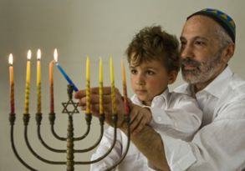
Background to the Murder
Setting the Stage
Holocaust: a thorough destruction involving extensive loss of life often through fire
Genocide: the deliberate & systematic destruction of a racial/political/cultural group
In the late 1930’s and early 1940’s, the Nazis led by Adolf Hitler attempted to wipe out the Jewish population of Europe ---> in the end they killed over 6 million Jews
Shoah: Jewish name for the Jewish Holocaust of the 1930’s and 1940’s

Slide 5
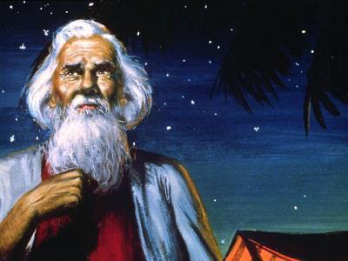
Background to the Murder
A Rocky Past: The Hebrew People
The Ancient Hebrew people were led by Abraham --> became the father of the Hebrew people

Slide 6
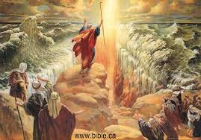
Background to the Murder
A Rocky Past: The Hebrew People
Eventually the Hebrews migrated to Egypt --> better land --> were enslaved for hundreds of years until Moses led the Hebrews out of Egypt through the Exodus
The Hebrews later became known as Jews and follow Judaism as a religion

Slide 7
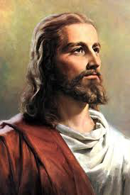
Background to the Murder
A Rocky Past: The Hebrew People
Judaism is monotheistic, one god; became a source of conflict for those who were polytheistic such as the Ancient Egyptians and Ancient Romans
Jesus Christ was born a Jew
Christians broke away from Judaism in part because they believe Jesus was the Messiah; Jews do not believe this

Slide 8
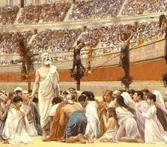
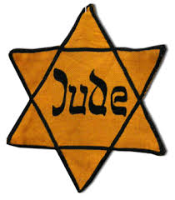
Background to the Murder
A Rocky Past: The Hebrew People
Jews have been targets of persecution by the Romans, Crusaders during the 11th and 12th centuries, and many others.
Anti-Semitism is hatred or prejudice against Jews

Slide 9
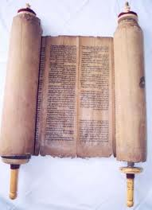
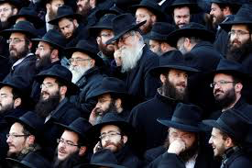
Background to the Murder
Jewish Culture
Sacred Text: The Torah
Most of what we know of early Hebrew history is found in the first five books of the Hebrew Bible known as the Torah.
Most Torahs are read on scrolls and are written in Hebrew
Rabbis are teachers of the Torah; like priests/pastors in Christianity

Slide 10
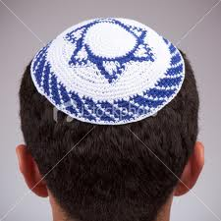
Background to the Murder
Cultural Traditions
Eating of pork is forbidden
Jews often only marry other Jews
Yom Kippur, or day of Atonement, is one of the holiest days for Jews
Jews do not believe in hell, (most don’t believe in an afterlife)
Many Jewish men cover their heads with yarmulke or kippas

Slide 11
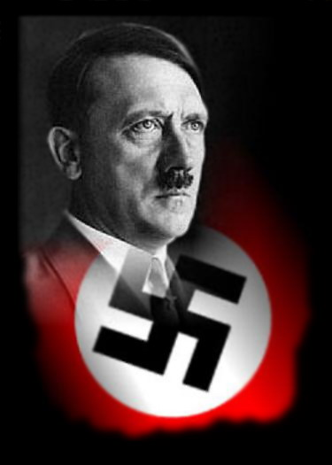
Adolf Hitler

Slide 12
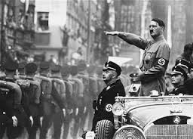
Background to the Murder
Rise of Adolf Hitler & Nazism
Germany had been hit hard by the Depression
Hitler came to power by promising to return Germany to glory
He also promised to get rid of the Jews
Fact: In times of need, people will follow those who will lead; Hitler delivered on his promises and this made him very popular

Slide 13
Background to the Murder
Why did Hitler hate the Jewish people?
Unclear; there are many theories but no clear answer
Hitler used the Jews as a scapegoat to strengthen his own power

Slide 14
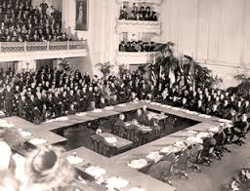
Background to the Murder
The Treaty of Versailles
Hitler was outraged by the end of WWI; felt Germany could still fight
The Allied Powers punished Germany for WWI
The Treaty of Versailles fueled Hitler’s motivation to create a new German empire called The Third Reich; started World War II (Sept ’39)

Slide 15
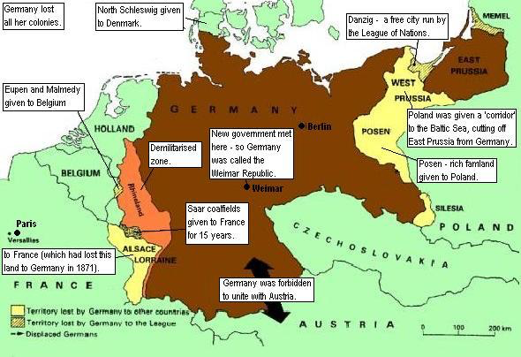
Terms of Treaty of Versailles

Slide 16
The Nazis

Slide 17
Background to the Murder
What is Nazism?
Hitler rose to power through the Nationalist Socialist Party in Germany
Became known as The Nazis
Through elections, Hitler and the Nazis took power in Germany
When President Paul von Hindenburg died, Hitler was next in line and became “Der Fuhrer” or The Leader

Slide 18
Background to the Murder
Anti-Semitism
Hitler was not the only person in Europe that disliked the Jews
Anti-Semitism existed within a lot of people in and around Germany
Hitler began passing laws stripping Jews of their citizenship; Germans believed in him and these laws
Propaganda was also used to help dehumanize Jews
In the early days of the Holocaust, Jews were removed from their homes and businesses and most German people were not upset
Most Nazis who rounded up or killed Jews did so out of orders, but many did so because they didn’t see the Jews as humans anymore

Slide 19
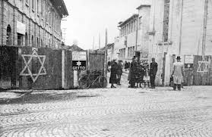
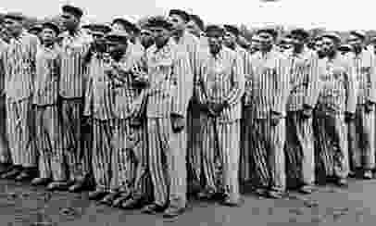
Background to the Murder
Result: The Nazis systematically made Jews the enemy and began removing them to create more “lebensraum” or living space. The Final Solution or decision to exterminate/kill millions of Jews would not be made for several more years, but through Nazi propaganda and law, life was very dangerous for Jews in Europe by the end of the 1930’s.

Slide 20
Constructive Response Question
Summarize: Other than the Holocaust, what other hardships have Jewish people experienced in their existence?

