Slide 1

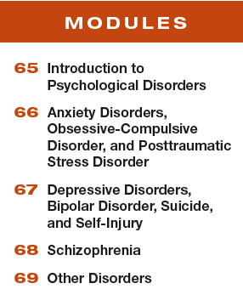

Unit 12
Abnormal Behavior

Slide 2

Learning Targets
Module 65
65-1 Explain how we draw the line between normality and disorder.
65-2 Contrast how the medical model and the biopsychosocial approach influence our understanding of psychological disorders.
Introduction to Psychological Disorders
65-3 Describe how and why clinicians classify psychological disorders, and explain why some psychologists criticize the use of diagnostic labels.

Slide 3
Learning Targets cont.
Module 65
65-4 Discuss the controversy over attention-deficit/
hyperactivity disorder.
65-5 Examine whether psychological disorders predict violent behavior.
Introduction to Psychological Disorders
65-6 Describe how many people have, or have had, a psychological disorder, and explore whether poverty is a potential risk factor.

Slide 4

Where is the line between normality and abnormality?
“Who in the rainbow can draw
the line where the violet tint ends
and the orange tint begins? Distinctly
we see the difference of the colors,
but where exactly does the one first
blendingly enter into the other? So
with sanity and insanity.”
~Herman Melville, Billy Budd,
Sailor, 1924

Slide 5
What is a psychological disorder?
a syndrome marked by a clinically significant disturbance in an individual’s cognition, emotion
regulation, or behavior
Significantly disturbed thoughts, emotions, or behaviors are dysfunctional or maladaptive—they interfere with normal day-to-day life.
For instance, believing your home must be thoroughly cleaned every weekend is not a disorder. But if cleaning rituals interfere with work and leisure, they may be signs of a disorder.

Slide 6
Can the definition of “significant disturbance” change over time?
From 1952 through December 9, 1973, homosexuality was classified as a psychological disorder.
As of December 10, 1973 it was not.
The American Psychiatric Association made this change because more and more of its members no longer viewed same-sex attraction as a psychological problem.
However, the stigma and stresses that people who are gay, lesbian, transgender, and gender nonconforming often experience can increase the risk of mental health problems. [Hatzenbuehler et al., 2009; Meyer, 2003]

Slide 7
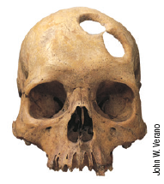
What was trephining?
In the Stone Age, drilling skull holes like these may have been an
attempt to release evil spirits and cure those with mental disorders.

Slide 8
How was mental illness treated during the Middle Ages?
During the Middle Ages, mental illness was believed to have been induced by the Devil and required a harsh cure that would drive out the evil demon.
People considered “mad” were sometimes caged or given “therapies” such as genital mutilation, beatings, removal of teeth or lengths of intestines, or transfusions of animal blood. (Farina, 1982).

Slide 9
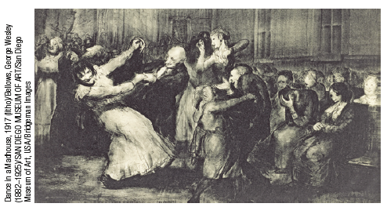
What were some efforts at reform at the turn of the nineteenth century?
Reformers such as Philippe Pinel in France opposed brutal treatments and under Pinel’s influence, hospitals sponsored patient dances, called “lunatic balls,” as depicted in this painting by George Bellows.
(Dance in a Madhouse)

Slide 10
What is the medical model?
the concept that diseases, in this case psychological
disorders, have physical causes that can be diagnosed, treated, and, in most cases, cured, often through treatment in a hospital
By the 1800s, researchers discovered that syphilis infects the brain and distorts the mind.
Researchers began to look for physical causes of other mental disorders and for treatments that would cure them.
Hospitals replaced asylums, and the medical model of mental disorders was born.

Slide 11
What is the biopsychosocial approach to understanding mental illness?
Biological, psychological, and social-cultural influences together weave the fabric of our behaviors, our thoughts, and our feelings.
As individuals, we differ in the amount of stress we experience and in the ways we cope with stressors.
Cultures also differ in their sources of stress and in their traditional ways of coping.

Slide 12
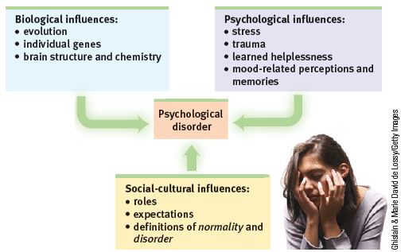
What are the biopsychosocial factors that influence mental health?
Today’s psychology studies how biological, psychological, and social-cultural factors interact to produce specific psychological disorders.

Slide 13
What is the vulnerability–stress
(or diathesis-stress) model?
The biopsychosocial approach gave rise to the stress vulnerability model (also called the diathesis-stress
model).
This model suggests that genetic predispositions combine with environmental stressors to increase or decrease the likelihood of developing a psychological disorder.
(Monroe & Simons, 1991; Zuckerman, 1999)

Slide 14
What is epigenetics?
the study of environmental influences on gene
expression that occur without a DNA change
Research on epigenetics (literally, “in addition to genetic”)
supports the vulnerability-stress model by showing how our DNA and our environment interact.
In one environment, a gene will be expressed, but in another, it may lie dormant.
For some, that will be the difference between developing
a disorder or not developing it.

Slide 15
1. What Would You Answer?
Which of the following describes the general idea that psychological disorders result from an interplay of a variety of factors?
A. the diathesis-stress model
B. the DSM–5
C. the biopsychosocial approach
D. the psychoanalytic model
E. the medical model

Slide 16
Why do clinicians classify psychological disorders?
In biology, classification creates order. To classify an animal as a “mammal” says a great deal—that it is warm-blooded, has hair or fur, and produces milk to nourish its young.
In psychiatry and psychology, too, classification orders and describes symptoms.
For instance, to classify a person’s disorder as “schizophrenia” suggests that the person talks incoherently, has bizarre beliefs, shows either little emotion or inappropriate emotion, or is socially withdrawn.

Slide 17
What, beyond describing symptoms, is the purpose of diagnosing disorders?
But diagnostic classification gives more than a thumbnail sketch of a person’s disordered
behavior, thoughts, or feelings.
In psychiatry and psychology, classification also aims to predict a disorder’s future course, suggest appropriate treatment, and prompt research into its
causes.
To study a disorder, we must first name and describe it.

Slide 18
What is the Diagnostic and Statistical Manual of Mental Disorders, Fifth Edition?
The American Psychiatric Association’s Diagnostic and Statistical Manual of Mental Disorders, Fifth Edition (DSM-5) is a widely used system for classifying psychological disorders.
Mental health professionals use the detailed diagnostic criteria in the DSM-5 to guide diagnosis and treatment.

Slide 19
What are some changes to diagnostic labels in the 5th edition of the DSM?
The conditions formerly called “autism” and “Asperger’s syndrome” were combined under the label autism spectrum disorder.
“Mental retardation” became intellectual disability.
New disorders, such as hoarding
disorder and binge-eating disorder, were added.

Slide 20
2. What Would You Answer?
Which of the following is the primary purpose of the DSM–5?
A. describing mental disorders
B. selecting appropriate psychological therapies for
mental disorders
C. placing mental disorders in their appropriate cultural
context
D. selecting appropriate medicines to treat mental
disorders
E. understanding the causes of mental disorders

Slide 21
Are some diagnoses controversial?
Yes. For instance, disruptive mood dysregulation disorder is a new DSM-5 diagnosis for children “who exhibit persistent irritability and frequent episodes of behavior outbursts three or more times a week for more than a year.”
Will this diagnosis assist parents who struggle with unstable children, or will it “turn temper tantrums into a mental disorder” and lead to overmedication, as the chair of the previous DSM edition warned?
(Frances, 2012)

Slide 22
Think critically
What are the benefits to diagnosing and labeling certain sets of behaviors?
How can labeling and diagnosing be detrimental to individuals or society as a whole?
Share your ideas with your partner.

Slide 23
What is one criticism of the DSM-5?
Critics have long faulted the DSM for casting too wide a net and bringing “almost any kind of behavior within the compass of psychiatry”
(Eysenck et al., 1983)
Some psychologists believe the DSM-5’s even wider net will extend the pathologizing of everyday life.

Slide 24
What is another criticism of the DSM-5?
Another concern critics of the DSM-5 raise is the over-labeling of what might be common everyday feelings and practical responses to traumatic events.
For example, The DSM also now classifies severe grief following the death of a loved one as a possible depressive disorder.
Critics suggest that such
grief could instead simply be considered a “normal” reaction to tragic life events.

Slide 25
What is a benefit of labeling disorders with the DSM-5?
For those who experience these challenging symptoms, diagnosis and treatment
can be a relief and bring improved functioning.
(Kupfer, 2012; Maciejewski et al., 2016)
In psychiatry and psychology, classification also aims to
predict a disorder’s future course, suggest appropriate treatment, and prompt research into its causes.
To study a disorder, we must first name and describe it.

Slide 26
How can diagnostic labels be misleading?
Once labeling a person, we view that person differently.
(Bathje & Pryor, 2011; Farina, 1982; Sadler et al., 2012)
Labels can change reality by putting us on alert for evidence that confirms our view.
In a classic study, teachers who were told certain students were “gifted” then acted in ways that elicited the behaviors they expected.
(Snyder, 1984)
Labels can be self-fulfilling.

Slide 27
What research has been conducted on mislabeling of behaviors?
David Rosenhan and seven of his graduate students went to hospital admissions offices, complaining (falsely) of “hearing voices” saying
empty, hollow, and thud.
Apart from this complaint and giving false names and occupations, they answered questions truthfully.
All eight healthy people
were misdiagnosed with disorders.

Slide 28
How did being labeled as “ill” impact how others viewed the grad students?
Until being released an average of 19 days later, those eight “patients” showed no other symptoms.
Yet after analyzing their (quite normal) life histories, clinicians were able to “discover” the causes of their disorders, such as having mixed emotions about a parent.
Even routine note-taking behavior was
misinterpreted as a symptom.

Slide 29
How do labels have power in everyday life?
Getting a job or finding a place to rent can be a challenge for people recently released from a psychiatric hospital.
Label someone as “mentally ill” and people may fear them as potentially violent.
That reaction may fade as people better understand that many psychological disorders involve diseases of the brain, not failures of character.

Slide 30

speaking out
Public figures have helped foster understanding by speaking openly about their own struggles with disorders such as depression and substance abuse.
During his campaign, Boston Mayor Martin Walsh spoke openly about his past struggles with alcohol.
His story of recovery helped him win in 2014—the closest Boston mayoral election in decades.

Slide 31

mental illness in Hollywood
Old stereotypes are slowly being replaced in media portrayals of psychological disorders.
Recent films offer fairly realistic depictions.
Iron Man 3 portrayed
a main character, shown at right, with
posttraumatic stress disorder.

Slide 32
How has broadening the diagnostic criteria of ADHD created a controversy?
For example, the DSM has broadened the diagnostic criteria for attention-deficit/hyperactivity
disorder (ADHD).
For those who experience these challenging symptoms, diagnosis and treatment can be a relief and bring improved functioning.
(Kupfer, 2012; Maciejewski et al., 2016)
However, critics suggest that the criteria are now too broad and may turn normal, childish rambunctiousness into a disorder.
(Frances, 2013, 2014)

Slide 33
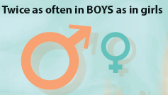
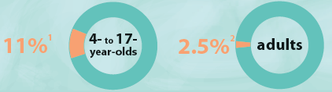
How frequently is Attention Deficit Hyperactivity Disorder (ADHS) diagnosed?

Slide 34

What are the symptoms of ADHD?
inattention and distractibility
hyperactivity
impulsivity

Slide 35
What are the arguments regarding the diagnosing of ADHD?
Energetic child + boring school =
ADHD overdiagnosis
Children are not meant to sit inside for hours in chairs.
The youngest children in a class tend to be more fidgety and more often diagnosed.
Older students may seek out stimulant ADHD prescription drugs–“good-grade pills.”
What are the long-term effects of drug treatment?
Why the increased diagnoses worldwide?

Slide 36
What do the supporters of ADHD diagnoses note?
More diagnoses reflect increased awareness.
ADHD is a real neurobiological disorder whose existence should no longer be debated.”
ADHD is associated with abnormal brain structure, abnormal brain activity patterns, and future risky or antisocial behavior.

Slide 37
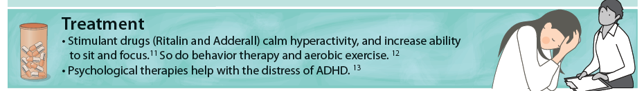
How can ADHD be treated?
Extreme inattention, hyperactivity, and impulsivity can derail social, academic, and work achievements.
The symptoms can be treated with stimulant medication, behavior therapy and aerobic exercise.
The debate continues over whether normal high energy is too often diagnosed as a psychiatric disorder, and whether there is a cost to the long-term use of stimulant drugs in treating ADHD.

Slide 38
Do disorders increase the risk of violence?
No. Most violent criminals are not mentally ill, and most mentally ill people are not violent.
(Fazel & Grann, 2006; Skeem et al., 2016)
The few people with disorders who commit violent acts tend to be either those who experience threatening delusions and hallucinated voices that command them to act, who have suffered a financial crisis or lost relationship, or who abuse substances. (Douglas et al., 2009; Elbogen et al., 2016; Fazel et al., 2009, 2010)

Slide 39
Thinking critically.
Using your understanding of the availability heuristic from Module 35, how could you explain why many people do have the belief that the mentally ill are more violent?
Discuss with your class.

Slide 40

AP® Exam Tip
Notice that the term insanity comes out of the
legal system.
Insanity in criminal law means that defendants cannot
be held accountable for their actions at the time of the crime, typically due to mental disorder.
It is not a psychological or medical diagnosis and
does not appear in the DSM-5.

Slide 41

What do you think?
Following the Newtown, CT., slaughter of 20 young children and 6 adults, people wondered: Could those at risk for violence be identified in advance by mental health workers and reported to police?
Would laws that require such reporting discourage disturbed gun owners from seeking mental health treatment?

Slide 42
How many people have or have had a psychological disorder?
The U.S. National Institute of Mental Health has estimated that just under 1 in 5 adult Americans currently have a “mental, behavioral, or emotional disorder (excluding developmental and substance use disorders)” or have had one within the past year. (NIMH, 2015)

Slide 43
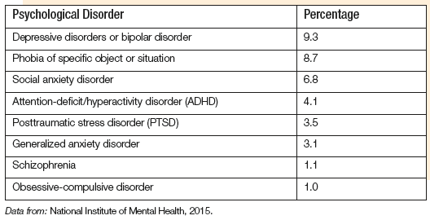
What disorders are most prevalent in America?

Slide 44
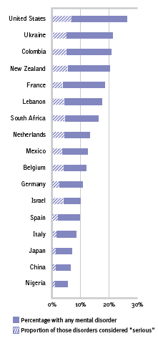
How prevalent are disorders across the globe?
A World Health Organization study—based on 90-minute interviews with thousands of
people who were representative of their country’s population—estimated the number
of prior-year mental disorders in 28 countries.
(Kessler et al., 2009)

Slide 45
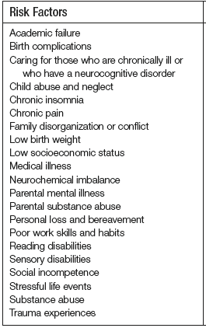
What are risk factors for mental illness?
One example of a risk factor for a psychological disorder—poverty—crosses ethnic and gender lines.
The incidence of serious psychological disorders is 2.5 times higher among those below the poverty line. (CDC, 2014)

Slide 46
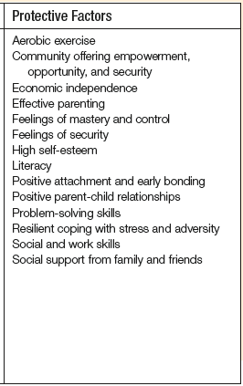
What are protective factors for mental illness?
There are many factors that can help shield people against mental illness.

Slide 47
Does poverty cause disorders or do disorders cause poverty?
It is both, though the answer varies with the
disorder.
For example, schizophrenia leads to poverty, but other disorders may not.
Yet the stresses and demoralization
of poverty can also precipitate disorders, especially depression in women and substance
abuse in men.
(Dohrenwend et al., 1992)

Slide 48
What do you think? Part II
How would you draw the line between sending mentally ill criminals to prisons or to psychiatric hospitals?
Would the person’s history (for example, having suffered child abuse) influence your decision?
Talk about it with your partner.

Slide 49
Learning Target 65-1 Review
Explain how we draw the line
between normality and disorder.
According to psychologists and psychiatrists, a psychological disorder is a syndrome marked by a clinically significant disturbance in an individual’s cognition, emotion regulation, or behavior.
Disordered thoughts, emotions, or behaviors are dysfunctional or maladaptive, interfering with normal daily life.

Slide 50
Learning Target 65-2 Review
Contrast how the medical model and the biopsychosocial approach influence our understanding of psychological disorders.
The medical model assumes that psychological disorders are mental illnesses with physical causes that can be diagnosed, treated, and, in most cases, cured through therapy, sometimes in a hospital.
The biopsychosocial approach assumes that three sets of influences—biological, psychological, and social-cultural— interact to produce specific psychological disorders.

Slide 51
Learning Target 65-2 Review cont.
Contrast how the medical model and the biopsychosocial approach influence our understanding of psychological disorders.
Culture-specific disorders, the vulnerability stress model, and epigenetics all provide insight into the ways in which biology and environment interact to make it more or less likely that a psychological disorder will develop.

Slide 52
Learning Target 65-3 Review
Describe how and why clinicians classify psychological disorders, and
explain why some psychologists criticize the use of diagnostic labels.
The American Psychiatric Association’s DSM-5 (Diagnostic and Statistical Manual of Mental Disorders, Fifth Edition) contains diagnostic labels and descriptions that provide a common language and shared concepts for communication and research.
Classification helps psychiatrists and psychologists to predict a disorder’s future course, suggest treatment, and prompt research into its causes.

Slide 53
Learning Target 65-3 Review cont.
Describe how and why clinicians classify psychological disorders, and
explain why some psychologists criticize the use of diagnostic labels.
Some critics believe the DSM-5 casts too wide a net and may pathologize normal behaviors.
Other critics view DSM diagnoses as arbitrary labels that create preconceptions that bias perceptions of the labeled person’s past and present behavior.

Slide 54
Learning Target 65-4 Review
Discuss the controversy over
attention-deficit/ hyperactivity disorder.
A child who displays inattention, hyperactivity, and impulsivity may be diagnosed with attention-deficit/hyperactivity disorder (ADHD) and treated with medication and other therapy.
The controversy centers on whether the growing number of ADHD cases reflects over diagnosis or increased awareness of the disorder. Long-term effects of stimulant-drug treatment for ADHD are not yet known.

Slide 55
Learning Target 65-5 Review
Examine whether psychological
disorders predict violent behavior.
Most violent criminals are not mentally ill, and most mentally ill people are not violent. People with disorders are more likely to be victims than attackers.
Whether people with mental disorders who become violent should be held responsible for their behavior raises moral and ethical questions. Psychology and law must often work hand-in-hand to determine the best course of action.

Slide 56
Learning Target 65-6 Review
Describe how many people have, or have
had, a psychological disorder, and
explore whether poverty is a potential risk factor.
Psychological disorder rates vary, depending on the time and place of the survey. In one multinational survey, rates for any disorder ranged from 6 percent (Nigeria) to 27 percent (the United States).
Poverty is a risk factor: Conditions and experiences associated with poverty contribute to the development of psychological disorders. But some disorders, such as schizophrenia, can drive people into poverty.

