Slide 1
Synonyms
By Deb Hanson © 2012

Slide 2
Synonyms are…
words that mean the same thing (or almost the same).
SYNONYMS = SAME

Slide 3
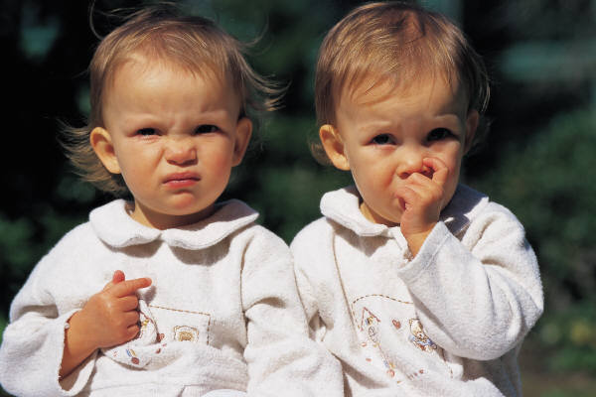
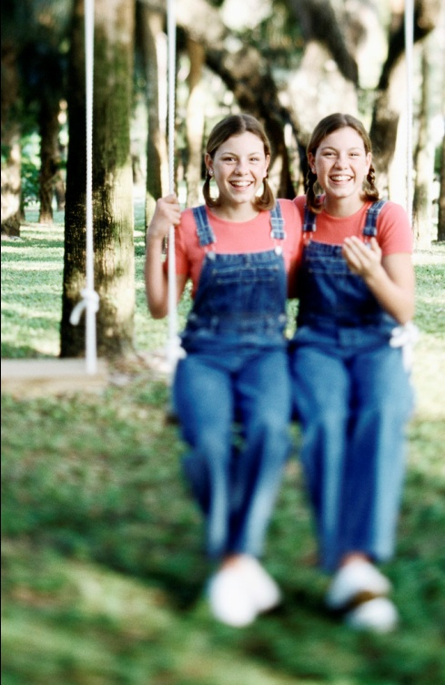
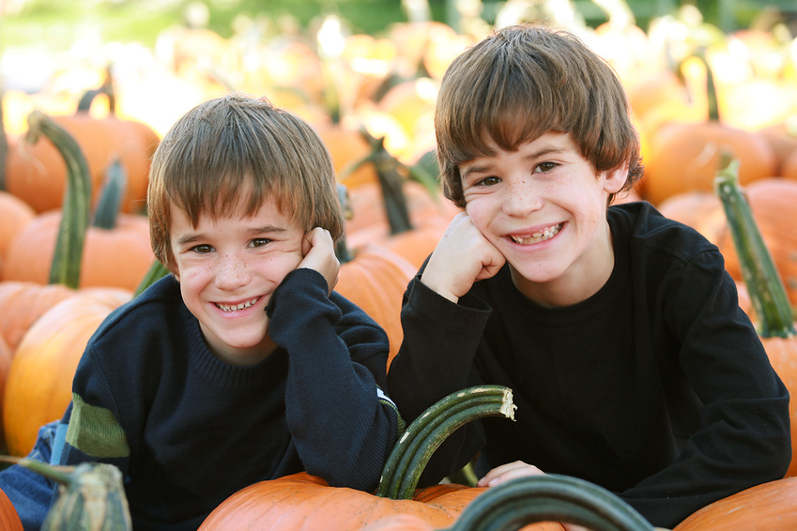
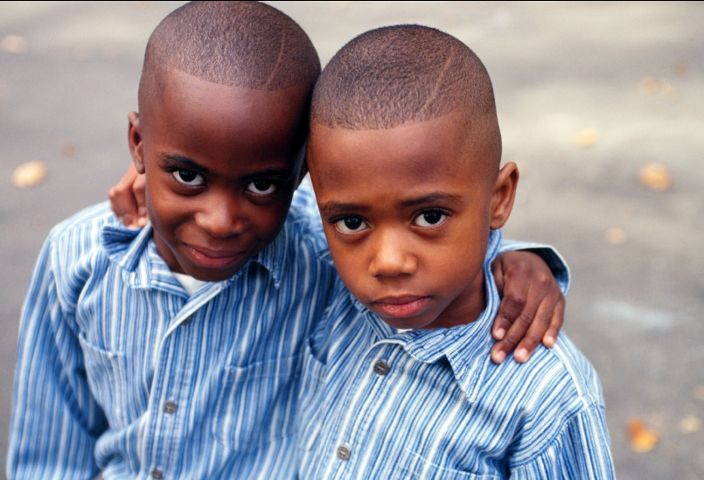
Synonyms are like…
Identical twins!
Identical twins look almost the same!
Synonyms mean the same or almost the same thing!

Slide 4
Name a synonym for big.
Did you name any of these words?
gigantic
huge
large
enormous
colossal
All of these words are SYNONYMS!

Slide 5
Name a synonym for small.
Did you name any of these words?
tiny
little
miniature
All of these words are SYNONYMS!

Slide 6

Name a synonym for loud.
noisy
blaring
earsplitting
These are all synonyms.
You could use any of them in this sentence, and they all make sense!
  The loud music hurt my ears!

Slide 7
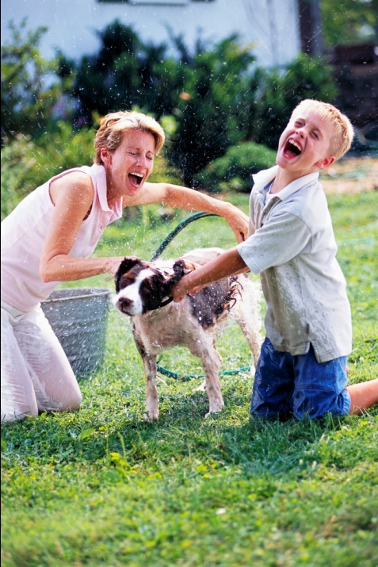
Name a synonym for laugh.
giggle
snicker
chuckle
These are all synonyms.
You could use any of them in this sentence, and they all make sense!
  I started to ________ when I saw the clown.

Slide 8
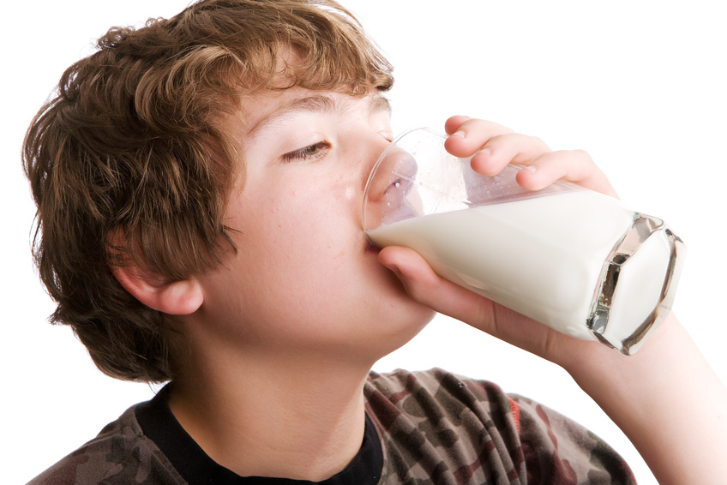
Which of the following is a synonym for “drink”?
A. pour
B. make
C. lemonade
D. sip
First, take your best guess.
Then, think of a sentence with the word “drink”.
  I will drink some milk.
    Does your word make sense and mean the SAME thing in that sentence? (Try the word in the sentence!)

Slide 9
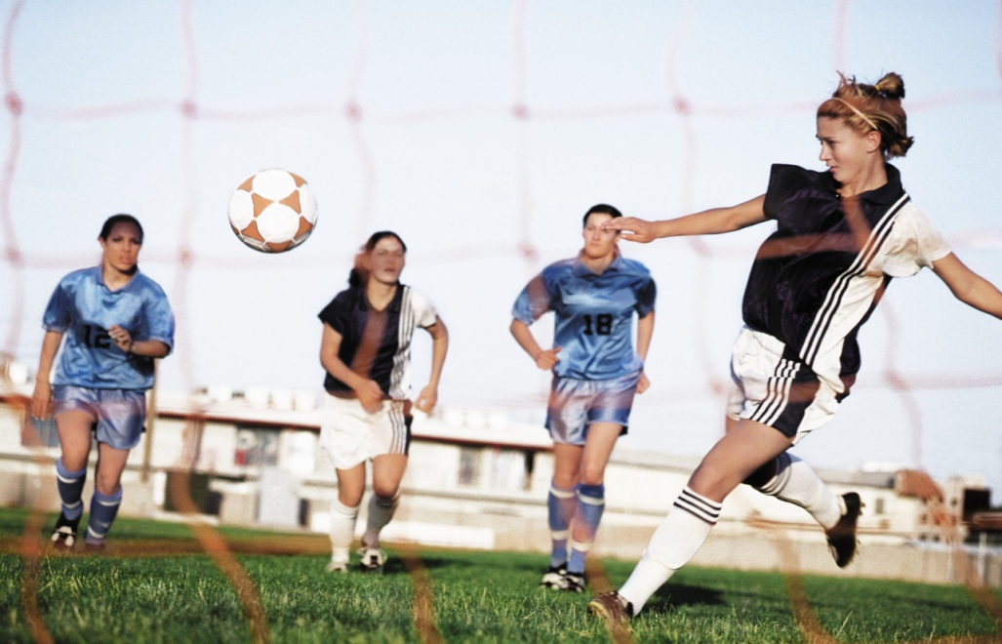
Synonyms
Which of the following is a synonym for the underlined word in this phrase?
the final game
A. hard
B. first
C. last
D. best
Which word could you place in the sentence and it would mean the same thing?
Notes:
Continue to model how you put it in an example sentence….

Slide 10
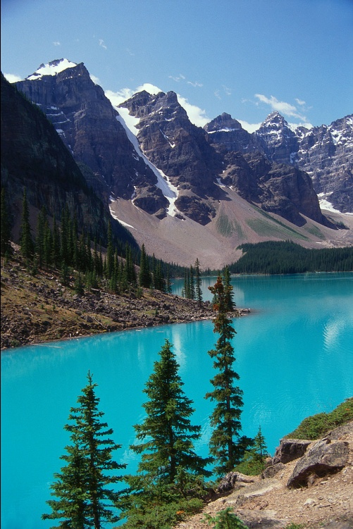
Synonyms
Which of the following is a synonym for the underlined word in this phrase?
the pretty lake
  A. swim
  B. water
  C. beautiful
  D. ugly
  Which word could you place in the sentence and it would mean the same thing?

Slide 11
Synonyms
Which of the following is a synonym for the underlined word in this phrase?
the sly thief
A. robber
B. sneaky
C. quickly
D. silly
  Which word could you place in the sentence and it would mean the same thing?

Slide 12
Synonyms
Which of the following is a synonym for the underlined word in this phrase?
the wealthy millionaire
A. nice
B. money
C. greedy
D. rich
  Which word could you place in the sentence and it would mean the same thing?

Slide 13
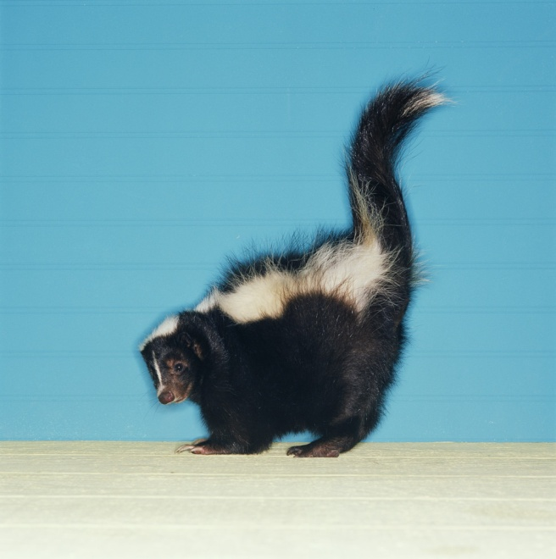
Synonyms
Which of the following is a synonym for the underlined word in this sentence?
the bad smell
A. odor
B. nose
C. skunk
D. gross
  Which word could you place in the sentence and it would mean the same thing?

Slide 14
Synonyms
Which of the following is a synonym for the underlined word in this sentence?
the scary movie
A. scream
B. watch
C. funny
D. frightening
  Which word could you place in the sentence and it would mean the same thing?

Slide 15
Synonyms
Which of the following is a synonym for the underlined word in this sentence?
shut the door
A. ring
B. knock
C. close
D. leave
  Which word could you place in the sentence and it would mean the same thing?

Slide 16
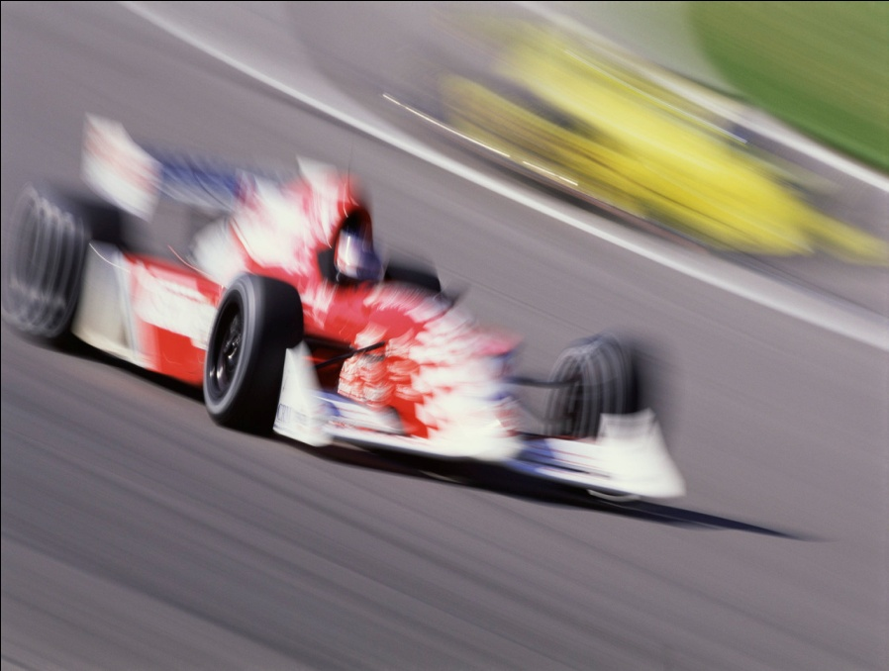
Synonyms
Which of the following is a synonym for the underlined word in this sentence?
the fast car
A. slow
B. race
C. speedy
D. awesome
  Which word could you place in the sentence and it would mean the same thing?

Slide 17
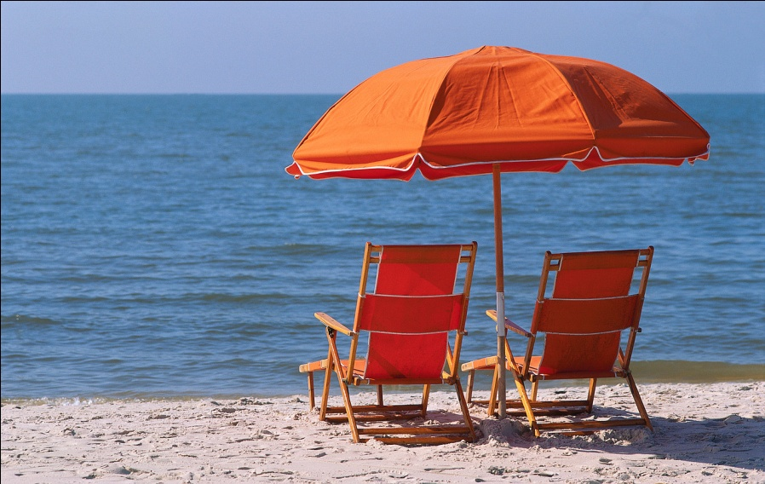
Synonyms
Which of the following is a synonym for the underlined word in this phrase?
the nice weather
A. kind
B. pleasant
C. friendly
D. sun
  Which word could you place in the sentence and it would mean the same thing?

Slide 18
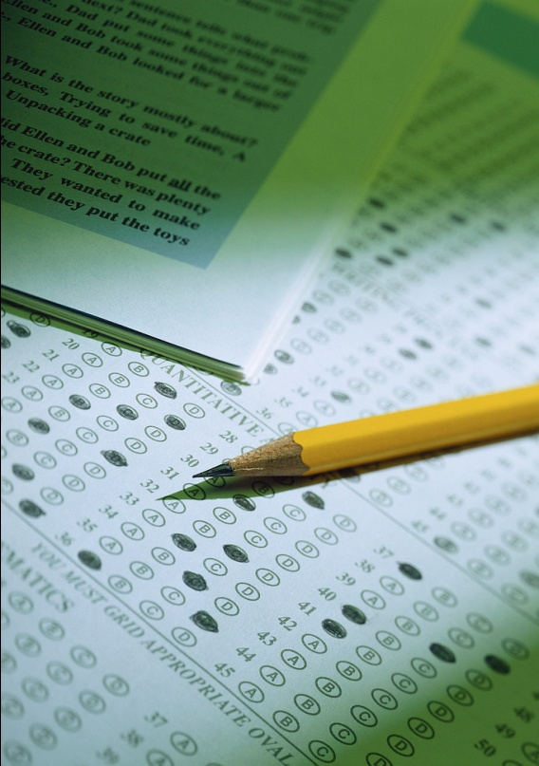
Synonyms
Which of the following is a synonym for the underlined word in this sentence?
the difficult test
A. long
B. easy
C. multiple choice
D. challenging
  Which word could you place in the sentence and it would mean the same thing?

Slide 19
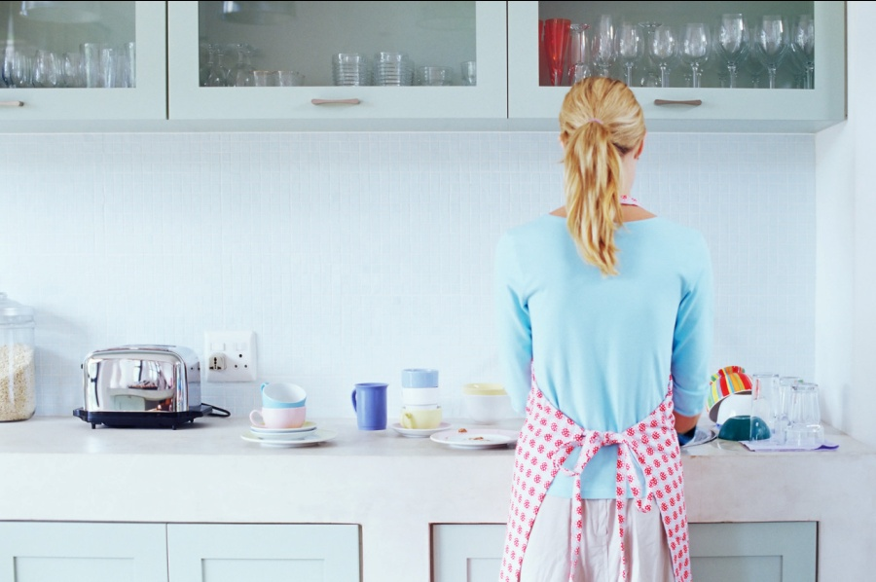
Synonyms
Which of the following is a synonym for the underlined word in this sentence?
start doing the dishes
A. begin
B. wash
C. finish
D. now
  Which word could you place in the sentence and it would mean the same thing?

Slide 20
Book Recommendations:
Pitch and Throw, Grasp and Know:
What is a Synonym? By Brian Cleary
Stroll and Walk, Babble and Talk:
More About Synonyms By Brian Cleary

