Slide 1
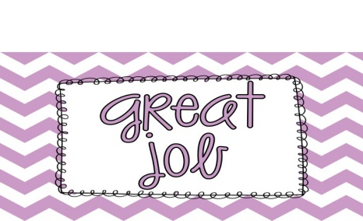
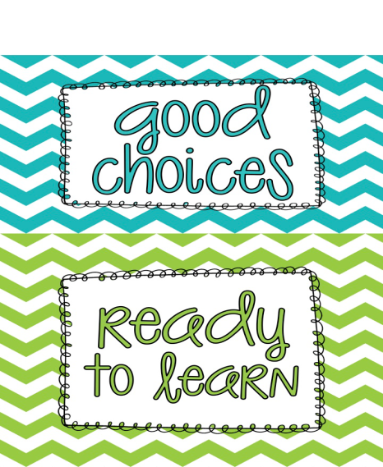
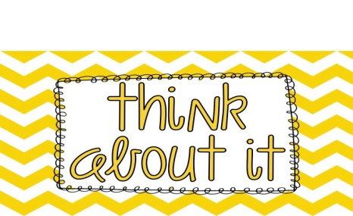
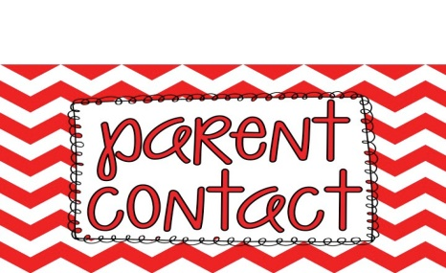
CliP It! Behavior Chart
Our classroom will use a clip chart to monitor behavior. A clip chart is a great tool that allows students to be rewarded for positive behavior, while discouraging negative behavior.
Each student has a clothespin, or clip, with his or her name on it. Everyone will start on green at the beginning of each day, and clips can be moved up and down throughout the day based on behavior.
Students will report their behavior to you daily in their behavior chart kept in their binders.
The Super Student level is reserved for outstanding behavior. A student who reaches this level will earn a jewel on their clothespin! Once a student has received three jewels, then they will earn a treat from the treat box.
Students can move to the Great Job level for continuing to display good behavior. You should be very proud of your child for reaching this level!
Students will move to the Good Choices level for showing that they are making the right behavior decisions! Ending the day on this level is great!
Every student will start the day on the Ready to Learn level. As the day goes on, clips can be moved up and down, based on behavior. This level is a good one to be on!
A student will be moved to the Think about It level as a warning about his/her behavior, and a reminder to follow the rules
Students who continue to display poor behavior can move down to the Teacher’s Choice level. Here, the teacher can decide what action to take. Silent lunch or loss of center time might be an option.
When a student moves to the Parent Contact level, the teacher will notify parents via note or phone call. A visit to the Principal’s office might also be in order. Students on this level may also lose recess time, etc.

