Slide 1
2020 FRQ # 1: Concept Application How To Tutorial
-15 minutes
-3 sections
-Earn up to 3 Points total
Video Link: https://www.youtube.com/watch?v=thVjn1Zc8ng&list=PLHwEFig3yI1bB27Ply9wOtM_e8LfwgIlI&index=4&t=0s

Slide 2
Format of FRQ
The Question: Short paragraph outlining a scenario which generally involves a conflict within a political institution. (You won’t know the scenario and that’s ok!)
The Tasks:
-Respond to each of the three sections of the prompt
- Be aware of the verbs (Explain, Describe, Identify) used in the prompt (the focus this year will be on explaining how concepts are inter-related rather than simply identifying and describing)
- Make sure your response addresses the entire prompt!!

Slide 3
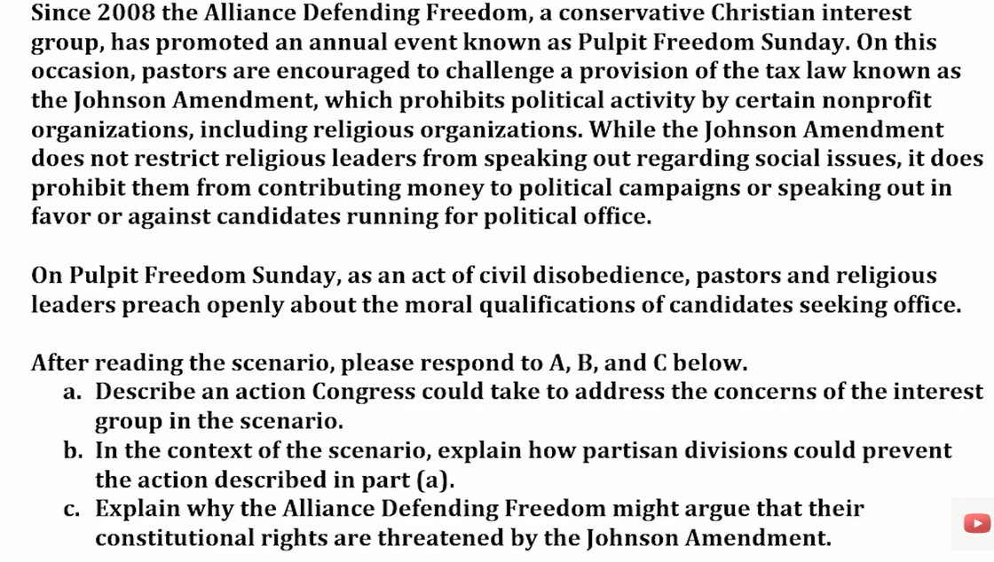

Slide 4
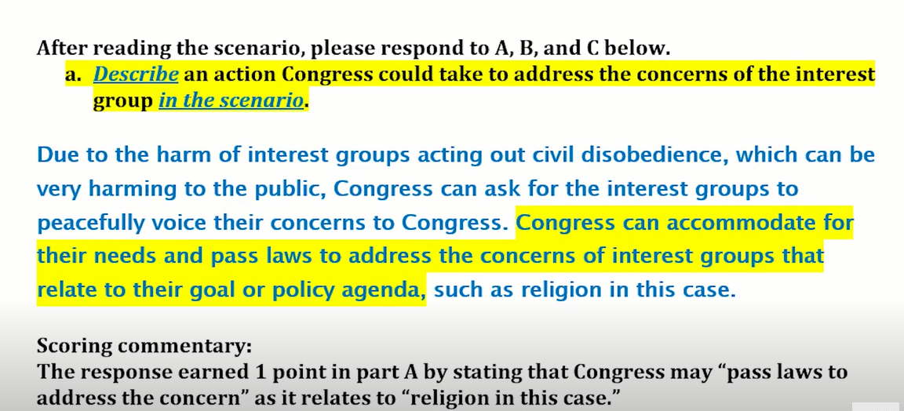
1st Section (A): 1 Point
No need for more than 2-3 sentences max.
DESCRIBE: Not just “identifying,” but describing an action IN THE SCENARIO
Whatever action description you give MUST be placed within the scenario and not generic like ” create a law.” Be specific!
Make sure your response addresses the entire prompt!
Worth 1 point - this response does not impact your ability to earn points on the other two sections
EXAMPLE:

Slide 5
2nd Section (B)- 1 Point
Make sure your response addresses the entire prompt.
Know the difference between your verbs
Identify - tell what it is (ex. Supremacy Clause)
Describe - tell what it is and something about it (ex. Supremacy Clause, which makes the Constitution the supreme law of the land, overruling state and local law)
Explain - tell what it is, something about it, and why it is relevant to the discussion .
A good “Explain response” describes or defines any relevant terms in the prompt & explains by elaborating, providing evidence, giving an example in the context of the prompt. Also, “CLOSE THE LOOP” by restating the prompt in the context of the scenario
(Ex. Supremacy Clause establishes the Constitution as the supreme law of the land, which took away the states’ power to segregate public schools after Brown V Board, when the Supreme Court ruled segregation violated the 14th Amendment. Because the act of segregation of public schools violated the Constitution, the states had to amend their practices.)
EXAMPLE - Next Slide

Slide 6
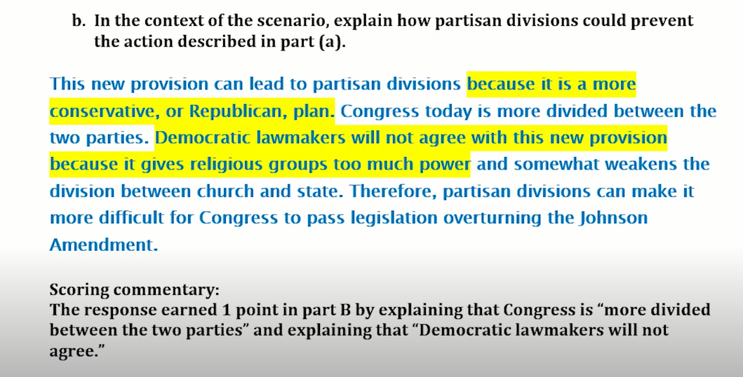

Slide 7
What NOT to do….
-When you are explaining, define all relevant terms. Cannot just assume the reader knows what it meants.

Slide 8
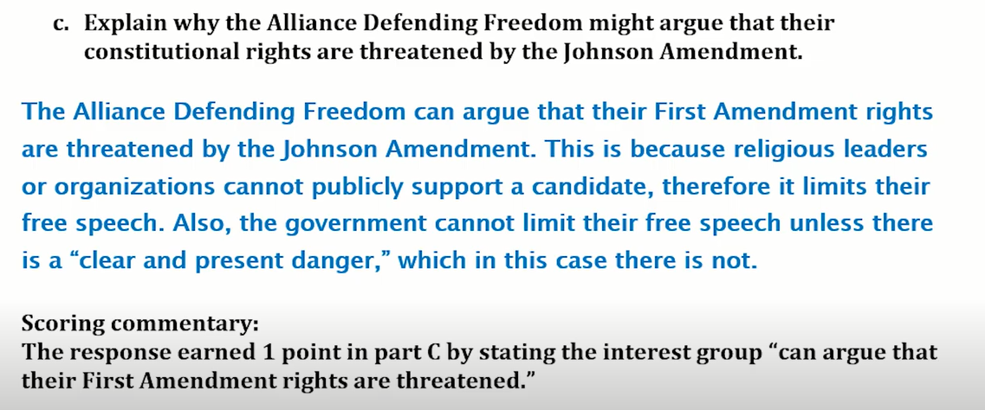
3rd Section (C): 1 Point
Make sure your response addresses the whole prompt.
Pay attention to the directions and the verbs used!
The Example below: This is clearly a free speech violation, but you have to EXPLAIN, not just identify the violation. The response below identifies the 1st amendment violation and EXPLAINS how the Johnson Amendment is violated the 1st amendment. It also explains what the Johnson amendment is. This earns the point.
EXAMPLE -

Slide 9
Reminders/Tips
-Avoid using pronouns. Be specific. EX: House, Senate, Congress NOT “the legislature.”
-Remember, you only have 15 minutes to write, so you need to keep it straight to the point without getting too “fluffy”; say what you have to say as concisely as possible while still hitting the requirements of the verbs used AND addressing the whole prompt.
-You also will not have enough time to try to look through the docs/notes/etc and answer the question, so get prepped before May 11!
- Remember, College Board is using plagiarism software to catch cheaters, so you want to make sure that anything you are trying to use (notes etc.) IS IN YOUR OWN WORDS!!!

