Slide 1
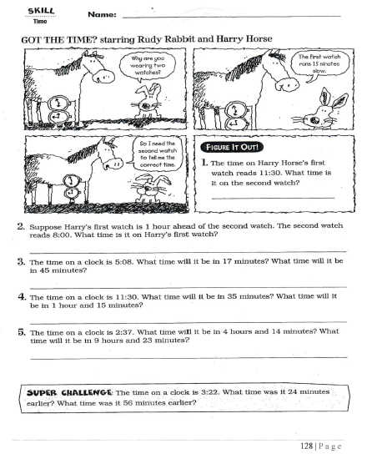
Wednesday, October 16, 2019
Tuesday: Classworks
M - Amiyah - 1
M – Erin - 2
M – Jaiden – 3
M – Caydance - 4
M – Jaylie – 5
M – Macon – 6
M – Paisleigh - 7
M – Jearon - 8
M – Landon – 9
M – Kaylee - TC
We have pledge this week: At 8:20, the following will go to the office to represent our class and state the pledge:
Jearon
Kaylah
Emma
McKenzie
Adalyn
Jaylie
7:55 – 8:30

Slide 3
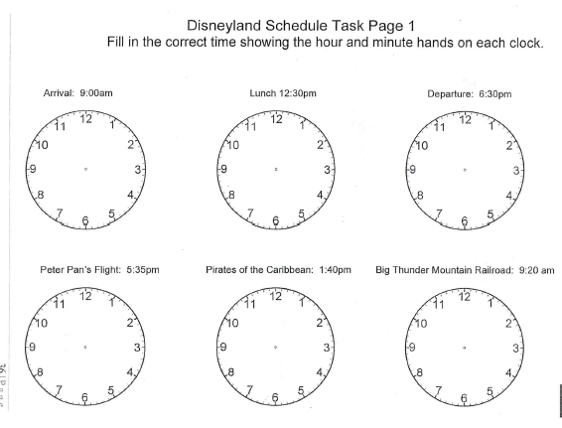

Slide 4
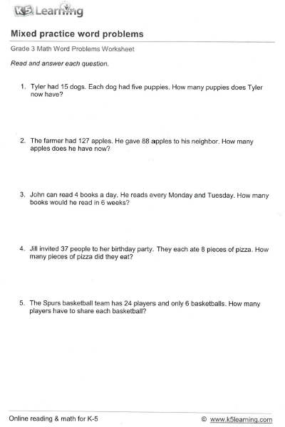
15 x 5 = 75
127 – 88 = 39
4 x 2 = 8; 8 x 6 = 48
With Jill 38 x 8 = 304; without Jill 37 x 8 = 296
24 ÷ 6 = 4
Review Homework

Slide 5
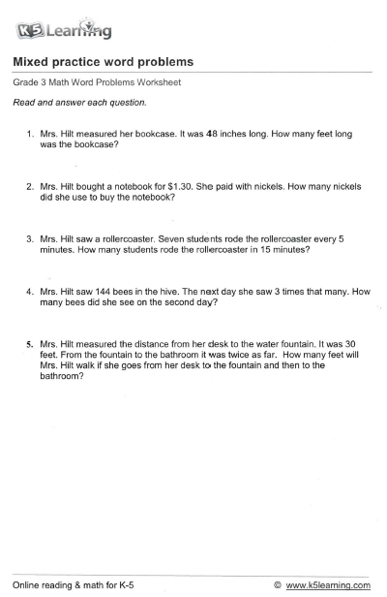
Homework

Slide 6

CHOMP TIME
F.A.S.T. Groups
Focused Academic Support Time

Slide 7
F.A.S.T. Designations
Computers – Classworks: M - Jaiden- 1 M - Erin - 2 M - Jearon - 3 R - Aiden - 4 M – Carleen– 5 M – Alexis - 6 M - McKenzie- 7 M - Cayli - 8 M - Noah – 9 M – Elin - TC | Mrs. Roby: LLI Kaylah Brena Emma Adalyn | Mrs. Thompson: SIPPS Cohen Amiyah Caydance Jaylie Kaylee Paisleigh | Paired Partners Book Club: Khamani - Katelynn
Landon – Phonics 1st with Mrs. Page
Macon – SIPPS with Mrs. Bess
8:40 – 9:10

Slide 8

Reading Time
Objective: RL.3.3 Describe characters in a story and explain how their actions contribute to the sequence of events.
Objective: RL.3.5 Refer to parts of stories and poems when writing or speaking about a text, using terms such as chapter, scene, and stanza; describe how each successive part builds on earlier sections.
Objective: RL.3.7 Use information gained from illustrations, other visual elements, and the words in a text to demonstrate understanding of the text.
9:10 – 9:45

Slide 9

Gather at the Carpet.
Are we still the best?

Slide 10
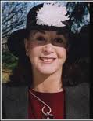

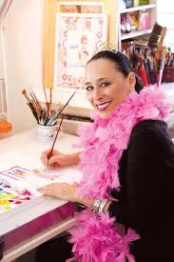
Author: Judith Viorst
Illustrator: Robin Preiss Glasser

Slide 11

After page 13
What are some things that Alexander imagines and worries about? Turn to your Partner

Slide 12
After page 23
Who are some of the people Alexander says good-bye to? How does Alexander know these people? Turn to your Partner

Slide 13
After page 25
What are some of the things Alexander says he is going to do when the movers come? What do you think he will do? Turn to your Partner

Slide 14

Classroom Discussion
Who is telling the story?
What is Alexander’s problem in the story? How is his problem solved?
Have you ever felt like Alexander in this story? What happened?

Slide 15

Restroom Break
9:45 – 9:55

Slide 16

Computers – Classworks:
  M - Katelynn - 1
  M – Kaylah -2
  M – Emma - 3
  M – McKenzie - 4
  M - Adalyn - 5
  M - Lexi - 6
  M – Jaiden – 7
  M - Brena - 8
  M – Erin – 9
  M – Cayli - TC
  Mrs. Roby
  Check In:
  Aiden
  Alexis
  Cayli
  Khamani
Independent Daily Reading & Teacher Conferences
  Mrs. Thompson:
  LLI
  Landon
  Paisleigh
  Jaiden
  Macon
Everyone else – Independent Novel
9:55 – 10:25

Slide 17



Vocabulary & Grammar Time
10:25 – 10:40

Slide 18

reluctant – do not want to do
Listen to pages 6 and 7, and think about why Nicky is reluctant to spend the summer at his grandma’s house.
Why is Nicky reluctant to spend the summer at his grandma’s house?

Slide 19
reluctant
What is something you are reluctant to do? Why? – Turn to your Partner
  I am reluctant to…because…

Slide 20
What’s the new word we are learning that means “do not want to do”?
reluctant

Slide 21
Have eyes in the back of your head - aware of everything around you, even things you cannot see
P 10-11
The phrase “Have eyes in the back of your head” is an idiom.
An idiom is an expression or phrase that means something different from what it appears to mean.

Slide 22
Eyes in the back of their heads
Why do parents of young children need to have eyes in the backs of their heads? Turn to your Partner
  Parents of young children need to have eyes in the backs of their heads because…

Slide 23
Eyes in the back of their heads
Who do you know who seems to have eyes in the back of his/her head? Turn to your Partner
  … seems to have eyes in the back of his/her head because…

Slide 24
What’s the new phrase we are learning that means “aware of everything around you, even things you cannot see”?
Have eyes in the back of your head

Slide 25
cluttered – ?
P10 - 11
Lets use context clues to determine the meaning of cluttered.
Remember context clues are words in the sentences that give you clues to what the word might mean.

Slide 26
Sentences from The Raft
“Books were scattered everywhere – on the tables, on the chairs, even on the floor. Three of the walls were cluttered with sketches and stuffed fish and charts of the river. Several fishing poles hung from the fourth with a tackle box, a snorkel, and a mask on the floor beneath them.”
Based on what you just heard, what do you think the word cluttered might mean?
Turn to your Partner
I think cluttered might mean…

Slide 27
Sentences from The Raft
“Books were scattered everywhere – on the tables, on the chairs, even on the floor. Three of the walls were cluttered with sketches and stuffed fish and charts of the river. Several fishing poles hung from the fourth with a tackle box, a snorkel, and a mask on the floor beneath them.”
What words in the sentences are clues to the meaning? Turn to your Partner
The clues…help me figure out the meaning
of the word cluttered.

Slide 28
Imagine That
You are visiting a friend. You walk into his bedroom, and it is cluttered.
What do you see in your friend’s cluttered bedroom? Turn to your partner
In my friend’s cluttered bedroom I see…

Slide 29
What’s the new word we are learning that means “messy”?
cluttered

Slide 30
Out of Classroom!
Recess 10:40 – 11:05

Slide 31
Writing Time
11:05 – 12:15

Slide 32


Slide 33
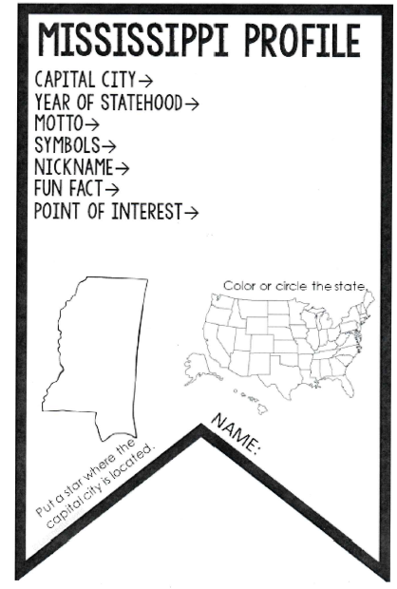

Slide 34
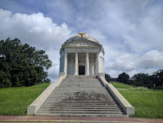
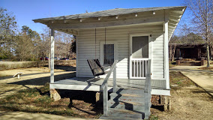
Points of Interest
Vicksburg National Military Park
Elvis Presley Birthplace

Slide 35
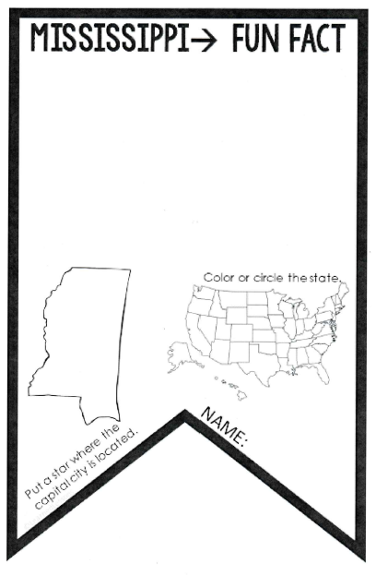

Slide 36
Math Fluency & Focus Lesson!
12:15 – 12:35

Slide 37
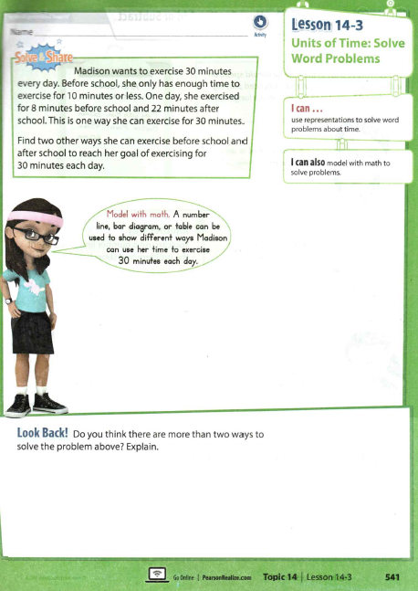

Slide 38
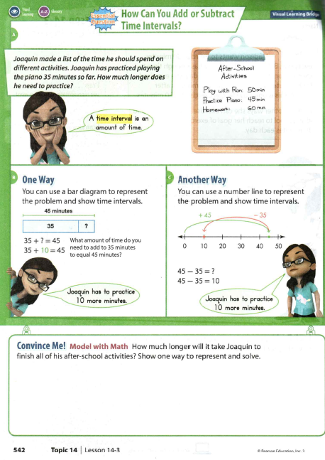
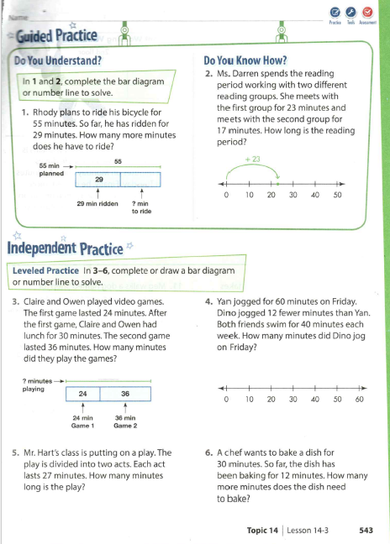

Slide 39
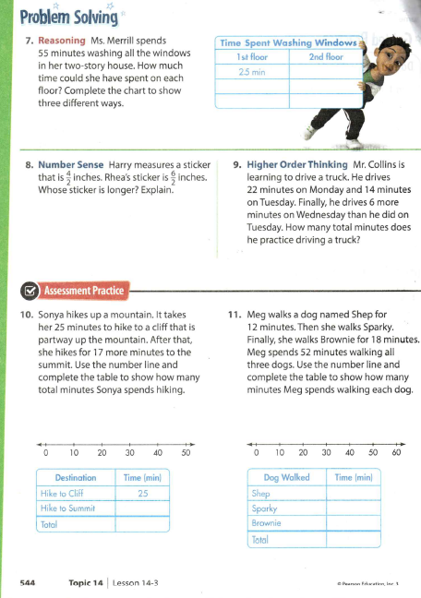

Slide 40

Out of Classroom!
Lunch 12:35 – 1:05

Slide 41
Restroom Break
1:05 – 1:10

Slide 42

Out of Classroom!
Activity 1:10 – 1:55

Slide 43
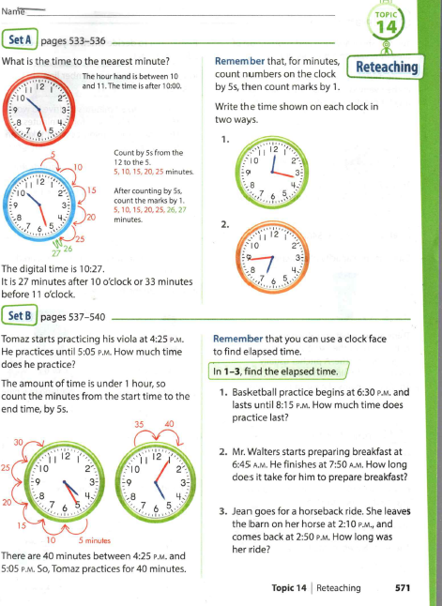

Slide 44
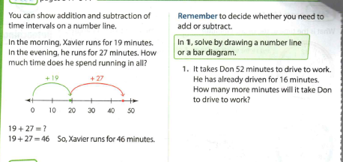
Turn in when finished

Slide 45


Slide 46
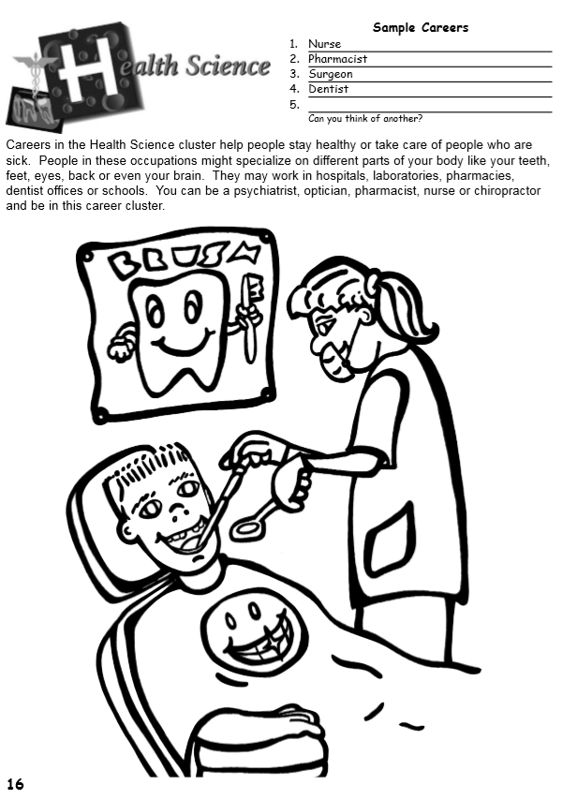

Slide 47
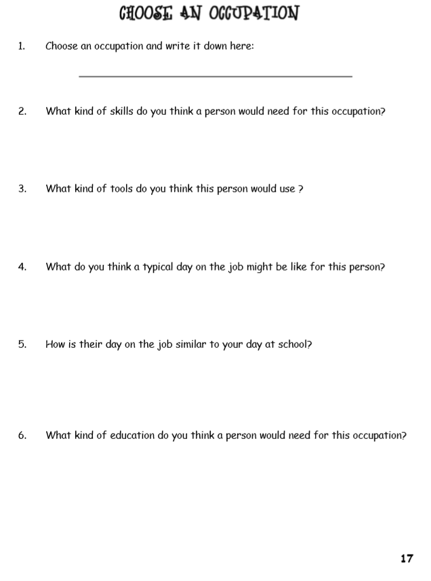

Slide 48
Restroom Break
3:10 – 3:15

Slide 49




3:10 – 3:15 Wrap Up!
Pair-Up back to back and share one thing you learned in class today with your partner
Pack-Up
Office will announce:
Car Riders – Leave around 3:20
Bus Riders – (listen to intercom for dismissal)
2:30 – 3:20
How much time has elapsed?

