Slide 1
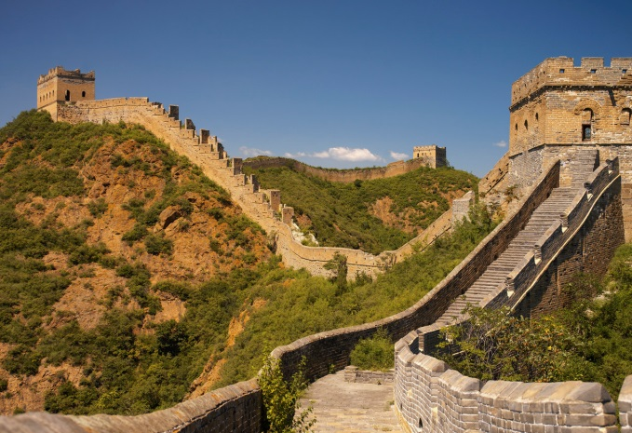
The Great Wall of China
By : Sydney and Morgan

Slide 2
Background Info
The Ancient Chinese workers built it
They started about 476 B.C. and ended about 1644
It was built in Northern China

Slide 3
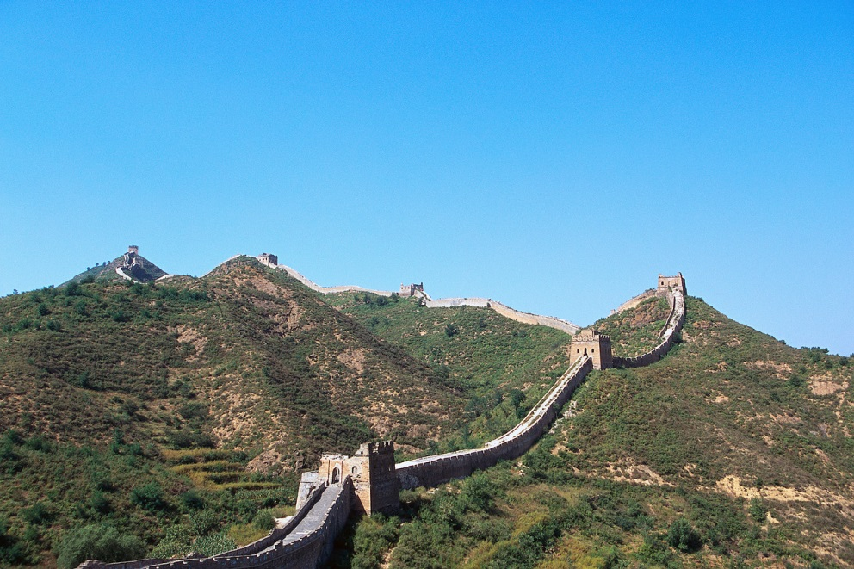
MATERIALS/SIZE
It is 5500 miles long
It is made up of stone, brick, wood, and earth

Slide 4
What is it used for????
The great wall is used as a barrier.

Slide 5
INTERESTING FACTS
It is the world’s longest human made structure.
It is one of the greatest wanders of the world.
The great wall of China is a Chinese cultural symbol
It took 2000 years to build
It goes all the way through China

Slide 6
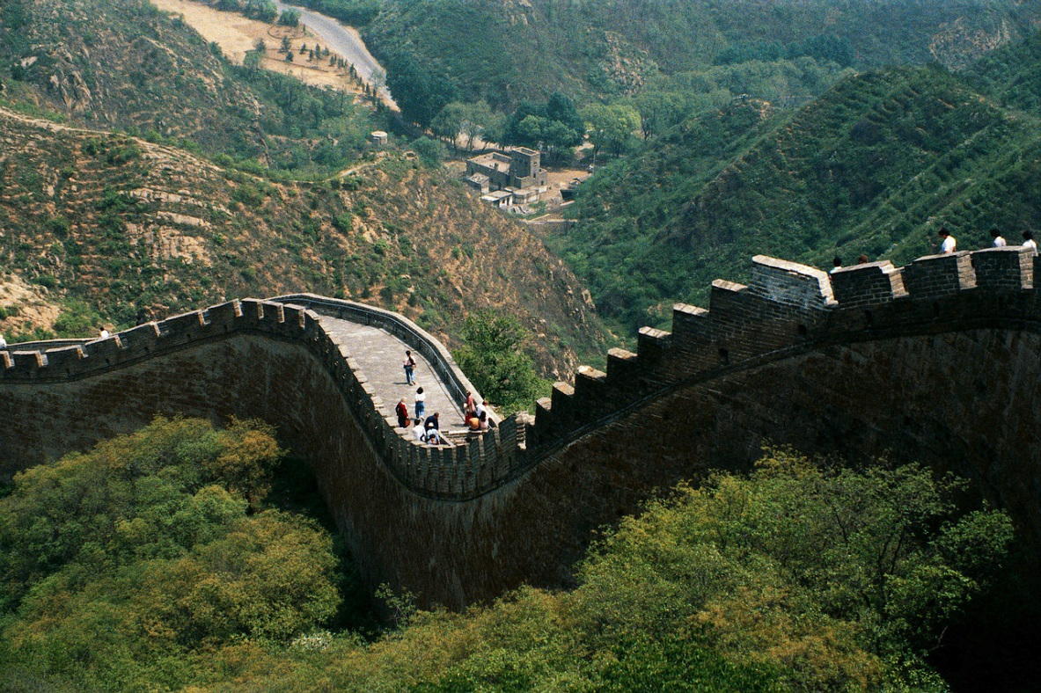
Websites
www.greatwall-of-china.com
www.travelchinaguide.com

