Slide 1
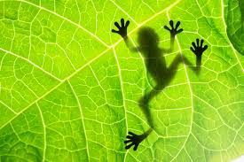
Introduction to Biology & Inquiry Skills
This Week’s Unit
Welcome to Room D14
With
Mr. Graves

Slide 2
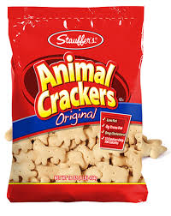
Peter really hates eating animal crackers!
Flashcard #1
Say it 6 times to a partner!

Slide 3
Problem Question
#2

Slide 4
Investigate Inquire
#3

Slide 5
Prediction Guess
#4
Another trick~
“Formulate” a
hypothesis

Slide 6
Conduct an experiment. Test your hypothesis.
#5

Slide 7
Observe Record
#6

Slide 8
Summarize Publish results
#7

Slide 9
Gather supplies Publish results
#8

Slide 10
Research
#9

Slide 11
Always tell the teacher!
#10

Slide 12
Tell the teacher!
#11

Slide 13
Tell the teacher! THEN get the fire extinguisher.
#12
I know this is not realistic but it is what the test is wanting you do answer!

Slide 14
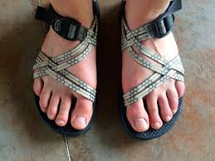
Because you could spill something corrosive or drop something sharp on your bare feet!
#13

Slide 15
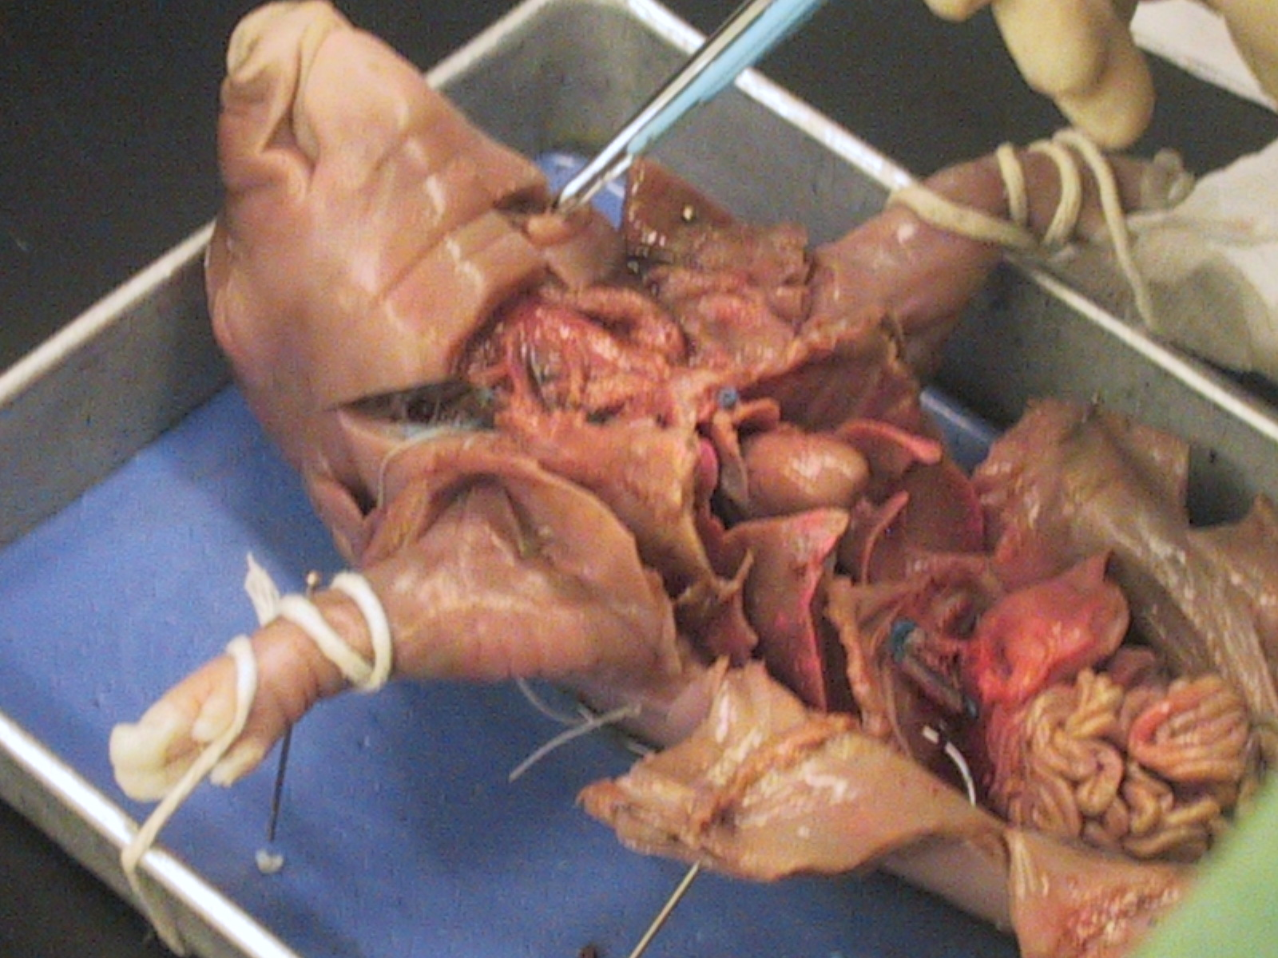
So that it doesn’t catch on fire or you don’t get pig guts in it!
#14

Slide 16
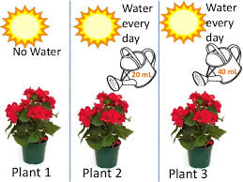
Independent variable Dependent variable Control variables
#15

Slide 17
Independent variable
#16
Draw an “I”
Now turn it into a “T” for “testing.”
It’s rarely the people, plants, or animals that you are testing!

Slide 18
Dependent variable
#17
Draw a “D”.
Now turn it into an “R” for “results”

Slide 19
Controlled variables
#18
Everything else in the experiment should stay the same!

Slide 20
Control group
#19
This group usually does NOT have the IV

Slide 21
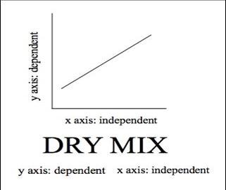
DRY MIX
#20
Draw an L shape graph and label
DRY MIX

Slide 22
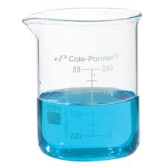
When you need to stir or mix something.
#21

Slide 23
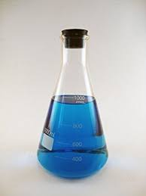
When you need to seal something up.
#22

Slide 24
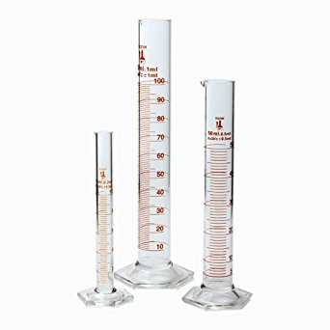
When you need more precise measurements.
#23
Example:
37 mL instead of
40 mL

Slide 25
Written or asked in reverse on the test!
#24
This is a common way to try to trick you!

Slide 26
YES! It’s all in how they ask the question!
#25
Example: ABCD
Is ABD still in alphabetical order?

Slide 27
Because they’re not usually the exact same words or pictures on the real test!
#26
This is another common way to trick you!

Slide 28
Do what he asks. And remain quite, in your seat with your hands to yourself
#27

