Slide 1
Geometry
Finding the missing Side Lengths of Irregular Figures
6.G.1
Notes:
TEACHERS! Read the notes section of each slide for answers.

Slide 2
Today,
we are going to focus on a skill that will help us find the area of some pretty strange looking shapes called complex figures.
Notes:
Teachers! The words Composed and Decomposed in used in this standard. Now would be a good time to explain what we me by “composed”.
Composed: Something that is made up of parts.
Decomposed: Means to break something down.

Slide 3
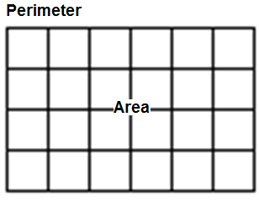
Vocabulary Review
PERIMETER
In previous years, you learned about Perimeter.
Perimeter is the distance around the outside of a shape
and is measured in regular units such as in, ft, mi.
AREA
Area is the measurement of the region inside of a shape and is measured in square units such as in², ft², mi².
Area = 24 u²
Perimeter = 20 u

Slide 4
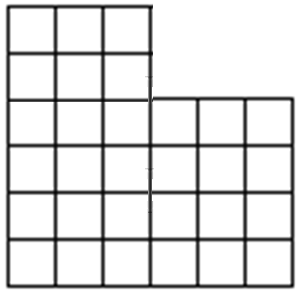
Vocabulary Review
A COMPLEX FIGURE is a figure that can be divided into more than one of the basic shapes. Some people call these figures irregular figures.
This complex shape is composed of two rectangles.

Slide 5
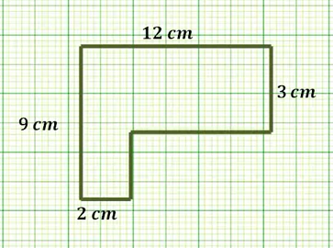
Look around the perimeter of this complex shape.
Do you see any missing lengths?
There are times when you may need to figure out a missing length before you can calculate the area.
Watch Video
https://www.youtube.com/watch?v=0HfnFXm7zHI

Slide 6
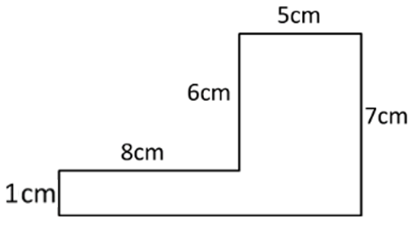
Sometimes you may need to ADD some numbers together to find a missing length.
Hint:
The side with the missing length is horizontal.
Now look for any horizontal sides that are directly across the street.
The 8 and the 5 will help you find your missing length.
?
8 + 5 = 13
Notes:
Missing Length Add: 8 + 5 = 13 cm

Slide 7
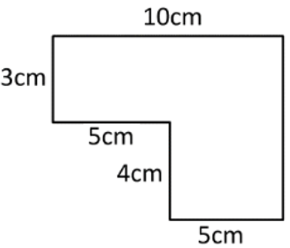
Let’s Look at This One
Hint:
The side with the missing length is vertical.
Now look for any vertical sides that are directly across the street.
The 3 and the 4 will help you find your missing length.
?
3 + 4 = 7
Notes:
Missing Length Add: 3 + 4 = 7 cm

Slide 8
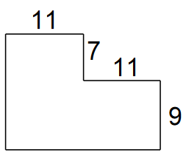
You Try - #1
This figure is missing a length of a horizontal and a vertical side.
Find the missing lengths.
Notes:
Missing Lengths 16 units and 22 units

Slide 9
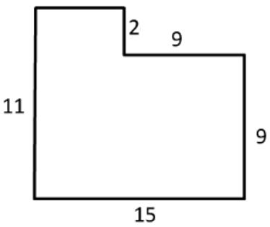
Sometimes you may need to SUBTRACT some numbers to find a missing side length.
Hint:
The side with the missing length is horizontal.
Now look for any horizontal sides that are directly across the street.
The 15 will help you find your missing length.
15 – 9 = 6
?
How can we use the 15 to help us find the missing side length?
What would we need to subtract from 15?
Notes:
Missing Length Subtract: 15 – 9 = 6 units

Slide 10
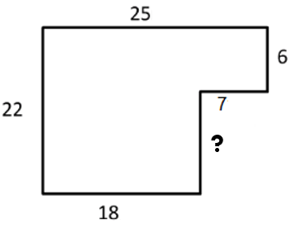
Let’s Look at This One!
Hint:
The side with the missing length is vertical.
Now look for any vertical sides that are directly across the street.
The 22 will help you find your missing length.
How can we use the 22 to help us find the missing side length?
What would we need to subtract from 22?
?
22 – 6 = 16
Notes:
Missing Length Subtract: 22 – 6 = 16 units

Slide 11
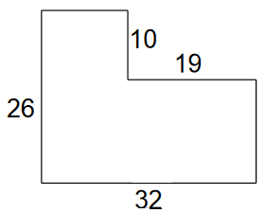
You Try - #2
This figure has two missing sides. Figure out the missing side lengths.
Notes:
Missing side lengths are13 units and 16 units

Slide 12
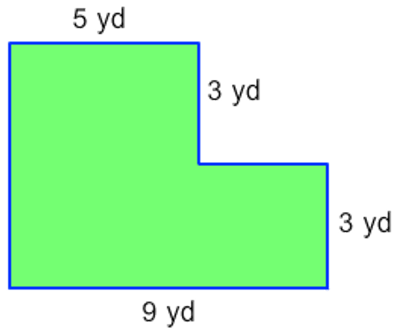
LAST ONE!
You Try - #3
This figure has two missing sides. Figure out the missing side lengths.
Notes:
Missing side lengths are 6 yd and 4 yd

Slide 13
End of PowerPoint

