Slide 1
Agricultural Geography
Basics Terms and Concepts

Slide 2
Agricultural Revolutions
First Agricultural Revolution – pages 315-319
Farming is new to the earth – about 12,000 years old - Surplus→Sedentary→Urban
1st – Root plants first cultivated in S and SE Asia 12,000 years ago – small population explosion, outmigration, diffusion of farm techniques, foragers absorbed
Plant Domestication chart – pages 315-318
Animal Domestication - Cattle first domesticated for religious purposes. Goat, pigs, sheep soon after. p. 318
Agricultural Innovations – map p. 316

Slide 3
Subsistence Farming – map p. 325
Growing of enough food to survive. Usually do not own land, may move often
Understand how colonialism and neocolonialism have impoverished many already poor subsistence farmers

Slide 4
Shifting Cultivation
Nutrients leached out, crops won’t grow anymore – so they move to another area.
AKA - Slash and burn, milpa, patch agriculture, swidden – mostly the use of fire
Not as wasteful and destructive to the environment as it appears. Why?
Nomadic existence- therefore lower populations

Slide 5
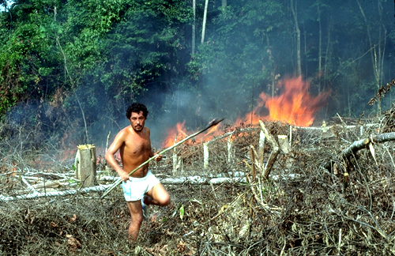
Swidden – from the Americas https://sites.google.com/a/risd.edu/indigenous-architecture-2012/terms/swidden

Slide 6
Milpa – means “small field” in Mesoamerica

Slide 7
Slash and Burn or Patch Agriculture http://upload.wikimedia.org/wikipedia/commons/4/4f/Jhum.jpg

Slide 8
Crop Origins and the Columbian Exchange
Old World and New World Products

Slide 9
Why are they called this?

Slide 10
Three Sisters Garden http://faq.gardenweb.com/discussions/2766718/three-sisters-garden http://www.notechmagazine.com/2013/02/how-to-plant-an-iroquois-garden.html

Slide 11
http://slideplayer.com/slide/11032591/

Slide 12
Second Agricultural Revolution – p. 320-321
17th and 18th Cent.
Farming revolutionized
Tools, fertilization, harvesting, storage, distribution, mechanization (rows of crops)
Productivity increased to meet new demand
Better diet means longer life span
More people begin to work in factories
Landscape altered regionally by different peoples & cultures – ranches, paddies, dairy, terraces, wetlands drained, irrigation, deforestation, etc.

Slide 13
3rd Agricultural Revolution – pp. 322-324
late 19th and 20th Century-present
Green Revolution – saved much of world from Malthusian famine – Still in progress
New high-yield crops, techniques
Genetic engineering – but not same as Green Revolution
Drip irrigation, artificial fertilizers, and other technologies
Food production vs population
Remember, last 120 years – 4-fold increase in population AND 8-fold increase in fresh water use – 70% of human water use by agriculture
Disadvantages of the Green Revolution – Economic, Political, Environmental, Social, Gender

Slide 14
Why are agricultural yields at all-time highs? Be able to define and use these terms
Extensive Agriculture
Intensive Agriculture
Mechanization – fossil fuels
Satellite imagery – remote sensing
Specialization
Hybridization
Chemical Technology – herbicides, pesticides, fungicides, artificial fertilizers, irrigation, etc.
Double Cropping
GMO or GMF
Industrialization of Food Production
Here’s first minute of a video as an example of Industrialization:
https://vimeo.com/73234721

Slide 15
Economic Sectors – p. 313-314
Primary or Extractive Activities
farming, mining, hunting (and gathering), timber, fishing, aquaculture. Living earned directly from the land. Most in periphery make their living this way. Most primary products are raw materials for next phase.
These products will need further Processing
Big money (on a natl. Scale) not here

Slide 16
Aquaculture – farming of fish, shrimp, etc. What about the hormones used to make these grow faster? What about the hormones released by human females that are neutering male fish?

Slide 17
Secondary Activities
manufacturing or processing which converts raw materials into intermediate or finished products.
Production – bauxite ore to sheet metal to a skin for jet
Much more money here
Core – semiperiphery mostly, or owned by the core or semiperiphery

Slide 18
Tertiary or Service Activities
Connect producers to consumers. Most mall and downtown businesses are tertiary.
What does Walmart make?
Nothing
Lawyers, teachers, doctors also
Core and semiperiphery mostly – all have service sectors, but are particularly large here

Slide 19
Quaternary and Quinary Activities
Quaternary – information processing – Info Age – high tech collection, recording, arranging, storage, retrieval, exchange and dissemination of information. Govt, culture, libraries, scientific research, education, information technology (IT), and insurance
Quinary – Specialized high tech information. Top executives of highest levels of decision-making in government, science, universities, nonprofit, healthcare, culture and medicine have this kind of information available to them

Slide 20
US and World Agriculture
A brief history of US farmers and agriculture:
Mid 19th C – 2 M farmers with 20 M total pop
1994 – under 2 M farmers – 280 M pop.
2005 – Just over 2.1 M farmers – 300 M pop
Less than 10% of farmers – core or upper semi-periphery
US – less than 1% of the population works in agriculture
Area of cultivation in U.S. increased until about 1870. Generally stable since. This shows how efficient farming has become
Today only about 17% of US land is cultivated
In the periphery – 20, 30, 50 or even 70% of people working to produce food
Thomas Malthus – he never accounted for technology
Is there enough food for everyone in the world?
Then why did we have famines in Somalia in the 1990s?

Slide 21
Organic Agriculture
Organic Agriculture – pages 311-313 – Map 312 – Read this section for:
Sales numbers
Where is the greatest demand?
Where are most organic foods sold (core)?
What kinds are sold (veggies and fruits-43%, food & non-dairy beverages-15% and dairy-9-11%)
“Certified” organic? What is this?
What are the costs of organic foods?
Environmental benefits and costs of organic agriculture

Slide 22
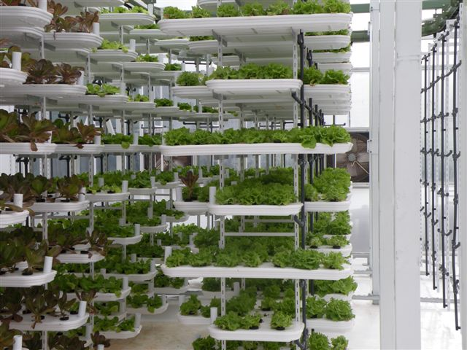
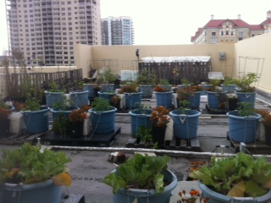
Vertical Farms
Tampa Marriott Hotel rooftop herb garden (below)
Commercial facility (above)
http://eatinggoodly.com/2010/12/31/the-vertical-farm/

Slide 23
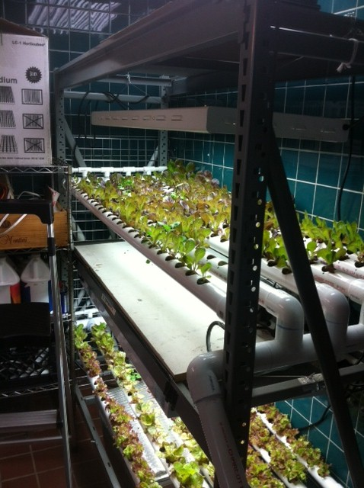
Vertical Farms (not to be confused with vertical integration)
Today called aquaponic
Using warehouses and rooftops
Some are growing tilapia/other fish in the recirculated water
Use fish excrement as fertilizer for plants
Certified organic
Is“on-demand” farming as growers can react to markets quickly
Energy is expensive indoors

Slide 24
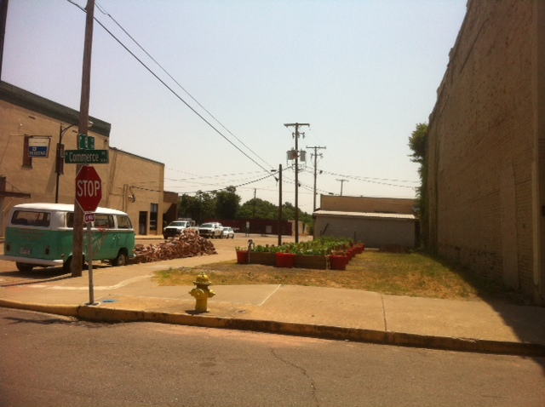
Urban Gardens

Slide 25
Cultural, Genetic, & Other Issues in food
How is land allocated? Land ownership?
What is grown? How is it grown?
How is livestock used?
Why do we consider some animals as pets (dogs/cats) that is food to others?
What about slaughtering and eating horses?
Food Taboos - What foods are forbidden or avoided? (pork, beef, shellfish, alcohol, etc.) and why?
What foods are not genetically tolerated? Food allergies (Dairy, eggs, fish)?
“Sell by” and “Expiration” dates on food.

Slide 26
Other agriculture terms and concepts we need to know
Core-Periphery Relationship
Periphery grows farm products for core, but the core determines the prices of products.
Many governments keep farm product prices artificially low
Subsidies – If a farmer can grow wheat for $1.00 a bushel, what happens if the market comes in at $.90 a bushel
http://farm.ewg.org/
Sustainable agriculture
Food Security

Slide 27
Plantation Agriculture – p. 333-335
Plantation agriculture is a commercial tropical agriculture system which is essentially export-oriented. The local government and foreign/ international companies exploit the natural resources of the area for making profit, usually short-term economic gain. It often involves the deliberate introduction and cultivation of economically desirable species of tropical plants at the expense of widespread replacement of the original native and natural flora.
They are often associated with plantation agriculture are widespread modifications or disturbance of the natural landscapes through such artificial practices as the permanent removal of natural vegetation, drainage improvement, soil improvement and application of chemicals, etc. For example, rubber plantation/oil palm plantation in West Malaysia
http://library.thinkquest.org/26634/forest/farming/plantation.htm

Slide 28
Tea Plantation

Slide 29
Commercial Agriculture – pp. 335-336
Modern commercial agriculture has its roots in colonialism
Europe became a market for agricultural products and other raw materials brought in from the colonies
Also, the colonials sold finished products, like clothing, back to the countries where the cotton came from (Egypt, Sudan, India, etc.)
Monoculture – many colonized countries became famous for the one crop they grew
Ghana – cacao
Mozambique – cotton
Sri Lanka – tea

Slide 30
More Agriculture Terms
What is a staple crop?
A crop which people can eat and use every day
What is a cash crop? (pp. 323, 325, 333, 334)
Nonsubsistence farming practices and products usually implemented by colonial powers. Examples are:
Cotton and Rubber, or even sugar (page 338)
What is a luxury crop? – p. 338
Crops which are not necessary for human survival. Examples include:
Tea, coffee, sugarcane, cacao, tobacco

Slide 31
Market Gardening http://encyclopedia2.thefreedictionary.com/truck+farming
Intensive farming
Cultivation, on suburban land of higher value, of vegetables and flowers for the supply of nearby cities.
Heavy fertilizing and the planting of successive crops are employed to obtain continuous returns from the high bid rent acreage

Slide 32
Truck Farming or Truck Products http://encyclopedia2.thefreedictionary.com/truck+farming
horticultural practice of growing one or more vegetable crops on a large scale for shipment to distant markets. It is usually less intensive and diversified than market gardening.
For your casual reading…
At first this type of farming depended entirely on local or regional markets. As the use of railroads and large-capacity trucks expanded and refrigerated carriers were introduced, truck farms spread to the cheaper lands of the West and South, shipping seasonal crops to relatively distant markets where their cultivation is limited by climate. The major truck-farming areas are in California, Texas, Florida, along the Atlantic Coastal Plain, and in the Great Lakes area. Centers for specific crops vary with the season. Among the most important truck crops are tomatoes, lettuce, melons, beets, broccoli, celery, radishes, onions, cabbage, and strawberries.

Slide 33
What is Mediterranean agriculture? p. 336 Dry summers & cool winters; located on western sides of continents (generally); grapes, wine, olives, citrus, figs, fruits, dates

Slide 34
Ethanol Production

