Slide 1
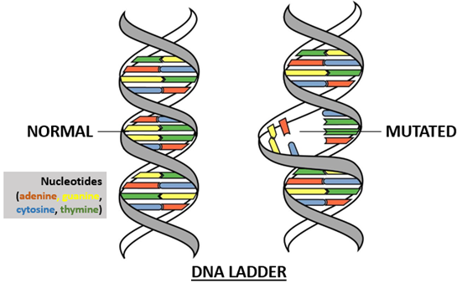
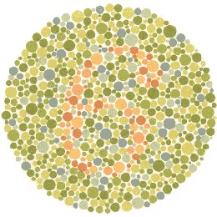
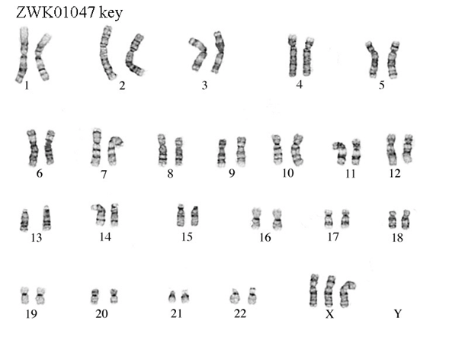
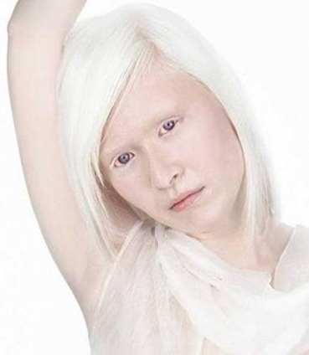
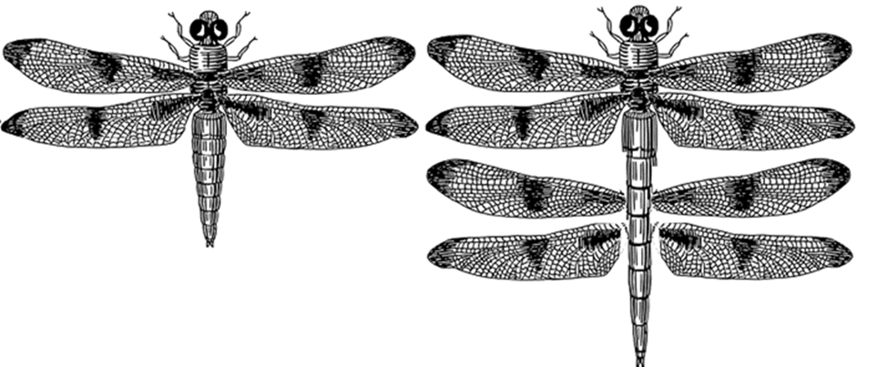
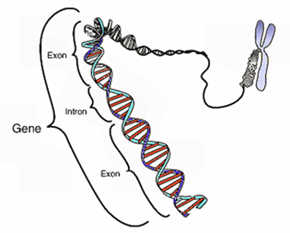
GENETIC DISORDERS: Mistakes in the DNA code
MIZZZ FOSTER © 2015

Slide 2
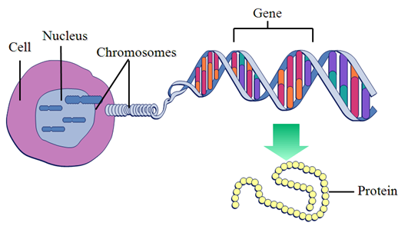
Quick review of Genes and Proteins
Genes are a sequence of DNA nucleotides which code (codons) for the building of a polypeptide chain at the ribosome which will be folded into a protein inside the rough endoplasmic reticulum.
Proteins are long chains of amino acids (polypeptide chains) which are folded into a specific 3-D shape and have a specific function. They are the foundation of an organism’s physical and behavioral characteristics.

Slide 3
What are genetic mutations?
When a “mistake” is made in the DNA sequence or chromosome which causes the wrong amino acid or group of wrong amino acids to be placed into a polypeptide chain.
This results a different or altered protein.
Mutation can be GOOD or BAD.
Bad mutations lead to an unhealthy organism which are unfit for their environment.
Good mutations can create a more fit and stable organism and drive evolution.

Slide 4
How do you think the extra set of wings will affect the dragon fly?
Think of both good and bad effects.

Slide 5
Mutations
Most mutations either occur within the DNA strand or to the chromosomes.
Types of mutations are: Deletion, Insertion, Duplication, Inversion
These mutations go unnoticed when they benefit a species, but are noticed when they cause disorders and syndromes.

Slide 6
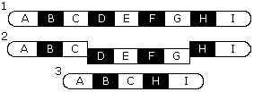
Deletion
A single nucleotide, group of nucleotides, piece of chromosome or whole chromosome is deleted or missing from the organism’s genome.

Slide 7
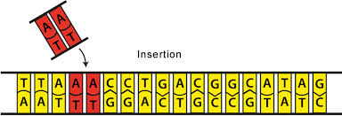
Insertion
A single nucleotide, group of nucleotides is added into a DNA strand. A piece of chromosome or whole chromosome is added into an organism’s existing chromosomes.

Slide 8
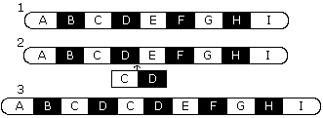
Duplication
A single nucleotide, group of nucleotides is duplicated within a DNA strand. A piece of chromosome or whole chromosome is duplicated in an organism’s genome.

Slide 9
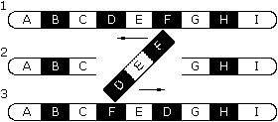
Inversion
A single nucleotide, group of nucleotides is flipped and reinserted into a DNA strand. A piece of chromosome is flipped and reinserted into an organism’s existing chromosome.

Slide 10
SINGLE DNA STRAND MUTATIONS
Mutations which occur within a single gene (DNA sequence) and will only affect one protein.
Point Mutation
Frameshift Mutation
Duplication Mutation
Inversion Mutation

Slide 11
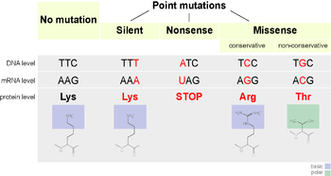
POINT MUTATION
Caused by a single nucleotide being deleted, substituted, or inserted into an existing DNA sequence.
Will cause a change in a single amino acid used to build the protein.
The single change can cause a protein to be malformed or nonfunctioning.

Slide 12
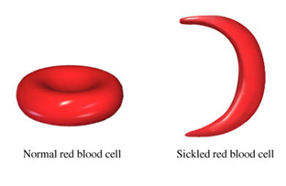
Point Mutation Disease: Sickle Cell Anemia
The codon GAG mutated to GTG which causes the wrong amino acid to be placed in the hemoglobin polypeptide chain.
The point mutation causes hemoglobin to have “sticky” ends and stick together when red blood cells are not carrying oxygen which causes them to elongate into the sickle shape.
When the red blood cells are carrying oxygen they retain a normal round shape.
The constant changing of shape shortens the RBC life to 10 – 20 days instead of 90 – 120 days.

Slide 13
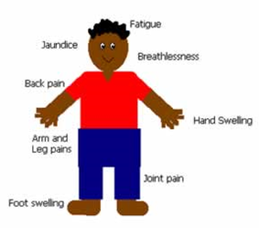
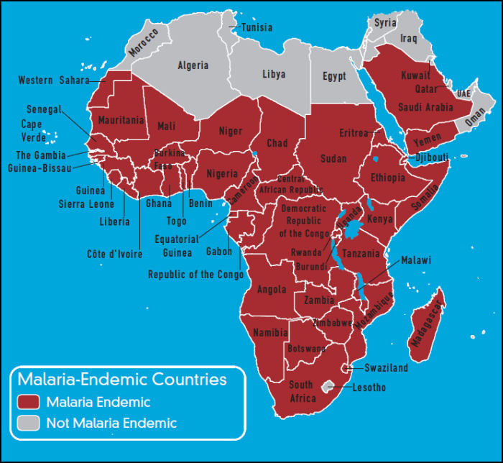
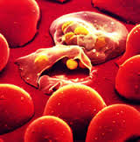
Point Mutation Disease: Sickle Cell Anemia
Found primarily in African descendants and African Americans.
In Africa sickle cell anemia protects against malaria because the malaria parasite is unable to stay inside the changing red blood cells.
In Africa sickle cell anemia increases children’s rate of survival who carry the gene which results in a high portion of the population being heterozygous for sickle cell anemia.

Slide 14
Point Mutation Disease: PHENYLKETONURIA = PKU
The codon GAT mutated to GTT in the enzyme responsible for phenylalanine breakdown is nonfunctional.
People with PKU cannot break down phenylalanine instead it builds up as a poison and causes irreversible neurological damage.
Children born normal will develop mental retardation and damaged nerves from consuming foods with phenylalanine.

Slide 15
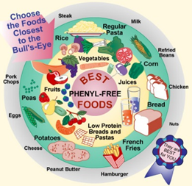
Point Mutation Disease: PHENYLKETONURIA = PKU
They must take care to NOT eat foods with phenylalanine.
Food labels are required by law to state whether or not phenylalanine is present.
This bull’s eye graphic is a great resource for determining which foods are safe.

Slide 16
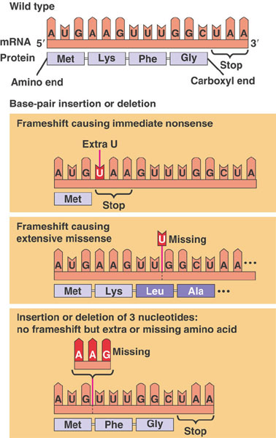
FRAMESHIFT MUTATION
When two or more nucleotides cause two or more amino acids to be changed resulting in a nonfunctioning or poorly functioning protein.
Can be caused by deletion, insertion, duplication or inversion.

Slide 17
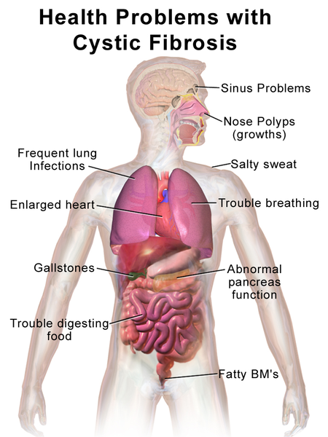
Frameshift Mutation Disease: Cystic Fibrosis
Cystic Fibrosis- Three nucleotides “G A A” have been deleted which results in a frameshift mutation causing two amino acids to be missing from the final cellular membrane protein which absorbs Chlorine.
Cystic fibrosis results in salty skin, greasy stool, phlegm build up in lungs, poor growth.
Found in European Americans and is a recessive gene.

Slide 18
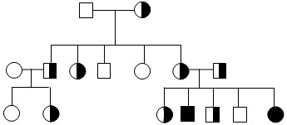
Frameshift Mutation Disease: Cystic Fibrosis
Because cystic fibrosis is a deadly disease many people who carry the gene go through genetic counseling.
A pedigree is a genetic family tree used in genetic counseling to trace the inheritance of a gene.
Circles are female and squares are men.
Pedigrees allow people to predict the possibility of inheriting a trait.

Slide 19
Duplication Mutation
In single strand DNA mutations, duplication mutations cause a repeat in the codons.
Repeats in codons cause additional amino acids to be added to the polypeptide chains.
The polypeptide chain ends up being folded into a larger than normal protein and can possible cause harm to an organism.

Slide 20
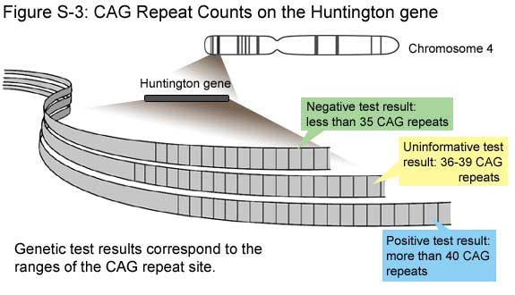
Duplication Mutation: HUNTINGTON DISEASE
Huntington disease is a degenerative disease that affects people as they get older.
The Huntington gene is located on chromosome 4’s short arm and has a sequence of CAG repeats.
Normal people only have 10 – 35 repeats.
People who develop Huntington’s disease have 40 or more repeats. The more repeats the earlier the disease’s symptoms show up in a person.
The earliest documented case was in a 2 year old boy who had 100 repeats of CAG.

Slide 21
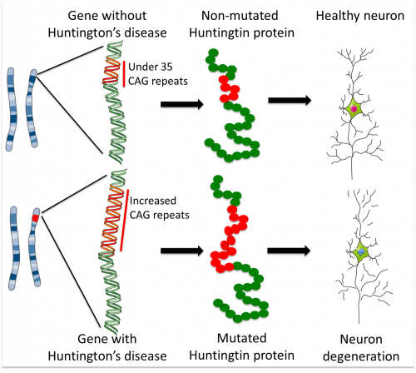
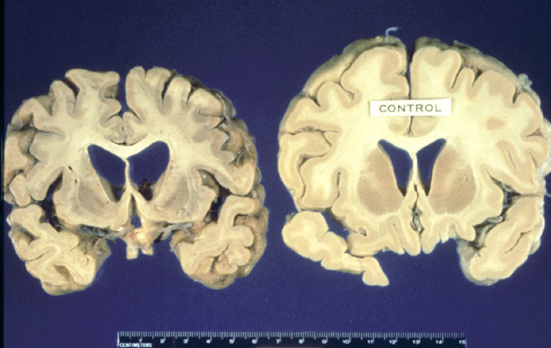
Duplication Mutation: HUNTINGTON DISEASE
All the extra CAG repeats cause the Huntingtin protein to be much larger and have too many glutamines.

Slide 22
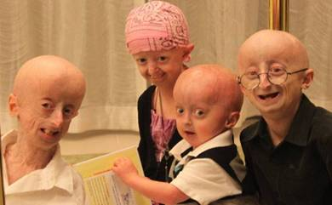
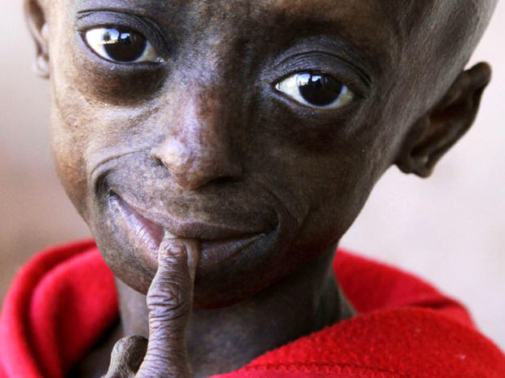
Inversion Mutation: PROGERIA
In the Inversion mutation a segment of DNA is sliced away, flipped and reinserted into the DNA sequence.
Progeria is an inversion genetic disorder that causes premature aging in people.
The inverted gene is located on chromosome 1.

Slide 23
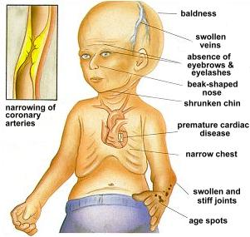
Inversion Mutation: PROGERIA
Children who have Progeria experience the same degenerative ailments as the elderly and die from things such as heart attack and stroke.
Progeria severely decreases the lifespan to only 11-19 years.

Slide 24
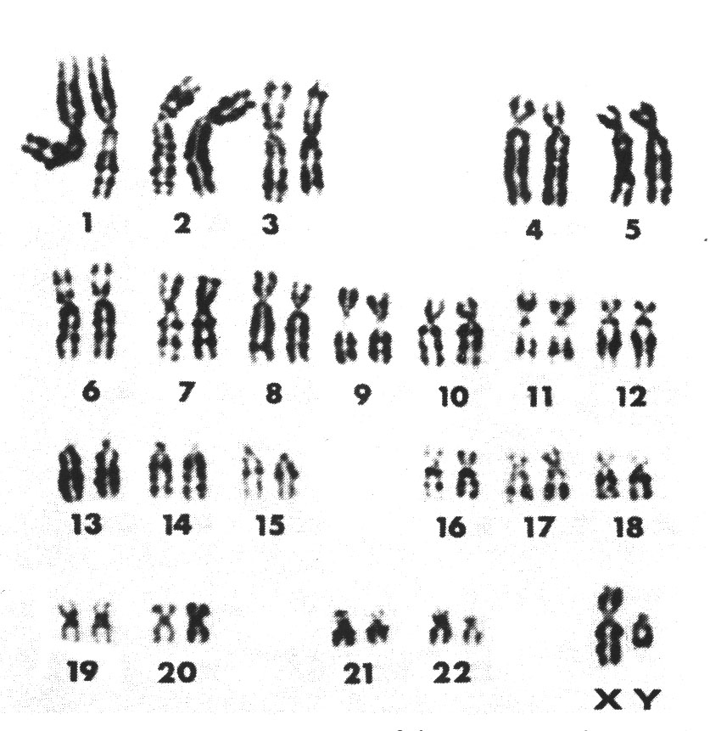
CHROMOSOMAL MUTATIONS
Mutations which affect the entire chromosome by extra copies, deletions, parts missing or translocated. Whole groups of proteins are affected.
Karyotypes are a photograph of a person’s chromosomes. Karyotypes are used to diagnose chromosomal mutations.
Normal karyotypes should only have two chromosomes at each number.
An person receives on set of chromosomes 1-23 from mom and one from dad.

Slide 25
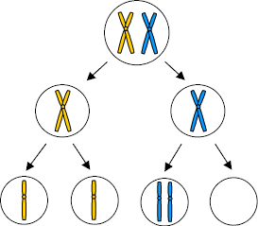
Nondisjunction
Two copies of a chromosome do not properly segregate during meiosis and end up in the same gamete leaving another gamete without the chromosome.
Nondisjunction causes polysomy and monosomy.

Slide 26
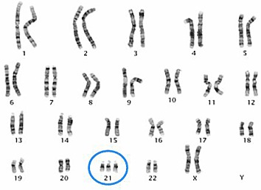
Chromosomal Mutation: POLYSOMY
More than 2 copies of a single chromosome resulting in excess proteins being synthesized.

Slide 27
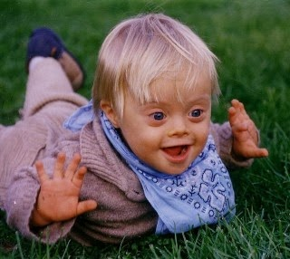
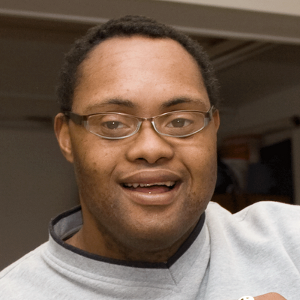
Downs Syndrome: Trisomy 21
Three copies of chromosome 21. A person affected has mental retardation, developmental delays, shorter stature, and some organ dysfunction. Modern medicine has helped to increase life span.
Downs Syndrome can be the result of gametes having an extra chromosome 21 or the early embryonic cells had a case of nondisjunction.

Slide 28
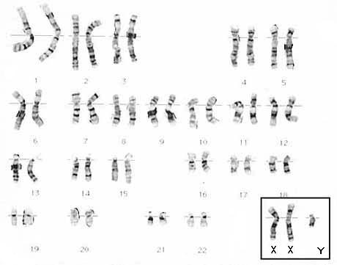
Klinefelter’s Syndrome
Nondisjunction of the sex chromosomes resulting in three sex chromosomes instead of only one. There are two types: XXX or XXY.
XXX can not be diagnosed without a karyotype and show no symptoms.
XXY results in a sterile male.
XXY is the one referred to as Klinefelter’s Syndrome.

Slide 29
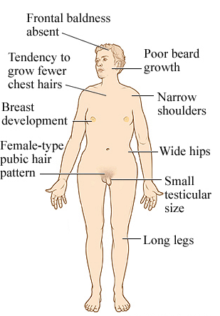
Klinefelter’s Syndrome
The XXXY male is sterile and can not father children.
They exhibit language impairment, gynecomastia, breast cancer, arthritis, varicose veins, pulmonary disease, and osteoporosis.
They have male and female characteristics, but do have male genitalia.

Slide 30
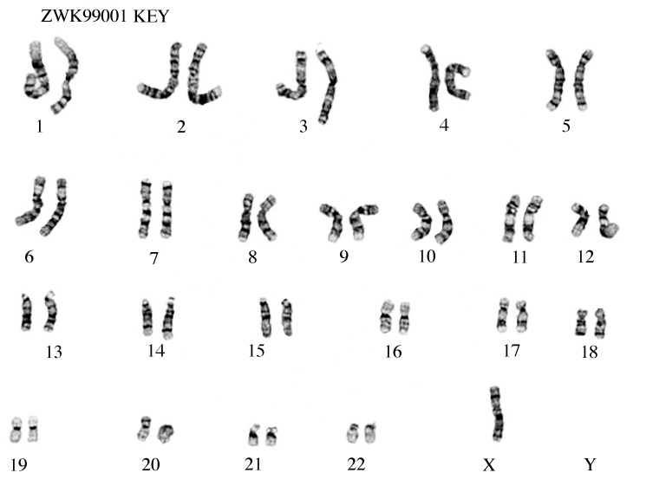
Chromosomal Mutation: MONOSOMY
Monosomy is when only one copy of a specific chromosome is present in an organism resulting in a lack of protein.

Slide 31
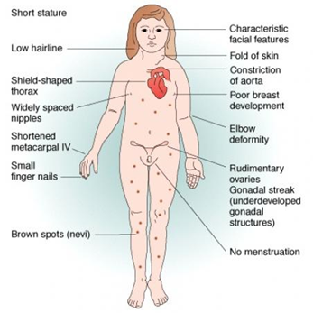
Turner’s Syndrome
Monosomy of the sex chromosomes.
Only found in females, results with only one X chromosomes.
Women with Turner’s syndrome are sterile, short stature, no ovarian development, no puberty, webbed neck, thyroid and skeletal problems. No menstruation.

Slide 32
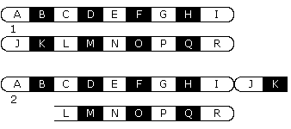
Translocation
A piece of one chromosome breaks off and joins to another chromosome. These mutations are difficult to diagnose because often they have no detrimental affect to the organism.

Slide 33
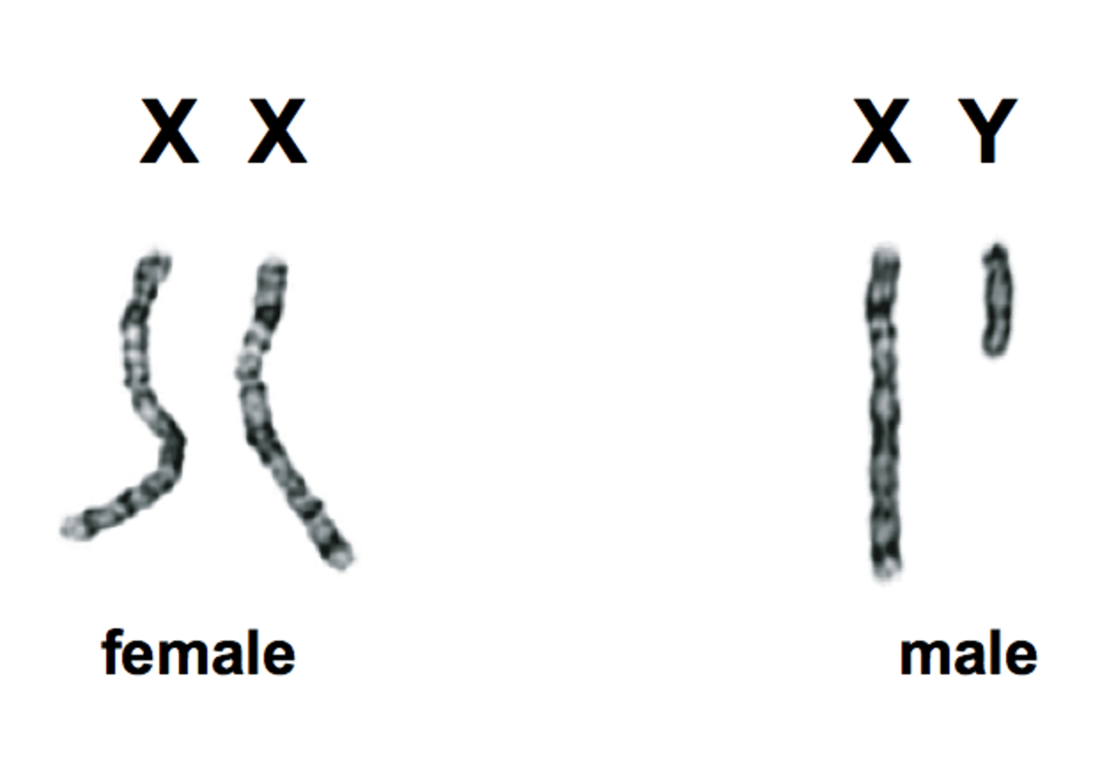
Sex-Linked Genetic Disorder
Mutations found on the sex chromosomes or affecting the sex chromosomes as we saw in Kleinfelter’s and Turner’s syndromes.
Most sex-linked genetic disorders are found on the X chromosome and passed from mother to son.
Women can sometimes have the disorder if they have a carrier mother and an affected father.

Slide 34
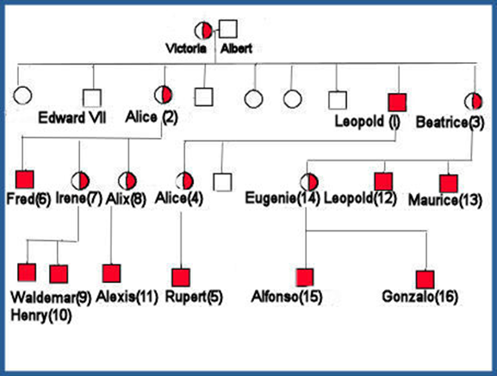
Sex-linked genetic disorder: HEMOPHILIA
Sex-linked genetic disorder on the X chromosome which affects blood clotting factors.
It is mostly found in males but can show up in females.
People with hemophilia are at a high risk of bleeding to death.
Hemophilia caused the death of many males in Queen Victoria’s family line.
Women can have hemophilia if it is on both X chromosomes.

Slide 35
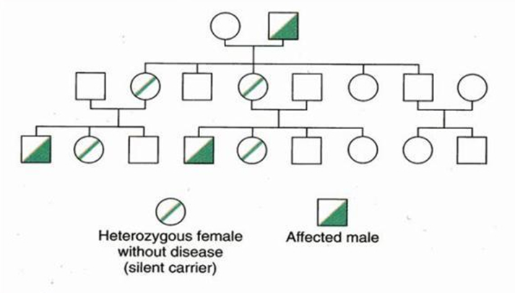
Sex-linked genetic disorder: COLORBLINDNESS
Sex-linked gene found on the X which interferes with a person’s ability to see color.
Some people have blindness in pairs of colors and few can see no color.
Mostly found in males and inherited from their mothers.
Women can be colorblind if they carry the gene on both x chromosomes.

Slide 36
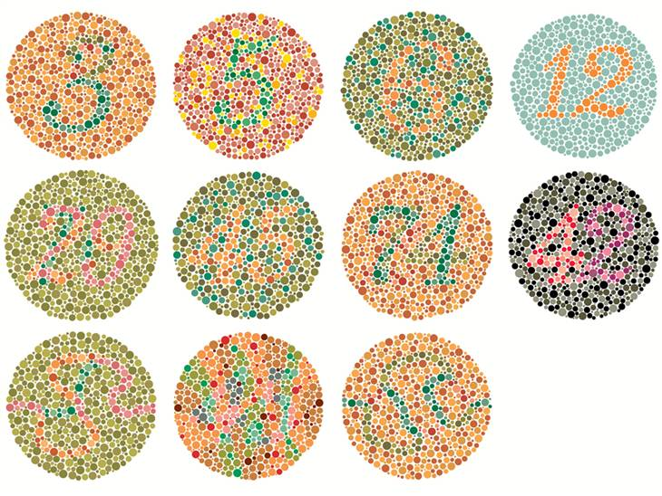
Sex-linked genetic disorder: COLORBLINDNESS
Colorblind test

Slide 37
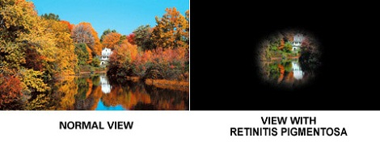
Sex-linked genetic disorder: Y-chromosome diseases
Lack of sperm production
Retinitis Pigmentosa
This mutation happens on the chromosome in an individual. They may not have children as a result.
A chronic hereditary eye disease characterized by black pigmentation and gradual degeneration of the retina.

Slide 38
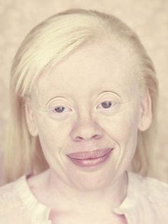
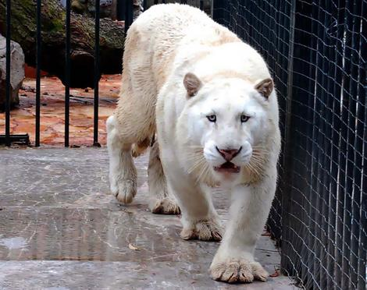
ALBINISM
Genetic disorder where the enzymes needed to produce melanin (pigment protein) are nonfunctioning resulting in an organism which is absent of color.
Albinism affects ALL organisms: Protists, plants, animals and fungus.

