Slide 1
WHAT IS A DRUG?
Lesson 1

Slide 2
DO NOW: (5 minutes)
Using a Post-It note, answer the questions below and stick your response to the chart paper on the wall.
What is a drug?
What is the first thing that comes to mind when you hear the word “drug”?
Notes:
Tell students:
“Using a Post-It note, answer the question below and stick your response to the chart paper on the wall. What is a drug? What is the first thing that comes to mind when you hear the word “drug?” This should take you about 5 minutes. We will review your responses after the pre-survey.”

Slide 3
LESSON OBJECTIVES
After completing this lesson:
I can define drug.
I can analyze how personal values and culture supports and challenges health beliefs, practices and behaviors surrounding drugs and drug use.
Notes:
Tell students:
“At the beginning of each lesson we will preview the lesson’s objectives. These objectives will let you know a little insight to what we will be learning in that lesson and be ideally what you are supposed to have learned in that lesson.”
Ask students:
“ Can someone read today’s lesson objectives?”

Slide 4
SURVEY: (20 minutes)
Notes:
Tell students:
“ Today we are starting a drug education program called ‘Safety First’.
Before we begin, we’re going to take a pre-survey. This test is anonymous and it is not graded. Its purpose is to help me and the program developers learn more about our classes’ knowledge, attitudes and beliefs about drugs. Please answer as honestly as you can – and remember not to put your name on the survey.”

Slide 5
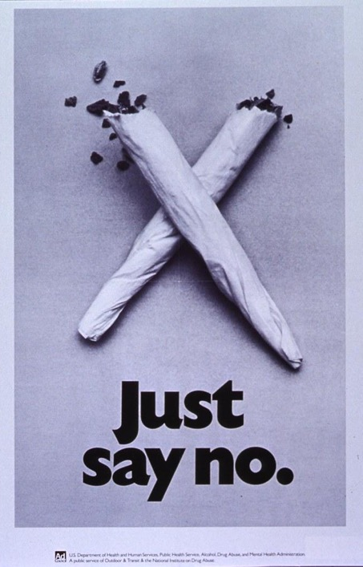
WHAT’S THE PHILOSOPHY BEHIND SAFETY FIRST?
Americans have been trying to prevent teenagers from drug use for more than a century. A variety of methods, from scare tactics to “Just Say No” techniques, have been used to try to persuade, coax and force young people to abstain.
Safety First is designed in the philosophy of harm reduction. This means helping people reduce risks by making the healthiest choice possible, based on current evidence-based research, and without judgment.
Notes:
Tell students:
“ Americans have been trying to prevent teenagers from drug use for more than a century. A variety of methods, from scare tactics to “Just Say No” techniques, have been used to try to persuade, coax and force young people to abstain.
“ Safety First is designed in the philosophy of harm reduction. This means helping people reduce risks by making the healthiest choice possible, based on current evidence-based research, and without judgment.”

Slide 6
HARM REDUCTION STRATEGIES
Do not:
Do:
Encourage or condone teen drug use.
See abstinence as an important strategy in reducing drug harms.
Teach teens how to use drugs.
Recognize that some teens will try drugs.
Judge teens who use drugs.
Empower teens to make healthier choices through accurate information.
Encourage teens to take steps to reduce the potential harms of drug use.
Notes:
“ The program’s goal is to help you make healthier decisions about drug use by providing you with real and honest information. Over the next few weeks we’re going to talk about the risks, benefits and potential harms of drug use. We’re going to ask ourselves how we know the information we get about drugs is accurate. And finally, we’ll discuss what you can do to help keep yourself and your friends healthier and out of harm in situations where drugs are involved.
“ Harm reduction is a set of strategies that encourages people to make the safest and healthiest choice they can based on their circumstances. Although it can apply to choices like wearing a seatbelt to minimize the risk of injury in a car accident, it usually refers to alcohol and other drug use. The purpose of this curriculum is to teach you harm reduction strategies to be used throughout your life.
“ Harm reduction does not
- encourage or condone drug use.
- It doesn’t teach people to use drugs.
- But it also doesn’t stigmatize or negatively judge people who
use drugs.
“ Instead, harm reduction encourages people to make the healthiest choice.
- See abstinence as an important strategy in reducing drug harms.
- Recognize that some teens will try drugs.
- Empower teens to make healthier choices through accurate
information.
- Encourage teens to take steps to reduce the potential
harms of drug use.
“ Take smoking cigarettes. The healthiest choice is not to smoke them. People who don’t smoke are using an important harm reduction strategy called abstinence – or the choice to not use drugs.”
Ask students: Encourage student response.
“ But what if someone smokes already? How could that person reduce harm?”
Tell students:
“ Some ways that person could reduce harm include cutting down on the number of packs smoked in a day or committing to smoking only on the weekends or at social events. They might not ever quit smoking cigarettes completely – which, again, would be the healthiest option – but they would be making healthier choices. Harm reduction recognizes that it isn’t realistic to expect all people to abstain from drug use, but it does encourage people to make the least risky choice.”

Slide 7
CLASS NORMS
One Mic
Step Up/Step Down
Assume good intent, acknowledge impact
Vegas Rule: “What happens in Vegas stays in Vegas”
SWIM: Someone Who Isn't Me
Disagree with ideas, not people
Is there anything else you would add to the list?
Notes:
Tell students:
“ Today, we are going to establish some classroom norms to insure that we create a learning environment where we all feel respected, we feel safe and we feel free of judgement.
“ Our first norm we are going to establish is “One Mic”. This basically means that one person is talking at a time.
“ The second norm we are going to establish is “Step Up/Step Down”. If you are someone who “Steps Up” and participates a lot, make sure you are leaving space for other students to participate as well and “Step Down”. If you are someone who does not participate often in conversations, Step Up and let your voice be heard. The purpose of the first two norms is to ensure that everyone gets to share their ideas equally and one person is not dominating the conversation.
“ Norm number three is to “Assume Good Intent, and Acknowledge Impact.” When people are expressing different viewpoints, if you are feeling defensive or conflicted, do not attack or assume the person is saying this to upset you. But, do acknowledge the impact that their comment has made to class discussion. Say something like, “What you are saying made me feel like…” or ask clarifying questions.
“ It is also important that we keep the information that is shared in class confidential. This is why we are going to establish norm number four and norm number five.
“ Norm number four is the “Vegas Rule.” What happens in Vegas stays in Vegas, right? We’ll apply the same to the class: what is said in the classroom, MUST remain in the classroom. Do not repeat stories or discussion from this classroom. We will keep what is shared in the classroom confidential.
“ The fifth norm is S.W.I.M., which stands for “Someone Who Isn’t Me.” So, if you are sharing about someone’s experience or your experiences with drugs, do not use names or personal details – even if the person is yourself. Try using language like, ‘I know someone who…’ or ‘I heard about something that happened at a party…”
“ And lastly, the sixth norm is “Disagree With Ideas, Not People.” Comments and questions should be stated in a way that promotes greater insight or awareness on an issue, not to cause a conflict with a classmate.”
Ask students:
“ Is there anything else you would add to the list?”

Slide 8
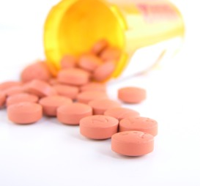
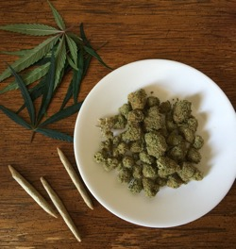
CLASS DISCUSSION
Let’s review your responses to the Do Now question.
What is a drug?
What is the first thing that comes to mind when you hear the word “drug”?
Reflection:
Do you notice any similarities/differences in your responses?
What do you think influences our ideas and perceptions of what a drug is?
Notes:
Tell students:
“ We’re going to start by reviewing your responses to the question, ‘What is a drug?’ Does anyone want to share what they wrote?”
Educator Notes: Allow students time to discuss their answers. Students may have conflicting opinions; this would be a good time to reinforce discussion norms.
Ask students:
“ Did you notice any similarities and/or differences between responses?”
“ What do you think influences our ideas and perceptions of what a drug is?”

Slide 9
WHAT IS A DRUG?
Drug: any substance that in small amounts produces significant changes in the brain, body or both.
Note: We will be using substance and drug interchangeably in the lessons.
Notes:
Tell students:
“The definition that we will use for ‘drug’ throughout this unit is that a drug is any substance that in small amounts produces changes in the brain, body or both.”
Instruct students to write the definition in their worksheet.

Slide 10
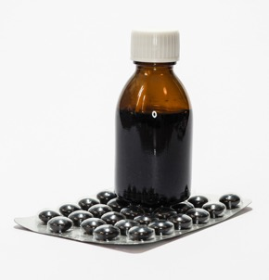
IS IT A DRUG? (3 minutes)
1
2
3
4
5
6
7
8
Notes:
Ask students:
“Based on our definition of drug, which of the examples on the PowerPoint are drugs? On the worksheet, write True next to the substance if you believe it would be classified as a drug. Write False next to a substance if you believe it is not a drug. Take about 3 minutes. If you finish early, pair up with a partner and share your responses.”
Educator Notes: Allow students some time to share out their responses, go through each substance and gather consensus.
Tell students:
“ They are all drugs! Because all of these substances in small amounts will produces changes in the body, brain or both.”

Slide 11
PHILOSOPHICAL CHAIRS
Instructions:
If you agree with a statement, move to the side of the room where the “Agree” sign is.
“I agree with the idea (example) because…”
If you disagree with a statement, move to the side of the room where the “Disagree” sign is.
“I disagree with the idea (example) because…”
Notes:
Educator Notes: Philosophical Chairs Protocol
Inform students that they will read the following statements, and on their worksheet they will discuss the reason(s) for their answer. Depending on time, allow students 10-15 minutes to write responses to the statements.
Teacher will read the statements, and students will move based on their responses. Ask students to move towards the “Agree” sign if they agree with the statement or towards the “Disagree” sign if they disagree with the statement.
Give students 1-2 minutes to discuss why they chose the side they did before moving onto the next question.
Possible modification could include:
Limiting or adding the number of statements depending on time
Allowing students to choose between 3-5 statements (ones they want to discuss more in depth)
Providing students with more time to process their reasons by either writing their “why” on the worksheet or discussing with a partner before beginning the activity
Having students just raise their hands to vote, as opposed to moving around the classroom

Slide 12
AGREE/DISAGREE STATEMENT
Drugs should be illegal and regulated by the government.
All drugs that are legal are good.
The use of marijuana will lead to the use of other drugs, such as cocaine or heroin.
The media and social media encourages teens to use drugs and promotes drug use.
All homeless people use drugs.
Teens feel pressured to try drugs because of what they hear, see or read in the media.
Teens use more drugs than adults.
People who use drugs are bad.
Drug addiction is a disease.
My family and friends have the biggest impact on my ideas about drugs.
Notes:
Read students each statement, and allow them to move to their positions and respond:
“ Drugs should be illegal and regulated by the government.
“ All drugs that are legal are good.
“ The use of marijuana will lead to the use of other drugs, such as cocaine or heroin.
“ The media and social media encourages teens to use drugs and promotes drug use.
“ All homeless people use drugs.
“ Teens feel pressured to try drugs because of what they hear, see or read in the media.
“ Teens use more drugs than adults.
“ People who use drugs are bad.
“ Drug addiction is a disease.
“ My family and friends have the biggest impact on my ideas about drugs.

Slide 13
EXIT TICKET
On an index card or on your worksheet, answer the question below.
(Turn in your index card before you leave class.)
What do I want to learn about drugs?
Notes:
Instruct students to write down 2-3 questions they have about drugs and drug use on an index card/sticky note or on their worksheet. Have students hand in their work before they leave the class.
Tell students:
“ On an index card or on your worksheet, answer the question below. Turn in your index card before you leave class. “What do I want to learn about drugs?”

