Slide 1
Problem Solving

Slide 2
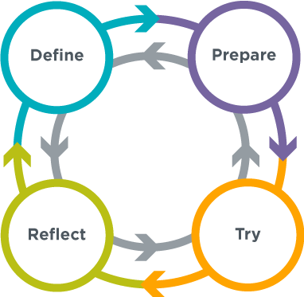
Where We Are Headed
Little Background
Define P/S Process
Charlie’s Recipes Exercise
Your Problem Exercise

Slide 3
Background
SNCOA
Moving to AL
Going to College

Slide 4
Process
Define
Prepare
Try
Reflect

Slide 5
Charlie’s Recipes

Slide 6
Your Problem
Elbow Partners
Agree on Problem
Work the Process

Slide 7
Birthday Party
A big group of 15 guests is getting together at a restaurant for a birthday. The restaurant has 3 tables that can each seat only 5 people. Below you can find some information about the people who are attending the party.
Close Friends (Try to put them together)
Aysha and Damien
Max and Isaias
Nazek and Laila
Owen and Genaro
Ben and Jessica
Genaro and Eric
In a Fight (Try to keep them apart)
Aysha and Genaro
Ben and Hannah
Fan and Max
Damien and Laila
Isaias and Owen
Kyla and Jessica

Slide 8
Road Trip
Criteria | Goals | How My Plan Accounts for It
Total Time for the Trip | One school day
Total Travel Time
Types of Things We Want To Do
You and your friends will be going on a trip. You’ve got the entire school day to travel, and you need to get back to school by the end of the trip, but otherwise how your trip goes it up to you. Plan the best trip that you can!
Explore the Tool
Head to https://www.google.com/maps and search for your school. Look at the different options for finding directions to other locations. Don’t worry about making a plan yet, but make sure you understand what kinds of information are available.

