Slide 1
Muscular system
DHO 7 CH. 7:5
Notes:
https://www.youtube.com/watch?v=ZlFOgeMT8FA Anatomical Movements Rap (Buzzin remix)

Slide 2
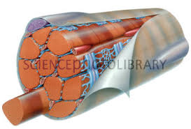
Muscle facts:
There are more than 600 muscles
Muscles are bundles of muscle fibers held together by connective tissue.

Slide 3
Characteristics of all muscles:
Excitability – irritability, the ability to respond to a stimulus such as a nerve impulse
{receives & responds to stimuli}

Slide 4
Characteristics of all muscles:
Contractibility – muscle fibers that are stimulated by nerves contract (become short and thick), which causes movement
{able to shorten & thicken}

Slide 5
Characteristics of all muscles:
Extensibility – the ability to be stretched
{able to stretch without damage}

Slide 6
Characteristics of all muscles:
Elasticity –allows the muscle to return to its original shape after it has contracted or stretched
{able to return to shape}

Slide 7
https://www.youtube.com/watch?v=d8mop0VxYFE&list=PL5Si5JKjk6dPfcr1hcw8zb9K67wu9zofT&t=0s&index=2

Slide 8
Muscle Control
Muscles can be voluntary or involuntary.
Voluntary – you have control over its action; example moving your arm
Involuntary – they function without conscious thought or control; example your diaphragm muscle for breathing

Slide 9
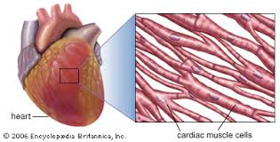
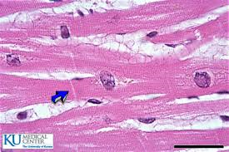
3 kinds of muscle:
Cardiac – forms the walls of the heart; contracts to circulate blood

Slide 10
Test your knowledge
Is cardiac muscle voluntary or involuntary?
INVOLUNTARY

Slide 11
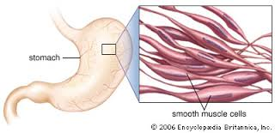
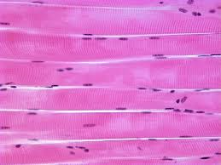
3 kinds of muscle:
2. Visceral (smooth) – found in the internal organs (digestive and respiratory system), blood vessels, and eyes; contract to cause movement in these organs.

Slide 12
Test your Knowledge
Is visceral muscle voluntary or involuntary?
INVOLUNTARY

Slide 13
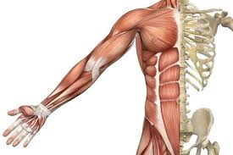
3 kinds of muscle:
3. Skeletal – attached to bones; contracts to cause body movement

Slide 14
Test your knowledge
Is skeletal muscle voluntary or involuntary?
VOLUNTARY

Slide 15
Functions of skeletal muscle:
Attach to bones to provide voluntary movement
Produce heat and energy for the body
Help maintain posture by holding the body erect
Protect internal organs

Slide 16
Do you Know?
One of the characteristics of muscle is extensibility. This allows muscles to:
React to an impulse
Contract
Stretch
Consume oxygen
And the answer is…C

Slide 17
Lecture 2,slides 16-24
Objectives:
To describe the process of muscle contraction through attachment, and origin and insertion

Slide 18
Do you know?
Which of the following is a characteristic of muscles?
Excitability
Portability
Stability
Feasibility
And the answer is…A

Slide 19
Do you know?
Where would you find a voluntary muscle?
In blood vessel walls
Attached to the femur
Inside the heart
Lining the stomach
And the answer is…B

Slide 20
Do you know?
After you swallow food, what kind of muscle moves the food toward your stomach?
Cardiac
Skeletal
Voluntary
Smooth
And the answer is…D

Slide 21
Skeletal muscle:
Skeletal muscles attach to bones in different ways:
Tendons – strong, tough, fibrous connective tissue cords that can attach muscles to bones.
ex: gastrocnemius on the calf attaches to heel bone by Achilles tendon

Slide 22
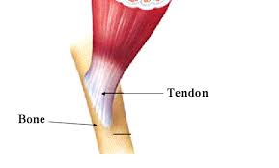
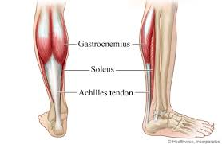
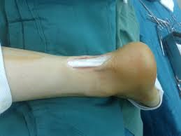
Tendons

Slide 23
Fascia – tough, sheet-like membrane that covers and protects the muscle tissue
ex: deep muscles of the trunk and back are surrounded by the lumbodorsal fascia

Slide 24
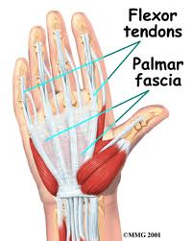
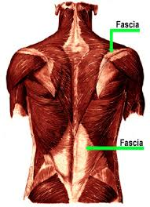
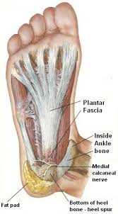
fascia

Slide 25
Origin vs insertion:
When a muscle attaches to a bone, the end that does not move is called the origin.
The end that moves when the muscle contracts is called the insertion.

Slide 26
Origin vs insertion:
Example: the origin of the deltoid (shoulder muscle) is by the clavicle & scapula. Its insertion is on the humerus. When the deltoid contracts, the area by the scapula remains stationary, but the area by the humerus moves and abducts the arm away from the body.

Slide 27
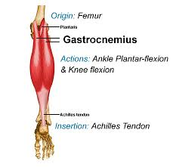
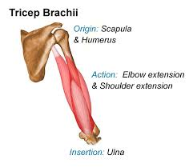
Origin vs insertion

Slide 28
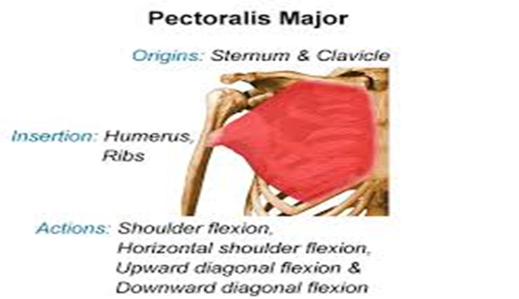
Origin vs insertion

Slide 29
Lecture 3, slides 25-33
Objectives:
To identify the vocabulary associated with active and passive range of motion

Slide 30
Muscle Vocabulary:
Superficial – closer to the surface of the body
Deep – farther away from the surface of the body

Slide 31
Muscle Vocabulary:
Back muscles from superficial to deep

Slide 32
Muscle Vocabulary:
Muscle tone – state of partial contraction or readiness to act. Muscles are partially contracted at all times, even when not in use.
{the state of muscle tension inside a muscle when it’s at rest}

Slide 33
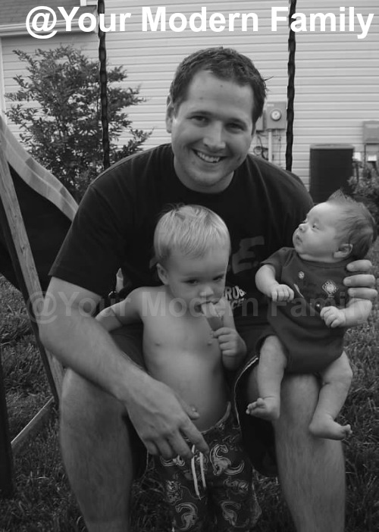
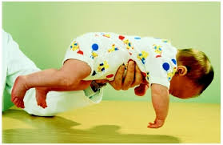
Muscle Vocabulary:
Muscle Tone
How alert are your muscles?

Slide 34
Muscle Vocabulary:
Muscle atrophy – muscles shrink in size and lose strength; can occur in severe illness (paralysis) when muscles aren’t used for a longtime

Slide 35
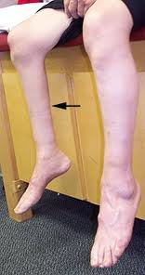
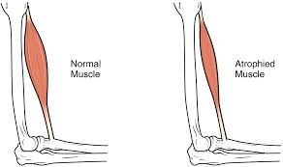
Muscle Vocabulary:
Muscle atrophy

Slide 36
Muscle Vocabulary:
Contracture – lack of use resulting in a severe tightening of a flexor muscle resulting in bending of a joint
ex: foot drop, but can also happen to the fingers, wrists, knees, & other joints

Slide 37
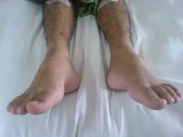
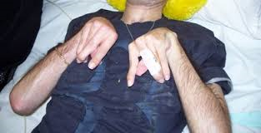
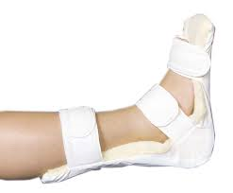
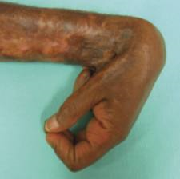
Muscle Vocabulary:
Contractures

Slide 38
Do you know?
When a muscle attaches to a bone, the end that does not move is the:
Tendon
Root
Origin
Insertion
And the answer is…C

Slide 39
Do you know?
Of the following, what muscle is superior to the other three?
Intercostals
Gastrocnemius
Sternocleidomastoid
Trapezius
And the answer is…C

Slide 40
Do you know?
Which muscle would do the most work if you ran 5 miles?
Sternocleidomastoid
Quadriceps femoris
Biceps
Pectoralis major
And the answer is…B

Slide 41
Do you know?
What muscle is located above the waist?
Deltoid
Tibialis anterior
Gastrocnemius
Gluteus maximus
And the answer is…A

Slide 42
Do you know?
Karina’s leg was in a cast for ten weeks. You would expect her leg muscles to experience some degree of :
Atrophy
Hypertrophy
Circumduction
Rotation
And the answer is…A

Slide 43
Do you know?
What would cause a muscle contracture?
Twisting
Pulling
Lack of use
Overuse
And the answer is…C

Slide 44
Lecture 4, slides 34-43
Objectives:
To identify active and passive range of motion
To identify the different patient positions
Anatomical Movements Rap (Buzzin remix)
https://www.youtube.com/watch?v=ZlFOgeMT8FA

Slide 45
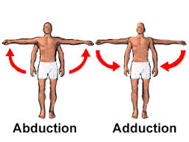
Types of muscle movements:
Adduction – moving a body part toward the midline
Abduction – moving a body part away from the midline

Slide 46
Types of muscle movements:
Flexion – decreasing the angle between 2 bones, or bending a body part
Extension – increasing the angle between 2 bones, or straightening a body part

Slide 47
Types of muscle movements:
Rotation – turning a body part around its own axis
Circumduction – moving in a circle at a joint or moving one end of a body part in a circle while the other end remains stationary

Slide 48
Types of muscle movements:
Supination – turning a body part upward
Pronation – turning a body part downward

Slide 49
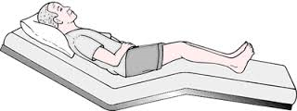
Positioning a patient:
Semi-Fowlers – HOB 45 degrees

Slide 50
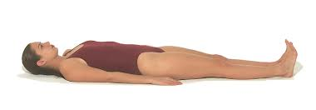
Positioning a patient:
Supine (horizontal recumbent) – flat on the back

Slide 51
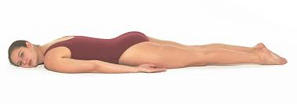
Positioning a patient:
Prone – pt lies on their abd

Slide 52
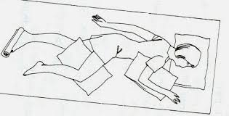
Positioning a patient:
Left lateral (Sims’) – pt lies on their left side

Slide 53
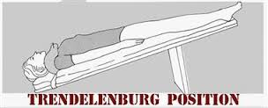
Positioning a patient:
Trendelenburg – pt lies on their back with their head lower than their feet

