Slide 1
Digital Monday
OFFICE 365

Slide 2
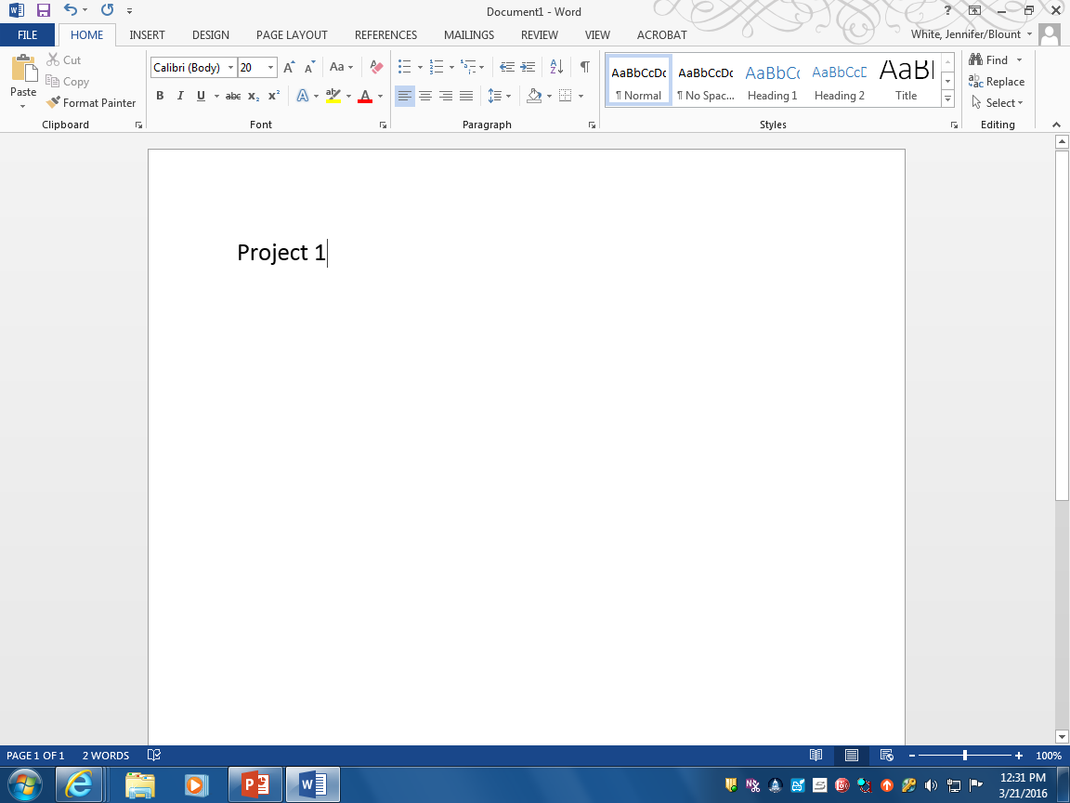
Saving to the cloud

Slide 3
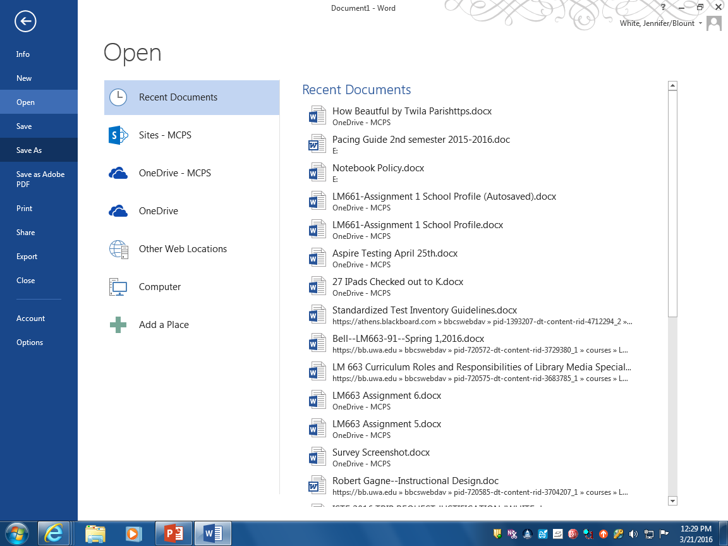
Saving to the cloud

Slide 4
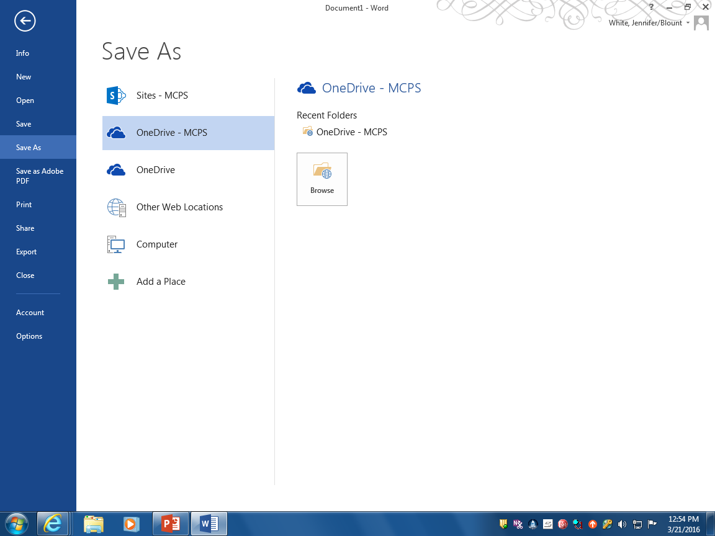
Saving to the cloud

Slide 5
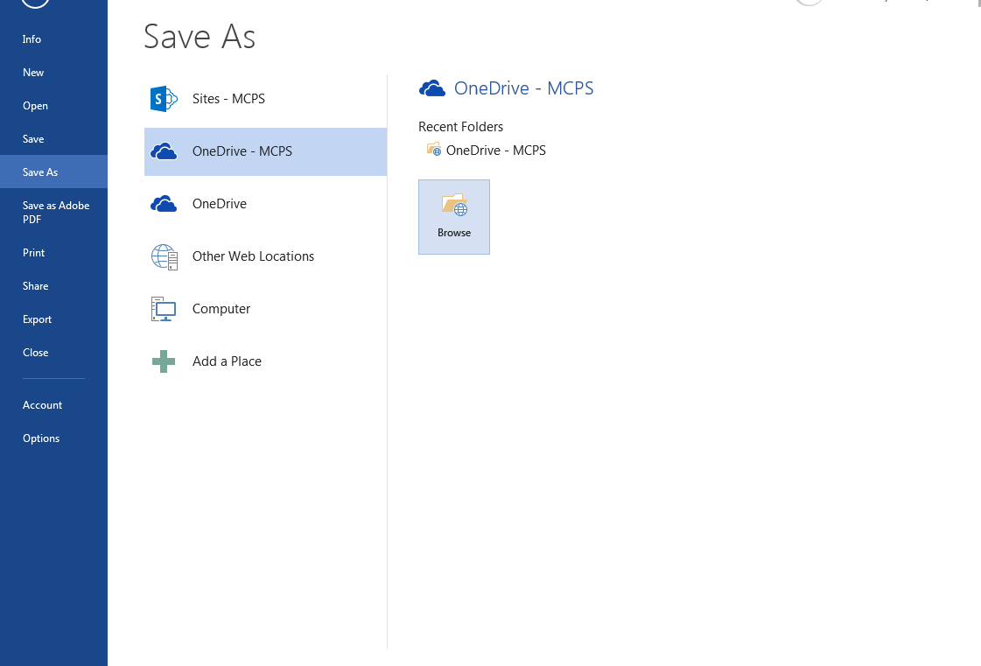
Saving to the cloud

Slide 6

Saving to the cloud

Slide 7
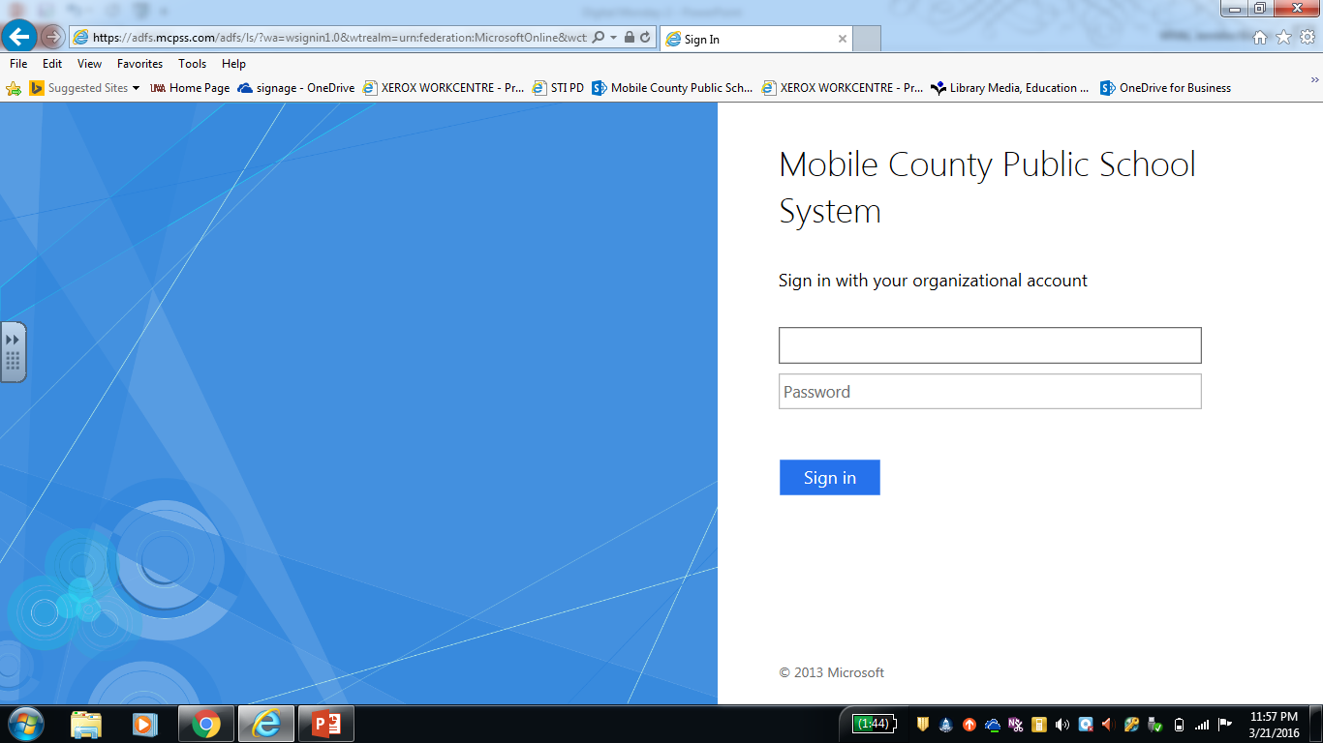
Saving to the cloud

Slide 8
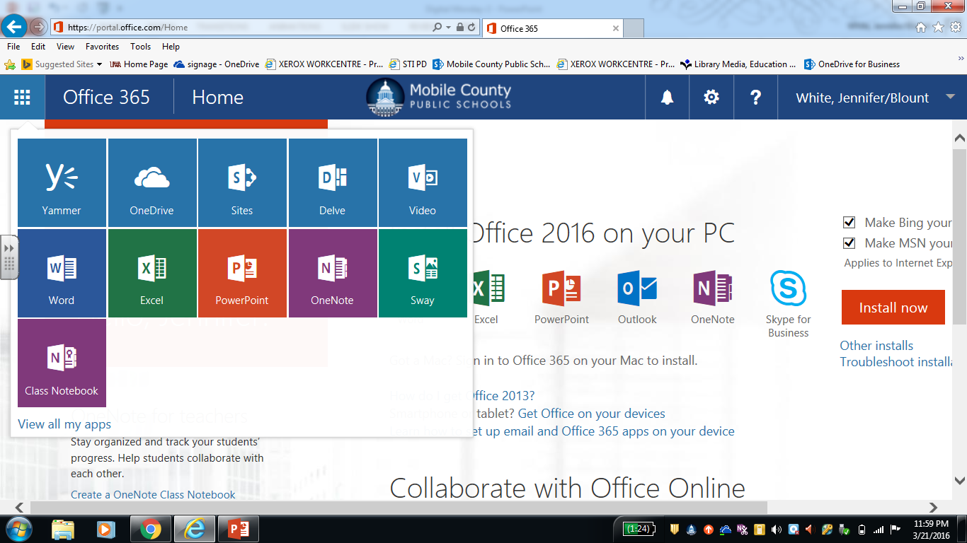
Saving to the cloud

Slide 9
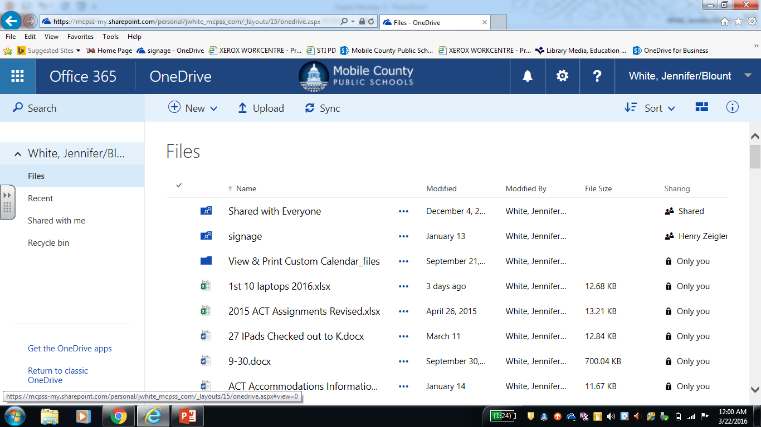
Saving to the cloud

