Slide 1

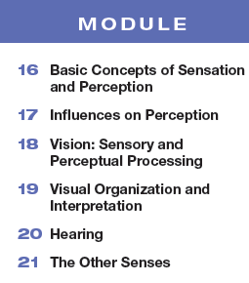

Unit 4
Sensation and Perception
6-8%

Slide 2

Learning Targets
Module 16
16-1 Describe sensation and perception, and explain the difference between bottom-up processing and top-down processing.
16-2 Discuss how selective attention directs our perceptions.
Basic Concepts of Sensation and Perception
16-3 Describe the three steps that are basic to all our sensory systems.
16-4 Discuss the difference between absolute thresholds and difference thresholds.
16-5 Discuss how we are affected by subliminal stimuli.
16-6 Explain the function of sensory adaptation.

Slide 3

What are sensation and perception?
sensation
perception
The process by which
our sensory receptors and nervous system receive and represent
stimulus energies from our environment.
The process of
organizing and interpreting
sensory information, enabling us
to recognize meaningful objects and events.

Slide 4
So what does that actually mean?
sensation
perception
Your nose, eyes or other sensory organs bring in information…. a smell… a color… a tall, blond boy with freckles…
Your brain makes sense of that information… oh.. that is my granddad’s rhubarb pie, that turquoise shirt is stunning, hey… is that my brother?

Slide 5
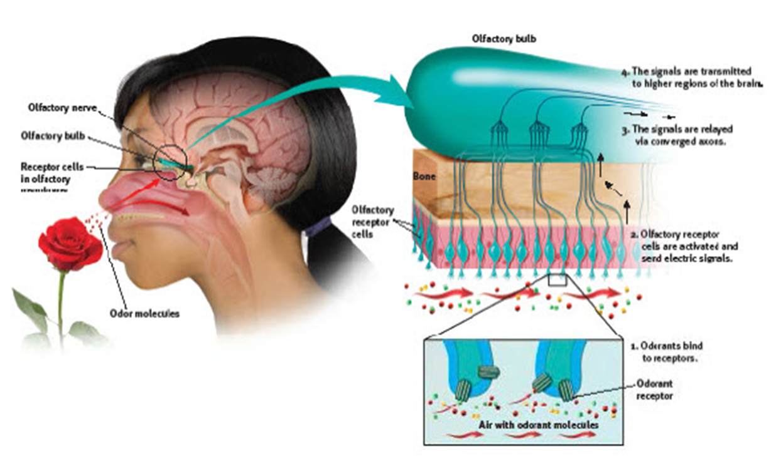
Does this image represent sensation or perception?
How do you know?

Slide 6
For each of the senses below, provide an example of how sensing differs from perceiving.
vision
audition (hearing)
gustation (tasting)
touch, temperature and pain

Slide 7
How does processing of stimuli work?
bottom-up processing
top-down processing
Starting with the sensory input, the brain attempts to understand/make sense.
You see a long, slim, slithering creature on the ground… you process… ah! A snake!
Guided by experience and higher-level processes, we see what we expect to see.
An experienced hiker, you expect to see snakes on your hike so windy stick, lizards, etc. all seem like snakes.

Slide 8

In the image below, what can we detect through bottom-up processing? Top down processing?

Slide 9
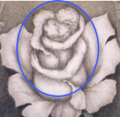
Did you see it?
Our sensory and perceptual processes work together to help us sort out complex images, including the hidden couple in Sandro Del-Prete’s drawing,
The Flowering of Love.

Slide 10
1. What Would You Answer?
What occurs when experiences influence our interpretation of data?
selective attention
B. transduction
C. bottom-up processing
D. top-down processing
signal detection theory

Slide 11
What is selective attention?
Our tendency to focus on just a particular stimulus among the many that are being received.
Although we are surrounded by sights and sounds, smells and tastes, we tend to pay attention to only a few at a time.

Slide 12
Has this happened to you?
You are at a crowded party with lots of your friends and everyone is talking so it is LOUD!
You are focusing your attention on the conversation with your friend nearby.
Then someone on the other side of the room says
YOUR name…and you HEAR it!!
This is called the cocktail party effect – you focused your attention on one particular voice (that person who called your name) amidst the crazy loudness of all those other voices.
The cocktail party effect is a great example of selective attention.

Slide 13
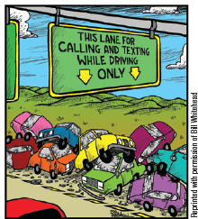
Do you text or talk on your cell phone while driving your car?
Selective attention and accidents

Slide 14
Let’s consider the research on selective attention…
fMRI scans show a 37% decrease in brain activity in areas vital to driving when a driver is listening to a conversation. (Just et al., 2008)
University of Sydney researchers found that cell phone users were four times more at risk of a car crash.
(McEvoy et al., 2005, 2007)
The National Safety Council found that 28% of traffic accidents occur when drivers are chatting on cell phones or texting. (NSC, 2010)

Slide 15
It is not about the cell phone.. it’s about distracting your attention!
Using a cell phone (even a hands-free set)
carries a risk 4 times higher than normal—
equal to the risk of drunk driving
(McEvoy et al., 2005, 2007).

Slide 16
What is selective inattention?
At the level of conscious awareness, we are in only one place at a time and so we miss salient objects that are available to be sensed.

Slide 17
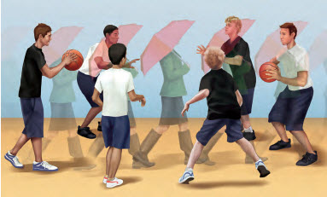
Inattentional blindness: failing to see visible objects when our attention or focus is directed elsewhere
Viewers of this basketball drill are asked to count the number of passes between white-shirted players.
An umbrella toting woman saunters across the screen.
Only 21% reported the presence of the woman.
(Neisser, 1979)

Slide 18
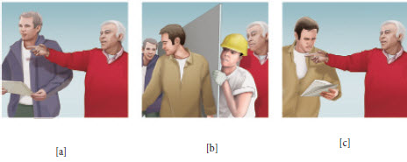
Change blindness: failing to notice changes in the visual environment
While a white-haired man provides directions to a construction worker…
two researchers rudely pass between
them interrupting his vision…
the original worker switches places with another person. 67% failed to notice the change.

Slide 19
What are the three steps involved in sensation and what is transduction?
Transduction:
conversion of one form of energy, such as light waves, into another form, like neural impulses that our brain can interpret
STEP ONE
receive
STEP TWO
transform
STEP THREE
deliver

Slide 20
2. What Would You Answer?
As Jeff reads his psychology textbook, he is able to convert the light waves into signals that his brain can interpret due to the concept of
transduction.
B. perception.
C. priming.
D. signal detection theory.
threshold.

Slide 21
What is psychophysics?
For instance…
…what is it about the smell, taste, and texture of buttery popcorn that produces a delicious, satisfied, happy response in you?
The study
of relationships between the physical characteristics of stimuli,
such as their intensity, and our psychological experience of them.

Slide 22
What is the difference between absolute threshold and difference threshold?
absolute threshold
difference threshold
The minimum stimulation
needed to detect a particular stimulus 50 percent of the time.
The minimum difference between two stimuli required for detection 50 percent of the time.
This is termed the just noticeable difference or JND.

Slide 23
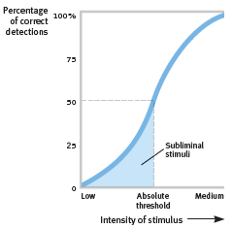
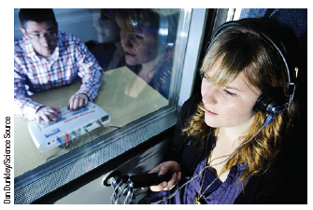
How do we test for absolute threshold in a sense like audition?
A hearing specialist exposes both of your ears to varying sound levels.
For each tone the test defines the pitch at which you can detect the tone 50% of the time.

Slide 24
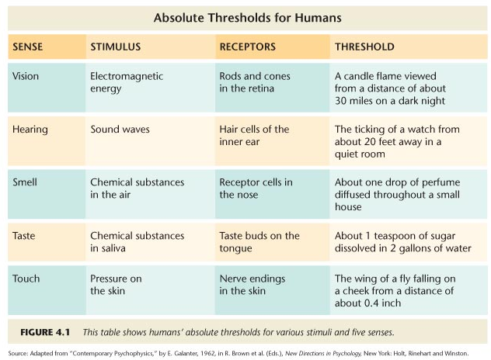


Slide 25
Why are some people better at detecting signals than others?
Have you ever been caught texting on your phone during class by a teacher in one class but can get away with it regularly in another class?
Did you know that even when parents of a newborn are exhausted from sleep deprivation, they can still hear the slightest whimper from their baby even though the loud sounds of the trash truck or screeching car on the street outside may go completely unnoticed?
Do you or your friends have different opinions about how much onion is too much onion on a burger?

Slide 26
A theory predicting how and when we detect the presence of a faint stimulus amid background stimulation
What is the signal detection theory?
Depends on two conditions:
the strength of the signal
(how loud the sound is, how bright the light, how heavy the touch….)
our psychological state
(our experience, our expectations, our motivation, and how alert we are)

Slide 27
So you can see the light…but how can you tell when it gets brighter?
Have you ever been in a crowd of families, like at a waterpark or amusement park, and you yell “Dad!” to get your father’s attention? How does YOUR Dad know to turn around?
How does a musician know when they are playing a little flat or sharp of their intended note?
How can you tell when just the slightest note of irritation is in your friend’s voice?

Slide 28
What is Weber’s Law?
How will I notice the difference?
Two lights must differ in intensity by 8% for you to notice the change.
Two objects must differ in weight by 2%.
Two tones must differ in frequency by .3%.
To be able to tell the difference between degrees of stimulation, two stimuli must differ by a constant minimum percentage.

Slide 29
How does Weber’s Law help explain the just noticeable difference (jnd) ?
The difference threshold is the minimum difference between two stimuli required for detection
50 percent of the time.
We experience the difference threshold as a just noticeable difference (or jnd).
Weber’s law tells us that the difference must vary by a constant percentage (as shown on the last slide), not a constant amount.

Slide 30

How many lines are required for you to experience a just noticeable difference (jnd)?

Slide 31
3. What Would You Answer?
What principle states that to be perceived as different, two stimuli must differ by a minimum percentage rather than a constant amount?
absolute threshold.
B. difference threshold.
C. signal detection theory.
D. priming.
Weber’s law

Slide 32
What are subliminal stimuli and how are we affected by them?
Subliminal stimuli are not detectable 50% of the time. They are below your absolute threshold.
You may not notice subliminal stimuli at all if they are weak.

Slide 33
What is priming?
Priming is the activation, often unconsciously, of certain associations, thus predisposing one’s perception, memory, or response.
Even if YOU don’t think YOU notice a stimuli, your brain might, and that can impact you.

Slide 34
Stop and talk. Has this happened to you?
Ever notice how your friend’s home has a certain….smell? And have you noticed that it “goes away” after you have been there a few minutes? Why?
Do you ever look all around for your cell phone only to realize it is in your pocket?
Has a family member fallen asleep in front of the TV and to be kind, you turn off the TV and cover them with a blanket? Do they wake up? Why?

Slide 35
What is sensory adaptation?
Sensory adaptation is diminished sensitivity to stimuli as a consequence of constant stimulation.
Evolutionary psychologists suggest that once we notice and evaluate a new stimuli as non-threatening, we can pay less attention to it.
This saves our attention for new incoming stimuli, or changes in the existing stimuli. This could be adaptive for survival.

Slide 36
Examples of Sensory Adaptation
Light-Dark Adaptation
Noise Adaptation
Smell Adaptation
Temperature Adaptation
Taste Adaptation

Slide 37
Dark Adaptation Problem
http://www.thedailybeast.com/articles/2013/04/09/why-did-pirates-wear-eye-patches.html

Slide 38
So why does sensory adaptation occur?
Being able to ignore unthreatening/unchanging stimuli leaves us free to focus on the stimuli that IS changing.
Our sense receptors are alert to novelty…a new situation means we need to evaluate and assess it and check for danger.
So it is functional…adaptive.
We perceive the world not exactly as it is, but as it is useful for us to perceive it.

Slide 39
4. What Would You Answer?
Tyshane went swimming with friends who did not want to get into the pool because the water felt cold. Tyshane jumped in and after a few minutes declared, “it was cold when I first got in, but now my body is used to it. Come on in!” Tyshane’s body became accustomed to the water due to
priming.
B. the absolute threshold.
C. the difference threshold.
D. selective attention.
sensory adaptation.

Slide 40
Learning Target 16-1 Review
Describe sensation and perception, and
explain the difference between bottom-up processing and top-down processing.
Sensation is receiving signals from our sensory receptors.
Perception is processing and interpreting those signals.
Bottom-up processing begins at the sensory level.
Top-down processing is guided by higher-level perceptions and expectations.

Slide 41
Learning Target 16-2 Review
Discuss how selective attention
directs our perceptions.
We selectively attend to, and process, a very limited portion of incoming information, blocking out much and often shifting the spotlight of our attention from one thing to another.
Focused intently on one task, we often display inattentional blindness (including change blindness) to other events and changes around us.

Slide 42
Learning Target 16-3 Review
Describe the three steps that are basic
to all our sensory systems.
Our senses (1) receive sensory stimulation (2) transform that stimulation into neural impulses, and (3) deliver the neural information to the brain.
Transduction is the process of converting one form of energy into another.
Researchers in psychophysics study the relationships between stimuli’s physical characteristics and our psychological experience of them.

Slide 43
Learning Target 16-4 Review
Discuss the difference between
absolute thresholds and difference thresholds.
absolute threshold: minimum stimulation necessary to be consciously aware of it 50% of the time.
signal detection theory: perception depends on 1) signal strength and 2) experience and expectations
difference threshold (just noticeable difference, or jnd): minimum stimulus difference we can discern 50% of the time.
Weber’s law states that two stimuli must differ by a constant percentage to be perceived as different.

Slide 44
Learning Target 16-5 Review
Discuss how we are affected by
subliminal stimuli.
Priming shows that we can be affected by stimuli so weak that we don’t consciously notice them, and we can evaluate a stimulus even when we’re not consciously aware of it.
We can be primed by subliminal stimuli, but research indicates that such stimuli cannot persuade us or change our behavior.

Slide 45
Learning Target 16-6 Review
Explain the function of
sensory adaptation.
Sensory adaptation (our diminished sensitivity to constant odors, sights, sounds, and touches) focuses our attention on informative changes in our environment.

Slide 46
Learning Targets
Module 17
17-1 Analyze the ways in which our expectations, contexts, motivation, and emotions influence our perceptions.
Influences on Perception
17-2 Describe the claims of ESP, and discuss what most research psychologists have concluded after putting these claims to the test.

Slide 47
What is a perceptual set?
a mental
predisposition to perceive one
thing and not another
…we see what we expect to see

Slide 48

How does priming influence perceptual set?
When viewing this image initially…
…subjects were more likely to see the
old woman.

Slide 49
Why the change in perception?
When viewing this image initially…
…subjects were more likely to see the
young woman.

Slide 50


Slide 51

What do you see here?
Share your answers with the class.

Slide 52


How does expectation influence perceptual set?
It’s the number 13!
… or is it?

Slide 53

How does top-down processing influence perceptual set?
our experience with numbers and letters
(13 comes between 12 and 14….
B comes between A and C)
influences our expectation…

Slide 54
How does context influence perceptual set?
Reading from left to right, our expectations
cause us to perceive the middle script differently than when reading from top to bottom.

Slide 55

What is on the woman’s head?
Where is the family? What are they doing?

Slide 56

How does cultural context impact perceptual set?
When asked what was above the woman’s head…. rural East Africans saw a woman with a box on her head and a family under a tree.

Slide 57
How does a different cultural context impact perceptual set?
Westerners,
used to running water and boxlike houses with corners, saw a woman sitting under a window and a family indoors.
(Gregory & Gombrich, 1973)

Slide 58
1. What Would You Answer?
On a warm summer day, Kimberly tells her brother to put on a suit. Kimberly’s brother knows
to put on a swimsuit instead of a
business suit because of
context.
B. priming.
C. sensory adaptation.
D. bottom-up processing.
clairvoyance.

Slide 59
What does research show about how motivation can influence perceptual set?
Desirable objects, such as a water bottle viewed by a thirsty person, seem closer than they really are.
(Balcetis & Dunning, 2010).
A to-be-climbed hill can seem steeper when we are carrying a heavy backpack, and a walking destination further away when we are feeling tired.
(Burrow et al., 2016; Philbeck &Witt, 2015; Proffitt 2006a,b)
Going on a diet can lighten our biological “backpack”. When heavy people lose weight, hills and stairs no longer seem so steep.
(Taylor-Covill & Eves, 2016).

Slide 60
What does research show about how emotion can influence perceptual set?
When angry, people more often perceive
neutral objects as guns.
Baumann & DeSteno, 2010)
Hearing sad music can predispose people to perceive a sad meaning in words that sound alike…mourning rather than morning, die rather than dye, pain rather than
pane. (Halberstadt et al., 1995)
When mildly upset by subliminal exposure to a scowling face, people perceive a neutral face as less attractive and likeable.
(Anderson et al., 2012)

Slide 61
What is parapsychology and ESP?
parapsychology
ESP
(extra sensory perception)
The study of
paranormal phenomena, including
ESP and psychokinesis (the ability of the mind to move objects).
The controversial claim that awareness can occur apart from sensory input; includes telepathy (mind to mind communication),
clairvoyance (seeing remote events), and precognition (seeing the future).

Slide 62
How have researchers tried to test
ESP claims?
In one study, psychologists
created a “mind machine” to see if people could influence or predict a coin toss.
Using a touch-sensitive screen, visitors to British festivals were given four attempts to call heads or tails, playing against a computer that kept score.
By the time the experiment ended, nearly 28,000 people had predicted 110,959 tosses—with 49.8 percent correct.
Wiseman and Greening, 2002

Slide 63
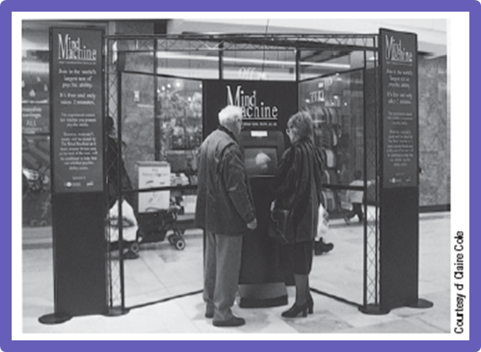
The Mind Machine.

Slide 64
What have most researchers concluded regarding the veracity of ESP claims?
Researchers have been unable to replicate ESP claims under controlled conditions.

Slide 65
Learning Target 17-1 Review
Analyze the ways in which our
expectations, contexts, motivation,
and emotions influence our perceptions.
Perceptual set is a mental predisposition that functions as a lens through which we perceive the world.
Our learned concepts (schemas) prime us to organize and interpret ambiguous stimuli in certain ways.
Our motivation, as well as our physical and emotional context, can create expectations and color our interpretation of events and behaviors.

Slide 66
Learning Target 17-2 Review
Describe the claims of ESP, and
discuss what most research
psychologists have concluded after putting
these claims to the test.
Parapsychology is the study of paranormal phenomena, including extrasensory perception (ESP); telepathy, clairvoyance, precognition, and psychokinesis.
Skeptics argue that (1) to believe in ESP, you must believe the brain is capable of perceiving without sensory input, and (2) researchers have been unable to replicate ESP phenomena under controlled conditions.

Slide 67
Learning Targets
Module 18
18-1 Discuss the characteristics of the energy that we see as visible light, and describe the structures in the eye that help focus that energy.
18-2 Describe how the rods and cones process information, and explain the path information travels from the eye to the brain.
Light Energy and Eye Structures
18-3 Discuss how we perceive color in the world around us.
18-4 Describe the location and function of feature detectors.
18-5 Explain how the brain uses parallel processing to construct visual perceptions.

Slide 68
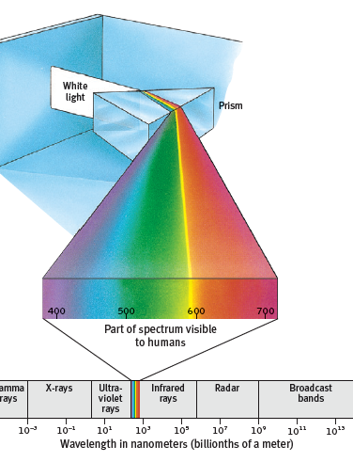
What light energy is visible to humans?
The part of the spectrum visible to humans is actually quite small.
We can see light waves with a frequency of a little less than 400nm and a little more than 700nm.

Slide 69
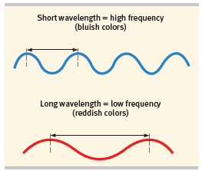
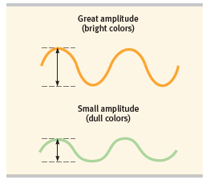
What are characteristics of light waves?
frequency (wavelength)
amplitude (height)

Slide 70
What information do light waves give us?
Wavelength: what hue (or color) am I seeing?
Amplitude: how bright is the color I am seeing?

Slide 71
1. What Would You Answer?
Your best friend decides to paint her room an extremely bright electric blue. Which of the following best fits the physical properties of the color’s light waves?
no wavelength; large amplitude
B. short wavelength; large amplitude
C. short wavelength; small amplitude
D. long wavelength; large amplitude
no wavelength; small amplitude

Slide 72
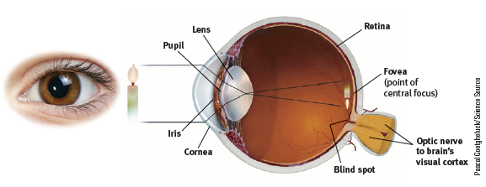
What structures of the eye help focus the energy?

Slide 73
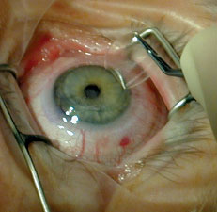
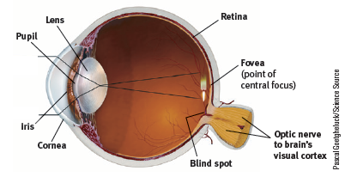
What is the cornea?
The cornea is the eye’s clear, protective outer layer covering the pupil and iris.
Light enters the eye first through the cornea.

Slide 74
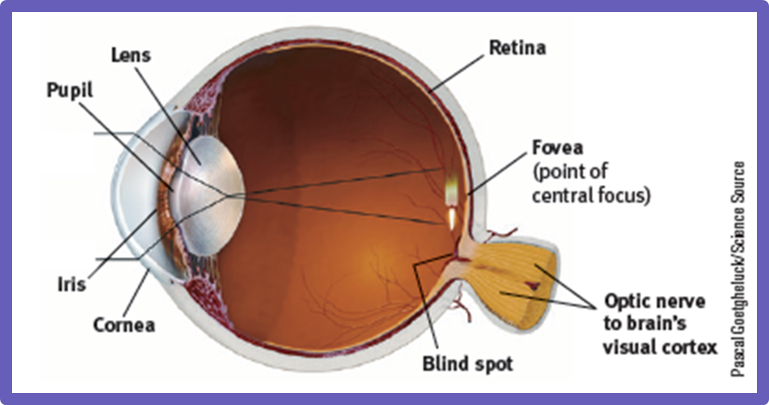
What is the pupil?
The pupil is a small adjustable opening in the center of the eye through which light passes.

Slide 75
What is the iris?
The iris is a ring of muscle tissue that
forms the colored portion of the
eye around the pupil and controls
the size of the pupil opening by expanding and contracting over the pupil.

Slide 76

What is the lens?
The lens is the transparent structure
behind the pupil that changes shape
to help focus images on the retina.

Slide 77
How does the lens change shape?
To focus the rays, the lens changes its curvature and thickness in a process called accommodation.
If the lens focuses the image on a point in front of the
retina, you see near objects clearly but not distant objects. This nearsightedness—myopia—
can be remedied with glasses, contact lenses, or surgery.
Hyperopia- farsightedness – is a result of the lens focusing light past the retina.

Slide 78

What is the retina?
The retina is the light-sensitive inner
surface of the eye, containing
the receptor rods and cones plus
layers of neurons that begin the
processing of visual information.

Slide 79
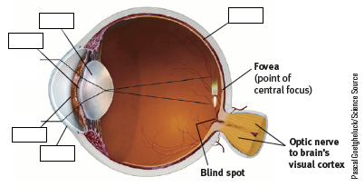
Can you name the structures of the eye?
Try to name the first five structures you have learned in the order which light passes through them.

Slide 80
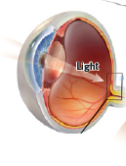
Where is the retina located?
The retina is along the back of the eye and contains the sense receptor cells (rods and cones) that will receive the incoming light waves.

Slide 81
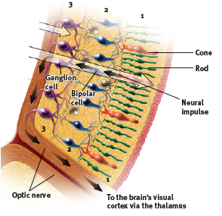
What happens in the retina?
Light waves are transduced into neural impulses by the rods and cones, then passed to the bipolar cells and the ganglion cells.

Slide 82
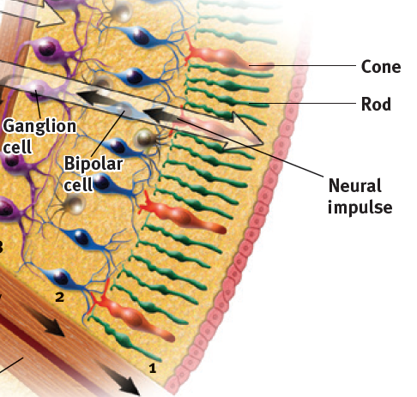
What are rods?
The rods are retinal photoreceptors that detect black, white, and gray, and are sensitive to movement.
Rods are necessary
for peripheral and twilight vision, when cones don’t respond.

Slide 83
What are some characteristics of rods?
Rods are located along the retina’s outer periphery.
Rods remain sensitive in dim light, and they enable
black-and-white vision.
Rods have no hotline to the brain…they share connections to a single bipolar cell sending a combined message to the brain.
Rods are sensitive to faint light and peripheral motion.

Slide 84
What are cones?
Cones are retinal photoreceptors that are
concentrated near the center of the retina and function in daylight or in well-lit conditions.
Cones detect fine detail and create color sensations.

Slide 85
What are some characteristics of cones?
Cones cluster in and around the fovea.
In dim light, cones become unresponsive and we are unable to see color.
Many cones have their own hotline to the brain: One
cone transmits its message to a single bipolar cell, which relays the message to the visual cortex (where a large area receives input from the fovea).

Slide 86
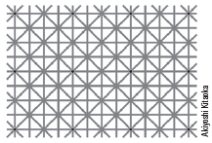
How many dots do you see at once?
Look at or near any of the twelve black dots and you can see them, but not in your peripheral vision.

Slide 87
What is the fovea?
The fovea is the central focal point in
the retina, around which the eye’s
cones cluster.
This is the area of greatest visual acuity… or sharpness of focus.

Slide 88
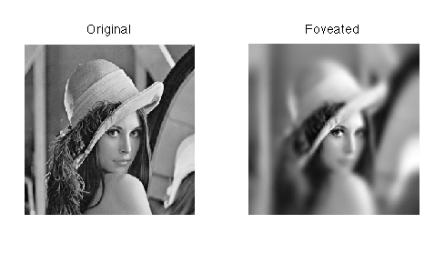

Slide 89
What is the optic nerve?
The optic nerve is comprised of the axons of the ganglion cells.
It leaves through the back of the eye and carries the neural impulses from the eye to the brain.

Slide 90
What is the blind spot?
The optic disk is the point at which the
optic nerve leaves the eye, creating
a “blind” spot because no receptor
cells (rods or cones) are located there.

Slide 91

Can you find the blind spot of your eye?
Close your left eye, look at the spot, and move your face away until one of the cars disappears. Repeat with your right eye closed. Did the other car disappear? Can you explain why?

Slide 92
2. What Would You Answer?
If you scratch your eye, which structure are you most likely to damage?
pupil
B. iris
C. cornea
D. lens
fovea

Slide 93
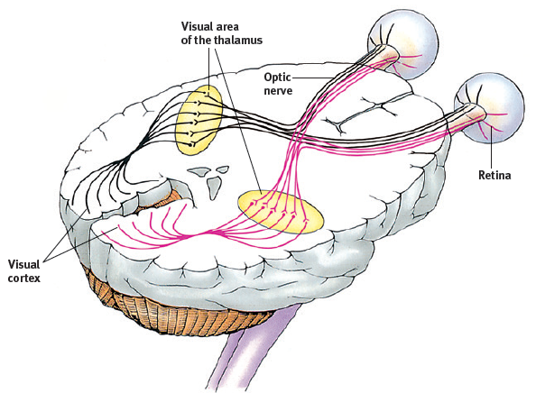
What happens to the neural impulse after it exits the eye?
The optic nerve carries the impulse to the thalamus and on to the visual cortex of the occipital lobes.

Slide 94
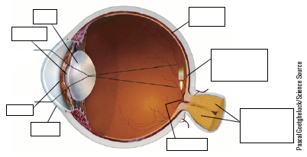
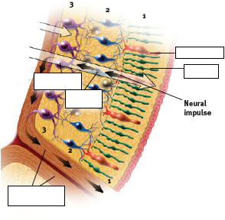
Can you put it all together now?
Use these two images to guide you as you correctly label the structures through which light passes.

Slide 95
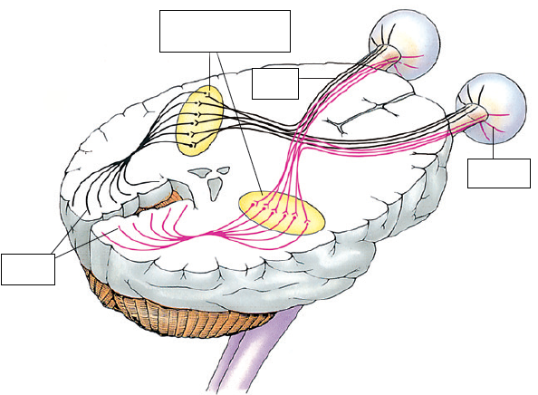
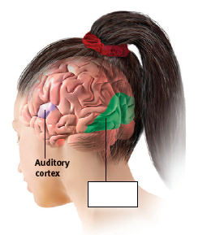
Can you put it all together now? Cont.
Can you finish tracing the path of the neural impulse once it leaves the eye?

Slide 96

AP® Exam Tip 1
There’s a lot of vocabulary here.
Make sure you understand the location and
function of each part of the eye.
To learn how all the parts fit together, it may help to make rough sketches and then compare your sketches with Figures 18.3 and 18.4 in your textbook.
You’ll be better off making several quick, rough sketches
than one time-consuming, nicely drawn one.

Slide 97
How do we see color?
“ Only mind has sight and hearing;
all things else are deaf and blind.”
Epicharmus, Fragments, 550 B.C.E.
We say that a tomato is red…but is it?
Is red housed in the tomato or in our mind?
If no one sees the tomato, is it still red?

Slide 98
What is the Young-Helmholtz trichromatic (three-color) theory?
The theory
that the retina contains three
different types of color receptors (cones)—
one most sensitive to red, one
to green, one to blue—which,
when stimulated in combination,
can produce the perception of any color.

Slide 99
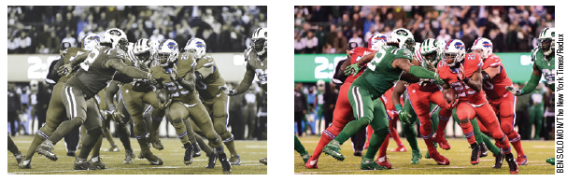
What about people who cannot see color?
The photo on the left shows how people with red-green deficiency perceived a 2015 Buffalo Bills versus
New York Jets football game.
“Everyone looks like they’re on the same team,”
said one color-blind fan.
The photo on the right shows how the game looked
for those with normal color vision.

Slide 100
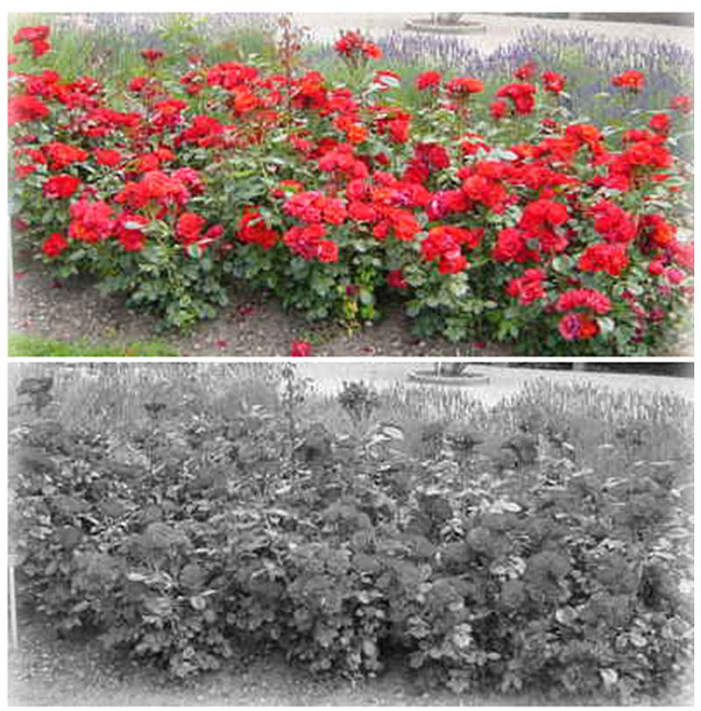

Slide 101
What are some characteristics of color blindness?
About one person in 50 is color blind.
Males are more affected since the defect is
genetically sex-linked.
Most people are not actually blind to all colors. They simply lack functioning red- or green-sensitive cones, or sometimes both.
Vision is monochromatic (one color) or dichromatic
(two-color) and seems ‘normal’ to them.

Slide 102
AP® Exam Tip 2
There is typically a question about color blindness on
the AP ® Exam.
It is important to remember that color blindness is most prevalent in males and that the red-green cone deficiency is the most common form of color blindness.

Slide 103
What is the Hering opponent-process theory?
The theory that cone photoreceptors are paired together (red-green, blue-yellow, white-black)
to enable color vision.
Activation of one color of the pair inhibits
activation of the other.
For example, some cells are stimulated by green and inhibited by red; others are stimulated by
red and inhibited by green.

Slide 104

The opponent-process theory.
Stare at the center of the flag for a minute.
Then go to the next slide.

Slide 105
The opponent-process theory, cont.
Stare at the black dot above.
What do you see?

Slide 106
So what happened?
Did you see a red, white and blue
British Union Jack?
Here’s the answer for why the green became red:
First, you stared at green bars, which tired your green response.
Then you stared at a white area.
White contains all colors, including red.
Because you had tired your green response, only the red part of the green-red pairing fired normally.
The same happened with the blue-yellow pair and the black-white pair.

Slide 107


Slide 109
So… how does color processing occur?
The retina’s red, green, and blue cones respond in varying degrees to different color
stimuli, as the Young-Helmholtz trichromatic theory suggested.
1
The cones responses are then processed by opponent-process cells, as Hering’s
opponent-process theory proposed.
2

Slide 110
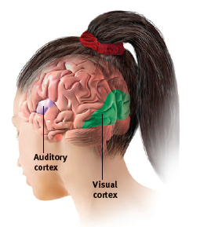
What are feature detectors and where are they located?
Feature detectors are nerve cells located in the visual cortex of the occipital lobe that respond to a scene’s edges, lines, angles and movements.

Slide 111
But what do feature detectors do?
Feature detectors receive information from individual ganglion cells in the retina and
pass it to other cortical areas, where
supercell clusters respond to more complex patterns.

Slide 112
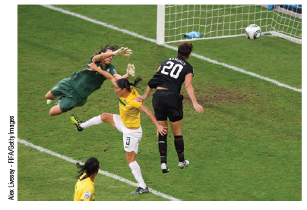
How do feature detectors operate in real life?
In a 2011 World Cup match, USA’s Abby Wambach instantly
processed visual information about
the positions and movements of
Brazil’s defenders and goalkeeper and managed to get the ball around them all and into the net.

Slide 113
What is parallel processing?
Parallel processing is thinking about many aspects of a problem simultaneously.
This is the brain’s natural mode of information processing for many functions, including vision.

Slide 114
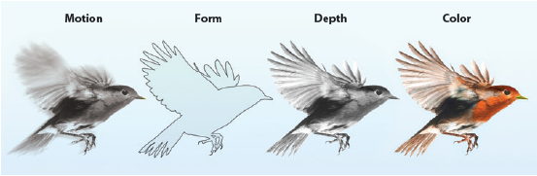
How does parallel processing operate?
The brain delegates the work of processing motion, form, depth, and color to different areas.
After taking a scene apart, the brain integrates these subdimensions into the perceived image.

Slide 115
How do we recognize faces using parallel processing?
To recognize a face, your brain integrates information projected by your retinas to several
visual cortex areas and compares it with stored information, thus enabling your fusiform
face area to recognize the face: Grandmother!
Some supercells—actually nicknamed
grandmother cells—do appear to respond very
selectively to 1 or 2 faces in 100.
(Bowers, 2009; Quiroga et al., 2013)

Slide 116
3. What Would You Answer?
Which perceptual process explains why you can see varied aspects of your favorite singer’s face and instantly recognize him or her?
selective attention
B. accommodation
C. psychokinesis
D. blindsight
parallel processing

Slide 117
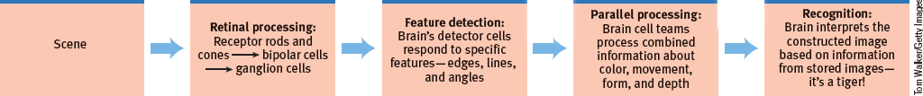
So in the end…. how do we “see”?
As you read these words, the letters reflect light rays onto your retina, which triggers a process that sends formless nerve impulses to several areas of your brain, which integrate the information and decode its meaning. The
amazing result: we have transferred information across time and space, from our minds to your mind.
That all of this happens instantly, effortlessly, and continuously is indeed awesome.

Slide 118
Learning Target 18-1 Review
Discuss the characteristics of the energy
that we see as visible light, and describe the structures in the eye that help focus that energy.
The hue we perceive in light depends on its wavelength, and its brightness depends on its intensity.
After entering the eye through the cornea, passing through the pupil and iris, and being focused by the accommodation of the lens, light energy particles strike the eye’s inner surface, the retina.

Slide 119
Learning Target 18-2 Review
Describe how the rods and cones process
information, and explain the path information
travels from the eye to the brain.
Rods and cones convert light energy into neural impulses.
Cones are found in and around the fovea, rods on the outer regions. Cones connect to one bipolar cell. Rods share a bipolar cell.
Cones are sensitive to detail and color, rods to faint light and peripheral motion.
Impulses move through bipolar and ganglion cells through the optic nerve, create a blind spot, then to the thalamus, and on to the visual cortex.

Slide 120
Learning Target 18-3 Review
Discuss how we perceive color
in the world around us.
The Young-Helmholtz trichromatic (three-color) theory: the retina contains three types of color receptors. each most sensitive to the wavelengths of one of either red, green, or blue
Hering’s opponent-process theory: neurons in the retina and the thalamus code the color-related information from the cones into pairs of opponent colors (red/green, yellow/blue and black/white).
Color processing occurs in two stages.

Slide 121
Learning Target 18-4 Review
Describe the location and function
of feature detectors.
Feature detectors, specialized neurons in the occipital lobe’s visual cortex, respond to specific aspects of the visual stimulus.
They receive information from individual ganglion cells in the retina and pass it to other cortical areas, where supercell clusters respond to more complex patterns.

Slide 122
Learning Target 18-5 Review
Explain how the brain uses parallel
processing to construct visual perceptions.
Through parallel processing, the brain handles many aspects of vision (color, movement, form, and depth) simultaneously.
Other neural teams integrate the results, comparing them with stored information and enabling perceptions.

Slide 123
Learning Targets
Module 19
19-1 Describe the Gestalt psychologists’ understanding of perceptual organization, and explain how figure-ground and grouping principles contribute to our perceptions.
19-2 Explain how we use binocular and monocular cues to perceive the world in three dimensions, and discuss how we perceive motion.
Visual Organization and Interpretation
19-3 Explain how perceptual constancies help us construct meaningful perceptions.
19-4 Describe what research on restored vision, sensory restriction, and perceptual adaptation reveals about the effects of experience on perception.

Slide 124
How did the Gestalt psychologists understand perceptual organization?
Early in the twentieth century, a group of German psychologists noticed that people who are given a cluster of sensations tend to organize them into a gestalt, a German word meaning a “form” or a “whole.”
Gestalt psychologists believe that in perception,
the whole may exceed the sum of its parts.

Slide 125
How is perception understood by the Gestaltists?
Underlying Gestalt principles is a fundamental truth:
Our brain does more than register information
about the world.
Perception is not just opening a shutter and letting a picture print itself on the brain. We filter incoming
information and construct perceptions. Mind matters.

Slide 126
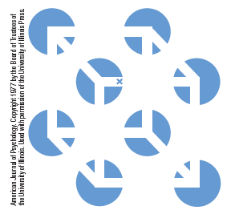
How does the Necker cube illustrate a Gestalt?
The individual elements of this figure, called a Necker cube, are really nothing but eight blue circles, each containing three converging white lines.
When we view these elements all together, however, we see a cube that sometimes reverses direction.

Slide 127
AP® Exam Tip 1
The Necker cube is an excellent vehicle for understanding the distinction between sensation and perception.
The only visual stimuli are the blue wedges. (sensation)
The circles, lines, and cube are all the products of your mind and not on the page. (perception)

Slide 128
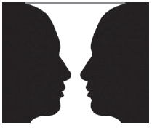
What is figure-ground?
the organization
of the visual field into objects (the figures) that stand out from their
surroundings
(the ground)

Slide 129
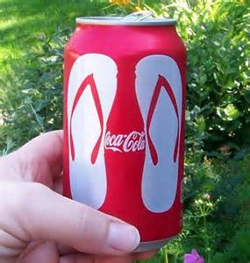

Slide 130


Slide 131


Slide 132


Slide 133
Can you detect figure and ground?
See if you can reverse the figure and make it the ground… now try making the ground the figure. Your choice of what is figure is what creates this illusion.

Slide 134
1. What Would You Answer?
Bryanna and Charles are in a dancing competition. It is easy for spectators to see them against the dance floor because of
the visual cliff.
B. the phi phenomenon.
C. color constancy.
D. relative motion.
figure-ground relationships.

Slide 135
How do the Gestaltists apply rules for grouping to perception?
Our mind brings order and form to stimuli by following certain rules for grouping, also identified by the Gestalt psychologists.
These rules, which we apply even as infants and
even in our touch perceptions, illustrate how the perceived whole differs from the sum of
its parts, rather as water differs from its hydrogen and oxygen parts.

Slide 136

What is proximity?
A Gestalt law of grouping that states we group nearby figures together.
We see not six separate lines, but three sets
of two lines.

Slide 137
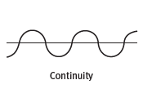
What is continuity?
A Gestalt law of grouping that states we perceive smooth, continuous patterns rather than discontinuous ones.
This pattern could be a series of alternating semicircles, but we perceive it as two continuous lines—one wavy, one straight.

Slide 138
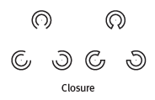
What is closure?
A Gestalt law of grouping that states we fill in gaps to create a complete, whole object.
Thus we assume that the
circles on the left are complete but partially blocked by the (illusory) triangle. Add
nothing more than little line segments to close off the circles and your brain stops
constructing a triangle.

Slide 139
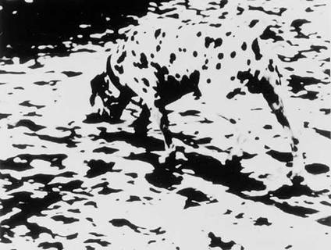

Slide 140
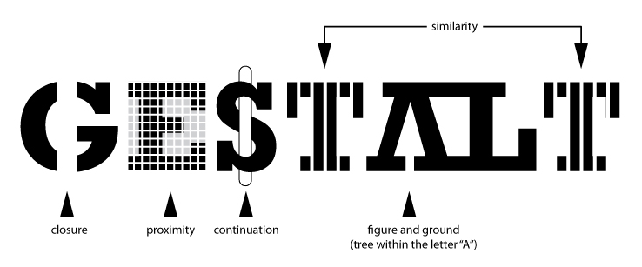

Slide 141








Slide 142
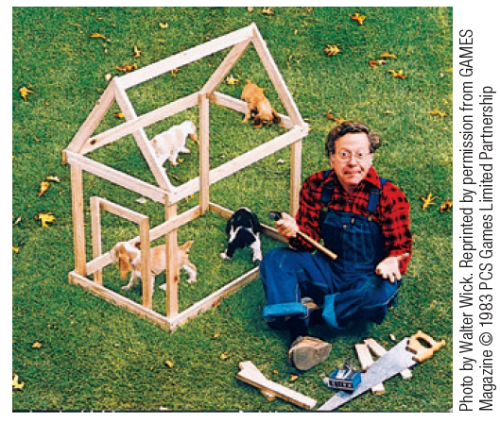
How can this be happening?
How are the principles of closure and continuity
illustrated in this image?

Slide 143
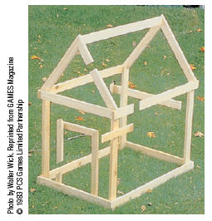
The impossible dog house.
From
the photo angle in the TRY IT picture,
the Gestalt grouping principle of closure leads us to perceive the boards
as continuous.

Slide 144
Talk with a partner: find one example from your life that illustrates each of the Gestalt laws below.
proximity
continuity
closure

Slide 145
What is depth perception and how have we tested for it?
Depth perception is the ability to see objects in three dimensions although the images that strike the retina are two-dimensional; allows us to judge distance.
Eleanor Gibson and Richard Walk (1960) designed a series of experiments in their Cornell University laboratory using a visual cliff—a model of a cliff with
a “drop-off” area that was actually
covered by sturdy glass.

Slide 146
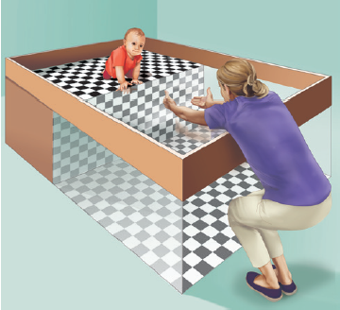
What did the visual cliff demonstrate?
6- to 14-month-old infants were placed on the edge of the “cliff” and coaxed by their mothers to crawl out onto the glass.
Most infants refused to do so, indicating that they could perceive depth.

Slide 147
What are binocular cues and how do they help us judge depth?
Binocular cues are depth cues, such
as retinal disparity and convergence, that depend
on the use of two eyes.
As an object becomes closer or father, both binocular depth cues operate to help us judge distance.

Slide 148
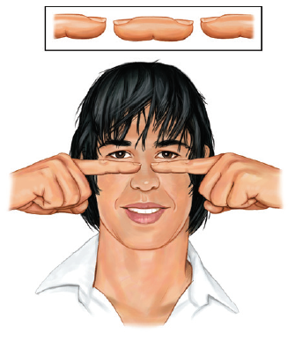
retinal disparity
Hold your two index fingers about 5 inches in front of your
eyes, with their tips half an inch apart. Now look beyond them and note the weird result.

Slide 149
How does retinal disparity work?
By
comparing retinal images from
the two eyes, the brain computes
distance—the greater the disparity
(difference) between the two
images, the closer the object.

Slide 150
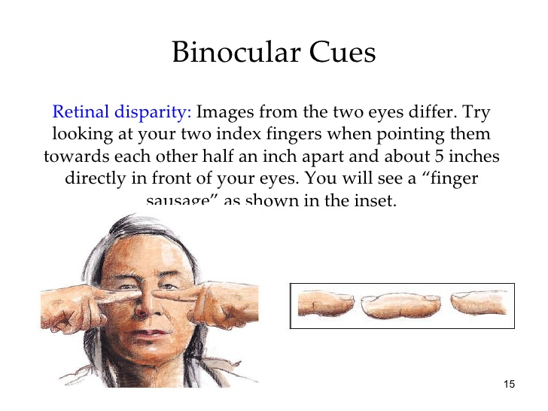

Slide 151
What is convergence?
the inward angle of the eyes focusing on a near object

Slide 152
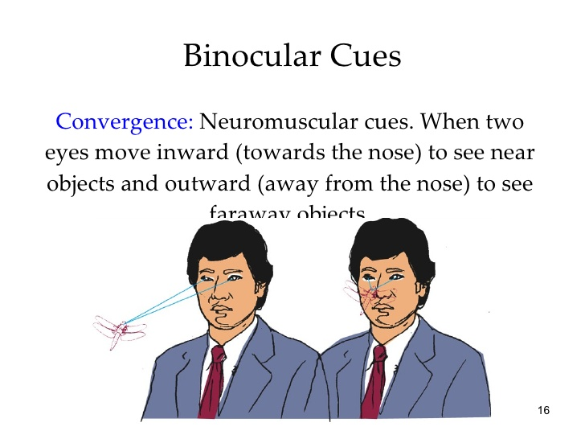

Slide 153
convergence
Hold your textbook or other written material out at arm’s length and focus on the words on the page. While maintaining your focus (you may have to blink!), slowly bring the book closer and closer to your eyes.
Do you feel the slight pain/tightening around your eyes?
As the four muscles surrounding the eye work to move the eye to focus, they send signals to the brain that the object in front of you is getting closer.

Slide 154
2. What Would You Answer?
Narmeen is viewing the board in the classroom. She knows that the board is located far away because the view from her left eye is slightly different than the view from her right eye. Her ability to judge the distance of the board is due to which depth cue?
retinal disparity
B. relative size
C. linear perspective
D. relative motion
convergence

Slide 155
What are monocular cues and how do they help us judge depth?
How do we judge whether a person is
10 or 100 meters away?
Retinal disparity won’t help us here, because there won’t be much difference between the images cast on our right and left retinas.
At such distances, we depend on monocular cues (depth cues available to each eye separately).

Slide 156

What is relative height?
We perceive objects
higher in our field of vision as farther away.
Because we assume the lower part of a figure-ground illustration is closer, we
perceive it as the figure.
Invert this illustration and the black will become ground, like a night sky.

Slide 157
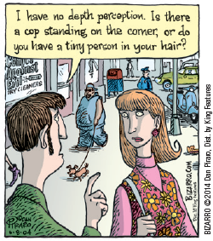
What is relative size?
If we assume two objects are
similar in size, most people perceive the one
that casts the smaller retinal image as farther
away.

Slide 158
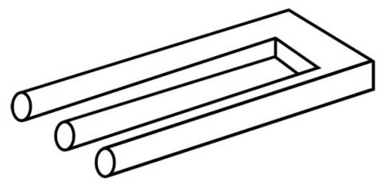

Slide 159

What is interposition?
If one object partially blocks
our view of another, we perceive it as closer.
The deer block the tree trunk…so the tree trunk seems farther.

Slide 160
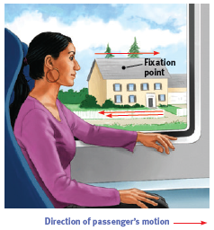
What is relative motion?
As we move, objects
that are actually stable may appear to move. If while riding on a bus you fix your gaze on some point—say, a house—the objects beyond the fixation point will appear to move with you.
Objects in front of the point will appear to move backward.
The farther an object is from the fixation point, the faster it will seem to move.

Slide 161

What is linear perspective?
Parallel lines appear to meet in
the distance.
The sharper the angle of convergence,
the greater the perceived distance.

Slide 162


Slide 163


How does the brain perceive depth using linear perspective cues?
The yellow sign and the car, which are farther away from where the two parallel lines of the road seem to come together are perceived as close.
The car in this image is closer to where the two parallel lines seem to come together and is perceived as farther away.

Slide 164


What is light and shadow?
Shading
produces a sense of depth consistent with our assumption
that light comes from above.
In the inverted view, the hollow will
become a hill.

Slide 165
AP® Exam Tip 2
The illustrations in the previous slides provide you with excellent opportunities to practice identifying
monocular depth cues.
To really demonstrate your understanding,
look for these cues in other drawings, photographs and real life.
There are almost always cues to identify and often more than one monocular cue will be present in an image.
This practice will help you master the terms for the
AP® exam.

Slide 166
What is stroboscopic movement and the phi phenomenon?
Our brain perceives a rapid series of slightly varying images as continuous movement (a phenomenon called stroboscopic movement).
We construct that motion in our heads, just as we construct movement in blinking marquees and holiday lights.
We perceive two adjacent stationary lights blinking on and off in quick succession as one single light moving back and forth. Lighted signs exploit this phi phenomenon with a succession of lights that creates the impression of, say, a moving arrow.

Slide 167

https://www.wimp.com/ghostbusters-halloween-light-show/

Slide 168
What is a perceptual constancy?
Perceptual constancy is a top-down process that recognizes objects without being deceived by changes in their color, brightness, shape, or size.
Regardless of the viewing angle, distance, and illumination, we can identify people and
objects quite quickly.
Even if the image on our retina seems changing, our brain can keep it constant.

Slide 169

What is color constancy?
perceiving
familiar objects as having consistent color, even if changing
illumination alters the wavelengths
reflected by the object

Slide 170

What is brightness constancy?
We
perceive an object as having a constant brightness even as its illumination varies. This perception
of constancy depends on relative luminance—the amount of light an object reflects
relative to its surroundings.

Slide 171
3. What Would You Answer?
Even though the banana seemed to change color as the lighting in the room changed, Jane knew that the color of the banana was not actually changing. This is due to
perceptual adaptation.
B. convergence.
C. color constancy.
D. interposition.
brightness constancy.

Slide 172

What is shape constancy?
We perceive an object as having an unchanging shape, even while
our distance from it varies.

Slide 173
What is size constancy?
We perceive an object as having an unchanging size
even while our distance from it varies.
We assume a car is large enough to carry people, even when we see its tiny image from two blocks away.
So…to our eyes…it appears an object
(a car, a friend…) moving away from us
is getting smaller.(sensation)
But our brain understands that friends and cars don’t shrink like that and interprets the visual input as an increase in distance. (perception)

Slide 174
A pause for a quote…
“ Sometimes I wonder: Why is that
Frisbee getting bigger?
And then it hits me.”
Anonymous

Slide 175

How does the Ames room alter our perceptions?
This distorted room, designed by Adelbert Ames, appears to have a normal rectangular shape when viewed through a peephole with one eye.
The girl in the right corner
appears very large
because we judge her size based on the false assumption that she is the same distance away as the girl in the left corner.

Slide 176

How does the Ames room work?
As the diagram reveals, the girls are actually about the same size,
but the room is distorted.

Slide 177
What have we learned from research on restored vision?
A few dozen adults who were blind from birth due to cataracts later gained sight. Most of their life they could see only diffused light.
After cataract surgery, the patients could distinguish figure from ground and could differentiate colors—suggesting that these aspects of perception are innate.
(Gregory, 1978; Huber et al., 2015; von Senden, 1932).

Slide 178
Is there a critical period for development of perception?
Surgery on children in India reveals that those who are blind from birth can benefit from removal of cataracts, and the younger they are, the more they benefit.
But their visual acuity (sharpness) may never be normal. For normal sensory and perceptual development, there is a critical period — an optimal period when exposure to certain stimuli or experiences is required.
(Chatterjee, 2015; Gandhi et al., 2014)

Slide 179
How does sensory restriction reveal the effects of experience on perception?
Researchers restricted the vision of infant kittens. After infancy, when their vision was restored, the kittens behaved much like the humans born with cataracts. They could distinguish color and brightness but not the form of a circle from that of a square. Their eyes had not degenerated; their retinas still relayed signals to their visual cortex. But lacking early
stimulation, their brain’s cortical cells had not developed normal connections.
(Hubel & Wiesel, 1963)

Slide 180
What is perceptual adaptation?
the ability to adjust to changed
sensory input, including an
artificially displaced or even
inverted visual field

Slide 181

Can we adapt to inverted vision?
“Oops, missed,” thought researcher Hubert Dolezal as he attempted a handshake while viewing the world through inverting goggles.
Yet, believe it or not, kittens, monkeys, and humans can
adapt to an inverted world.

Slide 182
Learning Target 19-1 Review
Describe the Gestalt psychologists’
understanding of perceptual organization.
Gestalt psychologists searched for rules by which the brain organizes fragments of sensory data into gestalts.
In pointing out that the whole may exceed the sum of its parts, they noted that we filter sensory information and construct our perceptions.

Slide 183
Learning Target 19-1 Review cont.
Describe how figure-ground and grouping
principles contribute to our perceptions.
To recognize an object, we must first perceive it (see it as a figure) as distinct from its surroundings (the ground).
We bring order and form to stimuli by organizing them into meaningful groups, following such rules as proximity, continuity, and closure.

Slide 184
Learning Target 19-2 Review
Explain how we use binocular and
monocular cues to perceive the world in
three dimensions.
Depth perception: seeing objects in three dimensions and judging distance.
The visual cliff and other research demonstrate that many species naturally perceive the world in three dimensions at, or very soon after, birth.
Binocular cues, such as retinal disparity, use information from both eyes.
Monocular cues use information from only one eye.

Slide 185
Learning Target 19-2 Review cont.
Explain how we perceive motion.
As objects move, we assume that shrinking objects are retreating and enlarging objects are approaching.
A quick succession of images on the retina can create an illusion of movement, as in stroboscopic movement and the phi phenomenon.

Slide 186
Learning Target 19-3 Review
Explain how perceptual constancies
help us construct meaningful perceptions.
Perceptual constancy enables us to perceive objects as stable despite the changing image they cast on our retinas.
Color constancy is our ability to perceive consistent color in objects even though the lighting and wavelengths shift.
Brightness (or lightness) constancy is our ability to perceive an object as having a constant lightness even when its illumination—the light cast upon it—changes.

Slide 187
Learning Target 19-3 Review cont.
Explain how perceptual constancies
help us construct meaningful perceptions.
Shape constancy is our ability to perceive familiar objects(such as an opening door) as unchanging in shape or silhouette.
Size constancy is perceiving objects as unchanging in size/dimension despite their changing retinal images.
Knowing an object’s size gives us clues to its distance; knowing its distance gives clues about its size, but we sometimes misread monocular distance cues and reach the wrong conclusions, as in the Moon illusion.

Slide 188
Learning Target 19-4 Review
Describe what research on restored vision,
sensory restriction, and perceptual adaptation
reveals about the effects of experience on perception.
People blind from birth who gained sight after surgery lack the experience to visually recognize shapes and forms.
Sensory restriction research shows a critical period for some aspects of sensory and perceptual development.
People given glasses that shift the world slightly experience perceptual adaptation. They are initially disoriented, but they manage to adapt to their new context.

Slide 189
Learning Targets
Module 20
20-1 Describe the characteristics of air pressure waves that we hear as sound.
20-2 Explain how the ear transforms sound energy into neural messages.
Hearing
20-3 Discuss how we detect loudness, discriminate pitch, and locate sounds.

Slide 190

What is audition?
the sense or act of hearing

Slide 191
How do air pressure waves become sound?
Draw a bow across a violin, and you will unleash the energy of sound waves.
Air molecules, each bumping into the next, create waves of compressed and expanded air, like the ripples on a pond circling out from a tossed stone.
As we swim in our ocean of moving air molecules,
our ears detect these brief air pressure changes.

Slide 192


What are characteristics of sound waves?
frequency (wavelength)
amplitude (height)

Slide 193
What information do sound waves give us?
What pitch am I hearing?
How loud is the sound I am hearing?

Slide 194
Would you expect long or short wavelengths…
1
…when a soprano sings an aria?
2
…when a baritone sings along?

Slide 195
AP® Exam Tip 1
Note that both light and sound travel in waves.
In each case, the amplitude and length of the waves
are important to learn for the AP® exam.

Slide 196

What are the three divisions of the ear?
The ear is divided into outer, middle and inner sections.

Slide 197

How does the ear transform sound into neural messages?
Passing through accessory structures to sense receptors, vibrating air triggers nerve impulses that the
brain decodes as sounds.

Slide 198
What is the auditory canal?
the channel located in the outer ear that funnels sound waves from the pinna to the tympanic membrane
(ear drum)

Slide 199
What is the ear drum (tympanic membrane)?
The ear drum, or the tympanic membrane, is a thin layer of tissue that vibrates in response to sound waves.

Slide 200
What are the ossicles?
The ossicles, made up of the three smallest bones in the human body, the incus, the malleus and the stapes, transfer the sound wave vibrations from the tympanic membrane to the oval window of the cochlea.

Slide 202
What is the oval window?
The oval window is the membrane-covered opening of the cochlea. It vibrates when it receives the sound waves and causes the fluid inside the cochlea to move.

Slide 203
What is the cochlea?
The cochlea is a coiled, bony, fluid-filled tube in the inner ear.
Sound waves traveling through the cochlear
fluid trigger
nerve impulses.

Slide 204

Can you trace the path of sound through the ear so far?
Use the terms you just learned to label each structure.

Slide 205
1. What Would You Answer?
When you listen to music, the sound waves cause your ____ to vibrate first.
cochlea
B. hammer, anvil, and stirrup (malleus, incus and stapes)
C. eardrum (tympanic membrane)
D. oval window
auditory nerve

Slide 206
AP® Exam Tip 2
You may notice that some sensory structures are referred to in more than one way. The Latin designation is important to know:
tympanic membrane
Your textbook author has simplified the terms and uses the popular name for the structure:
eardrum
Learn both names and understand they refer to the same structure(s) so you won’t be confused on the AP ® exam.

Slide 207

How does the sound wave move through the inner ear?
Accessory structures move the sound wave to the sense receptors(stereocilia) in the inner ear where the wave energy undergoes transduction to neural energy that the brain can interpret.

Slide 208
How does transduction occur in the inner ear?
The motion of the sound vibration against the oval window of the cochlea causes ripples in the basilar membrane,
bending the hair cells lining its surface,

Slide 209
AP® Exam Tip 3
Although the basilar membrane is not considered a key term in your text, it is considered a key term on the AP® exam.
Free-Response Questions (FRQs) and multiple choice questions frequently ask about the basilar membrane.
Make sure to learn about the way sound waves are transduced into neural impulses via the cilia on the basilar membrane.

Slide 210
How does the nerve impulse move out of the ear?
The hair cell (cilia) movements in turn trigger impulses in adjacent nerve cells, whose axons
converge to form the auditory nerve.

Slide 211

How does the message carry to the brain?
The auditory nerve carries the neural messages to your
thalamus and then on to the auditory cortex in
your brain’s temporal lobes.

Slide 212

Trace the path of sound through the ear.
Put it all together and label the process.

Slide 213
AP® Exam Tip 4
Pay attention to how many pages are devoted
to each of the senses.
Not only does this represent the complexity of the sensory system, it also represents how likely you are to find questions about that system on the AP® exam.
Given that more pages are devoted to vision than hearing, there are likely to be more exam questions on vision.

Slide 214
What are two types of hearing loss?
sensorineural
conduction
Damage to the cochlea’s hair cell receptors or the auditory nerve can cause
sensorineural hearing loss.
With auditory nerve damage, people
may hear sound but have trouble discerning what someone is saying.
Damage to the mechanical system—the eardrum and middle ear bones—that conducts sound waves to the cochlea can cause conduction hearing loss. It is less common than sensorineural hearing loss.

Slide 215

How much sound is too much sound?
As a general rule, any noise we cannot talk over (loud machinery, fans screaming
at a sports event, music blasting at maximum volume) may be harmful, especially if prolonged
and repeated.
(Roesser, 1998)

Slide 216

What is the problem with headphones?
Headphones direct all of the sound waves into the auditory canal and bombard the basilar membrane.
In the open air, sound waves disperse and are not all directed to one location.

Slide 217

How can headphones help?
When
Super Bowl-winning quarterback Drew
Brees celebrated New Orleans’ 2010
victory amid pandemonium, he used ear muffs to protect the vulnerable hair cells of his son, Baylen.

Slide 218
What is the research on hearing loss?
Since the early 1990s, teen hearing loss has risen by a third and now affects 1 in 5 teens.
(Shargorodsky et al., 2010)
After three hours of a rock concert averaging 99
decibels, 54 percent of teens reported not hearing as well, and 1 in 4 had ringing in their ears.
Teen boys more than teen girls or adults blast themselves with loud volumes for long periods.
(Zogby, 2006)

Slide 219
What is a cochlear implant?
a device for
converting sounds into electrical
signals and stimulating the
auditory nerve through electrodes
threaded into the cochlea

Slide 220

How does a cochlear implant work?
Cochlear implants work by translating
sounds into electrical signals that are
transmitted to the cochlea and, via the
auditory nerve, relayed to the brain.

Slide 221
2. What Would You Answer?
Because of the repeated exposure to loud noise they experience during their daily jobs, airport ground workers are most susceptible to damage which of the following?
olfactory nerve
B. cochlea
C. ganglion cells
D. bipolar cells
incus, malleus and stapes

Slide 222
How does the brain detect loudness?
A soft, tone activates only the few hair cells attuned to its frequency.
Given louder sounds, neighboring hair cells also respond.
Thus, the brain interprets loudness from the number of activated hair cells.

Slide 223
What is one theory of how the brain detects pitch?
Place theory presumes that we hear different pitches because different sound waves
trigger activity at different spots along the cochlea’s basilar membrane.
Thus, the brain determines a sound’s pitch by recognizing the specific area (on the membrane) that is generating the neural signal.

Slide 224
What is the frequency theory?
Frequency theory (also called temporal theory) suggests an alternative:
the brain reads pitch by monitoring the frequency of neural impulses traveling up the auditory nerve.
The whole basilar membrane vibrates with the incoming sound wave, triggering neural impulses to the brain at the same rate as the sound wave.
If the sound wave has a frequency of 100 waves per second, then 100 pulses per second
travel up the auditory nerve.

Slide 225
How does the volley principle explain hearing higher frequency sounds?
By firing in rapid succession, neurons can achieve a combined frequency above 1000 waves per second
Like soldiers who alternate firing so that some can shoot while others reload, achieving greater combined fire power, neural cells
can alternate firing.

Slide 226
How do the two theories work together to explain how we hear pitch?
Place theory best explains how we sense
high pitches.
Frequency theory, extended by the volley principle, also explains how we sense low pitches.
Finally, some combination of place
and frequency theories likely explains how we sense pitches in the intermediate range.

Slide 227
3. What Would You Answer?
Which of the following reflects the notion that pitch is related to the stimulation of different areas of the cochlea’s basilar membrane?
place theory
B. frequency theory
C. volley principle
D. sound localization
Stereophonic hearing

Slide 228

How do we locate sounds?
Sound waves strike one ear sooner and more intensely than
the other. From this information, our nimble brain can compute the sound’s location.

Slide 229
Learning Target 20-1 Review
Describe the characteristics of air
pressure waves that we hear as sound.
Sound waves are bands of compressed and expanded air.
Our ears detect these changes in air pressure and transform them into neural impulses, which the brain decodes as sound. This is audition… or hearing.
Sound waves vary in amplitude, which we perceive as differing loudness (measured in decibels), and in frequency, which we experience as differing pitch.

Slide 230
Learning Target 20-2 Review
Explain how the ear transforms sound
energy into neural messages.
The outer ear funnels sound to the middle ear
The inner ear consists of the cochlea, semicircular canals, and vestibular sacs.
Sound waves traveling through the auditory canal cause tiny vibrations in the eardrum. The ossicles amplify the vibrations and relay them to the fluid-filled cochlea. Rippling of the basilar membrane, causes movement of the tiny hair cells, triggering neural messages to be sent to the auditory cortex in the brain.

Slide 231
Learning Target 20-2 Review cont.
Explain how the ear transforms sound
energy into neural messages.
Sensorineural hearing loss (or nerve deafness) results from damage to the cochlea’s hair cells or their associated nerves.
Conduction hearing loss results from damage to the mechanical system that transmits sound waves to the cochlea.
Cochlear implants can restore hearing for some people.

Slide 232
Learning Target 20-3 Review
Discuss how we detect loudness,
discriminate pitch, and locate sounds.
Our brain interprets loudness from the number of activated hair cells.
Place theory explains how we hear high-pitched sounds, and frequency theory explains how we hear low-pitched sounds. A combination of the two theories explains how we hear pitches in the middle range.
Place theory proposes that our brain interprets a particular pitch by decoding the place where a sound wave stimulates the cochlea’s basilar membrane.

Slide 233
Learning Target 20-3 Review cont.
Discuss how we detect loudness,
discriminate pitch, and locate sounds.
Frequency theory proposes that the brain deciphers the frequency of the neural impulses traveling up the auditory nerve to the brain.
By alternating their firing (the volley principle), neural cells enable us to sense sounds with high frequencies.
Sound waves strike one ear sooner and more intensely than the other. The brain analyzes the minute differences in the sounds received by the two ears and computes the sound’s source.

Slide 234
Unit 4
Sensation and Perception

Slide 235
Learning Targets
Module 21
21-1 Describe the sense of touch.
21-2 Discuss the biological, psychological, and social-cultural influences that affect our experience of pain and explain how placebos and distraction help control pain.
The Other Senses
21-3 Compare and contrast our senses of taste and smell.
21-4 Explain how we sense our body’s position and movement.
21-5 Discuss how sensory interaction influences our perceptions, and explain the concept of embodied cognition.

Slide 236

How do we sense touch?
Our “sense of
touch” is a mix of four basic and distinct skin senses, pressure, warmth, cold, and pain and our other skin
sensations are variations of pressure, warmth, cold, and pain.

Slide 237

How does the somatosensory cortex help us sense touch?
We discussed the somatosensory cortex in Module 12. This section of the brain receives incoming sensory information from our skin, as well as other senses.

Slide 238
How is pain best understood?
Our experience of pain reflects both bottom-up sensations and top-down cognition.
Pain is a biopsychosocial event.
As such, pain experiences vary widely, from
group to group and from person to person.

Slide 239

How is pain a biopsychosocial event?

Slide 240

How is pain biological?
Sensory receptors called nociceptors—mostly in your skin, but also in your muscles
and organs—detect hurtful temperatures,
pressure, or chemicals.

Slide 241

What is a pain circuit?
Sensory receptors (nociceptors)
respond to potentially damaging stimuli by sending an impulse to
the spinal cord, which passes the message to the brain, which
interprets the signal as pain.

Slide 242
What is the gate-control theory?
The gate-control theory states that the spinal cord contains a neurological “gate” that blocks
pain signals or allows them to pass on to the brain.
The “gate” is opened by the activity of pain
signals traveling up small nerve fibers and is closed by activity in larger fibers (such as massage) or
by information coming from the brain
(such as distracting thoughts).

Slide 243
What is phantom-limb pain?
The brain can create pain, as it does in phantom limb sensations after a limb amputation.
Without normal sensory input, the brain may misinterpret and amplify spontaneous but irrelevant
central nervous system activity.
7 in 10 such people feel pain or movement in nonexistent limbs.
(Melzack, 1992, 2005)

Slide 244

How is pain psychological?
Pain is impacted by how much attention we give to it. If we distract our minds with other thoughts, the pain feels as if it has diminished.

Slide 245
How else is pain psychological?
Our memories of pain may be edited from the actual pain we felt.
People overlook a pain’s duration and recall two moments: pain’s peak moment and how much pain is
felt at the end.

Slide 246

How is pain social-cultural?
We tend to perceive more pain when others seem to be
experiencing pain.

Slide 247
How else is pain social-cultural?
We get cues on how to perceive pain from our culture’s views on pain.

Slide 248
Think of a recent pain event in your life…
…what were the biological causes?
…what were the psychological causes?
… what were the social-cultural causes?

Slide 249

What are some methods for controlling pain?
Pain control therapies may include drugs, surgery,
acupuncture, electrical stimulation, massage, exercise, hypnosis, relaxation training, meditation, and thought distraction.

Slide 250
How might placebos reduce pain?
In an experiment, researchers pitted two placebos—fake pills and pretend acupuncture—
against each other.
People with persistent arm pain received either fake acupuncture (with trick needles that
retracted without puncturing the skin)
or
blue cornstarch pills that looked like a medication often prescribed for strain injury.

Slide 251
What were the results?
After two months, both groups were reporting less pain, with the fake acupuncture group reporting the greater pain drop.
A quarter of those receiving the nonexistent needle pricks and 31 percent of those receiving the fake pills even complained of side effects, such as painful
skin or dry mouth and fatigue.
(Kaptchuk et al., 2006)

Slide 252

How might distraction reduce pain?
For burn victims undergoing painful skin repair, an escape
into virtual reality can powerfully distract attention, thus reducing pain and the brain’s response to painful stimulation.

Slide 253
What are the two chemical senses?
taste (gustation)
Smell (olfaction)
On the top and sides of your tongue are 200 or more taste buds, each containing a pore that catches food chemicals.
We smell something when molecules of a substance
carried in the air reach a tiny cluster of receptor cells at the top of each nasal cavity.

Slide 254

What are the five basic tastes we can detect?
Tastes exist for more than our pleasure.

Slide 255
What food can you think of that is….
sweet
salty
bitter
sour
umami

Slide 256
How do we actually taste food?
In each taste bud pore, 50 to 100 taste receptor cells project antenna-like hairs that sense food molecules. This is where the chemicals in food are transduced to neural messages for the brain.
Some receptors respond mostly to sweet-tasting molecules, others to salty-, sour-, umami-, or bitter-tasting ones.
Each receptor transmits its message to a matching partner cell in your brain’s temporal lobes.

Slide 257
How does our sense of smell operate?
These 20 million olfactory receptors
respond selectively—to the aroma of a cake baking, to a wisp of smoke, to a friend’s fragrance.
This is where odors are transduced to neural messages for the brain.
Instantly, they alert the brain through their axon fibers.

Slide 258

The process of olfaction (smell)

Slide 259

What happens next?
Sniffing swirls air up to the receptors, enhancing the aroma.
The receptor cells send messages to the brain’s olfactory bulb, and then onward to the temporal lobe’s primary smell cortex and to the parts of the limbic system involved in memory and emotion.

Slide 260
AP® Exam Tip
The sense of smell (olfaction) is the only one of the five senses that does not pass neural information through the thalamus.
This is often a question on the AP® exam.

Slide 261

How are taste, smell and memory related?
Information from the taste buds (yellow arrow) travels to an area between the frontal and temporal lobes of the brain.
This information registers near where the brain receives input from our sense of smell, which interacts with taste.

Slide 262
In what other way are taste, smell and memory related?
The brain’s circuitry for smell (red area) also connects with areas involved in memory storage, which helps explain why a smell can trigger a memory.

Slide 263
Let’s look at the research on the relationship…
When put in a foul-smelling room, people expressed harsher judgments of other people and of immoral acts.
(Inbar et al., 2011; Schnall et al., 2008)
Exposed to a fishy smell, people became more suspicious.
(Lee et al., 2015).
And when riding on a train car with the citrus scent of a cleaning product, people have left behind less trash.
(de Lange et al., 2012)

Slide 264
How do we sense our body’s position and movement?
kinesthetic sense
vestibular sense
Position and motion detectors in muscles, tendons and joints sense the position and movement of body parts.
Fluid-filled semicircular canals and a pair of calcium crystal-filled vestibular sacs located in the ears monitors the head’s (and body’s) movements.

Slide 265


Slide 266
1. What Would You Answer?
Which of the following is the best example of your kinesthetic sense?
Touching your nose with your eyes closed.
B. Maintaining balance in your chair.
C. Detecting both sweet and sour in a beverage.
D. Smelling the soup your dad is cooking for dinner.
Combining smell and taste together to create flavor.

Slide 267
How do our senses interact?
Our senses can influence each other.
Smell impacts taste…ever notice how bland food tastes when you have a cold?
We cannot detect various tastes when
we close our nose.
We see visual images better when they are accompanied by noise.
We can hear soft sounds better if paired
with a visual cue.

Slide 268

What is an example of sensory interaction?
We can hear soft sounds better when they are paired with a visual cue.
Seeing the speaker forming the words, which Apple’s FaceTime video-chat feature allows, makes those words easier to understand
for hard-of-hearing listeners.
(Knight, 2004)

Slide 269
What is embodied cognition?
the influence of bodily sensations,
gestures, and other states on
cognitive preferences and judgments

Slide 270
What does research show about embodied cognition?
After holding a warm drink rather than a cold one, people were more likely to rate someone more warmly, feel closer to them, and behave more generously.
(IJzerman & Semin, 2009; Williams & Bargh, 2008).
After being given the cold shoulder by others, people
judged the room to be colder than did those who had been treated warmly.
(Zhong & Leonardelli, 2008).
Sitting at a wobbly desk and chair makes others’ relationships, or even one’s own romantic relationship, seem less stable.
(Forest et al., 2015; Kille et al., 2013).

Slide 271
What is synesthesia?
In a few select individuals, the brain circuits for two or more senses become joined in a phenomenon called synesthesia, where the stimulation of one sense (such as hearing sound)
triggers an experience of another
(such as seeing color).
Synesthetes may hear music as colors or
experience numbers as tastes.

Slide 272
2. What Would You Answer?
Ester is walking to class when she notices someone
in the distance suddenly duck into a dark doorway.
As she chases the figure, she misjudges the distance
and runs into the door and falls down. She laughs
when she discovers that the mystery person is her
roommate, who was avoiding Ester, because she
had borrowed Ester’s favorite sweater without permission and was afraid Ester might be angry.
Question on next page…

Slide 273
2. What Would You Answer? cont.
Use the following terms to explain the perceptual
processes involved in Ester’s scenario:
gate-control theory
vestibular sense
selective attention
signal detection theory
binocular cues
perceptual set

Slide 274
Learning Target 21-1 Review
Describe the sense of touch.
Our sense of touch is actually several senses—pressure, warmth, cold, and pain—that combine to produce other sensations, such as hot.

Slide 275
Learning Target 21-2 Review
Discuss the biological, psychological,
and social-cultural influences that
affect our experience of pain.
The biopsychosocial perspective views our perception of pain as the sum of biological, psychological, and social-cultural influences.
Pain reflects bottom-up sensations (such as input from nociceptors, the sensory receptors that detect hurtful temperatures, pressure, or chemicals) and top-down processes (such as experience, attention, and culture).

Slide 276
Learning Target 21-2 Review cont.
Discuss the biological, psychological,
and social-cultural influences that
affect our experience of pain.
The gate-control theory of pain is that a “gate” in the spinal cord either opens to permit pain signals traveling up small nerve fibers to reach the brain or closes to prevent their passage.
The brain can also create pain, as it does in phantom limb sensations. (This phenomenon can affect the other senses as well.)

Slide 277
Learning Target 21-2 Review, part III
Explain how placebos and distraction
help control pain.
Pain treatments often combine physical and psychological elements, including placebos and distractions.
Placebos can diminish the central nervous system’s attention and responses to painful experiences.
Distraction can activate neural pathways that inhibit pain and increase pain tolerance.

Slide 278
Learning Target 21-3 Review
Compare and contrast our senses of
taste and smell.
Taste (gustation) and smell (olfaction) are both chemical senses.
Taste is a composite of five basic sensations—sweet, sour, salty, bitter, and umami.
There are no basic sensations for smell. We have some 20 million olfactory receptor cells, with about 350 different receptor proteins.

Slide 279
Learning Target 21-4 Review
Explain how we sense our body’s
position and movement.
Through kinesthesia, we sense the position and movement of our body parts.
We monitor our body’s position and movement and maintain our balance with our vestibular sense, which relies on the semicircular canals and vestibular sacs to sense the tilt or rotation of our head.

Slide 280
Learning Target 21-5 Review
Discuss how sensory interaction
influences our perceptions.
None of our senses operate in a vacuum. We experience sensory interaction: our senses influence one another, and our brain blends the information our senses provide to inform our perceptions.
With synesthesia, the stimulation of one sense (such as hearing sound) triggers an experience of another (such as seeing color).

Slide 281
Learning Target 21-5 Review cont.
Explain the concept of
embodied cognition.
The brain circuits that process physical sensations may interact with brain circuits responsible for cognition, leading to embodied cognition: the influence of our body sensations on our cognitive preferences and judgments.

