Slide 1
English 9 research paper

Slide 2
What is a research paper?
A research paper uses your ideas, accepted research methods, and reliable evidence to support a logical argument or provide information that is relevant to a given topic.
All research papers should contain one key component: RESEARCH!

Slide 3
Where do I find my research?
For this research paper, you will use the Alabama Virtual Library (AVL for short)
https://www.avl.lib.al.us/

Slide 4
Other valid sources
Outside of AVL, the only site you are allowed to use is Google Scholar
https://scholar.google.com/
IT IS NEVER OKAY TO USE WIKIPEDIA AS A SOURCE!!

Slide 5
I’ve gathered research…now what?
Step One: research will be taken down on note cards to organize your information about assigned topic
Step Two: Draft a thesis statement
Step Three: Write your paper!
Take down research
Draft Thesis
Write Paper

Slide 6
Paragraphs in your research paper

Slide 7
Introduction
5-7 sentences in length
1st paragraph in your paper
Attention Grabber
Creative Quote
Interesting Fact
Thesis Statement should be the LAST sentence in your paper
“There is nothing to fear but fear itself”
-- Franklin D. Roosevelt

Slide 8
Body Paragraphs
3 Body Paragraphs (8-10 sentences in length)
Written in AEC Paragraph Form (AECEC)
2 Quotes per Paragraph
**This is where you will include your research

Slide 9
Conclusion
Last Paragraph of your research paper (5-7 sentences in length)
Restated Thesis Statement
Sums up all of your research

Slide 10
Works cited page
The very last page of your research paper
Lists all sources that were used in alphabetical order
Minimum 3 sources in your research paper

Slide 11
AEC Writing Process
Assertion
Evidence
Commentary
Your paper should be written in AEC paragraph form
Each body paragraph will contain TWO AEC patterns

Slide 12
Assertion
Leading statement of the paragraph
Also known as your claim
Everything in the paragraph should be used to prove your assertion
One sentence long

Slide 13
Evidence
Your evidence should illustrate your point
You will use your research gathered to determine your evidence of your research paper.
There will be two pieces of evidence (two quotes) per body paragraph in your research paper
Two quotes X three paragraphs = six quotes in your paper

Slide 14
Commentary
Directly follows evidence
Explains to the reader how the quote you used (evidence) proves your idea (assertion)
This should be written in YOUR OWN WORDS
Ends with a transition sentence to next paragraph

Slide 15
What is plagiarism?

Slide 16
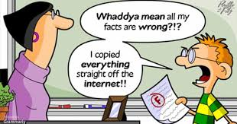
Plagiarism
According to Merriam-Webster Online Dictionary, plagiarism is:
To steal or pass off (ideas) as one’s own
To use without crediting the source
To commit literary theft

Slide 17
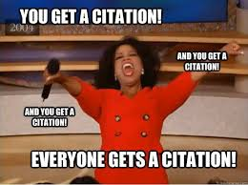
How do I avoid plagiarism??
The answer is so very simple…
Cite all information added to your paper that is not:
something you ALREADY knew
common knowledge

