Slide 1
Envirothon Prep
Identifying Ducks

Slide 2
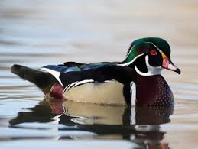
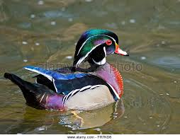
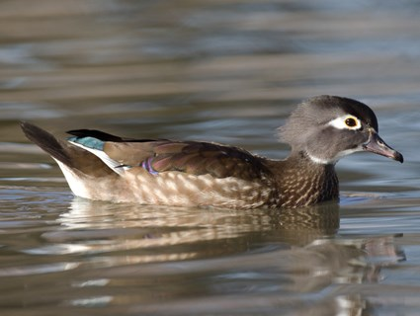
Wood Duck
Male
Female

Slide 3
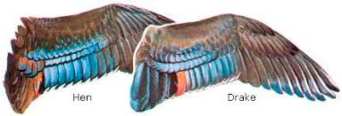
Wood Duck
Wing

Slide 4
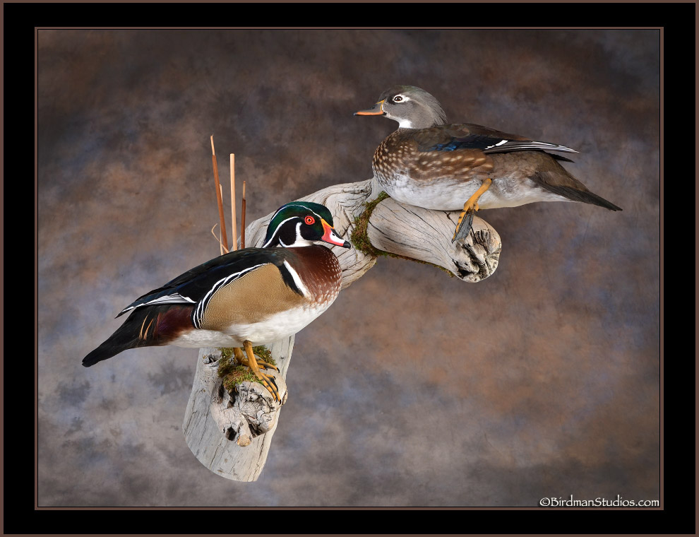
Wood duck
Mount

Slide 5
Mallard Duck
Male
Female

Slide 6
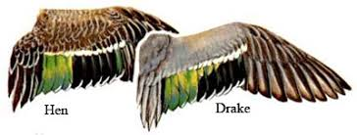
Mallard - wing
Wings

Slide 7
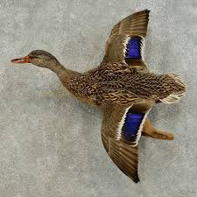
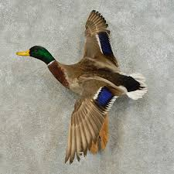
Mallard
Mount

Slide 8
American Black Duck

Slide 9
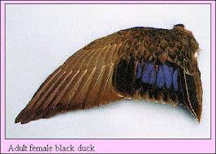
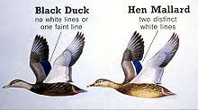
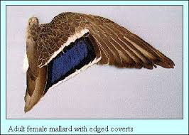
American Black Duck
Wings
Mallards have 2 white lines above and below the color, where Black Ducks do not have any white.

Slide 10
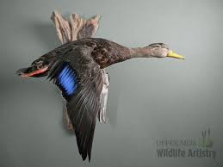
American Black duck
Mount

Slide 11
Northern Pintail

Slide 12
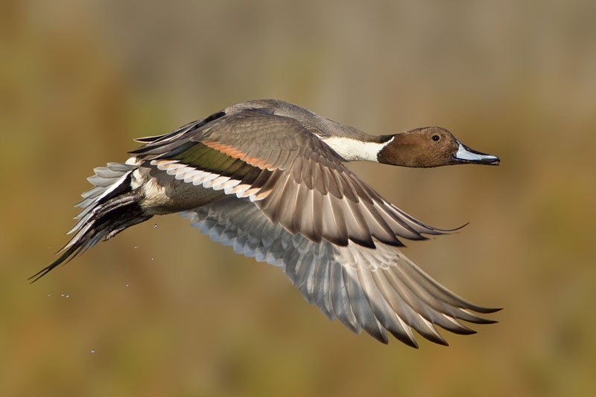
Northern Pintail
Wings

Slide 13
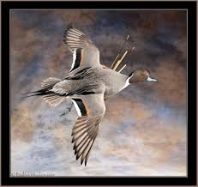
Northern Pintail
Mount

Slide 14
Gadwall

Slide 15
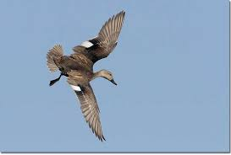
Gadwall
Wing

Slide 16
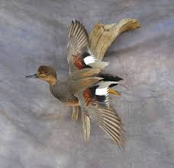
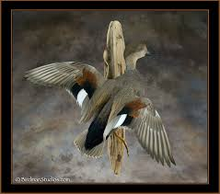
Gadwall
Mount

Slide 17
American Wigeon

Slide 18
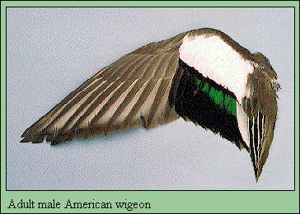
American Wigeon

Slide 19
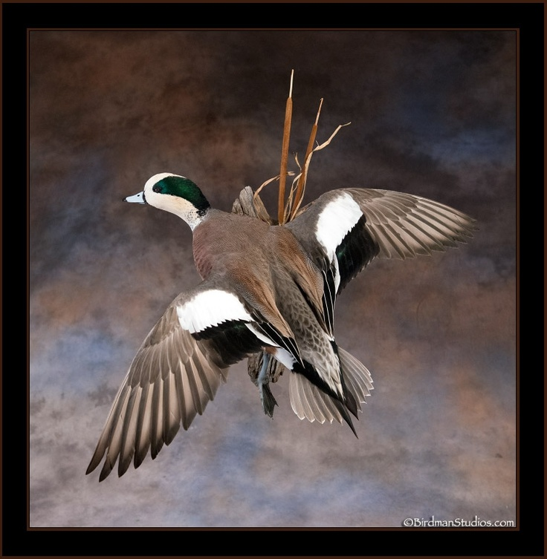
American Wigeon
Mount

Slide 20
Northern Shoveler

Slide 21
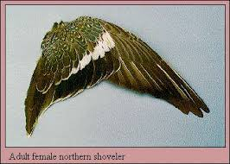
Northern Shoveler

Slide 22
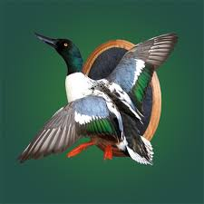
Northern Shoveler
Mount

Slide 23
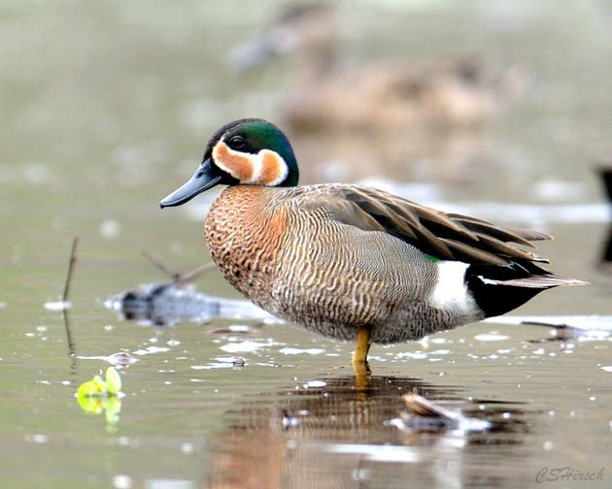
Blue-winged Teal

Slide 24
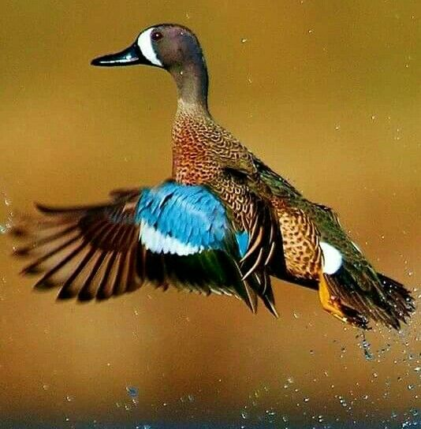
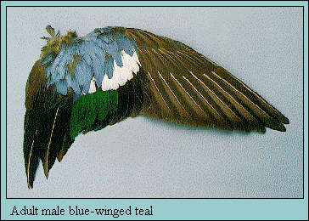
Blue-winged Teal
wings

Slide 25
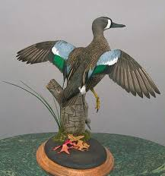
Blue-winged Teal
Mount

Slide 26
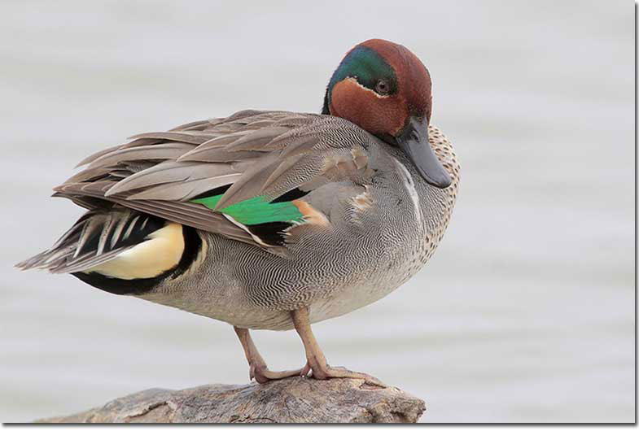
Green-winged Teal

Slide 27
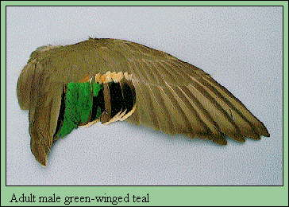
Green-winged Teal
Wings

Slide 28
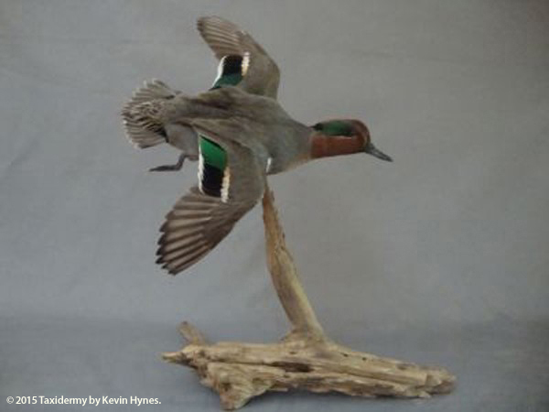
Green-winged Teal
Mount

