Slide 1
ECON / MISSISSIPPI STUDIES
COACH DAVIS

Slide 2
EDUCATION
2007 Grambling State University: Master of Science concentration: (Sport Administration)
2006 Grambling State University: Bachelor of Science concentration: (Sport Management/Kinesiology)

Slide 3
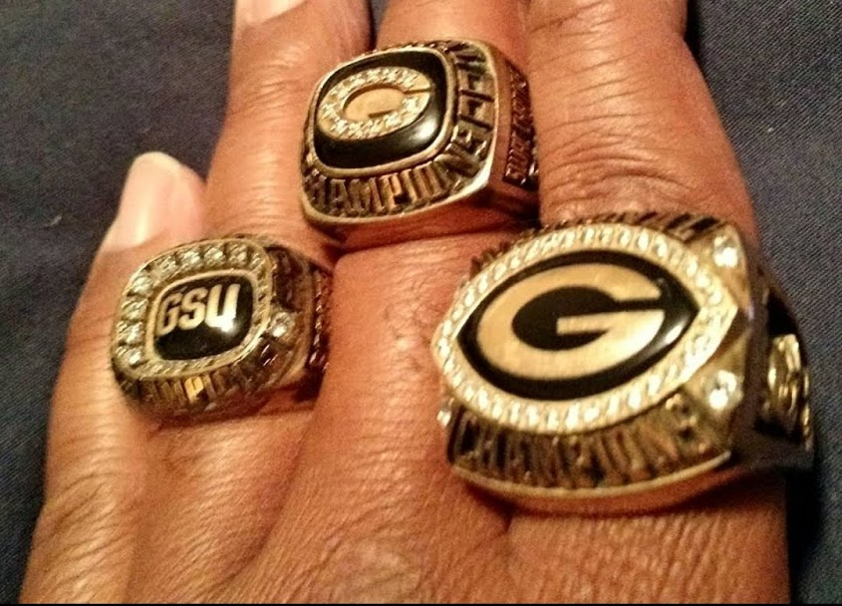
CAREER HIGHLIGHTS
(2018) NAACP Senior Bowl Defensive Coordinator
(2018) Baker High School LHSAA District 6-3A Public School Champions: Defensive Coordinator/Head Strength & Conditioning
(2017) NAACP Senior Bowl Position Coach: Defensive Line
(2016) U.S. Army Red Stick Bowl Position Coach: Defensive Line
(2015) Tioga High School Coach of the year Award: Football (Defensive line), Track & Field (Head Coach)
(2012) Homer Senior High LHSAA District 2-2A CHAMPIONS: Defensive line
(2008) Grambling State University SWAC & SHERIDAN POLL NATIONAL CHAMPIONS: Defensive Line
(2007) Grambling State University SWAC RUNNER UPS: Defensive Line
(2005) Grambling State University SWAC & SHERIDAN POLL NATIONAL CHAMPIONS: Assistant Strength & Conditioning
(2004 – 2007) 32-8 record (SAFL) Southern American Football Conference “North Louisiana Roughriders” Head Coach

Slide 4
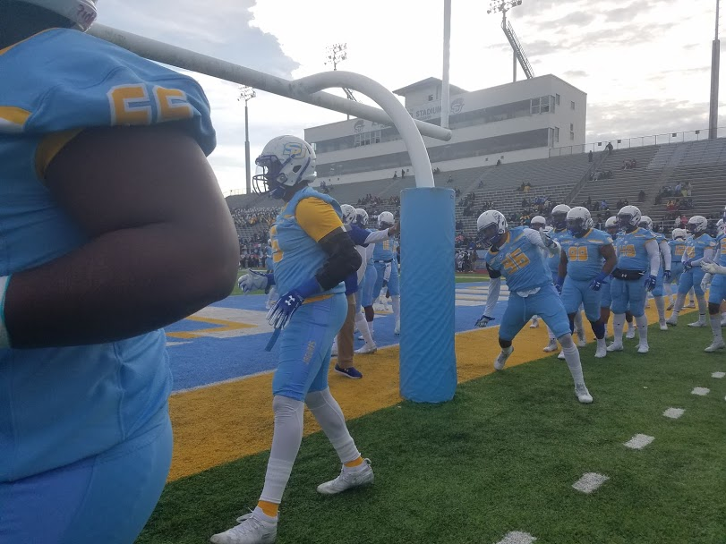
COACHING EXPERIENCE
2011 – 2012 Union Christian Academy: Head Coach/Head Strength & Conditioning
2010 – 2011 Union Christian Academy: Defensive Coordinator/Defensive Line & Linebackers
2007 – 2009 Grambling State University: Assistant Defensive Line
2005 – 2007 Grambling State University: Assistant Strength & Conditioning
2004 – 2007 North Louisiana Roughriders (SAFL) Southern American Football Conference: Head Coach/General Manager
2001-2003 Grambling Middle School: Head Football Coach

Slide 5
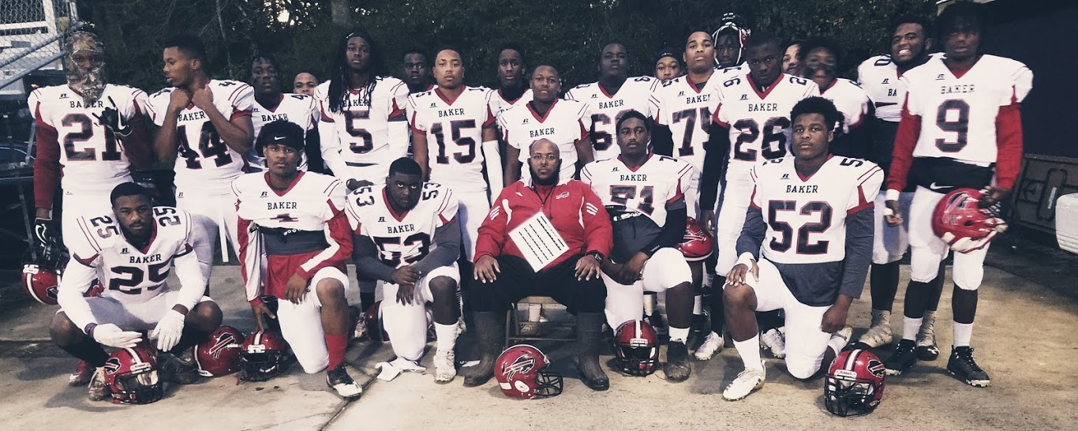
COACHING EXPERIENCE
2016-2019 Baker High School: Defensive Coordinator / Boys & Girls Track / Assistant Boys Basketball / Head Strength & Conditioning
2015 – 2016 Tioga High School: Defensive line / Head Boys Track / Assistant Girls Basketball
2014 – 2015 Bunkie New Tech High School: Running backs / Defensive line/ Head Girls Track
2013 – 2014 Arcadia Senior High: Offensive Coordinator/Head Strengthening & Conditioning
2012 Homer Senior High: Defensive & Offensive Line Coach

Slide 6
ICE
NAME: 1ST, LAST, NICKNAME
HOOD: WHERE YOU FROM
ACTIVITES: SPORTS, BAND, HOBBIES
MUSIC: GENRES, FAVORITE ARTIST
FAVORTIE SPORT/TEAM:
OB???

Slide 7
BELL SCHEDULE
BLOCKS
LUNCH SHIFTS
1ST BLOCK 7:35-9:09
9:09 BREAK/SNACK/QUISTOR
2ND BLOCK 9:37-11:11
3rd BLOCK 11:16-1:16
4TH BLOCK 1:21-2:55
ACTIVITY SCHEDULE
1ST 7:35-9:00, ACT-9:00-9:45, 2ND 9:45-11;11, RESUME REGULAR SCHEDULE
1ST 11:16-11:40 (C HALL, B9)
2nd 11:44-12:08 (B HALL)
CAFETERIA CLOSED 12:08-12:24
3RD 12:24-12:48 (A HALL, MINI AUD, F2)
4TH 12:52-1:16 (D HALL, G7, JROTC)

Slide 8
EXPECTATIONS
SHOW RESPECT TO ALL: TEACHERS & STUDENTS
BE ON TIME: BE PROMPT, PREPARED , AND PRODUCTIVE
STUDENTS ARE RESPONSIBLE OWN MATERIALS: PENCIL,PEN NOTE BOOK BINDER
BE SEATED QUIETLY AND ORDERLY, FIND ASSIGNED SEAT IMMEDITELY AND BEGIN BELL WORK
FOLLOW DIRECTIONS THE FIRST TIME INSTRUCTIONS ARE GIVEN
STUDENTS WRITE DOWN ALL DAILY WORK AND AGENDAS EVERYDAY
TURN IN ASSIGNMENTS ON TIME/DUE DATE

Slide 9
RULES
Rules: Consequences:
1.Listen Carefully 1. Warning
2. Participate Positively 2. Call Home
3. Be Respectful 3. Detention
4. Work Hard 4. Administrative Referral
5. Use Appropriate Language
6. NO FOOD/DRINK

Slide 10
DRESS CODE
NO
Holes in Jeans
T-shirts/Leggings
Spandex Dresses
Head Bands
Hoodies

Slide 11
GRADING SCALE/GRADING
GRADING SCALE
GRADING
(A) 90-100%
(B) 80-89%
(C) 70-79%
(D) 65-69%
(F) 0-64%
ALL GRADES (POWER SCHOOL)
DAILY WORK, QUIZZES, REPORTS, PROJECTS, TESTS, HOMEWORK
TESTS/ASSMENTS, PROJECTS = 40% OF CLASS GRADE

Slide 12
CLASSROOM PROCEDURES
1. Enter the classroom in a timely, controlled, quiet manner, gather materials quickly, and get seated.
2. Locate the daily agenda and objectives written on the board and copy them down. Ask any questions about the agenda or objectives for clarification.
3. Complete all activities and assignments given for the day. If you finish your assignment early, choose one of the following: read silently or work on missing assignments/extra credit.
4. If you need to use the restroom, wait for an appropriate time to ask. Do not interrupt instruction to ask. Do not abuse the privilege or you will lose it.
5. Make sure you name, class, and period appear on all assignments and turn them into designated location.
6. If you are absent, get the agenda and objectives from another student and ask for assignments handouts at the end of the period. See “Make-up Policy” section for late and absent work policy.
7. At the end of the period, put away all your materials, including textbooks, in an orderly fashion, clean up any trash under or around your desk, and wait quietly until the bell rings. If the room is not cleaned up and materials put away properly, you will remain in the classroom until this is accomplished.

Slide 13
CLASSROOM EMERGENCY RESPONSE
EVACUATION: EVENT, FIRE DRILL/ALARM OR ANNOUNCEMENT
LOCKDOWN: EVENT OR ANNOUNCEMENT (CODE RED)
SPECIAL SITUATIONS: EARTHQUAKE, TORNADO WARNING, AIR BORNE BIOLOGICAL OR CHEMICAL HAZARD
THREAT, INTRUDER OR KIDNAPPING

Slide 14
IMPORTANT DATES
FALL
SPRING
SEPT 2– LABOR DAY
OCT 14- COLUMBUS DAY
NOV 25-29 THANKSGIVING
DEC 20 - 1ST SEMESTER END
DEC 23 – CHRISTMAS BREAK
JAN 6 – STUDENTS RETURN
JAN 20 – MARTIN LUTHER KING
MARCH 9-13 SPRING BREAK
APRIL 10 - GOOD FRIDAY
APRIL 13 – EASTER BREAK
MAY 21 – LAST DAY OF SCHOOL

Slide 15
CHOICE IS YOURS
I expect each student to succeed. You have complete control over your academic success. If you need additional help, you need to be proactive in asking me. I will help you succeed in any way I can. If you work hard, attend class regularly, complete assignments on time, and participate in classroom activities and discussion, you will succeed. This is your education. You will take it with you when you leave here. It is up to you to make it what you want it to be. Invest your time and energy in this valuable asset. Be excited, be positive, and be enthusiastic about learning and you will do very well. COACH DAVIS

