Slide 1
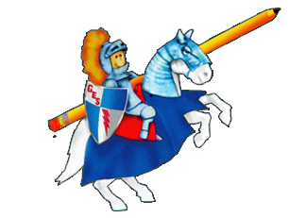
Daily Dose
Of
Second Grade
Week 1

Slide 2
What Can I do:
RL 2.9 Compare and contrast two or more versions of the same story.

Slide 3
READING
This week we are comparing and contrasting different versions of the same story. Remember compare means to tell how things are alike and contrast means to tell how things are different. We use a Venn diagram to compare and contrast.

Slide 4
READ ALOUD: Little Red Riding Hood
https://www.raz-plus.com/projectable/book.php?id=2532&lang=1&type=book

Slide 5
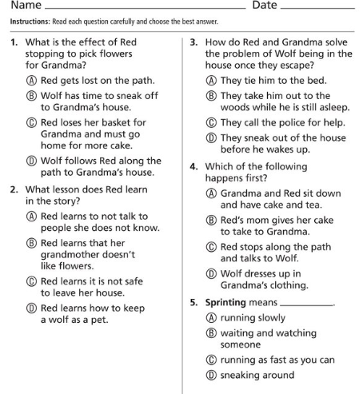
Answer the following questions.

Slide 6
IDR TIME
Students read independently for 20 minutes on Raz-Kids, Epic, or book from home!
Ask yourself:
Who are the characters?
What is the setting?
What is the plot of the story? (beginning, middle and end)
What is the problem?
What is the solution?
How can you relate what you already know to the story?
How does the story you read compare to another story? Contrast?

Slide 7
Spelling
break
great
leash
scream
squeak
team
breath
health
instead
leave

Slide 8
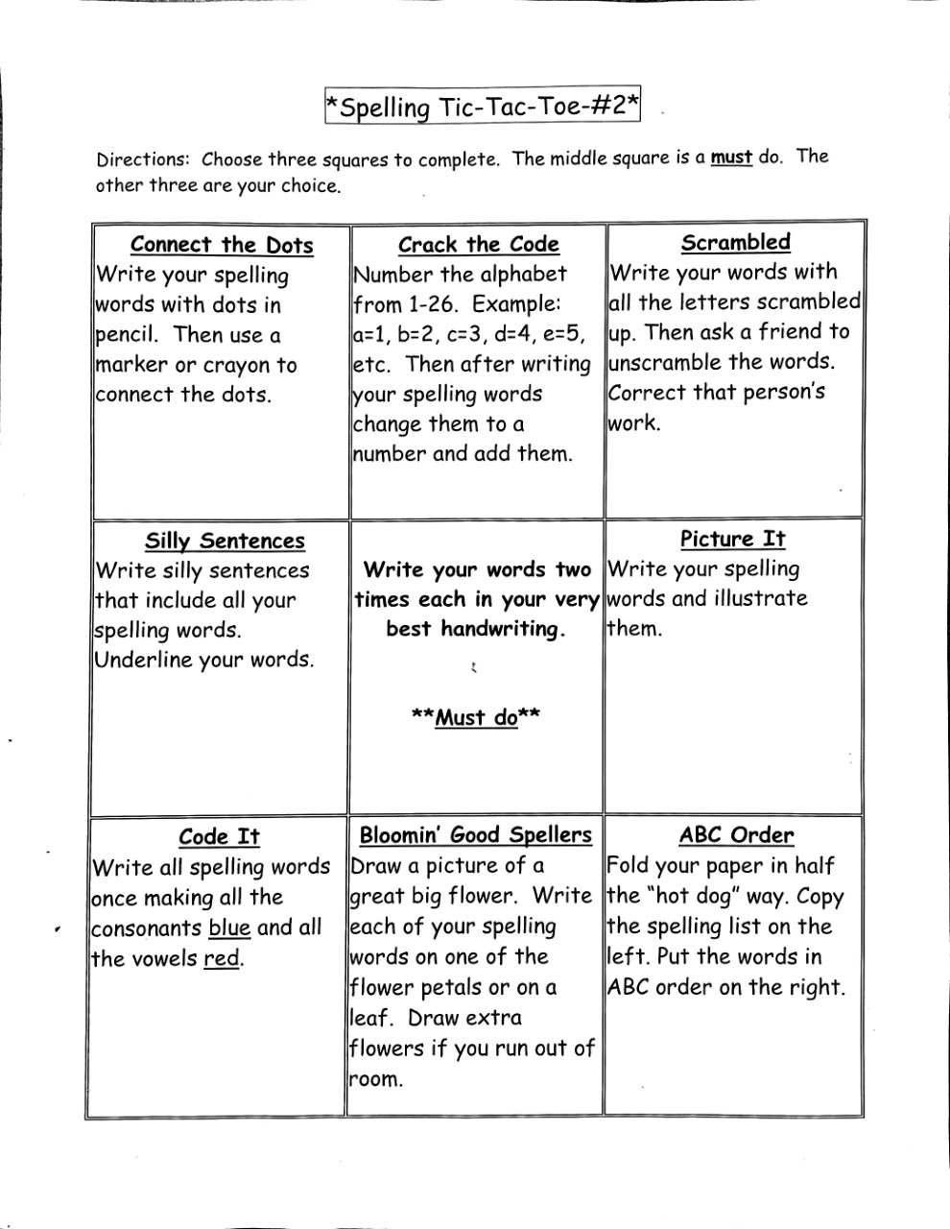
Spelling

Slide 9
Language Arts
L.2.2 Demonstrate command of the conventions of standard English capitalization, punctuation, and spelling when writing.

Slide 10
Punctuation
A sentence begins with a capital letter. A sentence must have a punctuation mark at the end.
We use a period (.) at the end of a statement (telling sentence) or command.
We use a question mark (?) at the end of a question (asking sentence).

Slide 11
Punctuation- Choose the correct ending.
We use an exclamation mark (!) at the end of an exclamation when emotion, excitement, or other feelings are shown.
Practice together.
John and Barbara are best friends
Do you like yellow roses
How many siblings do you have
That spider bite really hurt
I am in the second grade this year
The house is on fire

Slide 12
Punctuation- Choose the correct ending.
Use notebook paper. Copy sentences. Add punctuation and fix any capital letters.
my favorite colors are yellow and blue
do you prefer spring or summer
the tree has fallen on our house
did you find the lost glasses
why is your backpack on the floor
brenda likes to read books by the fire
that movie was the best
Put your papers in your desk

Slide 13
Scholastic News
Go to this website: https://sn2.scholastic.com
Click log in as a student. The password is gb2019.
Go to the issue: Why is this river green? Click explore.
Be sure to watch the videos and play the game!!!
ps://sn2.scholastic.com/etc/classroom-magazines/reader.html?id=12-030320

Slide 14
Questions from scholastic news
https://sn2.scholastic.com/content/dam/classroom-magazines/sn2/issues/2019-20/030320/SN2-030120-GreenRiver-SKILL-Checkpoint.pdf

Slide 15
Writing
Write about your favorite thing that happened over spring break.
Include the following:
Hook/topic sentence
3 to 5 details
Closing sentence

Slide 16
Math

Slide 19
I can use addition and subtraction to solve word problems involving lengths using the same units.

Slide 20
