Slide 1

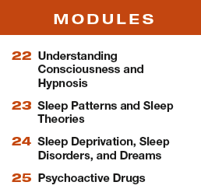

Unit 5
States of Consciousness
2-4%

Slide 2

Learning Targets
Module 22
22-1 Describe the place of consciousness in psychology’s history.
22-2 Define hypnosis, and describe how a hypnotist can influence a hypnotized subject.
Understanding Consciousness and Hypnosis
22-3 Discuss whether hypnosis is an extension of normal consciousness or an altered state.

Slide 3
Who were two major figures in consciousness research?
William James
Sigmund Freud
William James discussed a continuous “stream of consciousness,” with each moment flowing into
the next.
Freud believed the
unconscious was a hiding place for our most anxiety-provoking ideas and emotions, and that
uncovering those hidden thoughts could lead to healing.

Slide 4

What is the place of consciousness in psychology’s history?
In the early half of the twentieth century, the study of consciousness was abandoned for behaviorism. Psychologists wanted to talk about what could be seen.
After 1960, the study of mental process rebounded.
Neuroscience linked brain activity to consciousness.
The study of cognition and how it is altered is now a large field of study.

Slide 5
What is consciousness and what are some aspects of it?
Consciousness is our subjective awareness of ourselves and our environment.
Our conscious awareness
is one part of the dual processing of our two-track minds.
Although much of our information
processing is conscious, more is unconscious and automatic — outside our awareness.

Slide 6
What is hypnosis?
Hypnosis is a social interaction in
which one person (the hypnotist)
suggests to another (the subject)
that certain perceptions, feelings,
thoughts, or behaviors will
spontaneously occur.

Slide 7
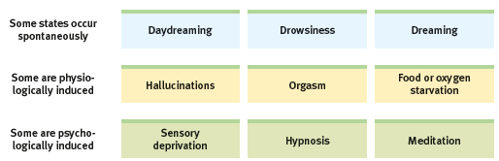
Altered states of consciousness
In addition to normal, waking awareness, consciousness
comes to us in altered states, including daydreaming, sleeping, drug-induced hallucinating, and meditating.

Slide 8
What are some frequently asked questions about hypnosis?
Can anyone experience hypnosis?
Can you recall forgotten events?
To some extent, we are all suggestible.
Highly hypnotizable people, about 20% of us, are usually very imaginative.
Children also make good subjects for hypnosis.
Not really.
All of our life experiences are not actually stored in memory “banks”.
Some memories retrieved through hypnosis seem to combine fact with fiction.

Slide 9
What is a post-hypnotic suggestion and how effective is it?
a suggestion, made during a hypnosis session, to be carried out after the subject is no longer
hypnotized; used by some clinicians to help control undesired symptoms and behaviors
Posthypnotic suggestions have helped alleviate headaches, asthma, and stress-related
anxiety and skin disorders.

Slide 10
Can I be forced to act against my will?
Hypnotized people who were induced to put their hand into “acid” at the command of the hypnotist they later denied that they would ever follow that order.
The same researchers also tested a control group who pretended they were hypnotized.
Laboratory assistants were unaware of who was hypnotized and who was not.
Both groups performed the same dangerous act of putting their hand in what they believed was “acid” showing that it was not hypnosis that made them follow the command.
(Orne & Evans, 1965)

Slide 11
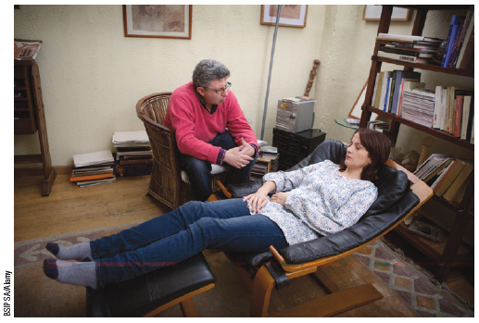
What is hypnotherapy?
Hypnotherapists try to help patients harness their
own healing powers.

Slide 12
What results has hypnosis brought about?
In one analysis of 18 studies, the average client whose therapy was supplemented with hypnosis showed greater improvement than 70 percent of other therapy patients.
(Kirsch et al., 1995, 1996)
Hypnosis seemed especially helpful for
the treatment of obesity.
Drug, alcohol, and smoking addictions have not responded well to hypnosis.
(Nash, 2001)

Slide 13
1. What Would You Answer?
Myla goes to a hypnotist because she is interested in losing weight. Under hypnosis she is told that, later on, when she is hungry, she will eat less than she normally would.
The hypnotist is making use of
selective attention.
dissociation.
social influence.
a hallucination.
a posthypnotic suggestion.

Slide 14
What are some other frequently asked questions about hypnosis?
Can hypnosis relieve pain?
Yes.
When unhypnotized people put their arm in an ice
bath, they felt intense pain within 25 seconds.
When hypnotized people did the same after being given suggestions to feel no pain, they indeed
reported feeling little pain.
(Elkins et al., 2012; Jensen, 2008).

Slide 15
Is hypnosis an extension of normal consciousness?
The social influence theory of hypnosis explains that people begin to feel and behave in ways appropriate for “good hypnotic subjects.”
The more the individual being hypnotized likes and trusts the hypnotist, the more they allow that person to direct their attention and fantasies.

Slide 16
Is hypnosis an altered state?
Psychologist Ernest Hilgard believed hypnosis involves not only social influence but also a special
dual-processing state of dissociation — a split between different levels of consciousness.
Hilgard viewed hypnotic dissociation as a vivid form of everyday mind splits — similar to doodling while
listening to a lecture or typing the end of a sentence while starting a conversation.

Slide 17
Have you ever dissociated?
Have you been driving on a long highway and arrive at your exit and not quite remember passing the miles in between?
Have you ever read to the end of a page and realized you hadn’t been attending to any of the words?
Did you find yourself tuning out during today’s class only to be brought back to attention when the bell rang?

Slide 18
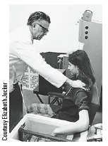
How did
Ernest Hilgard test hypnosis?
A hypnotized woman exhibited no pain
when her arm was placed in an ice bath.
When the same hypnotized woman was asked to press a key if some part of her felt the pain, she did

Slide 19
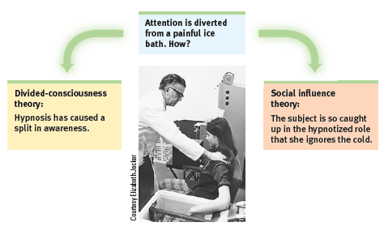
How do the two theories explain hypnosis?
Dissociated mind or well-behaved subject?

Slide 20
2. What Would You Answer?
Which of the following is the term most closely associated with the split in consciousness that allows some thoughts and behaviors to occur simultaneously with others?
consciousness
B. hypnosis
C. hallucination
D. dissociation
meditation

Slide 21
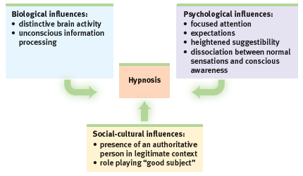
The biopsychosocial approach explains hypnosis.

Slide 22

AP® Exam Tip
Psychological research corrects the mistaken popular belief that hypnosis or other methods can be used to tap into a pure and complete memory bank. You will
learn much more about how memory really works when you get to Unit VII.
The topic of hypnosis has been seen on the AP® exam, so become knowledgeable about it.

Slide 23
Learning Targets
Module 23
23-1 Describe sleep as a state of consciousness.
23-2 Describe how our biological rhythms influence our daily functioning.
23-3 Describe the biological rhythm of our sleeping and dreaming stages.
Sleep Patterns and Sleep Theories
23-4 Explain how biology and environment interact in our sleep patterns.
23-5 Describe sleep’s functions.

Slide 24
What is sleep?
a periodic, natural loss
of consciousness — as distinct
from unconsciousness resulting
from a coma, general anesthesia,
or hibernation
(Adapted from Dement, 1999.)

Slide 25
What is the circadian rhythm?
Our bodies roughly
synchronize with the 24-hour cycle of day and night thanks to an internal biological clock
called the circadian rhythm (from the Latin circa, “about,” and diem, “day”).
Circadian rhythms impact our sleep-wake cycles, temperature, hormonal and digestive cycles as well.

Slide 26
How does the circadian rhythm affect our daily functioning?
Body temperature rises as dawn nears, peaks during the day, dips in the afternoon then drops again in the evening.
Thinking and memory improve as we approach our daily peak in circadian arousal.
Age and experience may alter our circadian rhythm.

Slide 27
1. What Would You Answer?
Which of the following represents a circadian rhythm?
A burst of growth occurs during puberty.
The sleep cycle is roughly 90 minutes long.
Our bodies sleep and wake on a roughly 24-hour schedule.
Our bodies become paralyzed when we enter REM sleep.
Pulse rate increases when we exercise.

Slide 28
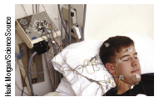
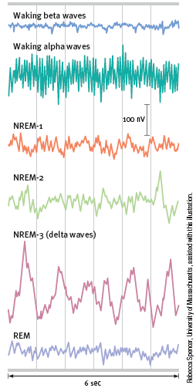
How do psychologists research biological rhythms that occur during sleep?
EEG records brain wave activity while sleeping.
Varying wave patterns occur during sleep.

Slide 29
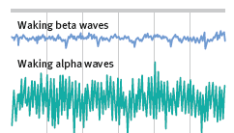
What are alpha waves?
When you are in bed with your eyes closed, the researcher in the next room sees on the
EEG the relatively slow alpha waves of your awake but relaxed state. Then you slowly enter sleep.

Slide 30

Moving into sleep.
We seem unaware of the moment we fall into sleep, but someone watching our brain waves could tell.
(Dement, 1999)

Slide 31
What are the two divisions of sleep stages?
NREM sleep
REM sleep
non-rapid eye
movement sleep; encompasses all
sleep stages except for REM sleep
rapid eye movement
sleep; a recurring sleep stage during which vivid dreams
commonly occur

Slide 32
What is NREM -1 stage sleep?
During this brief NREM-1 sleep you may experience fantastic images resembling hallucinations.
You may have a sensation of falling or floating weightlessly. Sometimes a leg or arm may jerk.
These hypnagogic sensations may later be incorporated into your
memories.

Slide 33
What is NREM -2 stage sleep?
You then relax more deeply and begin about 20 minutes of NREM-2 sleep, with its periodic
sleep spindles — bursts of rapid, rhythmic brain-wave activity, and K-complexes.
Although you could still
be awakened without too much difficulty, you are now clearly asleep.

Slide 34
What is NREM -3 stage sleep?
During this slow-wave sleep, which
lasts for about 30 minutes, your brain emits large, slow delta waves and you are hard to
awaken.
Have you ever said, “That thunder was so loud last night!” only to have a friend respond, “What thunder?” Those who missed the storm may have been in delta sleep.

Slide 35
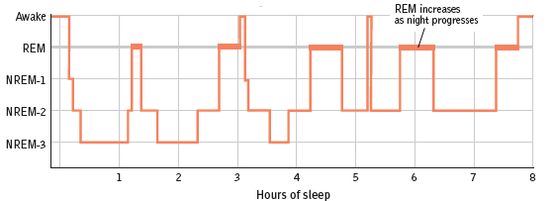
How do we move through the stages of sleep in a night?
Cycling through sleep stages is like being
on a roller coaster.

Slide 36
AP® Exam Tip
Study this cycle of sleep carefully.
One common mistake that students make is to believe that REM sleep comes directly after deep NREM-3 sleep.
As you can see, it does not.
Generally, NREM-2 follows NREM-3.
Then comes REM.
This clarification will help for the AP® exam.

Slide 37
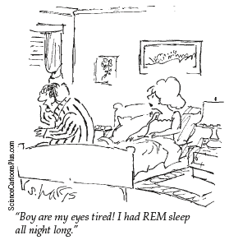
What is REM sleep?
rapid eye movement
sleep; a recurring sleep stage during which vivid dreams commonly occur
REM is known as paradoxical sleep, because the muscles are relaxed (except for minor twitches) but other body systems are active.

Slide 38
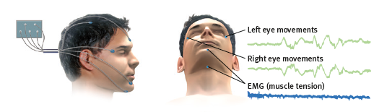
How do researchers study REM?
Using an EEG, researchers were able to see that the sleeper’s eyes moved rapidly from left to right
while emitting rapid, saw-toothed brain waves.

Slide 39
What physiological events occur during REM?
Heart rate rises; breathing becomes
rapid and irregular.
Genitals become aroused, men may have an erection, women may experience vaginal lubrication.
Muscle paralysis occurs, except for an
occasional twitch.

Slide 40
2. What Would You Answer?
Shortly after falling asleep, James experiences the hypnagogic sensations of falling. It is most likely that he is in which stage of sleep?
sleep spindles
B. NREM-1
C. NREM-2
D. NREM-3
REM

Slide 41
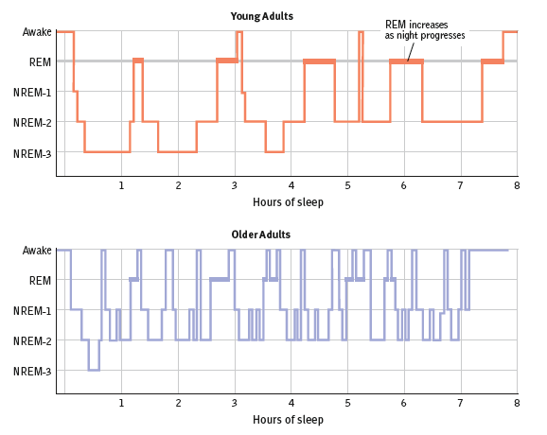
How does sleep change as we age?
As people age, sleep becomes
more fragile, with awakenings
common among older adults.
(Kamel & Gammack, 2006;
Neubauer, 1999).

Slide 42
How do biology and environment interact in our sleep patterns?
Sleep patterns are genetically influenced, but they are also culturally influenced.
In Britain, Canada, Germany, Japan, and the United States, adults average 7 hours of sleep a night on work days, 7-8 hours on other days.
(NSF, 2013)

Slide 43
Why do American students get less sleep than their Australian counterparts?
earlier school start times
increased extracurricular activities
lack of parent-set (and enforced) bedtimes

Slide 44
What three environmental factors play a role in our biological ability to sleep?
modern electric lighting
shift work
social-media diversions

Slide 45
What is the suprachiasmatic nucleus (SCN)?
a pair of cell clusters in the hypothalamus that controls circadian rhythm
In response to light, the SCN causes the
brain’s pineal gland to decrease its production of the sleep-inducing hormone melatonin in
the morning and to increase it in the evening thus modifying our feelings of sleepiness.
.

Slide 46
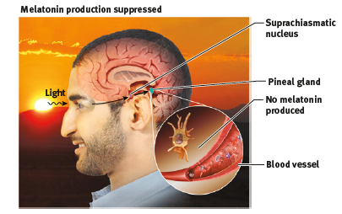
How does the SCN react during the day?
Light striking the retina signals the
suprachiasmatic nucleus (SCN)
to suppress the pineal gland’s
production of the sleep hormone
melatonin.

Slide 47
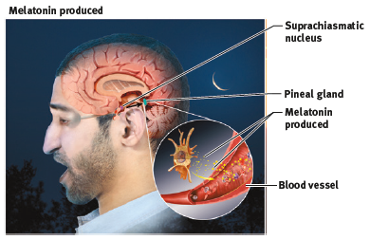
How does the SCN react at night?
At night, the SCN
quiets down, allowing the pineal
gland to release melatonin into the
bloodstream.

Slide 48
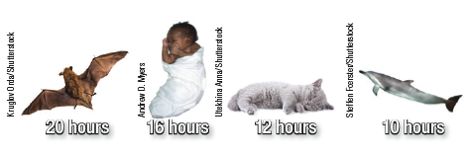
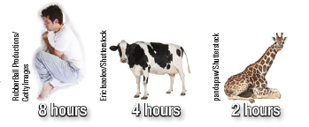
Would you rather be a brown bat or a giraffe?

Slide 49
What are sleep’s functions?
protection
recuperation
At the end of the day’s hunting, gathering, and travel, our ancestors were better off asleep in a cave, out of harm’s way.
Those who didn’t wander around dark cliffs were more likely to leave descendants; natural selection!
Sleep helps restore the immune system and repair brain tissue.
Sleep gives resting neurons time to repair themselves, while pruning or weakening
unused connections

Slide 50
What are more of sleep’s functions?
restoration and rebuilding
feeds creative thinking
Sleep consolidates our memories by replaying recent learning
and strengthening neural connections.
Dreams can inspire noteworthy artistic and scientific achievements.
A complete night’s sleep gives a boost to
our thinking and learning.

Slide 51
What are sleep’s other functions?
supports growth
During slow-wave sleep, which occurs mostly in the first half of a night’s sleep, the pituitary gland releases human growth hormone, which is necessary for muscle development.

Slide 52
3. What Would You Answer?
Which of the following sleep theories would best explain why athletes perform better after a full night’s sleep?
memory
B. protection
C. growth
D. recuperation
creativity

Slide 53
Learning Targets
Module 24
24-1 Describe the effects of sleep loss, and identify the major sleep disorders.
23-2 Describe the most common content of dreams, and identify the functions theorists have proposed for dreams.
Sleep Deprivation, Sleep Disorders and Dreams

Slide 54
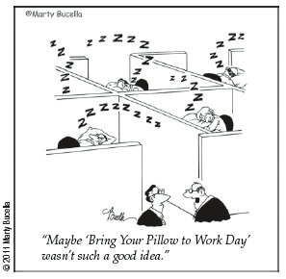
Sleep loss
In a 2013 Gallup poll, 40 percent of
Americans reported getting
6 hours or less sleep a night.
(Jones, 2013).

Slide 55
What are some consequences of sleep loss?
For students, less sleep predicts more conflicts in friendships and romantic relationships.
(Gordon & Chen, 2014; Tavernier & Willoughby, 2014)
Sleep loss is a predictor of depression.
(Baglioni et al., 2016)
Sleep deprivation increases appetite and eating; our tired brain finds fatty foods more enticing.
(Fang et al., 2015; Hanlon et al., 2015).

Slide 56
How does sleep loss impact our physical health?
Sleep deprivation can suppress immune cells that battle viral infections and cancer.
(Möller-Levet et al., 2013; Motivala & Irwin, 2007; Opp & Krueger, 2015)
Those who averaged less than 5 hours’ sleep a night were 4.5 times more likely to develop a cold than those who slept more than 7 hours a night.
(Prather et al., 2015)
Older adults who have no difficulty falling or staying asleep tend to live longer than sleep-deprived agemates.
(Dew et al., 2003; Parthasarathy et al., 2015; Scullin & Bliwise, 2015)

Slide 57
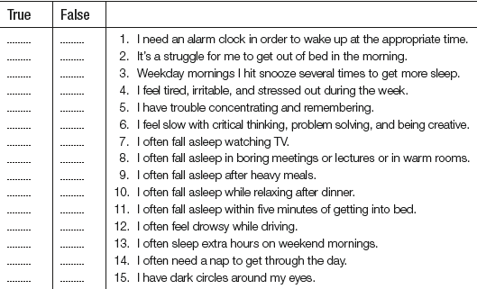
Are you sleep deprived?

Slide 58
How did you do?
If you answered “true” to three or more items, you probably are not getting enough sleep.
To determine your sleep needs, one researcher recommends
“go to bed 15 minutes earlier than usual every night for the next week — and continue this practice by adding 15 more minutes each week — until you wake without an alarm clock and feel alert all day.”

Slide 59
Smartphones as sleep stealers:
“ You wake up in the middle of the night and grab your smartphone to check the time — it’s 3 a.m. — and see an alert.
Before you know it, you fall down a rabbit hole of email and Twitter. Sleep? Forget it.”
Nick Bilton, “Disruptions: For a
Restful Night, Make Your Smartphone
Sleep on the Couch,” 2014

Slide 60
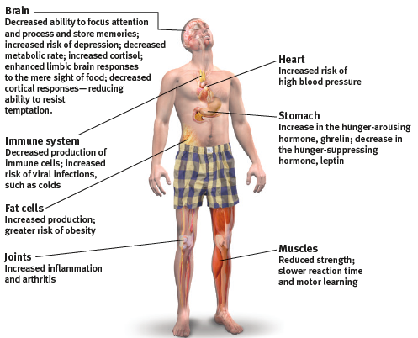
How sleep deprivation impacts us.

Slide 61
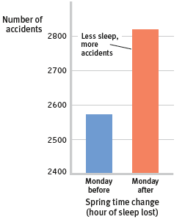
Sleep loss and car accidents
On the Monday after the spring time change, when people lose one hour of sleep, accidents
increased, as compared with the Monday before.

Slide 62
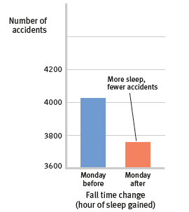
Sleep gain and car accidents
In the fall, traffic
accidents normally increase because of greater snow, ice, and
darkness, but they diminished
after the time change.
(Data from Coren, 1996.)

Slide 63
1. What Would You Answer?
Sleep deprivation can lead to weight gain, reduced muscle strength, suppression of the cells that fight common colds, and most likely which of the following?
increased productivity
depression
decreased mistakes on homework
increased feeling of well-being
sleep apnea

Slide 64
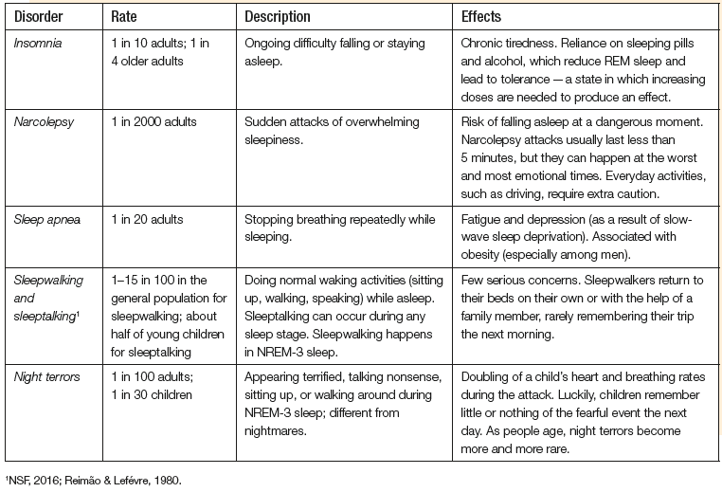
What are the most common sleep-wake disorders?

Slide 65
What is insomnia?
About 1 in 10 adults, and 1 in 4 older adults, complain of
insomnia — persistent problems in either
falling or staying asleep
(Irwin et al., 2006).
The result is tiredness and increased risk of depression.
From middle age on, awakening occasionally during the night becomes the norm, not something to fret over or treat with medication.
(Vitiello, 2009)
Insomnia tends to becomes worse when we worry about it.

Slide 66
How NOT to treat insomnia.
The most common quick fixes for true insomnia — sleeping pills and alcohol — can aggravate the problem, reducing REM sleep and leaving the person with next-day blahs.
Such drugs can also lead to tolerance — a state in which increasing doses are needed to
produce an effect.

Slide 67
What is narcolepsy?
People with narcolepsy — 1 in 2000 of us, (from the Greek narke, “numbness,” and lepsis, “seizure”), have sudden attacks of overwhelming sleepiness, usually lasting less than 5 minutes.
Narcolepsy attacks can occur at the most inopportune times, often triggered by strong emotions.
In severe cases, the person collapses directly
into a brief period of REM sleep, with loss
of muscular tension.

Slide 68
What is sleep apnea?
About 1 in 20 people have sleep apnea, (apnea means “with no breath,”) and intermittently stop breathing during sleep.
After an airless minute or so, decreased blood oxygen arouses them enough to snort in air for a few seconds, in a process that repeats hundreds of
times each night, depriving them of slow-wave sleep.
Sleep apnea sufferers don’t recall these episodes
the next day.

Slide 69
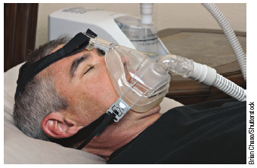
What is a possible treatment for sleep apnea?
For many with sleep apnea, a continuous positive airway pressure (CPAP)
machine applies mild air pressure to keep the airways open, making for sounder sleeping and better
quality of life.

Slide 70
What are night terrors?
Night terrors target mostly children, who may sit up or walk around, talk incoherently, experience doubled heart and breathing rates, and appear terrified
while asleep
(Hartmann, 1981).
They seldom wake up fully during an episode and recall little or nothing the next morning — at most, a fleeting, frightening image.
Unlike nightmares which are bad dreams typically occurring in REM, night terrors usually occur during the first few hours of NREM-3.

Slide 71
What are sleepwalking and sleeptalking?
Sleepwalking (somnambulism)
sleeptalking
A childhood disorder that runs in families.
Somnambulism occurs during NREM-3 sleep and is usually harmless.
Few sleepwalkers recall the nighttime trips.
A childhood disorders that runs in families.
Sleeptalking can occur in any sleep stage.

Slide 72
2. What Would You Answer?
Shortly after falling asleep, and hundreds of times during the night, Paola wakes up after a loud “snore” of breath, because she has stopped breathing. With which sleep disorder would she most likely be diagnosed?
narcolepsy
B. insomnia
C. sleep apnea
D. nightmares
night terrors

Slide 73
What do we dream?
8 in 10 dreams are marked by at least one negative event or emotion.
(Domhoff, 2007)
Common themes include repeatedly failing in an attempt to do something; being attacked, pursued, or rejected; or experiencing misfortune.
(Hall et al., 1982)
In one study, only 1 in 10 dreams among young men and 1 in 30 among young women had sexual content. (Domhoff, 1996)

Slide 74
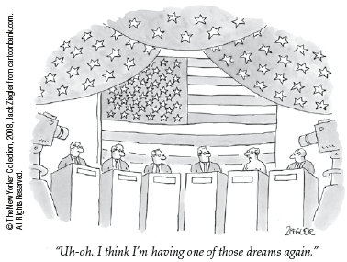
“Follow your dreams, except for that one where you’re naked at work.”
-Attributed to comedian Henny Youngman

Slide 75

Take a moment to write down your dream from your last night of sleep.
Hold on to that dream while we discuss the various theories of dreaming.

Slide 76
What is the Freudian theory of dreams?
Freud believed dreams existed to satisfy our own unconscious wishes. He thought dreams provided a safe place to discharge feelings and urges that would be unacceptable to express in society.
He viewed a dream’s manifest content (what we remember we dreamed) as a censored, symbolic version of its latent content, the unconscious drives and wishes (often erotic) that would be threatening if
expressed directly.
Thus, a gun might be a disguised
representation of a penis.

Slide 77
3. What Would You Answer?
Sigmund Freud believed that a dream’s ____ content reflected the deep, underlying meaning of the dream.
manifest
B. dissociative
C. cognitive
D. latent
circadian

Slide 78
What is the information-processing theory of dreams?
The information-processing perspective proposes that dreams may help sift, sort, and fix the day’s experiences in our memory.
Brain scans confirm the link between
REM sleep and memory.

Slide 79
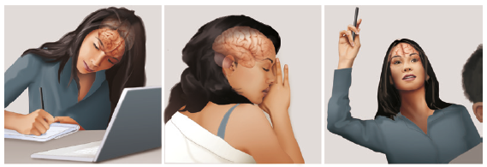
Sleep increases learning.
Researcher Robert Stickgold states “If you don’t get good sleep and enough sleep after you learn new stuff, you won’t integrate it effectively into your memories,” he warned. That helps explain why high school students with high grades slept about 25 minutes longer each night than their lower-achieving classmates.

Slide 80
What is the physiological function theory of dreams?
Perhaps dreams, or the brain activity associated
with REM sleep, serve a physiological function, providing the sleeping brain with periodic stimulation.
As you will see in Unit IX, stimulating experiences preserve and expand the brain’s neural pathways.
Infants, whose neural networks are fast developing, spend much of their abundant sleep time in
REM sleep.

Slide 81
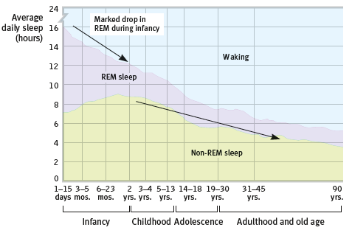
How does sleep and dreaming change as we age?
During our first few months, we spend progressively
less time in REM sleep. During our first 20 years, we spend progressively less time asleep.
(Data from Snyder & Scott, 1972.)

Slide 82
What is the activation synthesis theory of dreams?
According to activation-synthesis theory, dreams are the brain’s attempt to synthesize random
neural activity.
Dreams erupt from neural activation spreading upward from the brainstem.
(Antrobus, 1991; Hobson, 2003, 2004, 2009)

Slide 83
What is the cognitive development theory of dreams?
Some dream researchers prefer to see dreams as
part of brain maturation and cognitive development. (Domhoff, 2010, 2011; Foulkes, 1999)
Dreams overlap with waking cognition and feature
coherent speech. They simulate reality by drawing on our concepts and knowledge.
Dreams engage brain networks that also are active during daydreaming — and so may be viewed as
intensified mind wandering, enhanced by
visual imagery.
(Fox et al., 2013)

Slide 84
Take a look at the dream you wrote down earlier. How do each of the theories below explain your dream?
Freudian
Activation-synthesis
Information processing
cognitive development
physiological function

Slide 85
What is REM rebound?
REM rebound is the tendency for REM sleep to increase
Following REM sleep deprivation.
Most other mammals also experience REM
rebound, suggesting that the causes and functions of REM sleep are deeply biological.
That REM sleep occurs in mammals — and not in animals such as fish, whose behavior is less influenced by learning — fits the information-processing theory of dreams.

Slide 86
Learning Targets
Module 25
25-1 Describe substance abuse disorders.
25-2 Discuss the roles that tolerance and addiction play in substance use disorders, and how the concept of addiction has changed.
Psychoactive Drugs
25-3 Identify the depressants, and describe their effects.
25-4 Identify the stimulants, and describe their effects.
25-5 Identify the hallucinogens, and describe their effects.

Slide 87
What are psychoactive drugs and what is a substance abuse disorder?
psychoactive drugs
substance abuse disorder
chemical substances that alter perceptions and moods
a disorder characterized by continued substance craving and use despite significant life disruption and/or physical risk

Slide 88
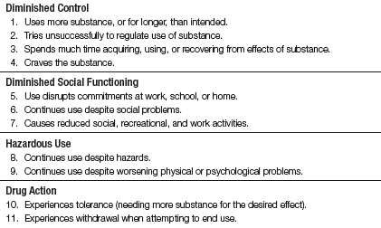
When is drug use a disorder?
How many of the 11 statements above do you think someone would have to agree with in order to be diagnosed with a substance abuse disorder?

Slide 89
How many did you guess?
On the previous slide, how many indicators did you think were needed to diagnose substance abuse disorder?
The severity of substance use disorder varies from
mild (two to three of the indicators) to
moderate (four to five indicators) to
severe (six or more indicators).
American Psychiatric Association, 2013.

Slide 90
What are tolerance and addiction?
tolerance
addiction
the diminishing effect
with regular use of the same dose of a drug, requiring the user to
take larger and larger doses before experiencing the drug’s effect
a primary, chronic disease of brain reward, motivation, memory and related circuitry

Slide 91
How is addiction characterized?
Addiction is characterized by inability to consistently abstain, impairment in behavioral control, craving, diminished recognition of significant problems with one’s behaviors and interpersonal relationships, and a dysfunctional emotional response.
Despite the adverse consequences of using the drug, people in the grip of addiction want the drug more than they like the drug.

Slide 92
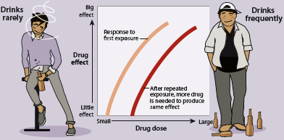
How can tolerance lead to a substance abuse disorder?
Due to neuroadaptation, brain chemistry changes to offset the effects of the drug. Users require larger and larger doses which increases the risk of becoming addicted and developing a substance abuse disorder.

Slide 93
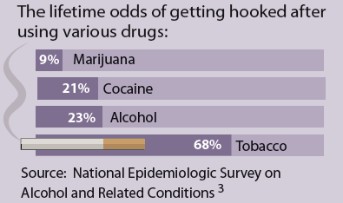

What is withdrawal?
the discomfort and
distress that follow discontinuing
an addictive drug or behavior
Most ex-smokers have kicked the habit on their own.
Newport, 2013.

Slide 94
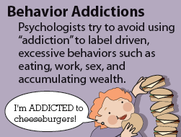
How has the concept of addiction changed?
Some behaviors can become compulsive and dysfunctional—
similar to problematic alcohol and drug use.
The DSM5 classifies gambling disorder but
some behavior addictions require more study, such as internet gaming disorder,
and internet use addictions.

Slide 95
What are the three major categories of psychoactive drugs?
1
depressants
2
stimulants
3
hallucinogens

Slide 96
AP® Exam Tip 1
These three categories — depressants, stimulants, and hallucinogens — are important.
There are likely to be questions on the AP® exam that will require you to know how a particular psychoactive
drug is classified and what affect the drug has on the body.

Slide 97
What are depressants and what are their effects?
drugs (such as alcohol, barbiturates, and opiates)
that reduce neural activity and
slow body functions

Slide 98
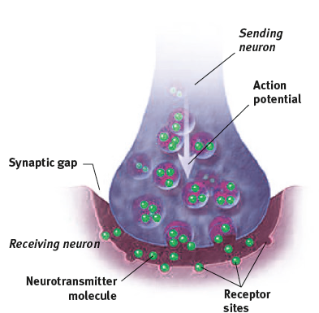
Alcohol
Alcohol is a central nervous system (CNS) depressant meaning it slows neural activity in the brain and spinal cord.

Slide 99
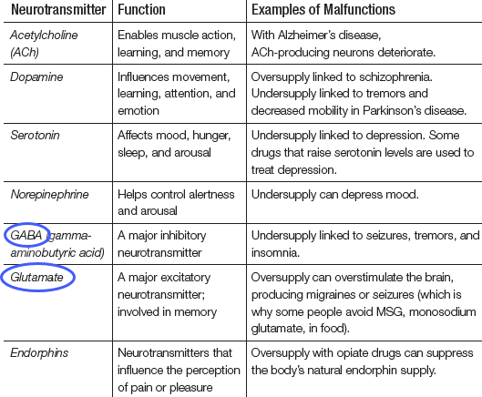
How does alcohol interact with neurotransmitters?
GABA, an inhibitory neurotransmitter, and glutamate, an excitatory neurotransmitter, both interact with alcohol to produce the effects we associate with drinking.

Slide 100
Alcohol and GABA
When alcohol enters the body, it acts as an agonist with inhibitory GABA receptors making them more inhibitory.

Slide 101
Alcohol and glutamate
Alcohol acts as an antagonist to glutamate receptors and prevents glutamate from exciting the cell.

Slide 102
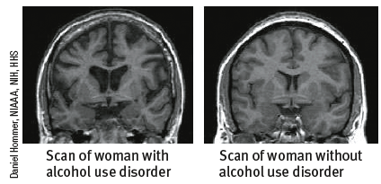
How does alcohol use disorder change the structure of the brain?
MRI scans show brain shrinkage(enlarged ventricles) in women with alcohol use disorder (left) compared with women in a control group (right).

Slide 103
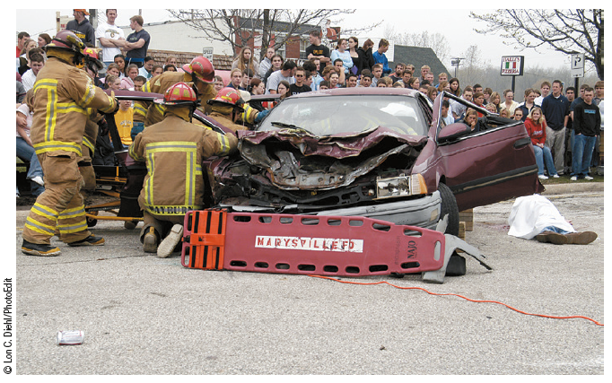
How does alcohol impair reaction time?
Slowed neural processing causes reactions to slow, speech to slur, and skilled performance to deteriorate.

Slide 104
What does research show about human’s awareness of drunken states?
When drunk, people aren’t aware how drunk they are.
(Moore et al., 2016).
Virtually all drinkers who
had insisted when sober that they would not
drive under the influence later decided to drive home from a bar, even if given a Breathalyzer test and told they were intoxicated.
(Denton & Krebs, 1990; MacDonald et al., 1995)

Slide 105
How does alcohol impair memory and self-awareness?
memory disruption
reduced self-awareness
Alcohol can disrupt memory formation, and heavy drinking can also
have long-term effects on the brain and cognition.
Alcohol suppresses REM sleep, which is needed for memory consolidation.
Those who consume alcohol are more likely to be caught mind-wandering yet not realize they had.
People who want to suppress their awareness of failures or shortcomings are more likely to drink.

Slide 106
What are expectancy effects?
Expectations influence behavior.
Simply believing we’re consuming alcohol can cause us to act out alcohol’s presumed influence.
(Christiansen et al., 2016; Moss & Albery, 2009)

Slide 107
What are barbiturates?
drugs that depress
central nervous system activity, reducing anxiety but impairing memory and judgment
Barbiturates such as Nembutal, Seconal and Amytal are sometimes prescribed to induce
sleep or reduce anxiety.
In larger doses, they can impair memory and judgment. If combined with alcohol, the total depressive effect on body functions can be lethal.

Slide 108
What are opiates?
Opium and its derivatives, such as morphine and heroin; depress neural activity, temporarily
lessening pain and anxiety.
As blissful pleasure replaces pain and anxiety, the user’s pupils constrict, breathing slows, and
the person becomes lethargic.
Those who become addicted to this short-term pleasure may pay a long-term price: a gnawing craving for another fix, a need for progressively larger doses (as tolerance develops), and the extreme discomfort of withdrawal.

Slide 109
How can an opiate addiction lead to death?
When repeatedly flooded with an artificial
opiate, the brain eventually stops producing endorphins, its own opiates. If the artificial opiate
is then withdrawn, the brain will lack the normal level of these painkilling neurotransmitters.
In recent years, more and more people have been unable or unwilling to tolerate this state and
have paid an ultimate price — death by overdose.
(CDC, 2015)

Slide 110
1. What Would You Answer?
Slowed reactions, slurred speech, and decreased skill performance are associated with abuse of which drug?
nicotine
methamphetamine
caffeine
alcohol
ecstasy

Slide 111
What are stimulants and what are their effects?
drugs (such as caffeine, nicotine, and the more
powerful cocaine, amphetamines,
methamphetamine, and Ecstasy)
that excite neural activity and speed up body functions

Slide 112

Why use stimulants?
People use
stimulants to feel alert, lose weight, or boost mood or athletic performance.

Slide 113
What is nicotine?
a stimulating and highly
addictive psychoactive drug found in tobacco
Tobacco products include cigarettes, cigars, chewing tobacco, pipe tobacco, snuff, and e-cigarettes (vaping).

Slide 114
Let’s look at the research on tobacco use…
Smoke a cigarette and nature will charge you 12 minutes — ironically, just about the length of time you spend smoking it.
(Discover, 1996)
Compared with nonsmokers, smokers’ life expectancy is “at least 10 years shorter”.
(CDC, 2013)
By 2030, annual tobacco deaths are expected to increase to 8 million. That means that 1 billion twenty-first-century people may be killed by tobacco.
(WHO, 2012)

Slide 115

How teens keep the cigarette industry in business.
Virtually nobody starts smoking past the vulnerable teen
years. Eager to hook customers whose
addiction will give them business for
years to come, cigarette companies
target teens.
Portrayals of smoking by popular actors, such as Scarlett Johansson in Hail, Caesar!, tempt teens to imitate.

Slide 116
Let’s pause for a quote…
Humorist Dave Barry (1995) recalling why he smoked his first cigarette the summer he turned 15:
“Arguments against smoking: ‘It’s a repulsive addiction that slowly but surely turns you into a gasping, gray-skinned, tumor-ridden invalid, hacking up brownish gobs of toxic waste from your one remaining lung.’
Arguments for smoking: ‘Other teenagers are doing it.’ Case closed! Let’s light up!”

Slide 117
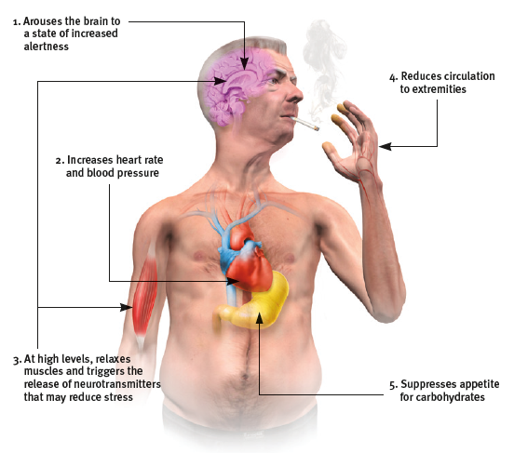
What are the physiological effects of nicotine?
Nicotine reaches the brain within 7 seconds, twice as fast
as intravenous heroin.
Within minutes, the amount in the blood soars.

Slide 118
What is cocaine?
a powerful and addictive stimulant derived from the coca plant; produces temporarily increased alertness and euphoria
Cocaine is snorted, injected, or smoked.
It enters the bloodstream quickly, producing a rush of euphoria that depletes the brain’s supply of the neurotransmitters dopamine, serotonin, and norepinephrine.

Slide 119
A quick refresher on neural transmission.
Neurotransmitters carry a message from a
sending neuron across a synapse to receptor
sites on a receiving neuron.

Slide 120
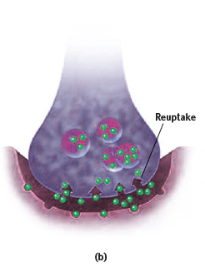
What happens next?
The sending neuron normally reabsorbs
excess neurotransmitter molecules, a
process called reuptake.

Slide 121
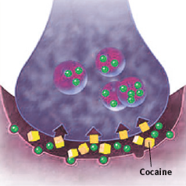
How does cocaine impact normal neural transmission?
By binding to the sites that normally reabsorb
neurotransmitter molecules, cocaine blocks reuptake of dopamine, norepinephrine, and
serotonin.
(Ray & Ksir, 1990)

Slide 122
How does this produce euphoria?
The extra neurotransmitter molecules remain in the synapse, intensifying their normal mood-altering effects and producing a euphoric rush.
When the cocaine level drops, the absence of these neurotransmitters produces a crash.

Slide 123
AP® Exam Tip 2
Many of the slides in this Module are an excellent review of how neurotransmitters work.
If there is any part of this that you don’t understand, head back to Module 9 for a complete explanation.
Neural communication is a topic that has been
on the AP® exam.

Slide 124
What is methamphetamine?
a powerfully addictive drug that stimulates
the central nervous system, with accelerated body functions and associated energy and mood
changes; over time, appears to reduce baseline dopamine levels
“Meth’s” aftereffects may include irritability, insomnia, hypertension, seizures, social isolation, depression, and occasional violent outbursts.

Slide 125
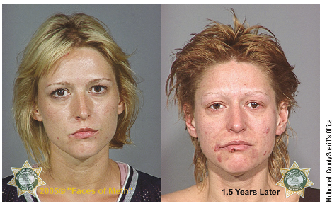
What physical changes result with methamphetamine use?
In the 18 months between these two mug shots, this woman’s methamphetamine addiction led to
obvious physical changes.

Slide 126
What is Ecstasy(MDMA)?
a synthetic stimulant and mild hallucinogen
produces euphoria and social intimacy, but with short-term health risks and longer-term harm to serotonin-producing neurons and to mood and cognition

Slide 127
How does Ecstasy (MDMA) work?
As an amphetamine derivative, Ecstasy (MDMA) triggers dopamine release, but its major effect is releasing stored serotonin and blocking its reuptake, thus prolonging serotonin’s feel-good flood.

Slide 128
Let’s look at the research on
Ecstasy (MDMA)…
Ecstasy’s dehydrating effect, can lead to severe overheating, increased blood pressure, and death.
Long-term, repeated leaching of brain serotonin
can damage serotonin-producing neurons, leading to decreased output and increased risk of permanently
depressed mood.
(Croft et al., 2001; McCann et al., 2001; Roiser et al., 2005)
Ecstasy also suppresses the immune system, impairs memory, slows thought, and disrupts sleep.
(Laws & Kokkalis, 2007; Schilt et al., 2007; Wagner et al., 2012).

Slide 129
2. What Would You Answer?
Which stimulant causes high energy and emotional elation, dehydration, and damage to serotonin producing neurons?
barbiturate
B. nicotine
C. ecstasy
D. caffeine
LSD

Slide 130
What are hallucinogens and what are their effects?
psychedelic (“mind-manifesting”) drugs, such
as LSD, that distort perceptions and evoke sensory images in the absence of sensory input

Slide 131
What are hallucinations and near-death experiences?
hallucinations
near-death experiences
distorted perceptions and sensory images in the absence of sensory
input
an altered state of consciousness
reported after a close brush with death (such as cardiac arrest);
often similar to
drug- induced
hallucinations

Slide 132
What is LSD?
a powerful hallucinogenic drug; also known as acid (lysergic acid diethylamide)
The emotions of an LSD (or acid) trip vary from euphoria to detachment to panic. Users’
mood and expectations (their “high hopes”) influence the emotional experience, but the perceptual distortions and hallucinations have some commonalities.

Slide 133
What is marijuana (cannabis) and what is THC?
Marijuana (cannabis) is usually classified as a mild hallucinogen because it amplifies sensitivity to colors, sounds, tastes, and smells.
But like alcohol, marijuana also relaxes, disinhibits, and may produce a euphoric high. Marijuana leaves and flowers contain THC (delta-9-tetrahydrocannabinol), the psychoactive ingredient.
Whether smoked or eaten THC produces a
mix of effects.

Slide 134
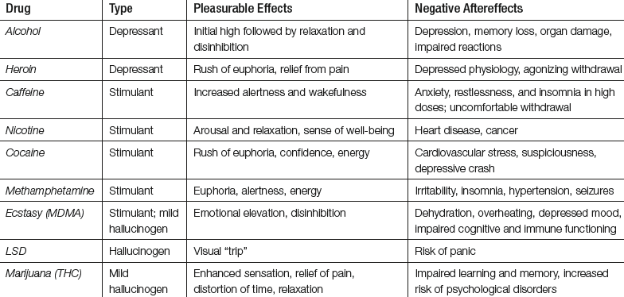
Take a moment to review the psychoactive drugs.

Slide 135
3. What Would You Answer?
Which drug is incorrectly matched with its category?
alcohol; stimulant
LSD; hallucinogen
amphetamine; stimulant
THC; hallucinogen
nicotine; stimulant

